Slide 1
Movie Recommendation System
By :
Kesha Bagadia (AU1841011)
Manal Shah (AU1841026)
Yashvi Gandhi (AU1841033)
Yashvi Pipaliya (AU1841092)
Notes:
Good Afternoon, we are here to present on the topic….

Slide 2
Introduction
Movie recommendations are important in our social life due to their strength in providing enhanced entertainment.
Such a system can suggest a set of movies to users based on their interest, or the popularities of the movies.
Notes:
As the name suggests we initially set out to work on two segments. The first one that we are currently working on …………….
A movie recommendation is important in our social life due to its strength in providing enhanced entertainment. Such a system can suggest a set of movies to users based on their interest, or the popularities of the movies. Movie recommendation systems usually predict what movies a user will like based on the attributes present in previously liked movies. Such recommendation systems are beneﬁcial for organizations that collect data from large amount of customers,and wish to effectively provide the best suggestions possible

Slide 3
Problem Statement
Recommendation system is needed because of the information overload in today’s world.
Therefore, also known as information filter system.
And so here, our intention is:
To build a content-based recommendation system which filters and predicts a movie based on some other movie that user prefers.
Notes:
The recommendation system is because of information overload, and we can call it an information filter system. It greatly influences what we interact with the world: shopping (Amazon, Best Buy), music(Spotify), video(Youtube, Netflix), etc.

Slide 4
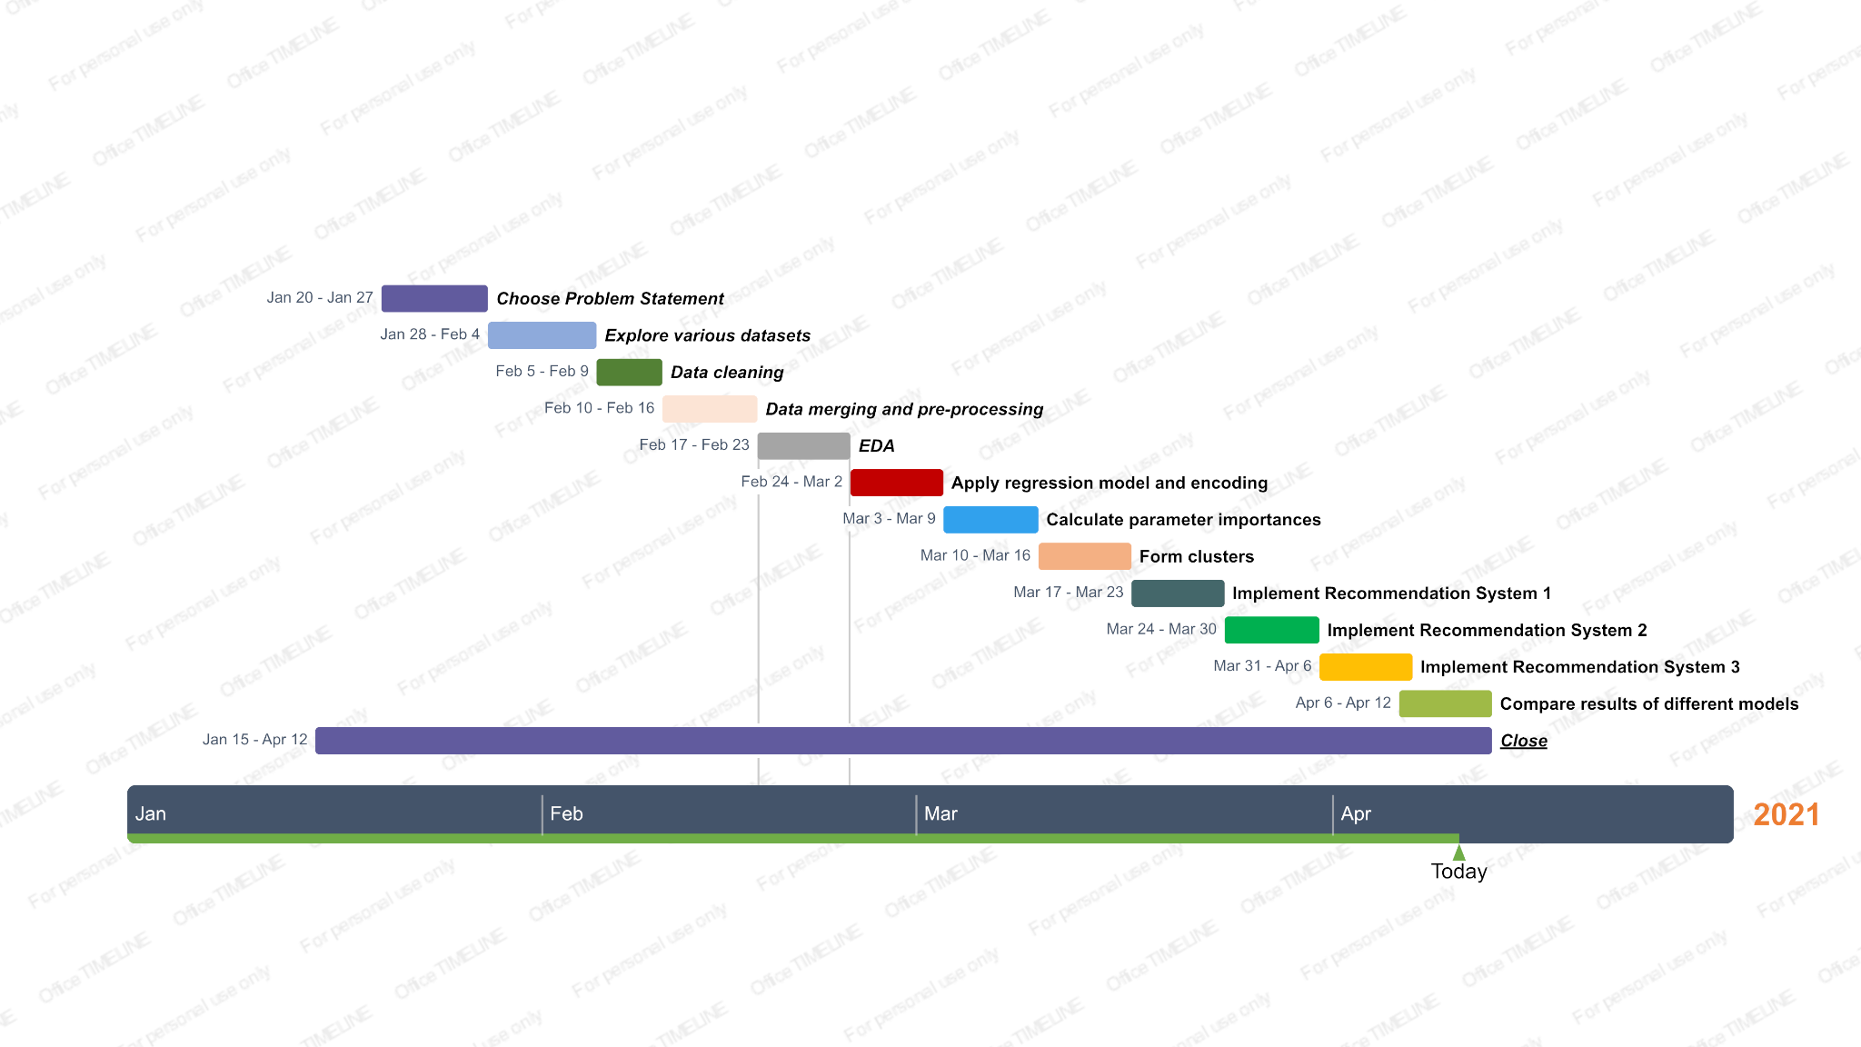
Gantt chart
Notes:
The recommendation system is because of information overload, and we can call it an information filter system. It greatly influences what we interact with the world: shopping (Amazon, Best Buy), music(Spotify), video(Youtube, Netflix), etc.

Slide 5
01
Movie Recommendation System
Existing body of work
Collaborative Filtering
Weighted Slope One-VU method
Using K-means clustering
Using computational intelligence
Using deep learning neural network and Data mining
Using Big data technique
Content based Filtering
By social-filtering method
Using genomic tags
Using TF-IDF Vectorization
Hybrid approach by combining content based filtering and collaborative filtering, using Support Vector Machine
Notes:
Content-based recommender systems do not include datas retrieved from the users other than the preference input provided by them. It simply helps in identifying products that are similar to the product the user likes.

Slide 6
Our approach
Research
Look up existing related source material
Data
Acquiring and exploring relevant data
Random forest regression
Create training model for prediction
Feature importance
Estimate the effect of fields on model
Permutation Importances
Uses random re-shuffling technique
Drop Column Feature Importances
Wipes features 1-by-1 and compares
Notes:
We have tried Xboost and Random Forest, but the latter was better in performance. So that’s what we proceeded with.

Slide 7
Our approach
Clustering
Determine density of data distribution
Text Similarity
Calculate similarities between descriptions
TF-IDF
Weighted-frequencies of words’ occurrence
Linear Kernel
To compute dot product of matrices
Cosine similarity
Measure similarity score from matrices
Compute output
Provide recommendation based on input
Notes:
TF-IDF stands for “Term Frequency — Inverse Document Frequency”. This is a technique to quantify a word in documents, we generally compute a weight to each word which signifies the importance of the word in the document and corpus.
Tf-idf is a transformation you apply to texts to get two real-valued vectors. You can then obtain the cosine similarity of any pair of vectors by taking their dot product and dividing that by the product of their norms. That yields the cosine of the angle between the vectors.

Slide 8
Recommendation system 2
Compute recommendations on single parameter using the above approach
Data Processing for Recommendation system 3
Converting to lowercase and eliminating space
Create Bag of words
Combining five important features
CountVectorizer and Cosine similarity
Computing sparse matrix of “BOW” and Measure similarity score
Compute Output
Provide recommendation based on input
Recommendation system 4
Get the clustered dataset and start Data Preprocessing
Recommendation system 2
Compute recommendations on single parameter using the above approach
Notes:
TF-IDF stands for “Term Frequency — Inverse Document Frequency”. This is a technique to quantify a word in documents, we generally compute a weight to each word which signifies the importance of the word in the document and corpus.
Tf-idf is a transformation you apply to texts to get two real-valued vectors. You can then obtain the cosine similarity of any pair of vectors by taking their dot product and dividing that by the product of their norms. That yields the cosine of the angle between the vectors.

Slide 9
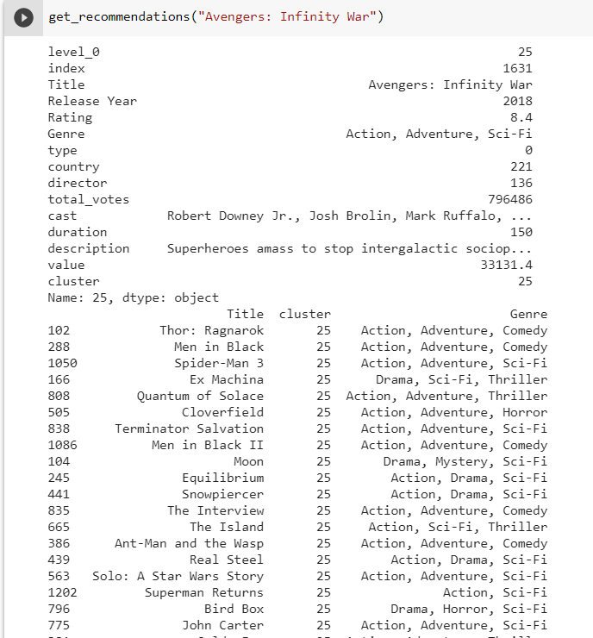
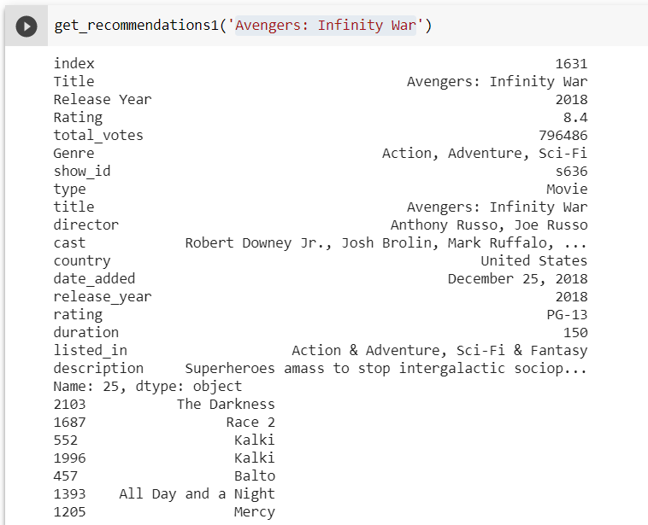
Final Results
Movie 1
TF-IDF Vectorization using Clustering
TF-IDF Vectorization with single parameter
Notes:
1.Count of movies and tv series.It is evident that there are more Movies on Netflix than TV shows.
2.Best time to release a new content.If the latest year 2019 is considered, January and December were the months when comparatively much less content was released.Therefore, these months may be a good choice for the success of a new release
3.Count of movies vs rating.The largest count of movies are made with the 'TV-MA' rating i.e. matured audiences. Second largest is the 'TV-14' stands for content that may be inappropriate for children younger than 14 years of age.
4. Count of movies vs duration.So, a good amount of movies on Netflix are among the duration of 75-120 mins.
5. Count of movies vs genre.Therefore, it is clear that international movies, dramas and comedies are the top three genres that have the highest amount of content on Netflix.

Slide 10
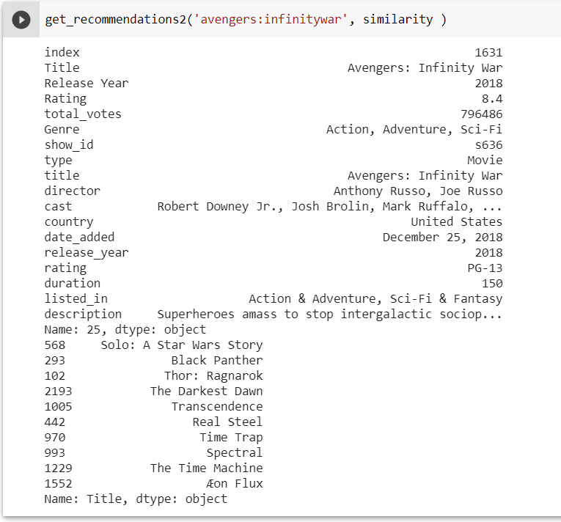
TF-IDF Vectorization using Clustering
Count Vectorization with multiple parameter
Notes:
1.Count of movies and tv series.It is evident that there are more Movies on Netflix than TV shows.
2.Best time to release a new content.If the latest year 2019 is considered, January and December were the months when comparatively much less content was released.Therefore, these months may be a good choice for the success of a new release
3.Count of movies vs rating.The largest count of movies are made with the 'TV-MA' rating i.e. matured audiences. Second largest is the 'TV-14' stands for content that may be inappropriate for children younger than 14 years of age.
4. Count of movies vs duration.So, a good amount of movies on Netflix are among the duration of 75-120 mins.
5. Count of movies vs genre.Therefore, it is clear that international movies, dramas and comedies are the top three genres that have the highest amount of content on Netflix.

Slide 11
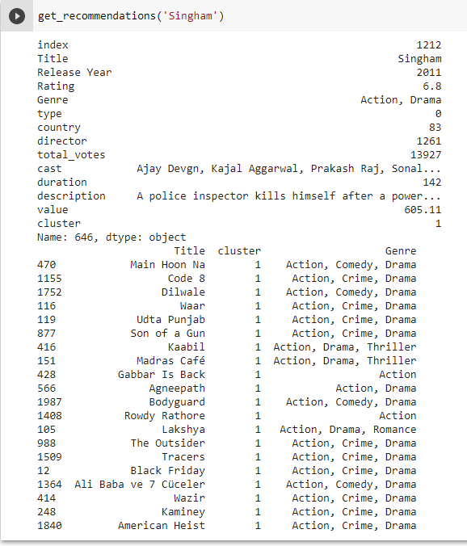
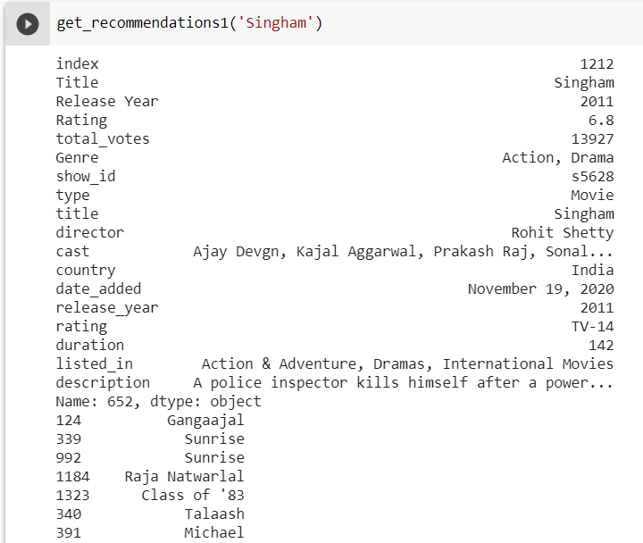
Movie 2
TF-IDF Vectorization using Clustering
TF-IDF Vectorization with single parameter
Notes:
1.Count of movies and tv series.It is evident that there are more Movies on Netflix than TV shows.
2.Best time to release a new content.If the latest year 2019 is considered, January and December were the months when comparatively much less content was released.Therefore, these months may be a good choice for the success of a new release
3.Count of movies vs rating.The largest count of movies are made with the 'TV-MA' rating i.e. matured audiences. Second largest is the 'TV-14' stands for content that may be inappropriate for children younger than 14 years of age.
4. Count of movies vs duration.So, a good amount of movies on Netflix are among the duration of 75-120 mins.
5. Count of movies vs genre.Therefore, it is clear that international movies, dramas and comedies are the top three genres that have the highest amount of content on Netflix.

Slide 12
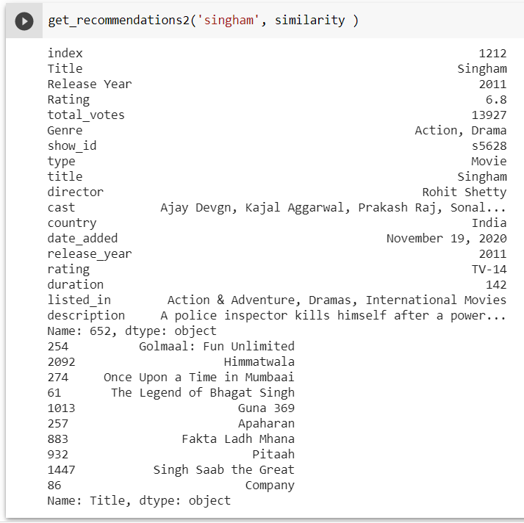
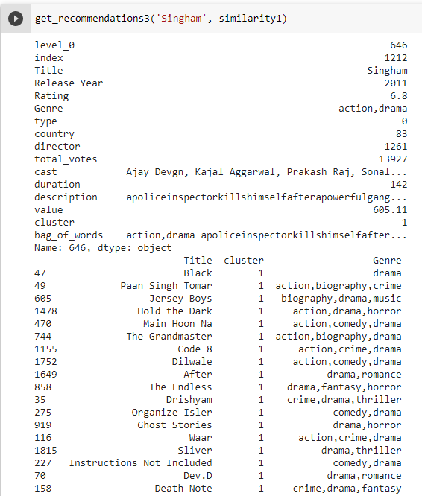
Hybrid recommendation system using Clustering and Count Vectorization
Count Vectorization with multiple parameter
Notes:
1.Count of movies and tv series.It is evident that there are more Movies on Netflix than TV shows.
2.Best time to release a new content.If the latest year 2019 is considered, January and December were the months when comparatively much less content was released.Therefore, these months may be a good choice for the success of a new release
3.Count of movies vs rating.The largest count of movies are made with the 'TV-MA' rating i.e. matured audiences. Second largest is the 'TV-14' stands for content that may be inappropriate for children younger than 14 years of age.
4. Count of movies vs duration.So, a good amount of movies on Netflix are among the duration of 75-120 mins.
5. Count of movies vs genre.Therefore, it is clear that international movies, dramas and comedies are the top three genres that have the highest amount of content on Netflix.

Slide 13
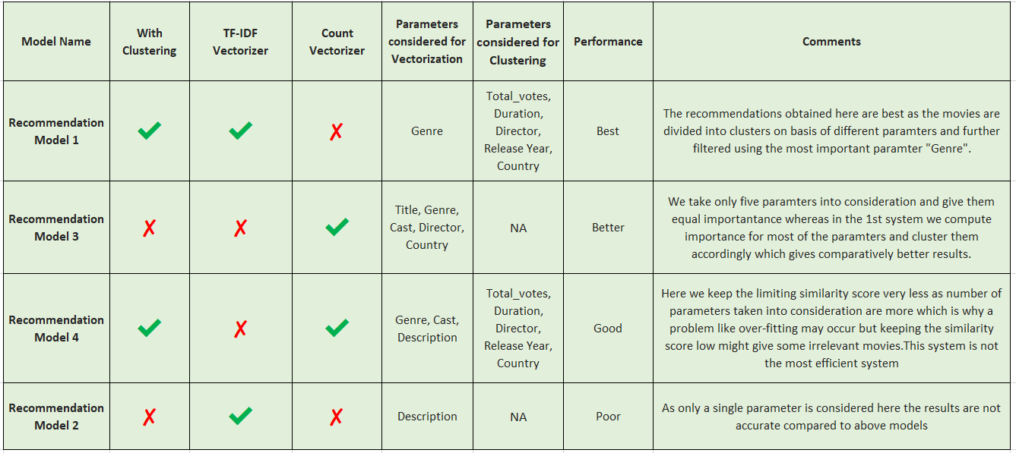
Comparison Table
Notes:
1.Count of movies and tv series.It is evident that there are more Movies on Netflix than TV shows.
2.Best time to release a new content.If the latest year 2019 is considered, January and December were the months when comparatively much less content was released.Therefore, these months may be a good choice for the success of a new release
3.Count of movies vs rating.The largest count of movies are made with the 'TV-MA' rating i.e. matured audiences. Second largest is the 'TV-14' stands for content that may be inappropriate for children younger than 14 years of age.
4. Count of movies vs duration.So, a good amount of movies on Netflix are among the duration of 75-120 mins.
5. Count of movies vs genre.Therefore, it is clear that international movies, dramas and comedies are the top three genres that have the highest amount of content on Netflix.

Slide 14
Conclusion
TF-IDF vectorization using single parameter gives the worst performance
TF-IDF vectorization using clustering gives better results than count vectorization method
chosen parameters in the latter have the same importance
whereas the former uses weighted parameters and gives filtered results
Count vectorization with clustering gives less accurate results compared to TF-IDF vectorization using clustering.
in former too many parameters causes high specificity and it’s hard to find similar movies
reduced similarity score threshold gives fluke results sometimes
Notes:
After comparing the outputs of different models for different movies, we can conclude that the model using TF-IDF vectorization with a single parameter gives the worst performance amongst all the tested recommendation models.
We observed TF-IDF vectorization using clustering gives better results than the count vectorization method. We inferred this must be so because the chosen 5 parameters in the latter have the same importance while in the former, the parameter importance is calculated using the computed feature importance for all parameters, using which the clusters are formed. Moreover, we filter the movies in the clusters using TF-IDF vectorization on the most important parameter "genre" and thus, the results are more accurate.
The results obtained after combining clustering and count vectorization methods were observed to be less accurate compared to the combined model of clustering and TF-IDF cectorization. On analysing, we concluded it happened because in the former system a higher number of parameters considered which causes high specificity and less similarity. This causes a low threshold similarity score which allows possibly and relatively irrelevant movie recommendations in the output.

Slide 15
Role of each group member in the project
Yashvi Pipaliya
Kesha Bagadia
Yashvi Gandhi
Manal Shah
Research,Coding, Documentation
Research,Coding, Documentation
Research,Coding, Documentation
Research,Coding, Documentation

Slide 16
References
TF-IDF & Cosine Similarity
https://monkeylearn.com/blog/what-is-tf-idf/
https://janav.wordpress.com/2013/10/27/tf-idf-and-cosine-similarity/
Feature Importance using Random Forest & KDE
https://towardsdatascience.com/explaining-feature-importance-by-example-of-a-rand
https://scikit-learn.org/stable/modules/density.html
CountVectorizer & KDE
https://scikit-learn.org/stable/modules/generated/sklearn.feature_extraction.text.CountVectorizer.html
Netflix and imdb Dataset
https://www.kaggle.com/shivamb/netflix-shows
https://www.kaggle.com/stefanoleone992/imdb-extensive-dataset
EDA Analysis & Kaggle Tutorial
https://www.datacamp.com/community/tutorials/kaggle-machine-learning-eda

