Slide 1
Movie Recommendation and Rating Prediction System
By :
Kesha Bagadia (AU1841011)
Manal Shah (AU1841026)
Yashvi Gandhi (AU1841033)
Yashvi Pipaliya (AU1841092)

Slide 2
Introduction
Movie recommendations are important in our social life due to their strength in providing enhanced entertainment.
Such a system can suggest a set of movies to users based on their interest, or the popularities of the movies.
Rating prediction is a good measure for the creators to speculate how the film will be received.
Different data can be used and manipulated to observe patterns and predict the outcome amongst different target audiences,
Notes:
A movie recommendation is important in our social life due to its strength in providing enhanced entertainment. Such a system can suggest a set of movies to users based on their interest, or the popularities of the movies. Movie recommendation systems usually predict what movies a user will like based on the attributes present in previously liked movies. Such recommendation systems are beneﬁcial for organizations that collect data from large amount of customers,and wish to effectively provide the best suggestions possible

Slide 3
Problem Statement
We aim to solve two connected problems with our project:
Recommendation system:
To filter and predict a movie a user would like, based on their preference.
Rating prediction system:
To predict how well a movie will be received by viewers utilising the data of average movie ratings.
Notes:
This paper focuses on ﬁnding a model to predict a movie’s IMDb rating using the movie’s information like studio, di-rector, screenplay, actor, actress, genre and country as input
features. In data set, title of the movie and year of the movie release is also stated. The model is built using machine learning techniques. It is trained and tested by the data set prepared from Wikipedia and IMDb movie rating website.Hence, the model built here is learned and tested by supervised learning technique.
The growth of the internet has resulted in an enormous amount of online data and information available to us. Tools like a recommender system allow us to filter the information which we want or need. Recommender systems can be utilized in many contexts, one of which is a playlist generator for video or music services.

Slide 4
Existing body of work
01
Movie Recommendation System
Collaborative Filtering
Content based Filtering
Classification based Filtering

Slide 5
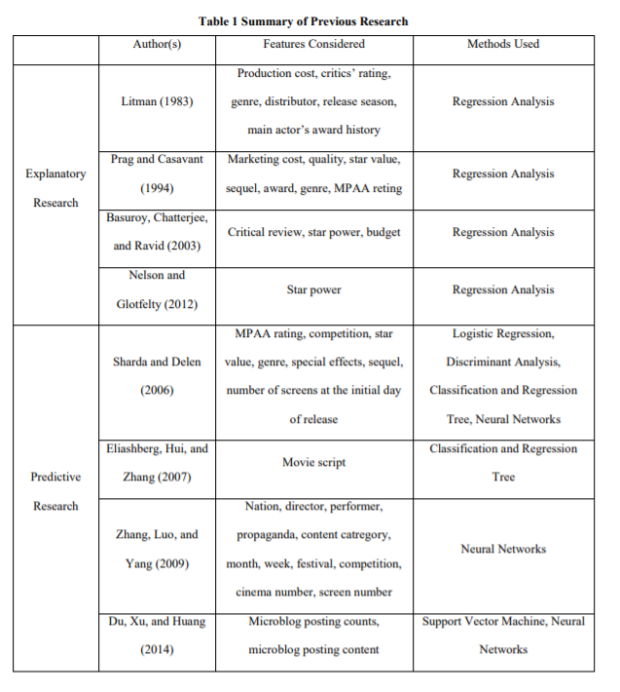
02
Movie Rating Prediction

Slide 6
Our approach
Research
Look up existing related source material
Data
Acquiring and exploring relevant data
Random forest regression
Create training model for prediction
Feature importance
Estimate the effect of fields on model
Permutation Importances
Uses random re-shuffling technique
Drop Column Feature Importances
Wipes features -by-1 and compares

Slide 7
Our approach
Clustering
Determine density of data distribution
Text Similarity
Calculate similarities between descriptions
TF-IDF
Weighted-frequencies of words’ occurrence
Linear Kernel
To compute dot product of matrices
Cosine similarity
Measure similarity score from matrices
Compute output
Provide recommendation based on input

Slide 8
Collected and merged different datasets to obtain the required parameters for Recommendation and Prediction
Progress made so far
Detecting and correcting corrupt or inaccurate records from the database that may negatively impact a predictive model
RandomForestRegressor
Data Gathering
Performed EDA to identify obvious errors, as well as better understand patterns within the data, detect outliers or anomalous events, find interesting relations among the variables
Data Preprocessing and Cleaning
Exploratory Data Analysis
Splitting the data and Encoding
We have split the whole dataset as 20% test data and 80% as training data. Used Label encoder to convert the string parameter to integer
Obtaining Feature Importance using three methods
Obtained Feature importance of RandomForestRegressor, Permutation feature importance and Drop Column feature importance to find ideal parameters

Slide 9
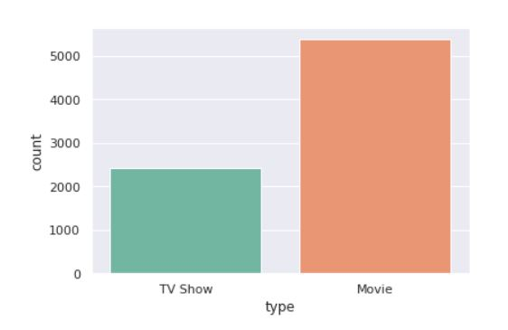
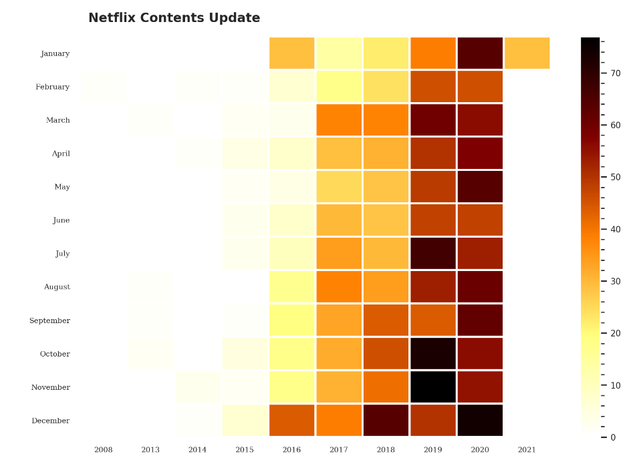
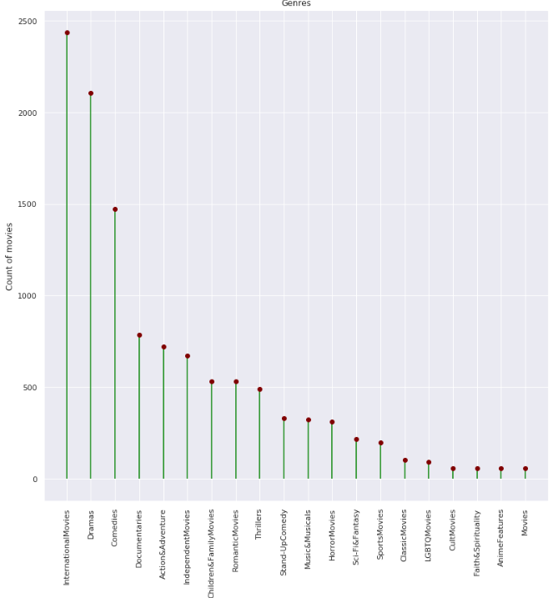
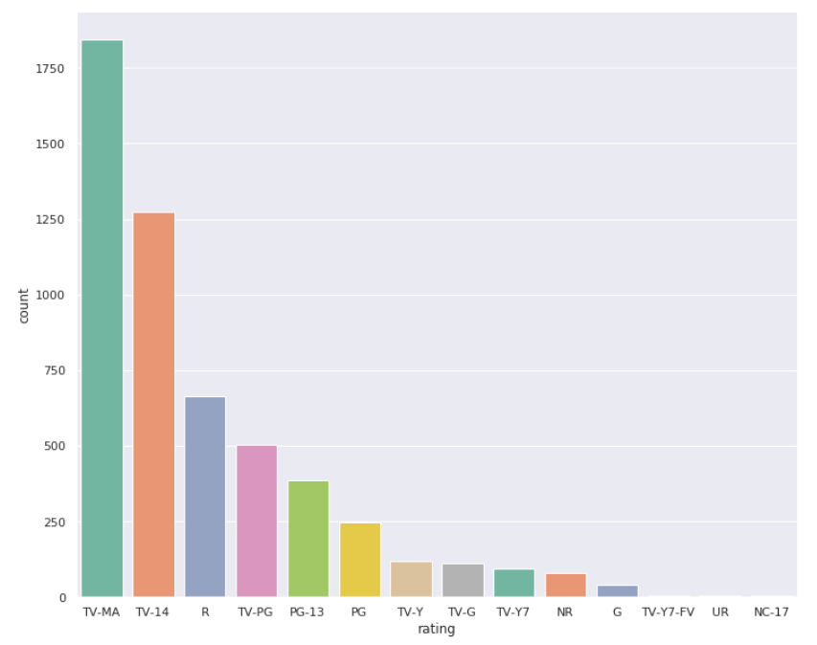
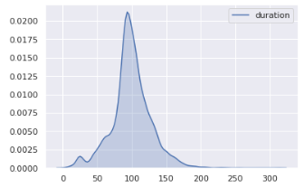
Implementation
Exploratory Data Analysis:

Slide 10
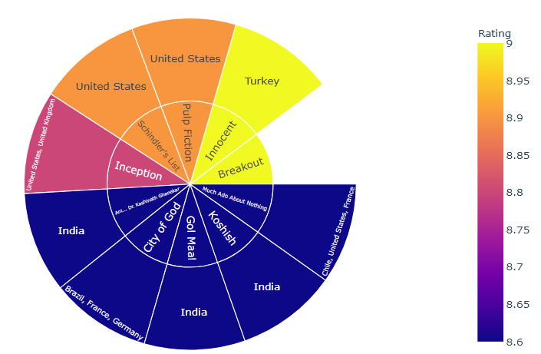
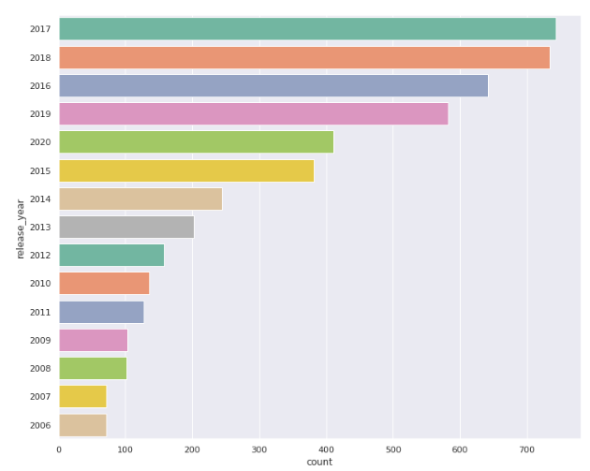
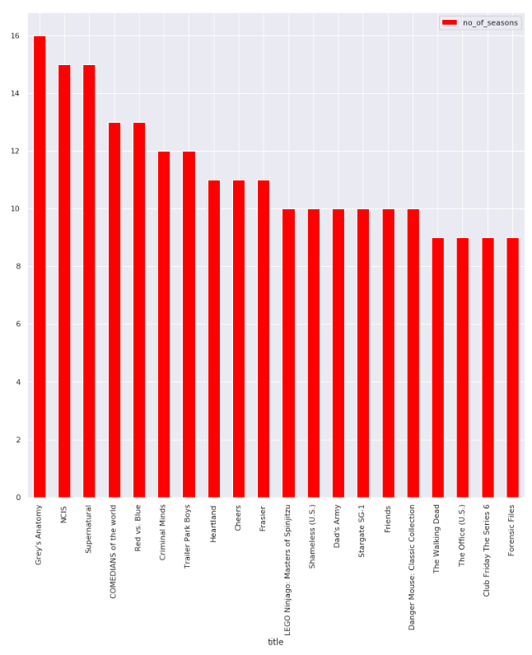
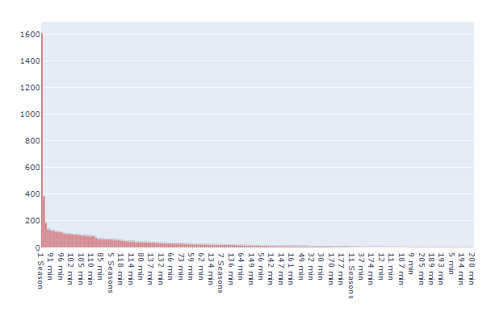
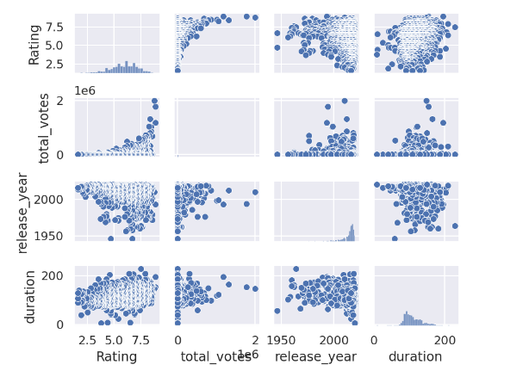

Slide 11
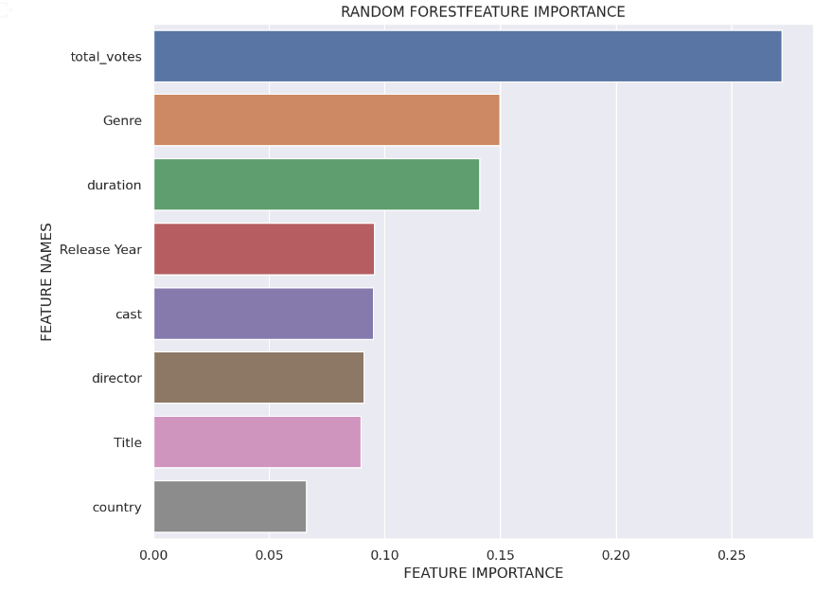
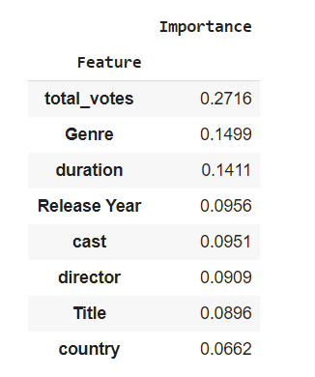
Feature importance calculation:

Slide 12
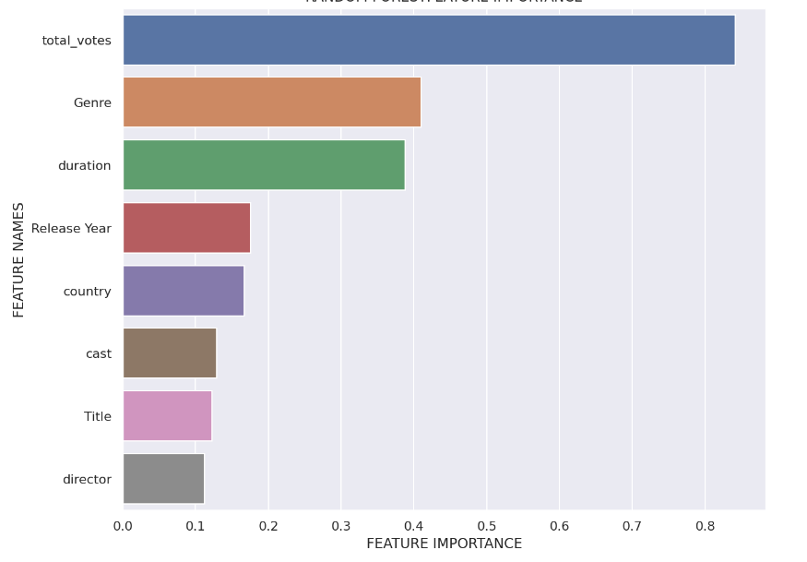
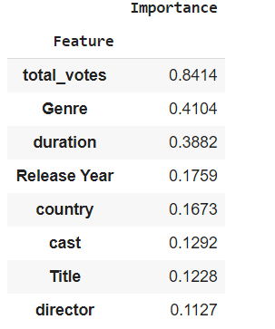
Permutation feature importance

Slide 13
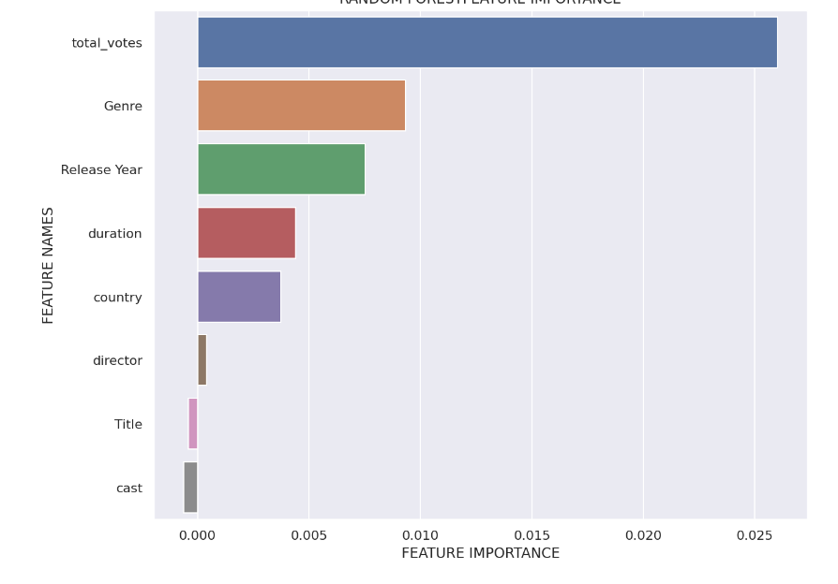
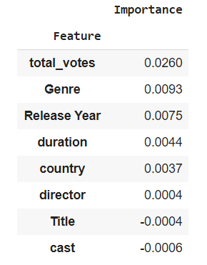
Drop Column feature importance

Slide 14
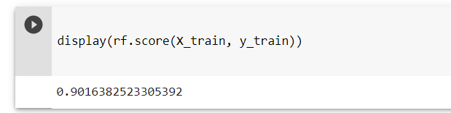
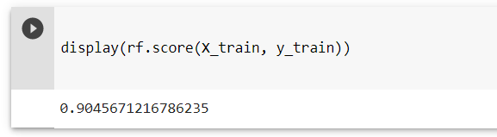
Accuracy of the model using all the parameters
Accuracy of the model after removing the non important parameters obtained by Drop Column feature importance

Slide 15
Role of each group member in the project
Yashvi Pipaliya
Kesha Bagadia
Yashvi Gandhi
Manal Shah
Coding, Documentation
Documentation, Coding
Coding, Research
Research, Coding

Slide 16
Future Work
Completing recommendation system
Building rating prediction system
Combining and optimising the models, as time permits

Slide 17
References
TF-IDF & Cosine Similarity
https://monkeylearn.com/blog/what-is-tf-idf/
https://janav.wordpress.com/2013/10/27/tf-idf-and-cosine-similarity/
Feature Importance using Random Forest
https://towardsdatascience.com/explaining-feature-importance-by-example-of-a-rand
Clustering
https://www.gee
ksforgeeks.org/clustering-in-machine-learning/
Netflix and imdb Dataset
https://www.kaggle.com/shivamb/netflix-shows
https://www.kaggle.com/stefanoleone992/imdb-extensive-dataset
EDA Analysis & Kaggle Tutorial
https://www.datacamp.com/community/tutorials/kaggle-machine-learning-eda

