Slide 1








Video Game Sales
Manal Mohamed Al_Naseef /Project/T5o07

Slide 2
Goal :
help Video Game Company to improve and predict selling.

Slide 3
DataSet :
Rank - Ranking of overall sales
Name - The games name
Platform - Platform of the games release (i.e. PC,PS4, etc.)
Year - Year of the game's release
Genre - Genre of the game
Publisher - Publisher of the game
NA_Sales - Sales in North America (in millions)
EU_Sales - Sales in Europe (in millions)
JP_Sales - Sales in Japan (in millions)
Other_Sales - Sales in the rest of the world (in millions)
Global_Sales - Total worldwide sales.

Slide 4
DataSet :
Volume of Sales

Slide 5
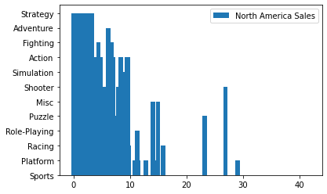
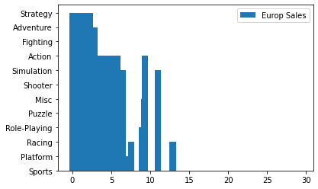
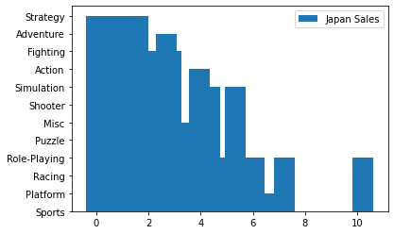
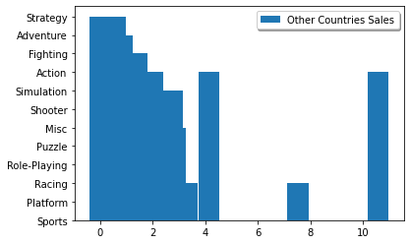

Slide 6
Modling :
Calssification Model | Score
KNN | 99.47%
DecisionTreeClassifier | 99.42%
SVC | 99.43%
MPLClassifier | 99.85%
RandomForestClassifier | 99.06%
AdaBoostClassifier | 98.05%
Regression Model | Score
LinearRegression | 99.47%
DecisionTreeRegression | 99.42%

Slide 7
Conclusion

