Slide 1
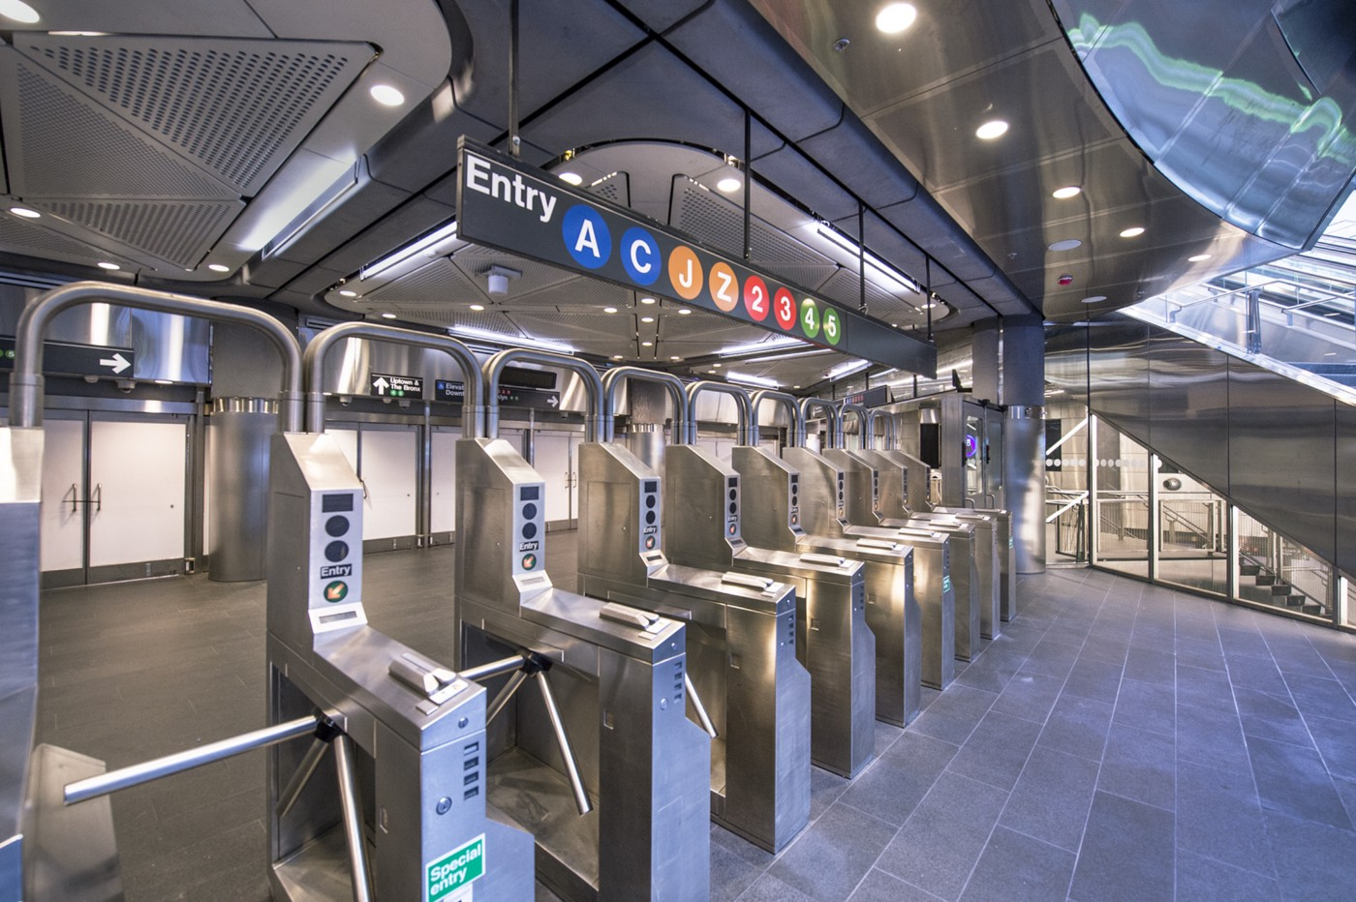


MTA Turnstile Data Analysis
Nadia

Slide 2
Motivation & goal
EDA Process
Findings
Recommendations
Outline

Slide 3
Motivation
An imaginary client organization (WTWY) hosts summer gala, and want o deploy street teams on NYC subway stations to attract more attendance to sign up for their gala
Introduction
Goal
Using MTA data to provide WTWY with
recommendation based on:
1- The top 10 busiest stations determined by
daily average foot traffic
2- The busiest stations by weekday
3- The optimal time to deploy street teams on
these stations

Slide 4
1- Sourcing Data
2- Cleaning Data
3- Visualizing results
EDA Process

Slide 5

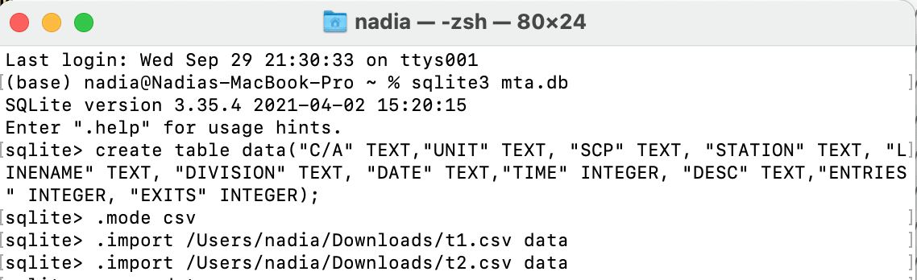
Sourcing Data
Historical data for the weeks from 29 May 2021 to 29 August 2021
Scraped from MTA Turnstile :
1- Creating local db using SQLite:
- download desired data files from MTA as csv
- use command line to create db and table then import csv files into table

Slide 6
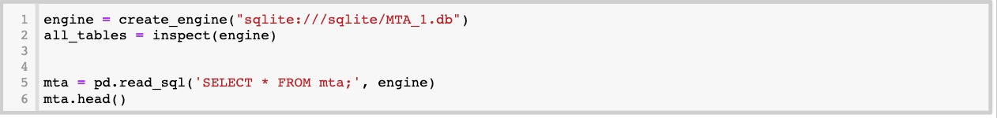
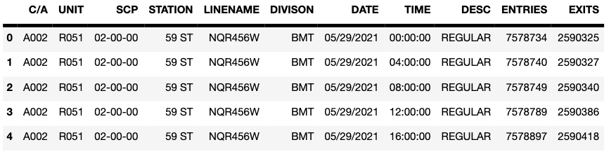
Sourcing Data
2- read it on Jupyter notebook using Sqlalchemy library:
3- delete duplicated columns names :
4- the data output finally is ready to be explored:

Slide 7
Cleaning Data
Checking for nulls and drop them
Combining Date & time columns
Getting total turnstile traffic out of entries and exits

Slide 8
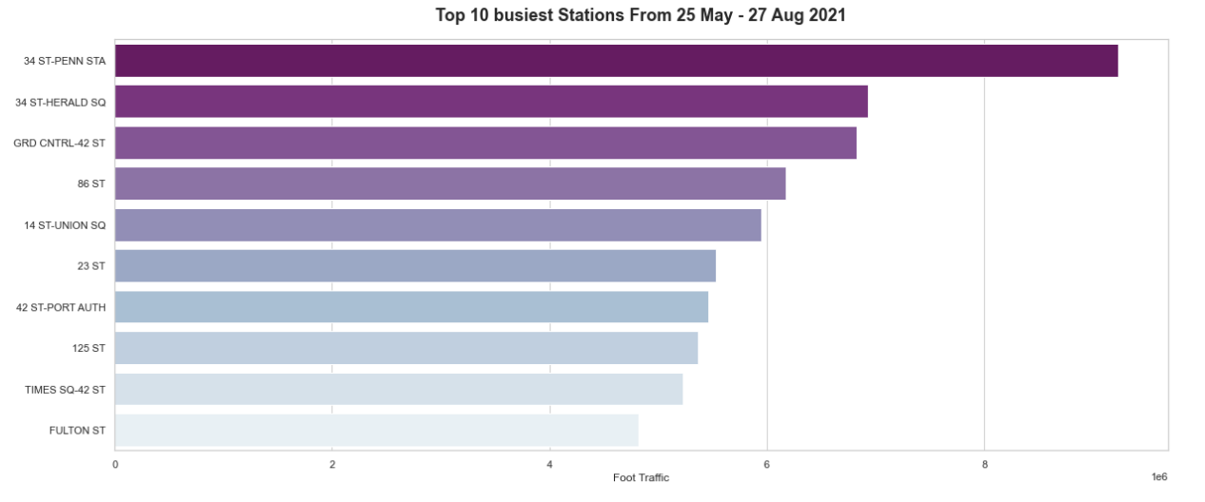
Findings
1- The busiest stations by daily average

Slide 9
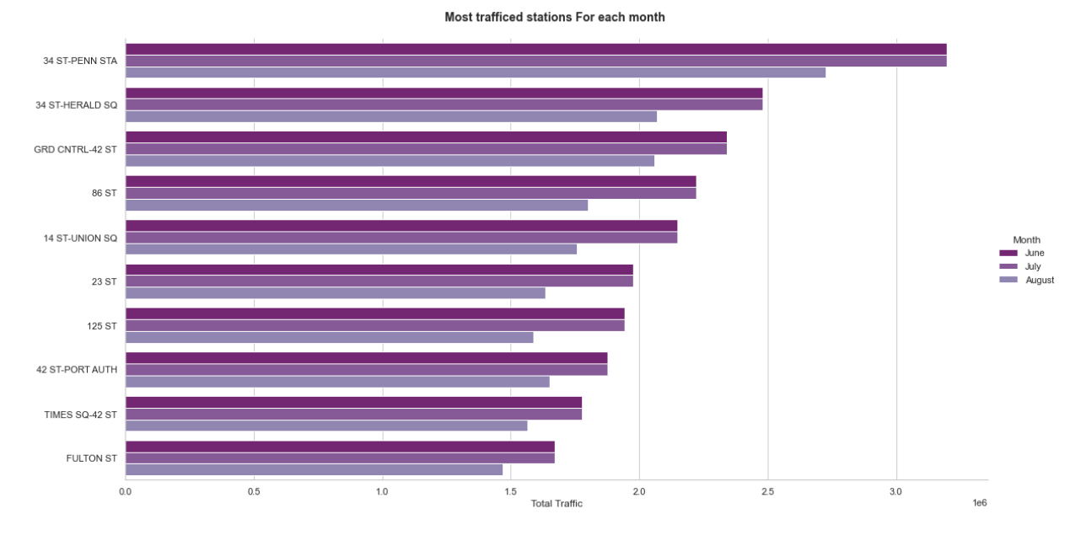
Findings
Findings
2- The busiest stations for each month

Slide 10
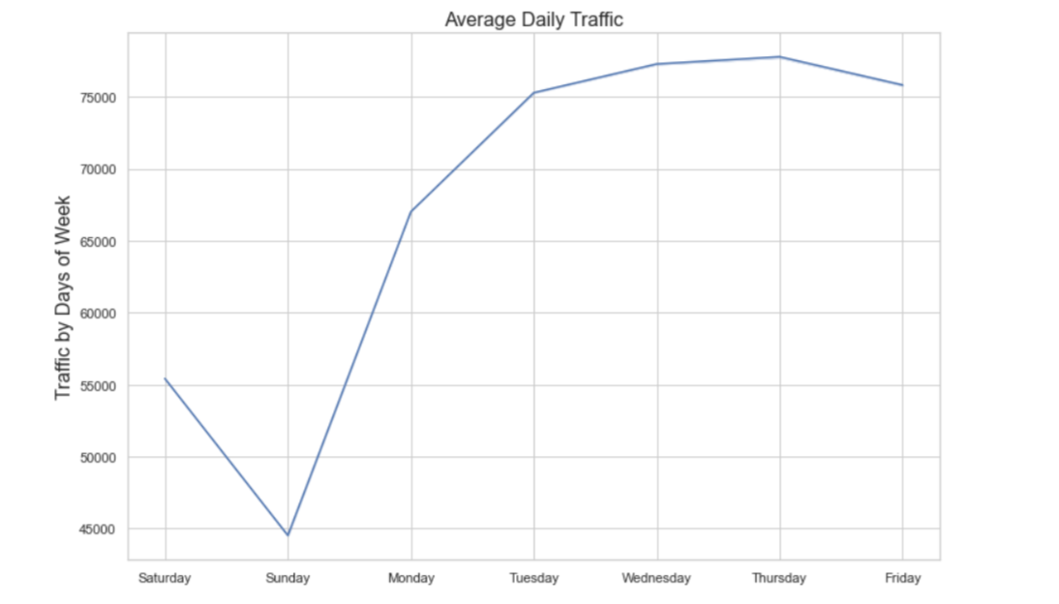
Findings
Findings
3- Busiest weekdays

Slide 11
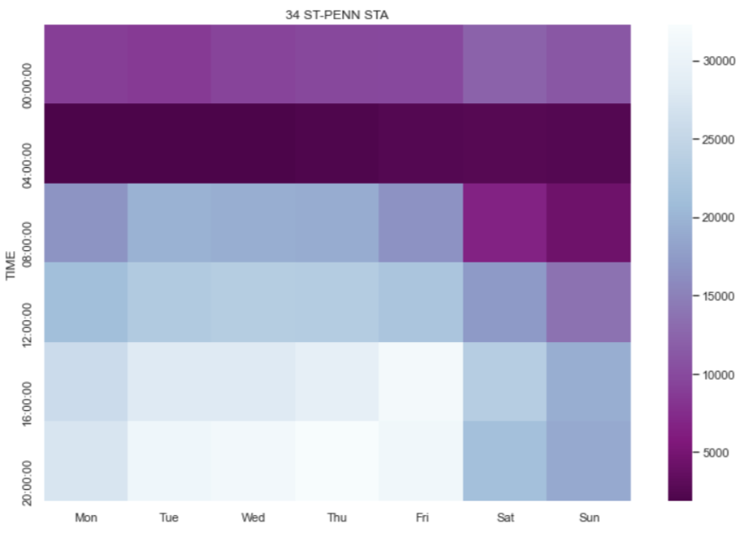
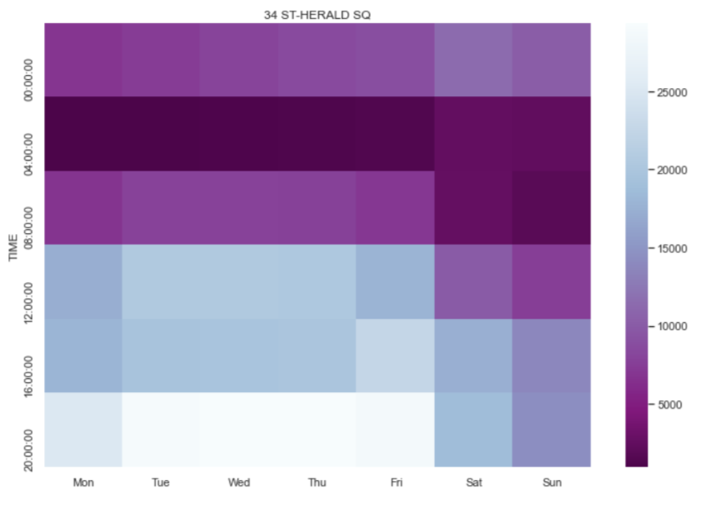
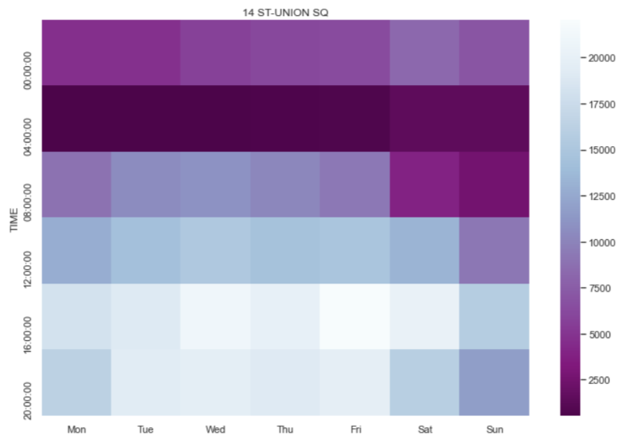
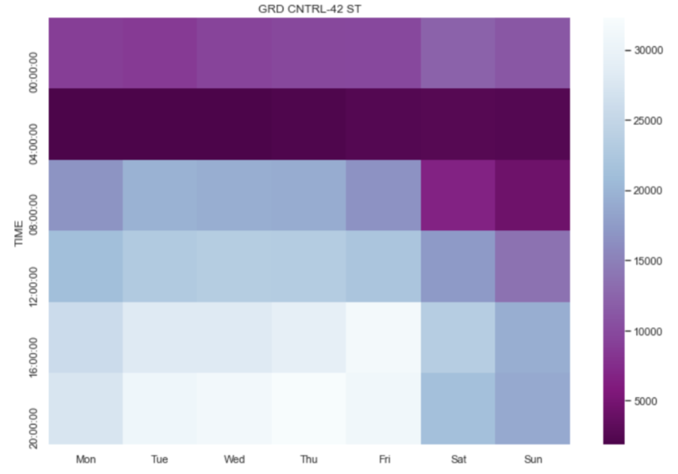
3- Busiest Hours for top 4 stations in terms of traffic (86 ST is excluded)

Slide 12
I recommend targeting stations that have a high traffic to maximize the number of sign-ups people to attend the gala. Based on this criteria:
Recommendations
1
34 St-Penn STA and GRD CNTRL-42 ST on Thursday between (4:00 – 8:00)pm & Friday between (12:00 – 4:00) pm
2
34 St-HERALD SQR on Tuesday & Wednesday & Thursday between (4:00 – 8:00)pm
3
14 ST-UNION SQ on Friday between (12:00 – 4:00) pm

Slide 13
Thank you !

