Slide 1


Modeling Citation Trustworthiness
In Evolving Scholarly Networks
26-1-R-9
Fatma Dabbah
SUPERVISED BY
213675549
Dr. Dvora Toledano-Kitai
Manal Nama
325393999
Prof. Zeev Volkovich
Slide 1

Slide 2


Motivation & Context: The Era of "Big Science"
Exponential Growth
Citations as Currency
Scientific literature is growing exponentially; manual verification is impossible.
Citations are the “currency” of academia, shaping careers, funding, and reputation.
High pressure to cite → fertile ground for manipulation.
Slide 2

Slide 3




The Threat: Citation Manipulation
Citation Cartels
Citation Mills
Coercive Citation
Groups of authors excessively citing each other to boost metrics.
Industrialized generation of fake papers and references for profit.
Editors forcing authors to cite specific journals or papers.

Slide 4


The Problem: Challenges in Trustworthiness
Widespread Citation Manipulation
Citation Cartels, Mills, and Coercion are undermining scientific integrity.
Current Methods Fail in:
Rule-based metrics & peer review:
Limited & Static (e.g. self-citation count).
The Gap
Hard to distinguish genuine links from artificial noise at scale.
Graph/ML anomaly detection:
Often lack structural & temporal depth.
Slide 3

Slide 5
Our Goal
Develop an automated framework to distinguish genuine scholarly relationships from artificial noise.
Key idea: analyze Structural Stability & Temporal Evolution in citation networks.
Slide 4

Slide 6

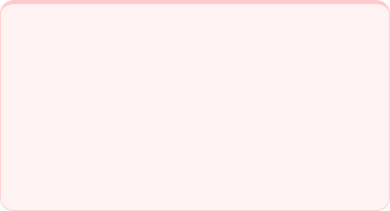


Citation Stability Hypothesis
Reliable citations are structurally stable; manipulative ones are fragile
Stable citations
Fragile citations
Embedded in a dense network of indirect connections.
Weak connections.
→Topologically supported
→Lack structural justification
Slide 5

Slide 7






Structural Stability Pipeline
Perturb
Embed
Randomly remove a fraction of edges to test network resilience.
Map nodes to vectors (Node2Vec/ GraphSAGE).
Reconstruct
Score
Predict missing links via similarity.
Compute stability score over N iterations.
Slide 6

Slide 8
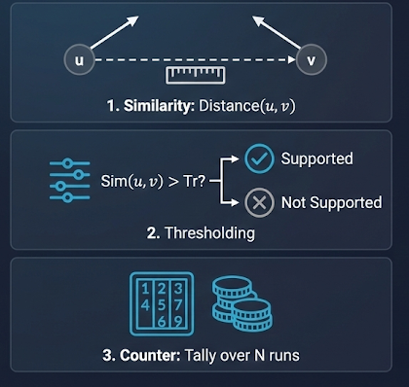
Reconstruction logic
The reconstruction process is formulated as a link prediction task. For every removed edge (u, v):
Similarity: Measure the distance between vector u and vector v.
Thresholding: If Sim(u,v) > Tr, the link is considered "supported" by the network.
Counter: Successes are tallied over N runs to filter out noise from single random removals.

Slide 9


Dual Embedding Strategy
Node2Vec (Static)
GraphSAGE (Dynamic)
Based on Biased Random Walks.
Captures topological neighborhoods effectively.
Inductive learning using Neighbor Aggregation.
supports evolving networks & new nodes.
Slide 7

Slide 10
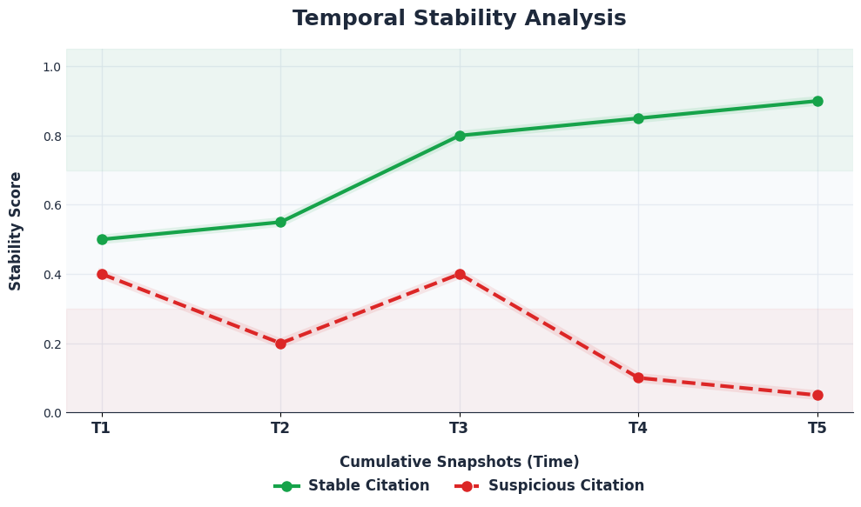



Temporal Stability Analysis
Key Idea: Citations evolve over time → stability should be tracked across snapshots.
1. Snapshots
Divide network into cumulative time windows (e.g., by year)
2. Processing
Apply Structural Stability pipeline to each snapshot.
3. Aggregation
Compute temporal consistency score.
Slide 8

Slide 11






Citation Classification
Stable Citations
Suspicious Citations
Delayed-Imapct Citaions
Consistently recovered across multiple snapshots.
reliable academic links.
Exhibit repeated reconstruction failures
potential manipulation.
Low initial recovery but consistent later.
legitimate “sleeping beauties”
Slide 9

Slide 12
Innovation & Market Edge
Limitations of Current Solutions
Static Snapshots: Analyzes network at a single point, missing manipulative evolution over time.
Binary Logic: Often flags legitimate "late bloomers" as suspicious anomalies.
Proposed Novel Contribution
Inductive Learning: Generalize patterns to new papers without retraining the entire model.
Temporal Dynamics: Model network evolution to distinguish legitimate delays from manipulative patterns.
Perturbation-Based Concepts: Assess citation reliability via stress-testing.
Slide 10

Slide 13






Tech Stack
Google Colab
Python
PyTorch Geometric GraphSAGE
NetworkX
Scikit-Learn
Genesim
Slide 11

Slide 14









Testing Plan
Unit Tests
Integration Tests
›
Verify graph connectivity.
Confirm injection rates.
Validate score ranges.
›
Graph → Embeddings flow.
Prediction consistency.
Correct score storage.
›
›
›
›
End-to-End System Tests
Load Testing
›
Execute full workflow.
Validate all outputs.
Ensure result consistency.
›
High perturbation rates.
Sparse network handling.
Graceful error handling.
›
›
›
›
Slide 12

Slide 15





Validation Procedure: Controlled Noise Injection
Challenge:
How to validate without ground truth labels?
Proposed Approach:
Use controlled noise injection to simulate manipulative citations.
Procedure:
Inject Noise
Assess
Evaluate
Add P% artificial edges.
Apply Structural Stability Pipeline.
Detection of injected anomalies.
Slide 13

Slide 16

Metrics for Validation
AUC
Recall
Dist
Assess ranking quality of citations
Detection Rate for injected/artificial Edges
Maximize statistical separation distance between real and injected edges.
Target > 0.85
Target> 90%
These metrics define how we will evaluate the pipeline once implemented.
Slide 14

Slide 17




Expected Behavior Of Citations
Original Edges
Injected Noise
High Reconstruction Rate
Failure to Reconstruct
Well-Supported by network structure
lacks topological support
Slide 15

Slide 18
Key Challenges & Planned Solutions
Scalability
Temporal Sparsity
Large graphs risk of OOM.
Early years have few links.
Planned Solution: Use sparse tensors / memory-efficient operations.
Planned Solution: Use cumulative snapshots to ensure sufficient data.
Missing Features
No Labels / Ground Truth
No text data for GraphSAGE.
Cannot directly verify manipulation.
Planned Solution: Use structural/topological features instead.
Planned Solution: Controlled noise injection and synthetic evaluation
Slide 16

Slide 19
Thank You!
Questions?
Slide 17

