Slide 1
JSON
Presented by: Manal Asghar

Slide 2
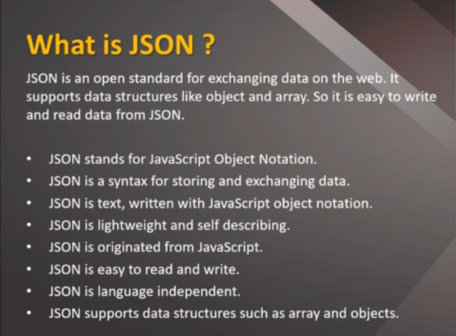

Slide 3
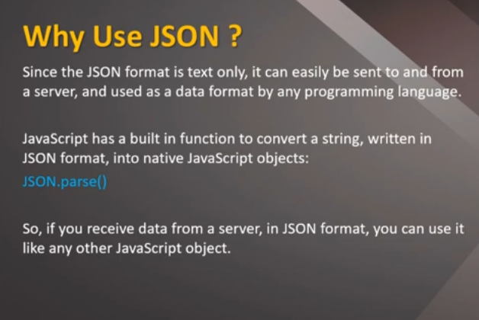

Slide 4
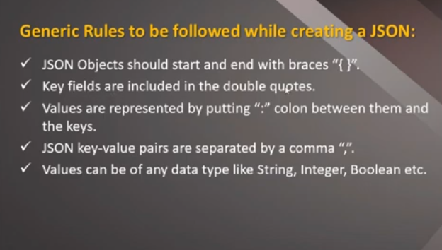

Slide 5
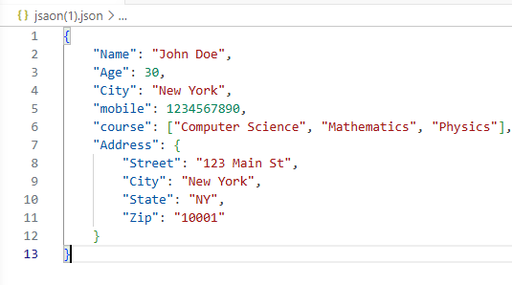

Slide 6
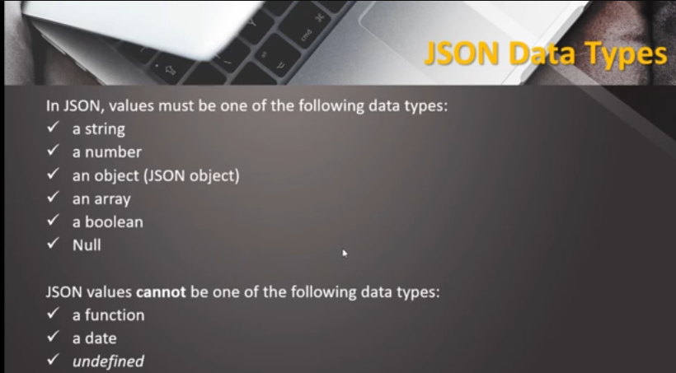

Slide 7


JSON Object With String and numbers
The string value must be enclosed with double Quotes
JSON support numbers in double precision floating-point format. The number can be digit(0-9), fraction(.33,.221) and exponents.

Slide 8
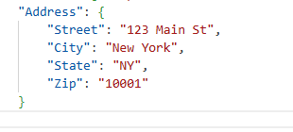
JSON Object with object
Values in JSON can be object

Slide 9
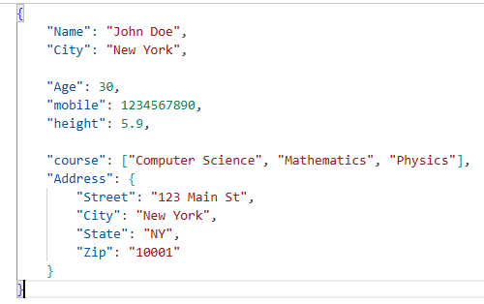
JSON Nested object

Slide 10


Slide 11
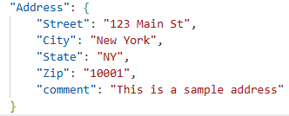
JSON Comments
JSON doesn’t support comments.it is not a standard but you can do some tricks such as adding extra attribute for comments in JSON object.
Here , “comments” attribute can be treated as comment

Slide 12
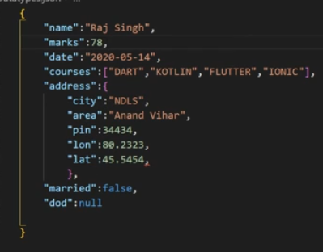

Slide 13
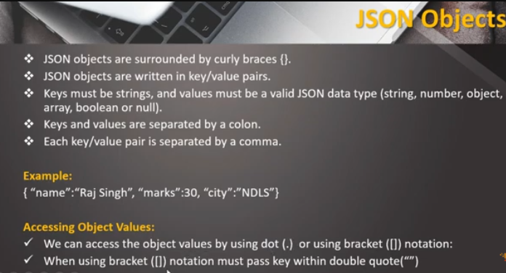

Slide 14
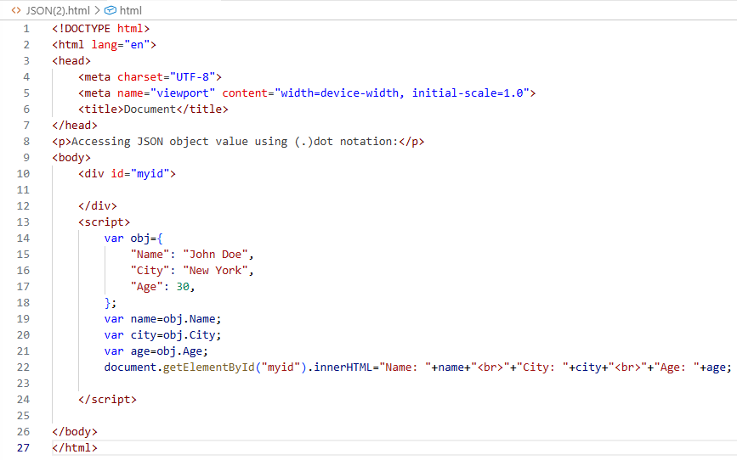

Slide 15
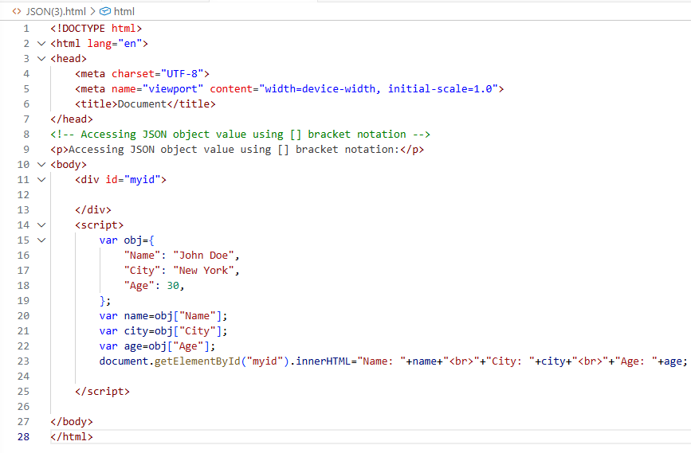

Slide 16
