Slide 1
JSON Parsing
Presented by: Manal Asgahr

Slide 2
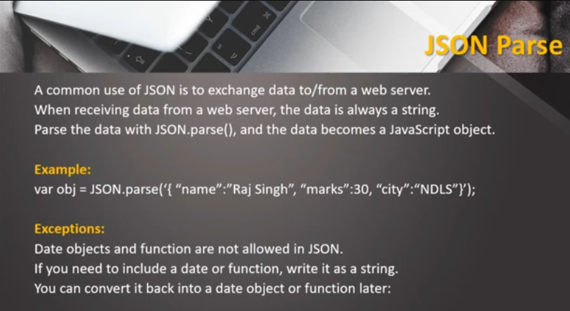

Slide 3
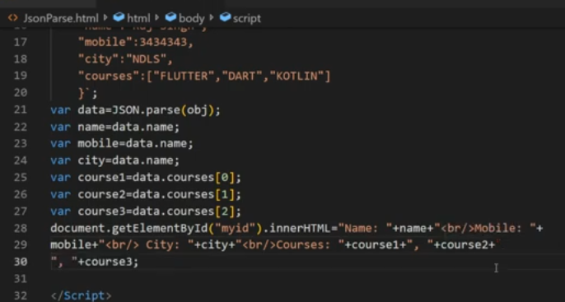

Slide 4
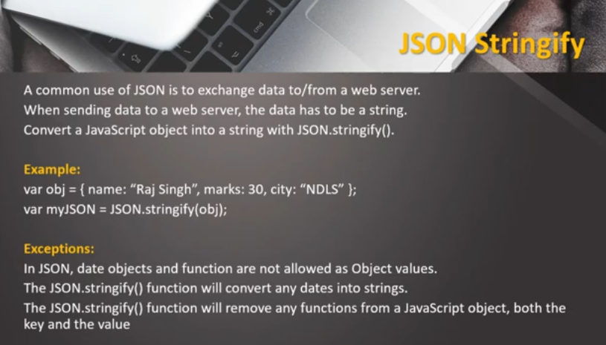

Slide 5
