Slide 1
CSS Grid Layouts
Presented by Manal Asghar

Slide 2
CSS Grid Layout Module
The Grid Layout Module offers a grid-based layout system, with rows and columns.
The Grid Layout Module allows developers to easily create complex web layouts.
The Grid Layout Module makes it easy to design a responsive layout structure, without using float or positioning.

Slide 3
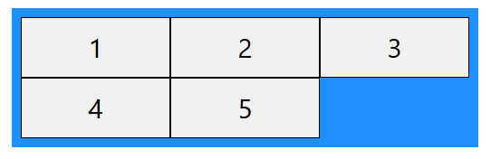
CSS Grid Components
A grid always consists of:
A Grid Container - The parent (container) element, where the display property is set to grid or inline-grid
One or more Grid Items - The direct children of the grid container automatically becomes grid items
A Grid Container with Five Grid Items
The element below represents a grid container (the blue area) with five grid items.

Slide 4
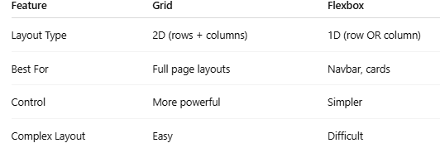
Grid vs Flexbox comparison

Slide 5
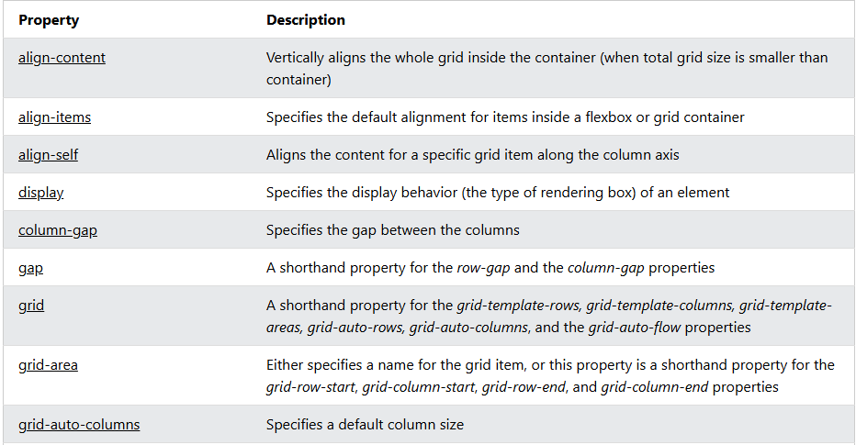
CSS Grid Properties

Slide 6
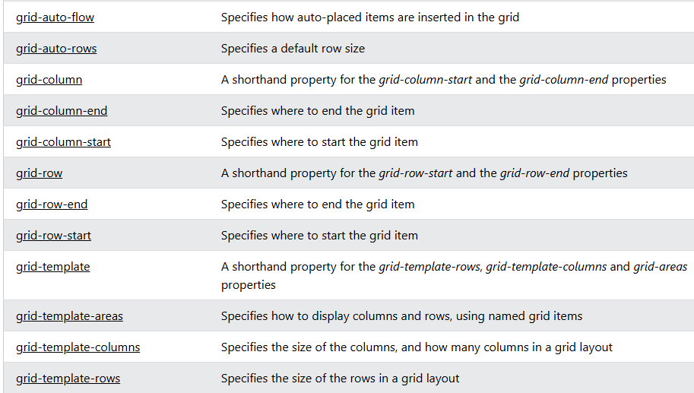
CSS Grid Properties

Slide 7
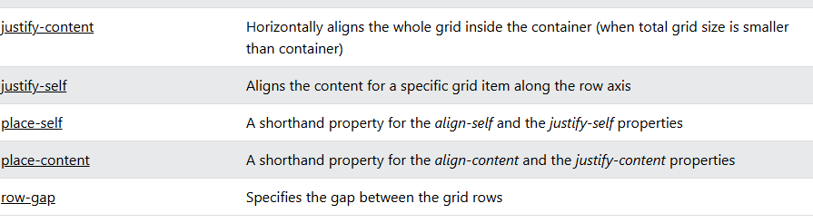
CSS grid properties

Slide 8
CSS Grid Container
A grid container contains one or more grid items arranged in columns and rows.
All direct child elements of a grid container automatically become grid items.
An element becomes a grid container when its display property is set to grid or inline-grid.

Slide 9
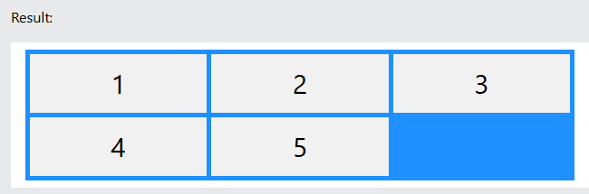
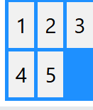
Display Grid Property
The <div> element becomes a grid container when its display property is set to grid or inline-grid.
Example
Use display: grid to make a block-level grid container:
.container {
display: grid; }
Use display: inline-grid to make an inline grid container:

Slide 10
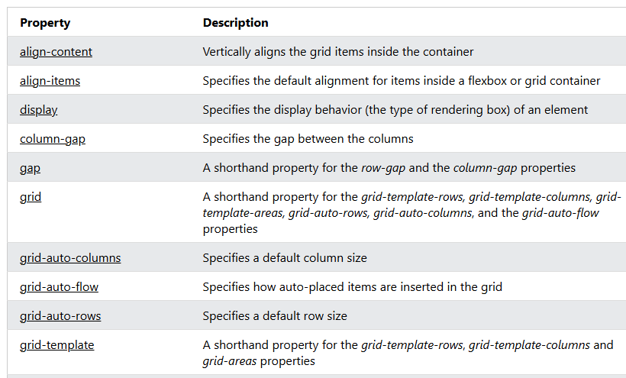
CSS Grid Container Properties

Slide 11
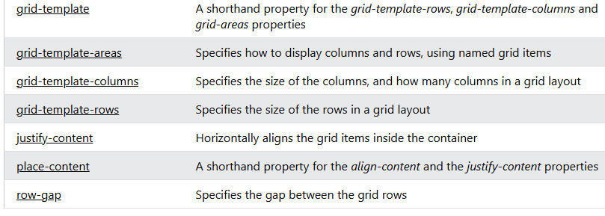
CSS Grid Container Properties

Slide 12
CSS Grid Tracks (Rows and Colums)
Inside the grid container you define the number and size of the grid columns and rows.
For this, we will use the following properties:
grid-template-columns - Defines the number and width of the columns in the grid
grid-template-rows - Defines the number and height of the rows in the grid
grid-template-areas - Defines how to display columns and rows, using named grid items

Slide 13
CSS Grid Gap
The space between the rows and columns in a grid container are called gaps (or gutters).
The gaps are created between the grid rows and columns, not on the outer edges of the grid container.
The default size of the gap is 0, which means that there are no spacing between grid items.
The size of the gap can be adjusted with the following properties:
column-gap - Specifies the gap between grid columns
row-gap - Specifies the gap between grid rows
gap - Shorthand property for row-gap and column-gap

Slide 14
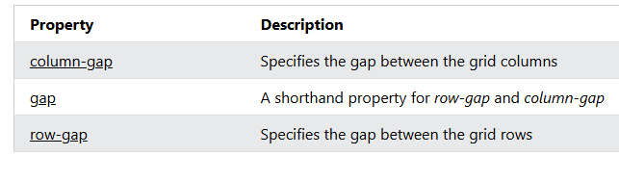
CSS Grid Gap Properties

Slide 15
CSS Sizing/Spanning Grid Items Grid Items
A grid item can span over mulitiple columns or rows.
We can specify where to start and end a grid item by using the following properties:
grid-column-start - Specifies on which column-line the grid item will start
grid-column-end - Specifies on which column-line the grid item will end
grid-column - Shorthand property for grid-column-start and grid-column-end
grid-row-start - Specifies on which row-line the grid item will start
grid-row-end - Specifies on which row-line the grid item will end
grid-row - Shorthand property for grid-row-start and grid-row-end
The lines between the columns in a grid are called column-lines, and the lines between the rows in a grid are called row-lines.

Slide 16
CSS Naming Grid Items
Naming Grid Items with grid-area
The CSS grid-template-areas is a grid container property, and it specifies areas within the grid layout.
You can name grid items by using the CSS grid-area property, and then reference to the name in the grid-template-areas property.
Each area is defined within apostrophes. The named grid items in each area is defined inside the apostrophes, separated by a space.

Slide 17
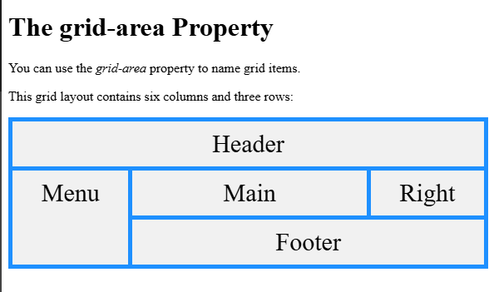
Practical: Web Page Template

Slide 18

Task: Magazine Layout

