Slide 1
Canvas in HTML5
Presented by: Manal Asghar

Slide 2
Introduction to Canvas in HTML5
Canvas is an HTML5 element used to draw graphics on a web page using JavaScript.
It allows developers to create:
2D graphics
Animations
Games
Interactive applications
Data visualizations
Canvas provides a drawable region defined in HTML and controlled using JavaScript.

Slide 3
What is Canvas?
The <canvas> element is a rectangular area on a webpage where we can draw graphics dynamically.
Syntax:
<canvas id="myCanvas" width="500" height="300"></canvas>
Important Points:
Width and height must be defined.
By default, canvas is blank.
Canvas does NOT draw anything by itself.
JavaScript is required to draw on canvas.

Slide 4
Why Do We Use Canvas?
Canvas is used because:
HTML elements cannot create complex graphics easily.
It allows dynamic drawing.
Used for:
  Game development
  Chart and graph visualization
  Image manipulation
  Drawing tools
  Animations
Canvas gives pixel-level control over graphics.

Slide 5

Canvas Context
To draw on canvas, we must get its context.
Explanation:
getContext("2d") gives drawing tools.
ctx is used to draw shapes, text, images.
Without context, drawing is not possible.

Slide 6
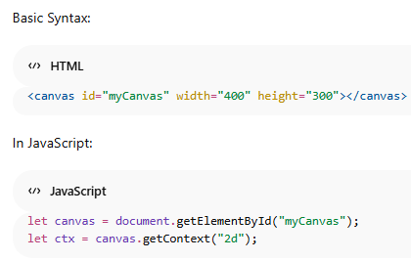
Canvas Element & Context
canvas → HTML element
getContext("2d") → gives drawing tools
ctx → used to draw
Without context, nothing can be drawn.

Slide 7
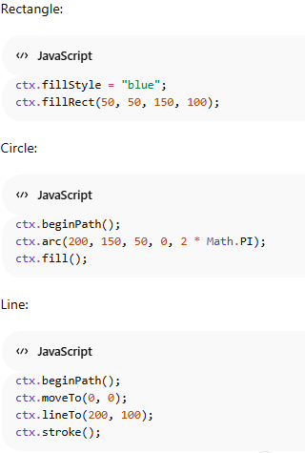
Practical: Drawing Shapes
Methods Used:
fillRect()
arc()
moveTo()
lineTo()
stroke()

Slide 8
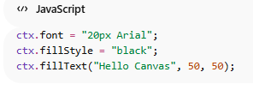
Drawing text
Canvas can also display text.
Text Methods:
fillText() → filled text
strokeText() → outlined text
Font and color can be customized.

Slide 9
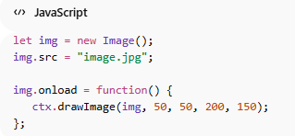
Drawing Images
Steps to draw image:
Create image object
Set image source
Wait for image to load
Draw image on canvas
Method Used:
drawImage()

Slide 10
Practical – Simple Drawing App

