Slide 1
HTML5 Storage & App-Like Features
Presented by: Manal ASGHAR

Slide 2
Introduction to HTML5 Storage
Why Client-Side Storage?
Before HTML5:
Only Cookies were available
Limited to 4KB
Sent to server with every HTTP request
Performance issues
With HTML5:
Large storage capacity (5MB+)
Stored in browser
Not sent with every request
Faster & secure (same-origin policy)

Slide 3

Web Storage API
HTML5 introduced:
localStorage
sessionStorage
Both:
Store data as key-value pairs
Data stored in browser
Same-origin restricted
Syntax:

Slide 4
LocalStorage
What is Local Storage?
Stores data permanently
No expiration time
Remains even after browser close
5MB storage limit (approx)
Use Cases:
Theme preference (dark/light)
Remember login (non-sensitive)
Store cart items
Save form data

Slide 5
SessionStorage
What is SessionStorage?
Stores data temporarily
Deleted when tab/browser closes
Separate for each tab
Use Cases:
Temporary form progress
OTP verification session
Multi-step forms

Slide 6
LocalStorage vs SessionStorage
Feature | Local Storage | Session Storage
Lifetime | Permanent | Until tab closes
Shared across tabs | Yes | No
Storage Size | ~5MB | ~5MB
Access | Same Origin | Same Origin

Slide 7
IndexedDB Overview
What is IndexedDB?
Advanced client-side database
Stores large structured data
NoSQL Database
Supports transactions
Can store:
  Objects
  Files
  Blobs
  Arrays
Used In:
Offline apps
Complex web applications
Large datasets

Slide 8
Why Indexed DB Instead of Local Storage?
LocalStorage | IndexedDB
Simple key-value | Structured database
Synchronous | Asynchronous
Small storage | Large storage
No indexing | Supports indexing

Slide 9
HTML5 vs Native App
HTML5 Web App
Runs in browser
Cross-platform
Easy updates
Requires internet (unless PWA)
Examples:
Gmail Web
Facebook Web
Native App
Installed from App Store
Platform-specific (Android/iOS)
Better performance
Access to device hardware

Slide 10
What is PWA (Progressive Web App)?
PWA = Web App + App Features
Features:
Installable
Offline support
Push notifications
App-like UI
Fast loading
Technologies Used:
Service Workers
Web Manifest
HTTPS

Slide 11
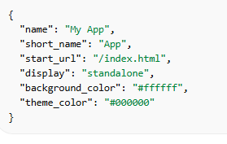
App Manifest
What is Web App Manifest?
A JSON file that defines:
App name
Icons
Theme color
Start URL
Display mode

Slide 12

Linking Manifest File
Purpose:
Makes website installable
Adds app icon on mobile
Launches like native app

Slide 13
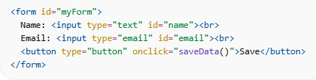
Store Form Data in Local Storage

Slide 14
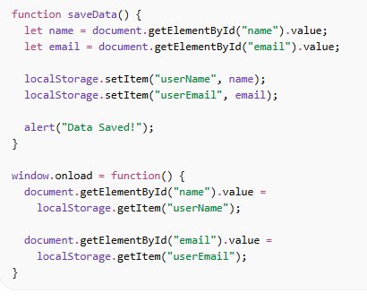
JavaScript Code
User enters data
Clicks Save
Data stored in browser
On page reload → data auto-filled

Slide 15
Advantages of HTML5 Storage
Fast performance
Reduces server load
Better user experience
Offline capability
Easy to implement

