Slide 1
Geolocation, Drag & Drop, and Offline Web Technologie(HTML5)
Presented by: Manal Asghar

Slide 2
Introduction to Modern HTML5 APIs
HTML5 introduced powerful browser APIs:
Location detection
Offline storage
File handling
Drag & Drop
App-like experiences
These APIs allow web apps to behave like native apps.

Slide 3
HTML5 Geolocation API
What is Geolocation?
Geolocation API allows websites to access:
User's Latitude
User's Longitude
Accuracy
Altitude (if available)
It works only with:
User permission
HTTPS connection

Slide 4
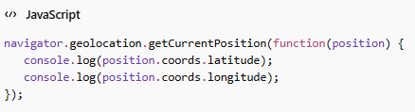
Security & Permission Model
Important Rules:
User must allow location access
Works only on secure sites (HTTPS)
Browser shows permission popup
Can be blocked by user
Why?
→ Privacy protection

Slide 5
Geolocation Methods
Geolocation Methods
getCurrentPosition()
  Gets location once
watchPosition()
  Tracks location continuously
clearWatch()
  Stops tracking

Slide 6
Google Maps API Integration (Introduction)
What is Google Maps API?
A JavaScript API provided by
Google
Allows:
Display interactive maps
Add markers
Draw routes
Show user location

Slide 7
Steps to Use Google Maps API
Create account on Google Cloud
Generate API Key
Enable Maps JavaScript API
Add script in HTML
Example:
<script src="https://maps.googleapis.com/maps/api/js?key=YOUR_API_KEY"></scrip>

Slide 8
Display User Location on Map
Basic Example Logic:
Get user location using Geolocation API
Pass coordinates to Google Maps
Add marker at user location
This creates:
Location-based apps
Delivery tracking systems
Ride sharing apps

Slide 9
Drag and Drop API
HTML5 Drag & Drop allows:
Drag elements
Drop into specific area
Transfer data between elements
Used in:
File upload areas
Kanban boards
Image rearranging

Slide 10
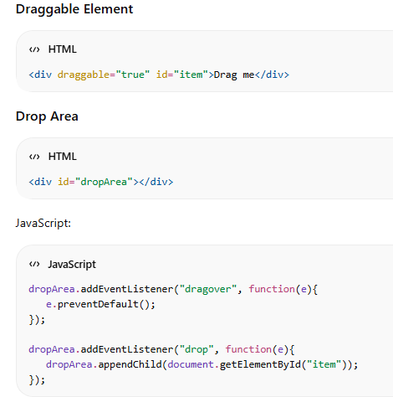
Drag and Drop Events
Important Events:
dragstart
drag
dragenter
dragover
drop
dragend

Slide 11
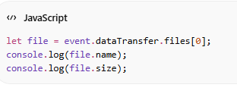
Drag & Drop File Upload
HTML5 allows users to:
Drag files from desktop
Drop into browser
Read files using File API
File API allows:
Reading file content
Getting file size
Getting file type
This creates modern upload systems.

Slide 12
Application Cache (AppCache)
Application Cache allows:
Store website files offline
Access website without internet
BUT
AppCache is deprecated now.

Slide 13
Why AppCache Was Removed?
Problems:
Hard to update cache
Poor error handling
Security issues
It has been replaced by:
Service Workers
Service Worker is a script that:
Runs in background
Handles caching
Enables offline mode
Intercepts network requests
Used in:
Progressive Web Apps (PWAs)

Slide 14
Offline Usage in Modern Web
Modern Offline Features Use:
Service Workers
Cache API
IndexedDB
Web Manifest
This makes website installable & offline-ready.

Slide 15
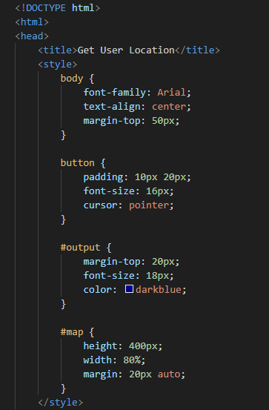
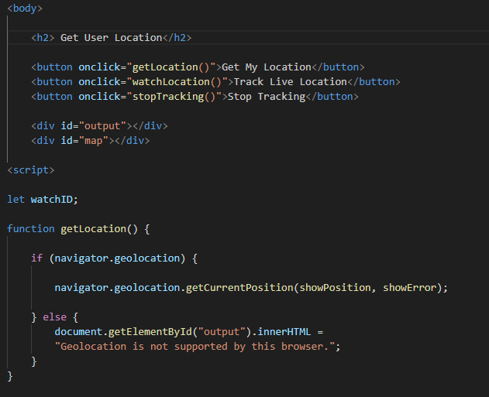
Practical – Get User Location

Slide 16
