Slide 1
Responsive Design & Media Queries
Presented by: Manal Asghar

Slide 2
What is Responsive Design?
Responsive Design means:
Website automatically adjusts according to screen size.
Devices:
Mobile
Tablet
Laptop
Desktop
Large screens
Goal:
Better user experience
No horizontal scroll
Clean layout on every device

Slide 3
Why Responsive Design is Important?
70%+ traffic from mobile
Google prefers mobile-friendly websites
Better SEO
Better accessibility
Improved performance

Slide 4
Mobile-First Design Principles
Mobile-first means:
First design for small screen.
Then scale up for larger screens
Why?
Small screen has limited space
Forces clean & simple layout
Better performance
Strategy:
Write base CSS for mobile
Add media queries for larger screens

Slide 5
Viewport Meta Tag
Adjust page width to device width
Prevent zoom issues
Enable proper scaling
<meta name="viewport" content="width=device-width, initial-scale=1.0">

Slide 6
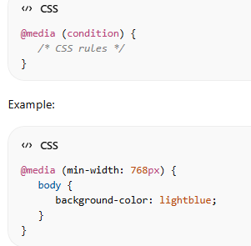
Media Queries
@media (min-width: 600px)
@media (min-width: 768px)
@media (min-width: 1024px)

Slide 7
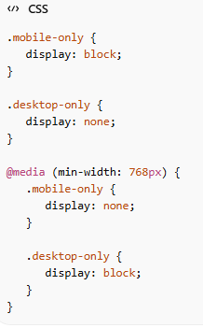
Hide / Show Content Based on Screen
Used for:
Different navigation menus
Different layouts
Optimized content display

Slide 8
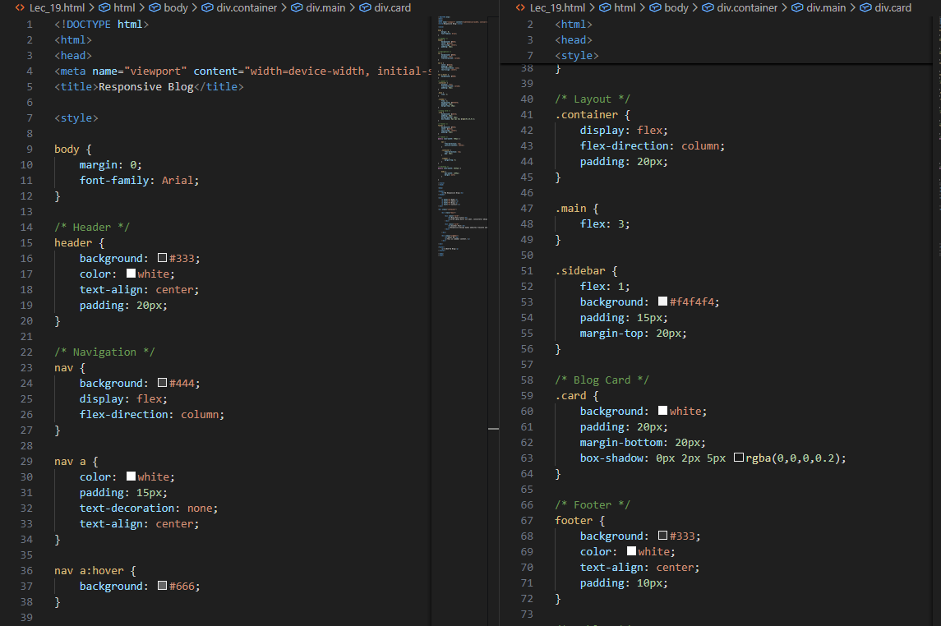
Practical: COMPLETE RESPONSIVE BLOG PROJECT

Slide 9
