Slide 1
JavaScript Objects and DOM
Presented by Manal Asghar

Slide 2
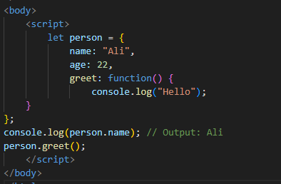
What is an Object?
An object is a collection of properties and methods.
Properties → store data
Methods → functions inside objects
Access using dot notation

Slide 3
Methods for Defining JavaScript Objects
There are multiple ways to create objects in JavaScript:
Using an Object Literal
Using the new Keyword
Using an Object Constructor
Using Object.assign()
Using Object.create()
Using Object.fromEntries()

Slide 4
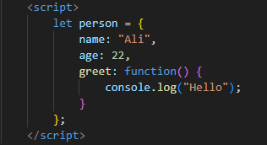
Using an Object Literal
The simplest and most common way.
Most commonly used
Simple syntax
Best for small objects

Slide 5
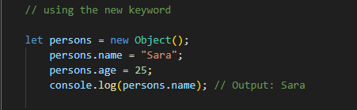
Using the new Keyword
Create object using built-in Object constructor.
Less common
Similar result as object literal
More verbose

Slide 6
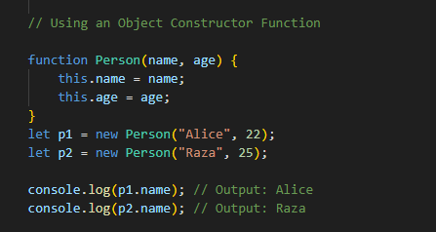
Using an Object Constructor Function
Used to create multiple objects.
Key Points
Reusable template
Use this keyword
Must use new

Slide 7
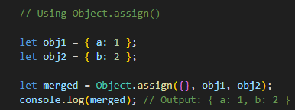
Using Object.assign()
Used to copy or merge objects.
Key Points
Combines multiple objects
Creates shallow copy
Useful for cloning

Slide 8
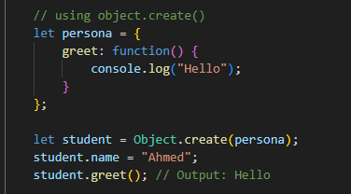
Using Object.create()
Creates a new object using an existing object as prototype.
Key Points
Uses prototype inheritance
New object inherits properties
Advanced concept

Slide 9
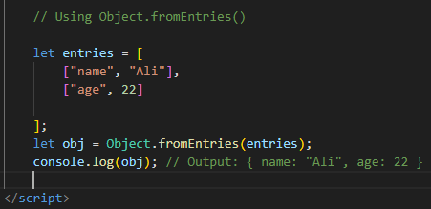
Using Object.fromEntries()
Creates object from key-value pairs.
Key Points
Converts array → object
Very useful with Map
Modern JavaScript method

Slide 10
Comparison
Method | Use Case
Object Literal | Simple object creation
new Object() | Traditional style
Constructor Function | Multiple objects
Object.assign() | Merge/clone objects
Object.create() | Inheritance
Object.fromEntries() | Array to object conversion

Slide 11
Introduction to DOM
What is DOM?
DOM stands for Document Object Model.
It represents HTML as a tree of objects.
Browser creates DOM when a web page loads.
JavaScript uses DOM to:
Access elements
Change content
Modify styles
Handle events

Slide 12
Querying Elements
getElementById
Select element by ID.
let heading = document.getElementById("title");
Select using CSS selectors.
let box = document.querySelector(".box");
let para = document.querySelector("p");
More flexible
Uses CSS Syntax
Query Selector

Slide 13
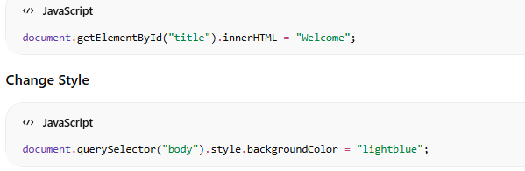
Changing Content with DOM

Slide 14
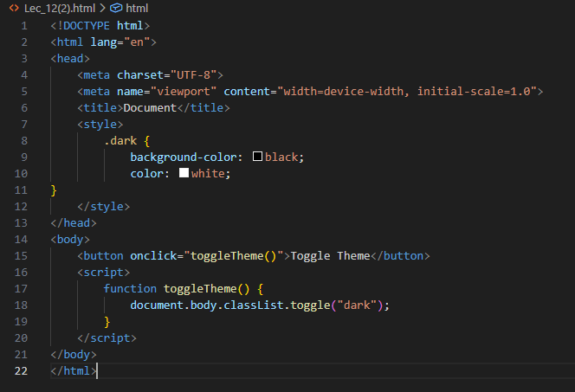
Practical

Slide 15
How It Works
Button click calls function
classList.toggle() adds/removes class
CSS changes theme automatically
DOM selection
Object methods
Event handling

Slide 16
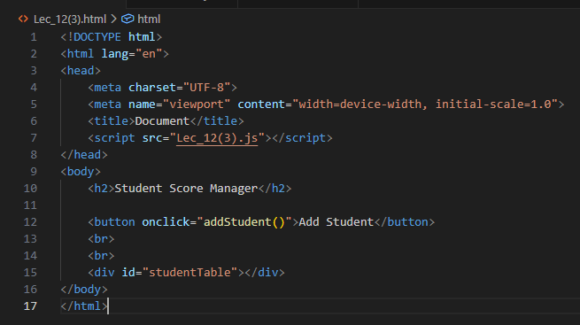
Practical: Student Score Manager
Create students as objects
Store scores in objects
Show table dynamically in HTML
Add “Update Score” button

Slide 17
