Slide 1
JavaScript Event Handling
Presented by: Manal Asghar

Slide 2
Events
What is an Event?
Event = an action that happens in the browser
Example: click, key press, mouse movement
Why Use Events?
Make pages interactive
Respond to user actions dynamically

Slide 3
Common Events in JavaScript
Event Type | Description
click | Triggered when user clicks an element
keyup | Triggered when user releases a key
mouseover | Triggered when mouse moves over an element
submit | Triggered when a form is submitted
change | Triggered when input value changes

Slide 4
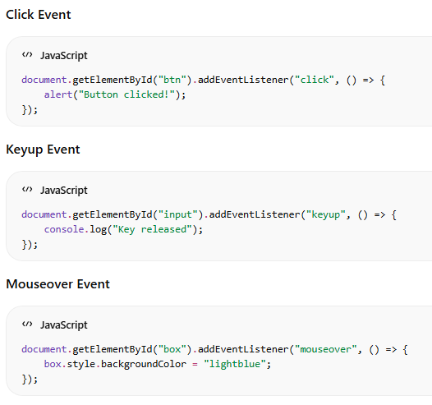
Event Handling – Examples

Slide 5
Form Submission & Validation
Form Submission:
happens when user clicks “Submit” button. Normally, browser reloads the page and sends data to the server.
Validation :
checking user input before sending it to the server.Example: make sure username is not empty, password has minimum length, email is valid, etc.
Why use JS for validation?
Prevents wrong data
Gives instant feedback
Avoids unnecessary server requests

Slide 6
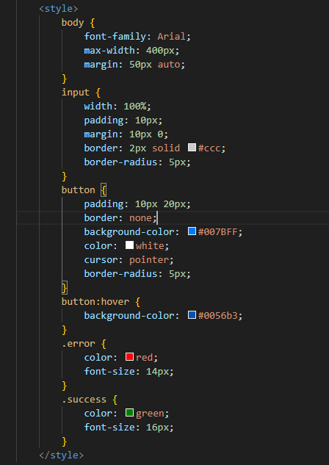
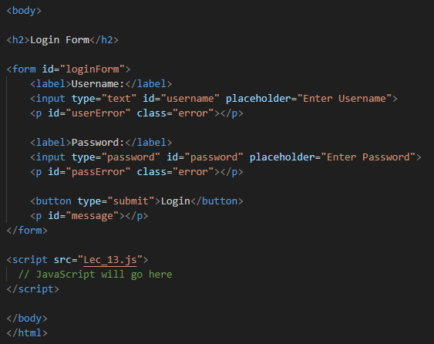
Practical: Create a login validator with form validation

Slide 7
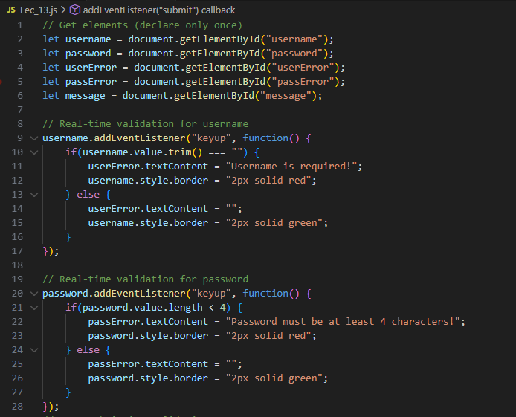
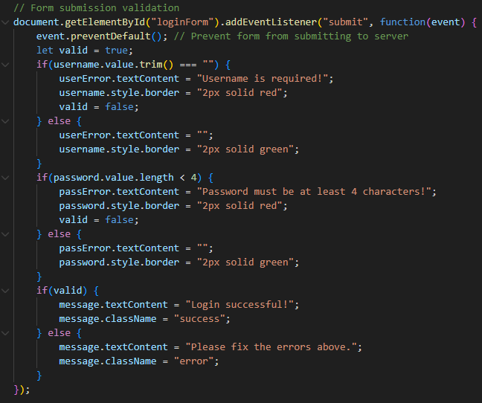
Javascript

