Slide 1
JavaScript ES6 Essentials
Presented by: Manal Asghar

Slide 2
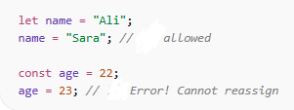
let & const
let → can be reassigned
const → cannot be reassigned
Both are block-scoped

Slide 3
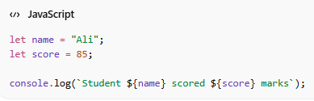
Template Literals
Use backticks `
Embed variables using ${variable}
Multi-line strings supported

Slide 4
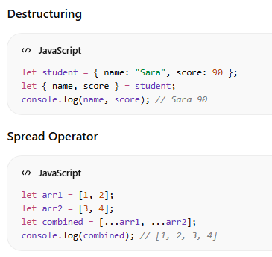
Destructuring & Spread Operator

Slide 5
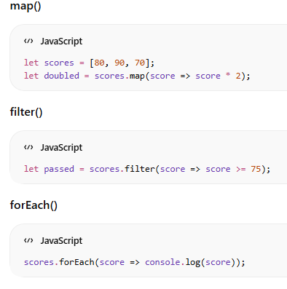
Array Method
map → transform array
filter → select elements
forEach → iterate without returning

Slide 6
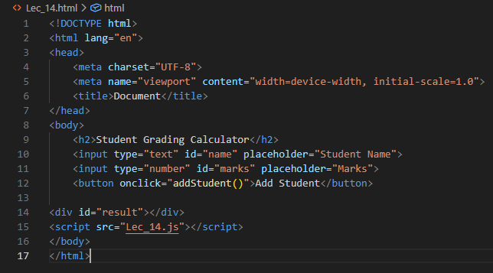
Practical – Student Grading Calculator

Slide 7
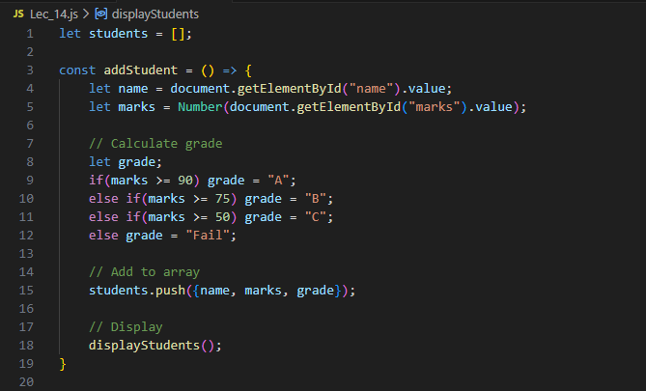
Practical – Student Grading Calculator

Slide 8
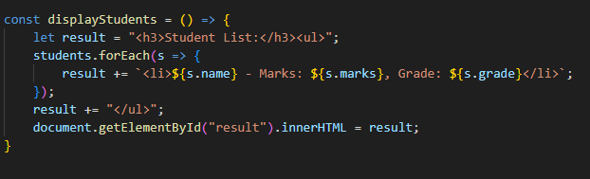
Practical – Student Grading Calculator

