Slide 1
JSON, Classes & Modern JS
Presented by: Manal Asghar

Slide 2
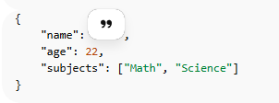
JSON Structure
JSON = JavaScript Object Notation
Lightweight data format
Used to store & transfer data
Key-value pairs like JS objects
Key Points:
Strings for keys "name“
Values can be string, number, array, object, Boolean, or null
Data is text-based → easy to transfer

Slide 3
What is Parsing?
Parsing means converting data from one format into another format so JavaScript can understand and use it.
In our case:
JSON (text format) ➜ JavaScript Object
Because:
JSON is text
JavaScript works with objects
So we must convert it.
That conversion = Parsing

Slide 4
Why Parsing is Needed?
When data comes from:
JSON file
Server
API
Database
It comes as string (text).
Example:
'{"name":"Ali","age":22}’
This is just a string.
You cannot do:
data.name
It will give error So we parse it first

Slide 5
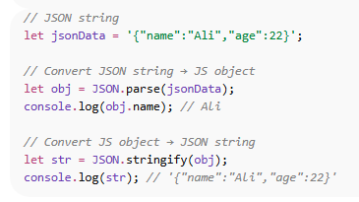
Parsing JSON in JavaScript
Key Points:
JSON.parse() → string to object
JSON.stringify() → object to string

Slide 6
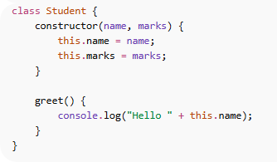
What is a Class?
A class is a blueprint (design) for creating objects.
Think like this:
Class = Design of a house
Object = Actual house built from that design
You don’t manually rewrite structure every time.
You define it once → create multiple objects from it.
Basic syntax of class.

Slide 7

What is a Constructor?
Constructor is:
A special method inside a class
Automatically runs when object is created
Used to initialize properties
Important rule:
Constructor name must always be:

Slide 8
What is this Keyword?
Refers to current object.
Used to assign values to object properties.
Example:
this.name = name;
Without this, properties will not attach to object.

Slide 9
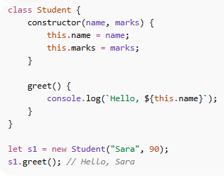
JavaScript Classes & Constructors
Class = blueprint for objects
Constructor = special method to initialize object

Slide 10
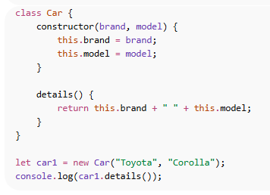
Practice

Slide 11
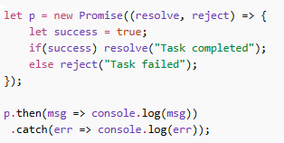
Promises
Promises = way to handle asynchronous operations
Key Points:
resolve() → success
reject() → failure
then() → handle success
catch() → handle failure

Slide 12
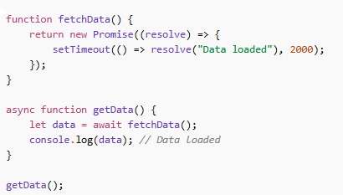
Async/Await
async → function returns promise
await → waits for promise to resolve
Makes async code look synchronous & readable

Slide 13
Practical: Student Grades Dashboard
Fetch student data from a JSON file
Display dynamically in a table
Calculate grades (A, B, C, Fail)
Color-code Pass/Fail
Use async/await, fetch, template literals, and array methods

Slide 14
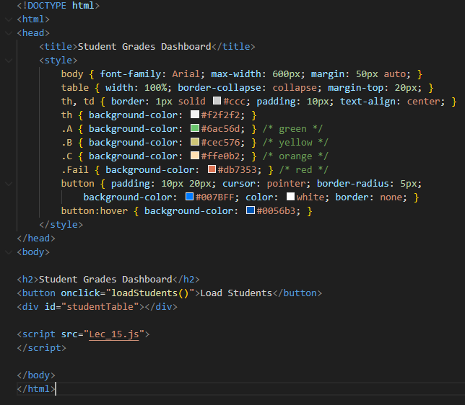
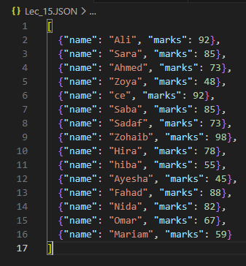

Slide 15
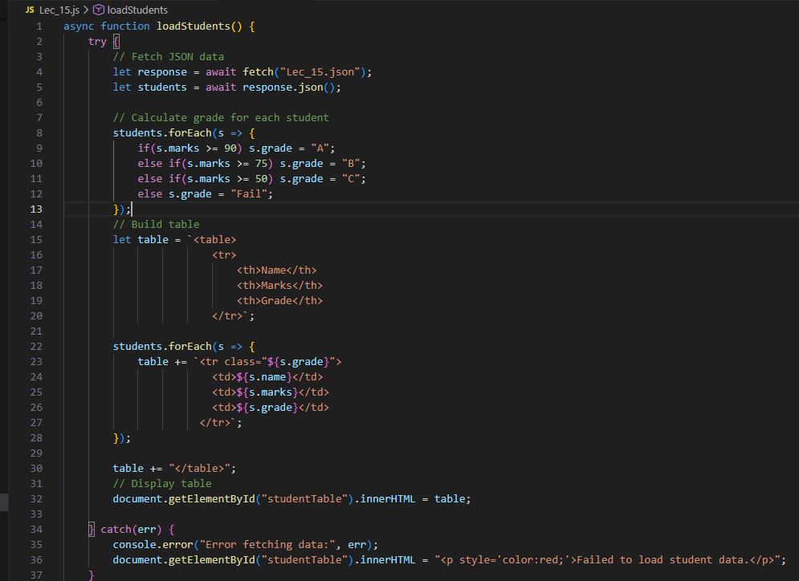

Slide 16
How it work?
fetch("students.json")
→ connects HTML page to JSON file
response.json()
→ converts JSON text into JavaScript object
forEach()
→ loops through JSON data
innerHTML
→ displays data inside HTML
That’s it. That’s the connection.

