Slide 1
Box Model and Div
Presented by: Manal Asghar

Slide 2
Introduction to <div>
<div> stands for Division
It is a block-level element
Used to group HTML elements together
Commonly used for layout and structure
The <div> tag acts as a container for other elements.

Slide 3
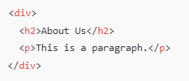
Why Do We Use <div>?
Purpose of <div>
Organize content into sections
Apply CSS styling to a group of elements
Create page layouts
Structure web pages clearly

Slide 4

Real-Life Layout Example
Used for:
Website header
Navigation bar
Content area
Footer section

Slide 5
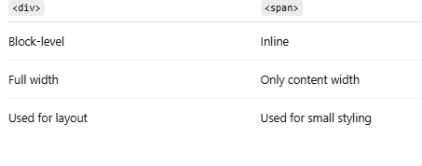
<div> vs <span>

Slide 6
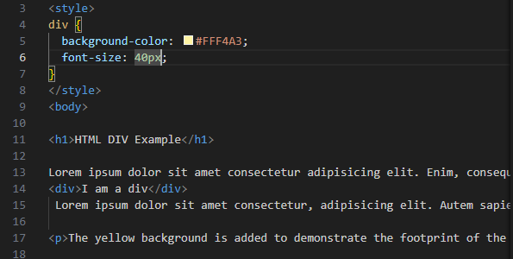
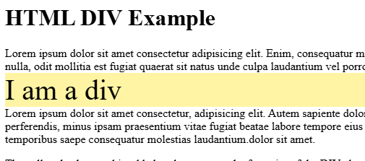
HTML Div Element
The <div> element is by default a block element, meaning that it takes all available width, and comes with line breaks before and after.
The <div> element has no required attributes, but style, class and id are common. The <div> element is often used to group sections of a web page together.

Slide 7
Why do we use <div> in HTML?
<div> stands for division.
It is used to group and organize content on a webpage.
To Create Layout Sections
We use <div> to divide a webpage into different sections like:
Header, Navigation bar, Main content, Sidebar, Footer

Slide 8
Nesting & Specificity
Nesting means placing one element inside another element in HTML.
Example (HTML Nesting):
<div class="parent"> <p>This is inside div</p></div>
<p> is nested inside <div>

Slide 9
Specificity in CSS
Specificity decides which CSS rule will apply when multiple rules target the same element.
Think of it like a priority system.
Specificity Order (Low → High)
Element selector → p, div
Class selector → .box
ID selector → #main
Inline style → style=""!important → Highest priority

Slide 10
Line-height, letter-spacing, word-spacing
Line-height:
Line-height decides vertical space between lines of text.
Think of it as height of each line.
Example:
<p style="line-height: 1.5;">This is line one.<br>This is line two.<br>This is line three.</p>
line-height: 1.5; → 1.5 times the normal line height
Bigger number → lines are more spaced
Smaller number → lines are closer

Slide 11
Letter-spacing
:Letter-spacing controls space between letters in a word.
Example:<p style="letter-spacing: 3px;">Hello World</p>
letter-spacing: 3px; → adds 3px space between each letter
Can also use negative values → letters get close

Slide 12
Word-spacing
Word-spacing controls space between words in a sentence.
Example:
<p style="word-spacing: 10px;">This is a spaced out sentence.</p>
word-spacing: 10px; → adds 10px between words
Can use negative values → words get closer

Slide 13
CSS Position Property
The position property decides how an element is placed on a webpage and what it’s positioned relative to.
Static (default)Default position for all elements.
Element stays in normal document flow.
top, left, right, bottom do not work.
Relative: Element moves relative to its original position. Top, left, right, bottom can shift it.
Absolute: Element is placed relative to its nearest positioned ancestor (relative, absolute, or sticky).If no ancestor → positioned relative to the body.
Fixed: Element is fixed relative to the viewport. Does not move when scrolling.
Sticky Combination of relative + fixed. Stays in normal flow until a scroll point, then becomes fixed.

Slide 14
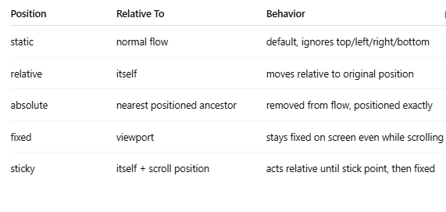
CSS Position Property

Slide 15
Z-index & Stacking Context
z-index controls the stacking order of elements (which element appears on top of others).
Higher z-index → element appears above lower z-index.
Only works on positioned elements (relative, absolute, fixed, or sticky).
A stacking context is like a layer or group of elements on a webpage that stick together in terms of z-index

Slide 16
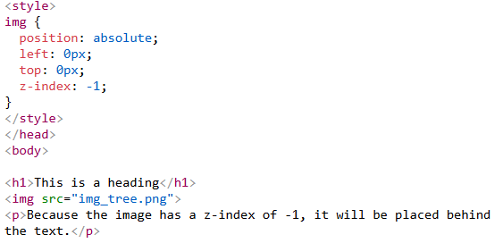
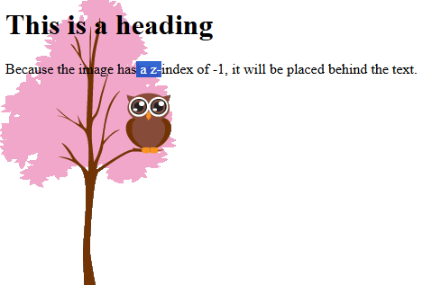
Practice Using z-index

Slide 17
What is Layout?
Layout = arrangement of elements on a webpage
Organizes header, footer, sidebar, main content
Improves UX & readability
Common techniques:
Float Flexbox (display: flex)
Grid (display: grid)
Positioning
Visual: Simple diagram of header, sidebar, main, footer

Slide 18
Float Property
Moves element left or right
Text wraps around floated element
Float image left → text flows around it.
Float image left → text flows around it
Clear Property
Stops elements from wrapping around floats
clear: left | right | both | none;

Slide 19
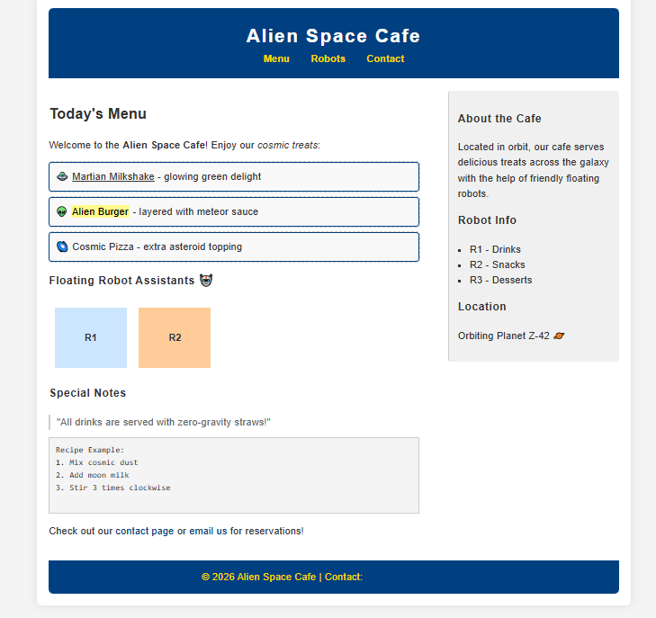
Practical Task

