Slide 1
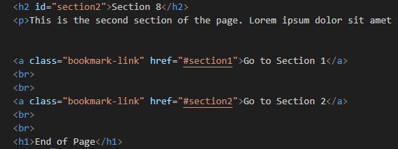
Create Bookmarks
Bookmarks can be useful if a web page is very long.
To create a bookmark - first create the bookmark, then add a link to it.
When the link is clicked, the page will scroll down or up to the location with the bookmark.

Slide 2
Practical Task
bookmark

Slide 3
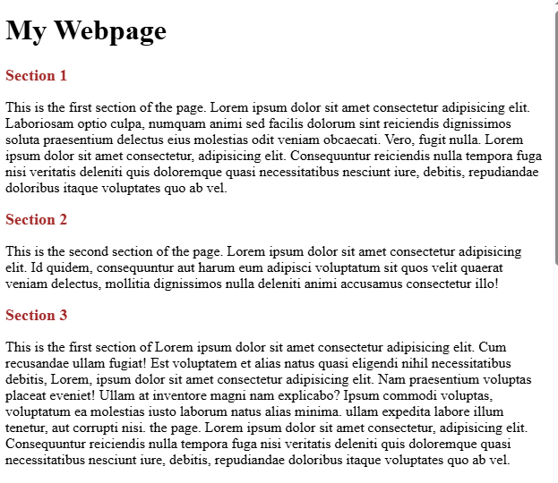
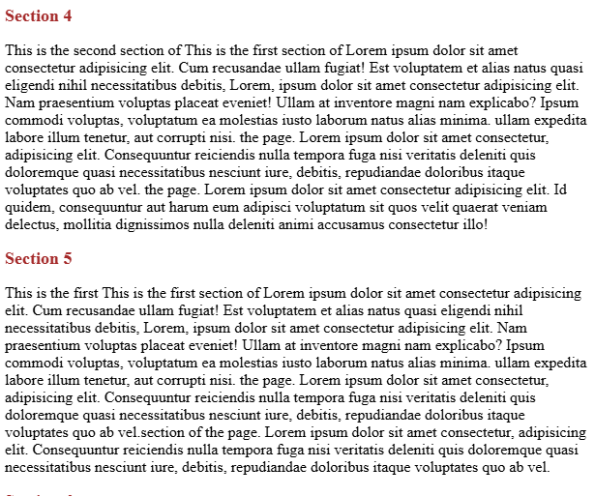
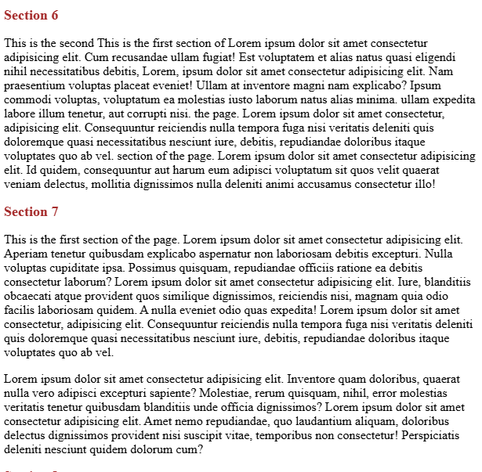
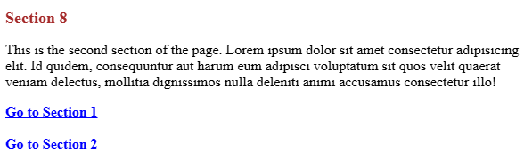

Slide 4
Tables in HTML
HTML tables allow web developers to arrange data into rows and columns.

Slide 5
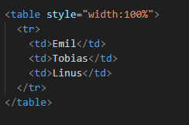
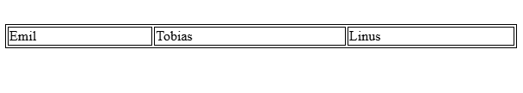
Define an HTML Table
A table in HTML consists of table cells inside rows and columns.
Table Cells:Each table cell is defined by a <td> and a </td> tag.
td stands for table data.

Slide 6
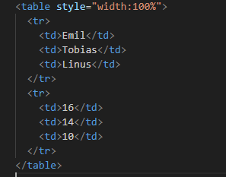
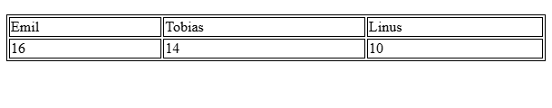
Table Rows
Each table row starts with a <tr> and ends with a </tr> tag.
tr stands for table row.

Slide 7
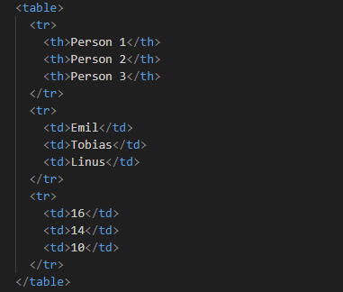
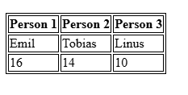
Table Headers
Sometimes you want your cells to be table header cells. In those cases use the <th> tag instead of the <td> tag.
th stands for table header.

Slide 8
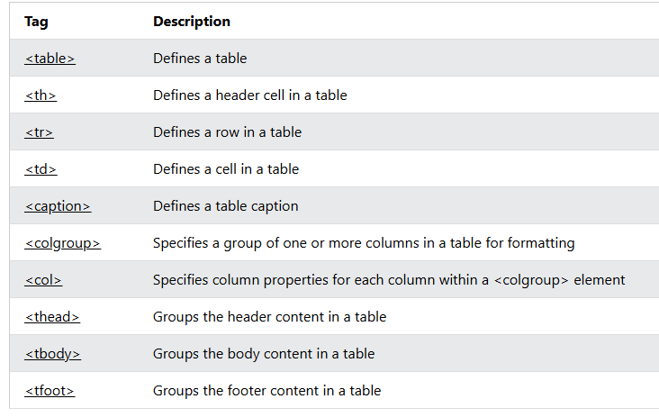
HTML Table Tags

Slide 9
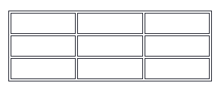
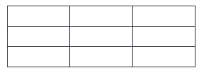

HTML Table Borders
HTML tables can have borders of different styles and shapes.
How To Add a Border
To add a border, use the CSS border property on table, th, and td elements:
Collapsed Table Borders
To avoid having double borders like in the example above, set the CSS border-collapse property to collapse.
Style Table Borders
If you set a background color of each cell, and give the border a white color (the same as the document background), you get the impression of an invisible border:

Slide 10
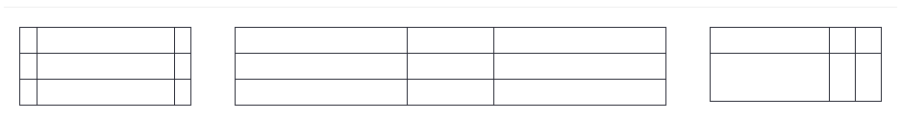
HTML Table Sizes
HTML tables can have different sizes for each column, row or the entire table
HTML Table Width
To set the width of a table, add the style attribute to the <table> element.
<table style="width:100%“>
HTML Table Column Width
To set the size of a specific column, add the style attribute on a <th> or <td> element
<th style="width:70%">Firstname</th>
HTML Table Row Height
<tr style="height:200px">

Slide 11
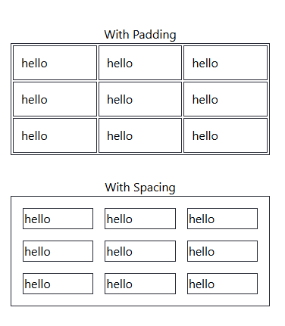
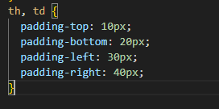
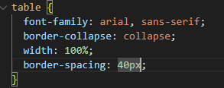
HTML Table Padding & Spacing
HTML tables can adjust the padding inside the cells, and also the space between the cells.

Slide 12
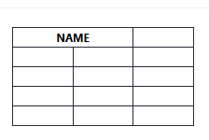
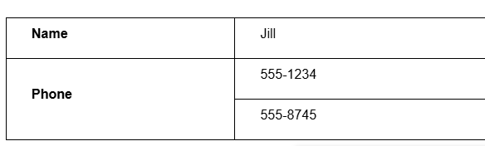
HTML Table Colspan & Rowspan
Colspan
To make a cell span over multiple columns, use the colspan attribute:
<th colspan="2">Name</th>
Rowspan

Slide 13
Block-level Elements
A block-level element always starts on a new line, and the browsers automatically add some space (a margin) before and after the element.
A block-level element always takes up the full width available (stretches out to the left and right as far as it can).
Two commonly used block elements are: <p> and <div>.
The <p> element defines a paragraph in an HTML document.
The <div> element defines a division or a section in an HTML document.

Slide 14
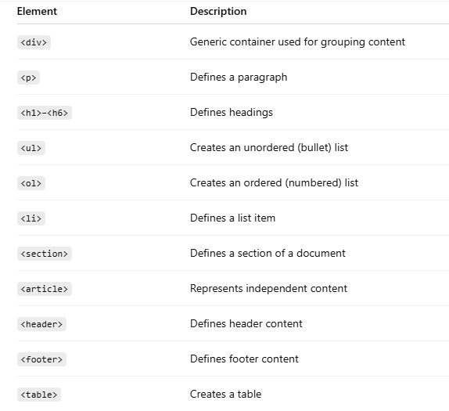
Common block level Elements

Slide 15
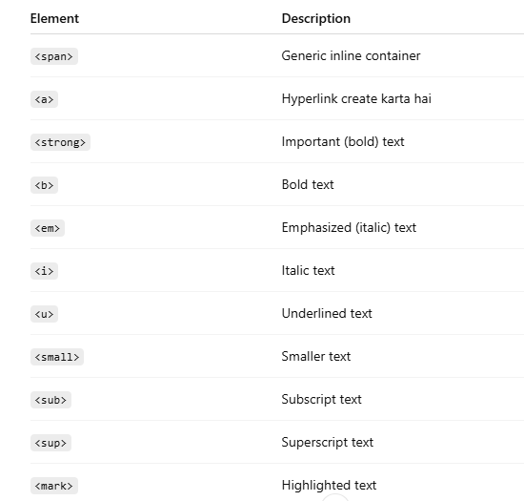
Inline Elements
An inline element does not start on a new line.
An inline element only takes up as much width as necessary.

Slide 16
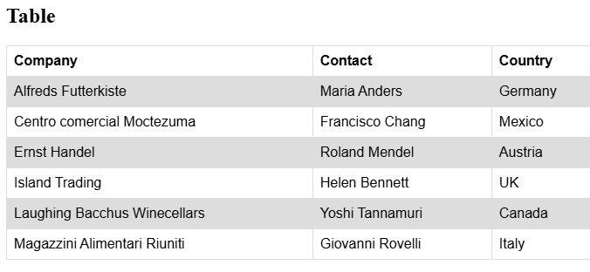
Practical task:
Use hover property

