Slide 1
Forms & Input Elements
Presented by : Manal asghar

Slide 2
Forms & Input Elements in HTML
Forms are used to collect user data.
The user input is most often sent to a server for processing.
HTML provides a variety of input elements, validation attributes, and form controls.

Slide 3
The HTML <form> Elements
The HTML <form> element can contain one or more of the following form elements:
<input>
<label>
<select>
<textarea>
<button>
<fieldset>
<legend>
<datalist>
<output>
<option>
<optgroup>

Slide 4
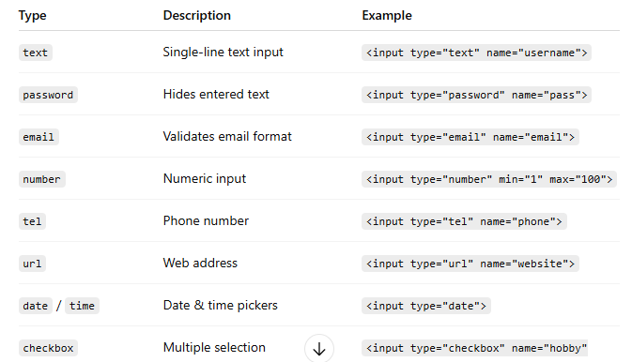
Input Types

Slide 5
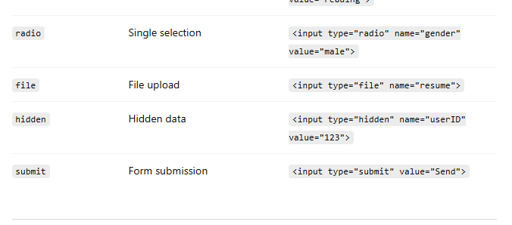
Input Types

Slide 6
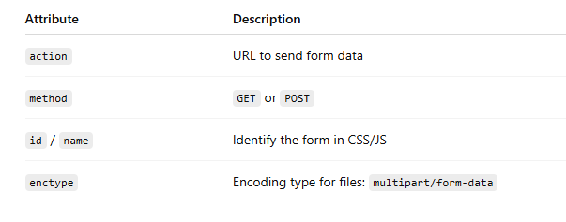
Form Attributes

Slide 7
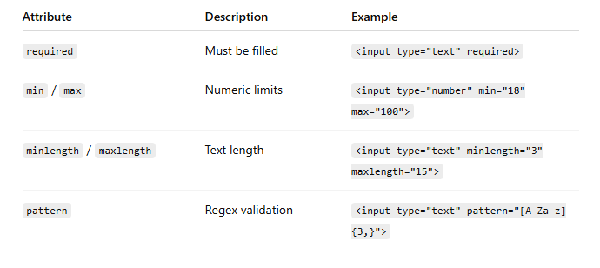
Validation Attributes
Validation helps ensure correct user input before submission.

Slide 8
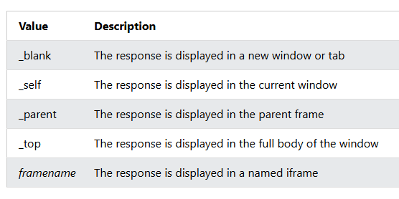
The Target Attribute
The target attribute specifies where to display the response that is received after submitting the form.

Slide 9
Hidden Fields
Hidden fields store data that users don’t see but is sent with the form.
<input type="hidden" name="userID" value="12345">
Use cases:
User IDs, session tokens, tracking info.

Slide 10
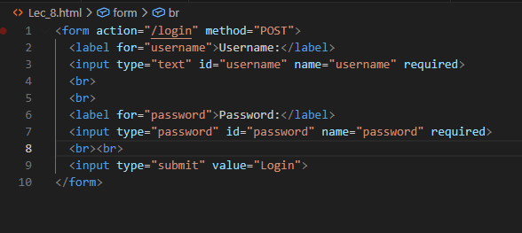
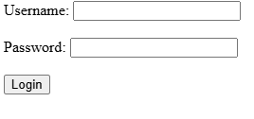
Practical

Slide 11
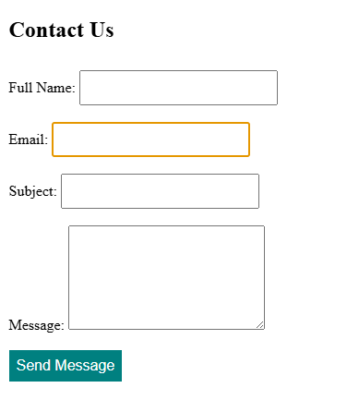
Practical:
design contact form

Slide 12
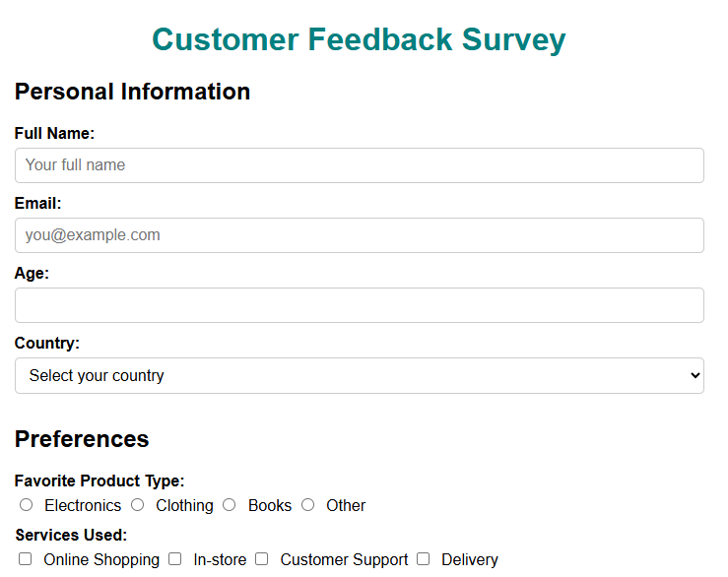
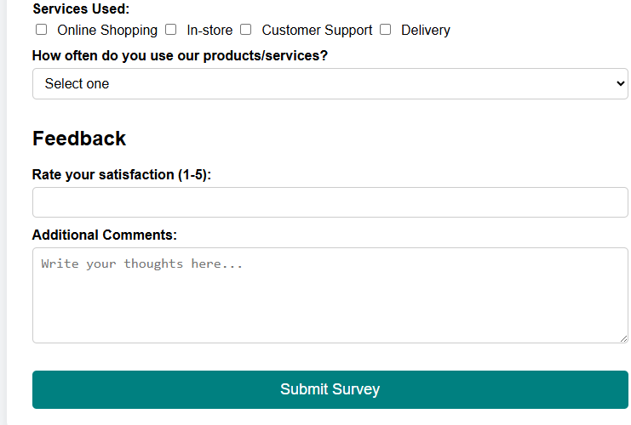
Practical
Survey form

