Slide 1
Flexbox Layout Mastery
Presented by Manal Asghar

Slide 2
What is Flexbox?
Content: Flexbox = CSS layout module for flexible, responsive layouts
Helps align, distribute space, and control order of items.
CSS Flexbox is short for the CSS Flexible Box Layout module.
Flexbox is a layout model for arranging items (horizontally or vertically) within a container, in a flexible and responsive way. Flexbox makes it easy to design a flexible and responsive layout, without using float or positioning.
Key properties: display: flex, flex-direction, justify-content, align-items, flex-wrap, order, flex

Slide 3
CSS Flexbox Components
A flexbox always consists of:
A Flex Container - The parent (container) element, where the display property is set to flex or inline-flex
One or more Flex Items - The direct children of the flex container automatically becomes flex items
A Flex Container with Three Flex Items
The element below represents a flex container (the blue area) with three flex items.

Slide 4
CSS Flex Container Properties
The flex container element can have the following properties:
display - Must be set to flex or inline-flex
flex-direction - Sets the display-direction of flex items
flex-wrap - Specifies whether the flex items should wrap or not
flex-flow - Shorthand property for flex-direction and flex-wrap
justify-content - Aligns the flex items when they do not use all available space on the main-axis (horizontally)
align-items - Aligns the flex items when they do not use all available space on the cross-axis (vertically)
align-content - Aligns the flex lines when there is extra space in the cross axis and flex items wrap

Slide 5
CSS flex-direction Property
The flex-direction property specifies the display-direction of flex items in the flex container.
This property can have one of the following values:
row (default)
column
row-reverse
column-reverse

Slide 6
CSS flex-wrap Property
The flex-wrap property specifies whether the flex items should wrap or not, if there is not enough room for them on one flex line.
This property can have one of the following values:
nowrap (default) The nowrap value specifies that the flex items will not wrap (this is default):
Wrap: The wrap value specifies that the flex items will wrap if necessary
wrap-reverse: The wrap-reverse value specifies that the flex items will wrap if necessary, in reverse order

Slide 7
CSS justify-content Property
The justify-content property is used to align the flex items when they do not use all available space on the main-axis (horizontally).
This property can have one of the following values:
center
flex-start (default)
flex-end
space-around
space-between
space-evenly

Slide 8
CSS Flexbox Align
This page covers align-items, align-content, and true centering with Flexbox.
CSS align-items Property
The align-items property is used to align the flex items vertically (on the cross-axis).
This property can have one of the following values:
normal (default)
stretch
center
flex-start
flex-end
baseline

Slide 9
CSS Flex Items
The direct child elements of a flex container automatically becomes flex items.
Flex items can have the following properties:
order - Specifies the display order of the flex items inside the flex container
flex-grow - Specifies how much a flex item will grow relative to the rest of the flex items
flex-shrink - Specifies how much a flex item will shrink relative to the rest of the flex items
flex-basis - Specifies the initial length of a flex item
flex - Shorthand property for flex-grow, flex-shrink, and flex-basis
align-self - Specifies the alignment for the flex item inside the flex container

Slide 10
CSS order Property and gap(pg. no 166)
The order property specifies the display order of the flex items inside the flex container.
The first flex item in the source code does not have to appear as the first item in the layout.
The order value must be a number, and the default value is 0.

Slide 11
CSS flex-grow Property
The flex-grow property specifies how much a flex item will grow relative to the rest of the flex items.
The value must be a number, and the default value is 0.
CSS flex-shrink Property
The flex-shrink property specifies how much a flex item will shrink relative to the rest of the flex items.
The value must be a number, and the default value is 1.
CSS flex-basis Property
The flex-basis property specifies the initial length of a flex item.

Slide 12
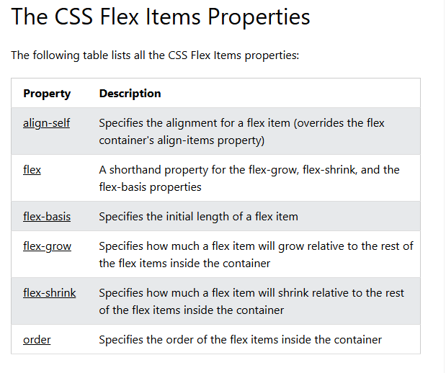

Slide 13
CSS Responsive Flexbox
Responsive Flexbox
You learned from the CSS Media Queries chapter that you can use media queries to create different layouts for different screen sizes and devices.
For example, if you want to create a three-column layout for large screen sizes, and a one-column layout for small screen sizes (such as phones), you can change the flex-direction from row to column at a specific breakpoint (600px)

Slide 14

Practical Task: Build a responsive navbar and card layout using Flexbox

