Slide 1
HTML5 Frameworks Overview
Presented by: Manal Asghar

Slide 2
What are HTML5 Frameworks?
HTML5 Frameworks are:
Pre-written CSS & JS libraries
Used to build responsive UI faster
They provide:
Grid systems
Buttons
Forms
Cards
Navigation bars
Modals
Purpose:
Save time
Maintain consistency
Responsive design

Slide 3
Why Use Frameworks?
Without framework:
Write CSS from scratch
Time-consuming
More bugs
With framework:
Ready-made components
Cross-browser compatibility
Faster development
Professional UI

Slide 4
Bootstrap Overview
Bootstrap is a popular CSS framework.
Created by:
Twitter
Features:
12-column grid system
Pre-designed components
Responsive utilities
Built-in JS plugins

Slide 5
Bootstrap Features
Bootstrap Features
Navbar
Cards
Buttons
Carousel
Modal
Forms
Alerts
Uses:
Class-based styling Example:
class="btn btn-primary"

Slide 6
Tailwind CSS Overview
Tailwind CSS is a utility-first CSS framework for rapidly building custom user interfaces. Instead of providing pre-designed components like traditional frameworks (e.g., Bootstrap), Tailwind offers low-level utility classes that can be applied directly in HTML to create unique designs without writing custom CS
Instead of components, it gives utility classes.
Example:
class="bg-blue-500 text-white p-4 rounded"

Slide 7
Bootstrap vs Tailwind
Feature | Bootstrap | Tailwind
Type | Component-based | Utility-first
Design | Pre-styled | Customizable
Learning | Easy | Medium
Flexibility | Limited | Very high
File Size | Medium | Can be optimized

Slide 8
When to Use What?
Use Bootstrap if:
Quick project
Beginner level
Need ready UI
Use Tailwind if:
Custom design required
Modern UI
Full design control

Slide 9
Google Material Design Lite (MDL)
Material Design Lite (MDL) was a front-end component library introduced by Google in July 2015 to help developers apply the Material Design aesthetic to websites using vanilla CSS, HTML, and JavaScript. It was designed to be "lite" - framework-agnostic, with few dependencies, and a small code size (~27KB gipped)
Based on:
Material Design Principles
Features:
Clean design
Shadow effects
Ripple effects
Cards, buttons, layouts
Note:
MDL is now outdated and replaced by Material Components.

Slide 10
What are UI Libraries?
UI Libraries provide:
Pre-built components
Reusable UI elements
Interactive features
Examples:
React
Vue.js
Angular
Difference:
Framework = Full structure
Library = Specific functionality

Slide 11
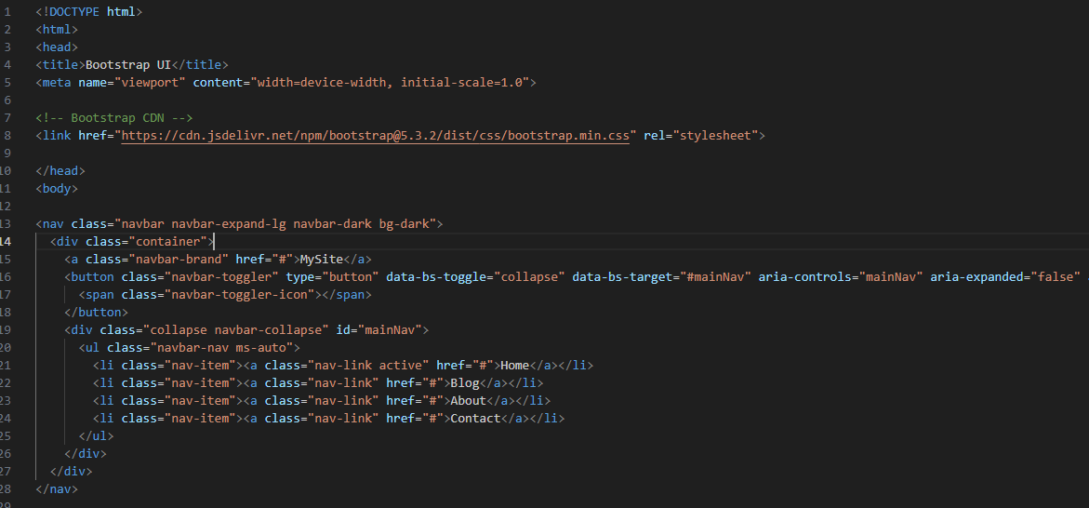
Practical: Bootstrap

Slide 12
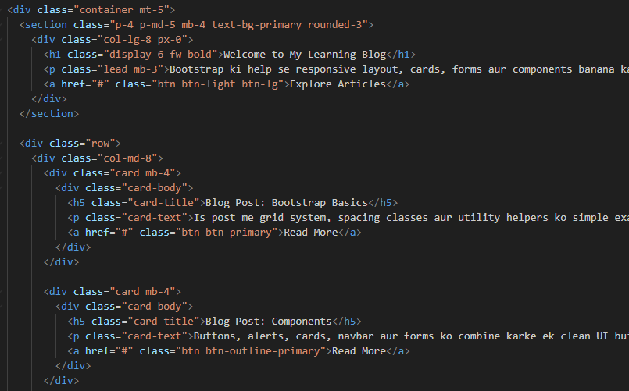
Practical: Bootstrap

Slide 13
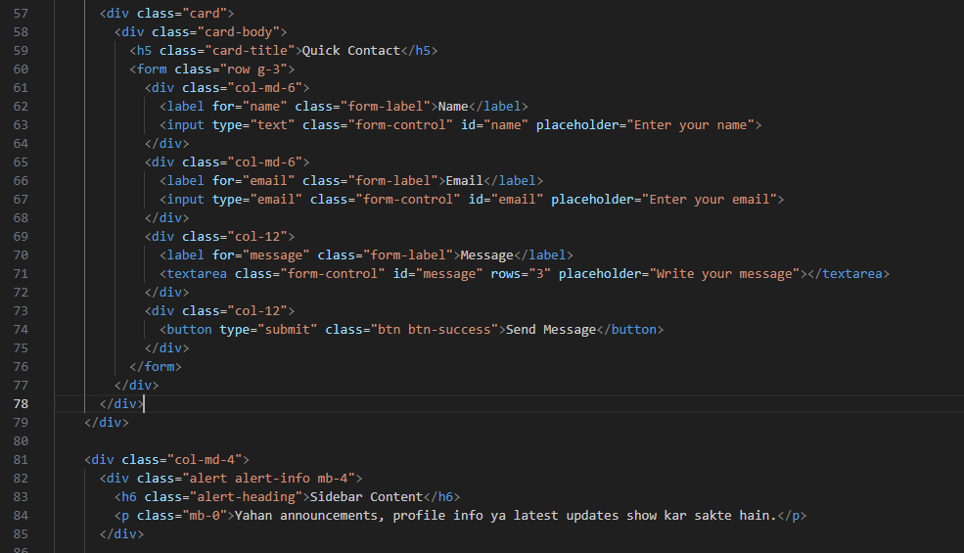
Practical: Bootstrap

Slide 14
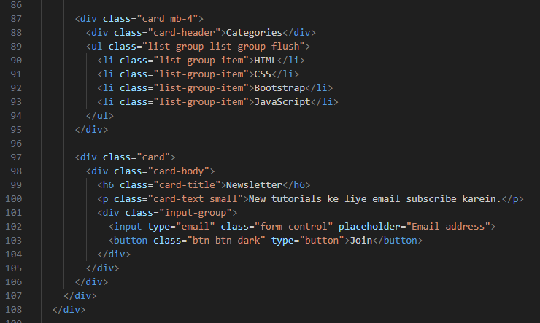
Practical: Bootstrap

Slide 15
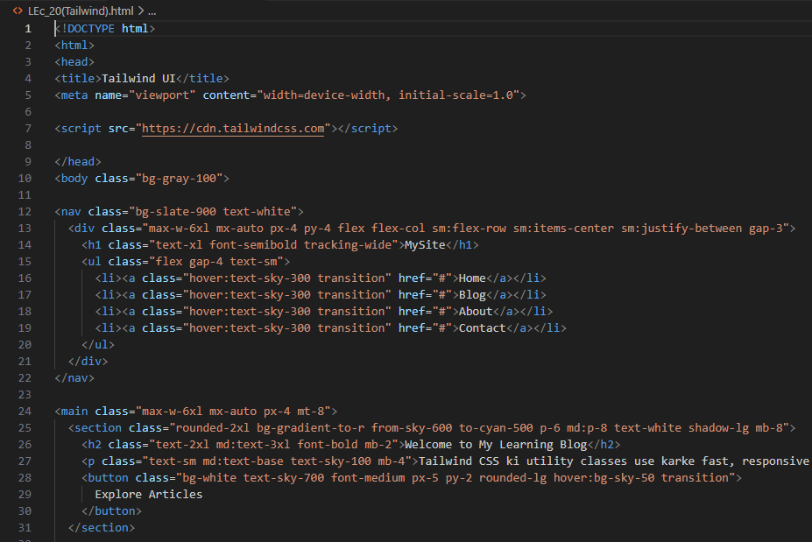
Practical: Tailwind

Slide 16
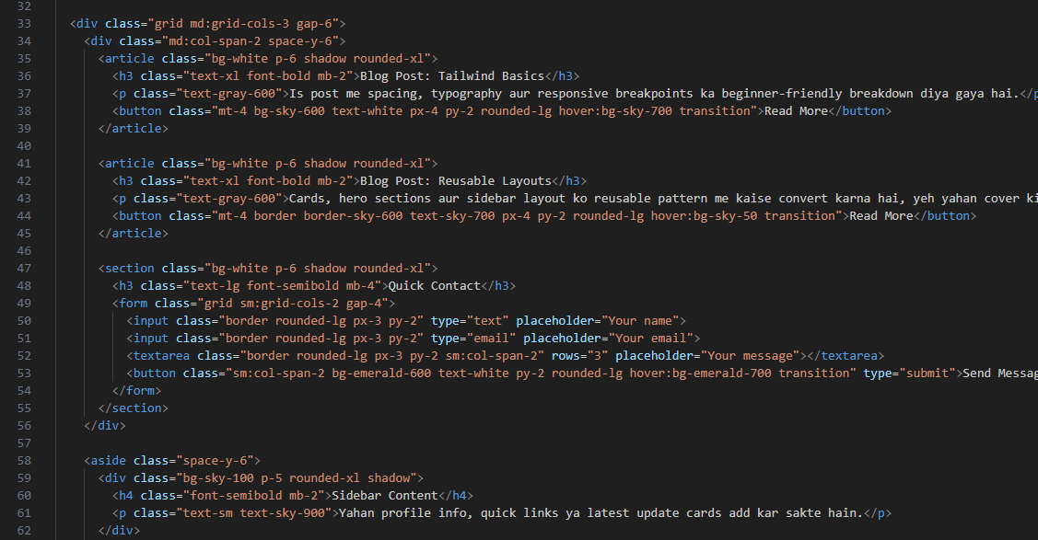
Practical: Tailwind

Slide 17
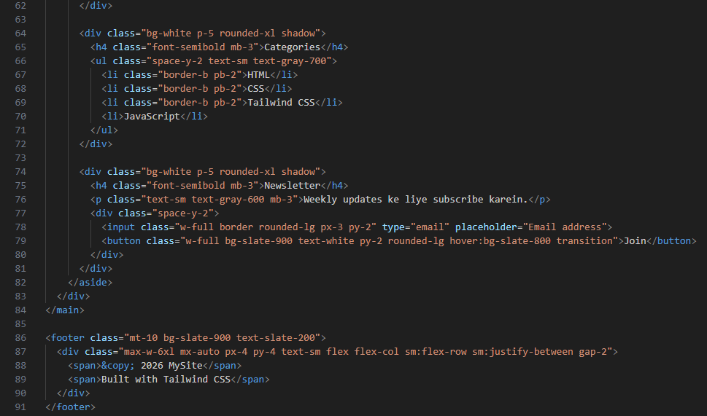
Practical: Tailwind

