Slide 1
Embedding Audio and video in HTML
Presented by: Manal Asghar

Slide 2
Embedding Audio in HTML
HTML5 provides the <audio> element to add sound files to a webpage.
Basic Syntax:
<audio controls>
<source src="audio.mp3" type="audio/mpeg">
Your browser does not support the audio element.
</audio>
Important Attributes:
controls → Shows play/pause buttons
autoplay → Plays automatically
loop → Repeats audio
muted → Starts muted
The <source> tag allows multiple audio formats for better browser support.

Slide 3
Embedding Video in HTML
HTML5 provides the <video> element to display videos.
HTML5 provides the <video> element to display videos.
Basic Syntax:
<video width="400" controls>
<source src="video.mp4" type="video/mp4">
Your browser does not support the video tag.
</video>
Important Attributes:
controls → Video controls
width / height → Set size
autoplay → Plays automatically
loop → Repeats videoposter → Shows preview image

Slide 4
Fallback Content
Fallback Content
Fallback content is displayed when:
The browser does not support audio/video
The file format is not supported
Example: Your browser does not support the video tag.
We can also provide multiple formats:
<source src="video.mp4" type="video/mp4">
<source src="video.webm" type="video/webm">This improves compatibility across browsers.

Slide 5
Accessibility in Audio & Video
Accessibility ensures media is usable by everyone.
Best Practices:
Use controls so users can manage playback
Provide captions for videos
Add subtitles using <track> tag.
Provide text transcripts for audio
Example with captions:
<track src="subtitles.vtt" kind="subtitles" srclang="en" label="English">
This helps:
Hearing-impaired
users on-native speakers
Users in noisy environments

Slide 6
Why Accessibility Matters
Makes website inclusive
Improves user experience
Required by modern web standards
Enhances SEO
Accessible media content ensures equal access for all users.

Slide 7
CSS Subgrid
What is it?
Normally, a grid container defines rows and columns.
Sub grid allows a child grid container to inherit the row or column definitions from its parent grid.
This helps keep alignment consistent across nested elements.

Slide 8
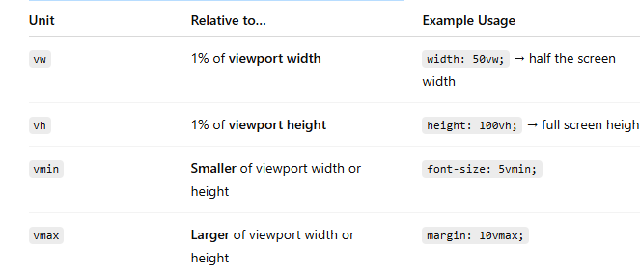
Viewport Units
Viewport units are relative to the browser window size:

Slide 9
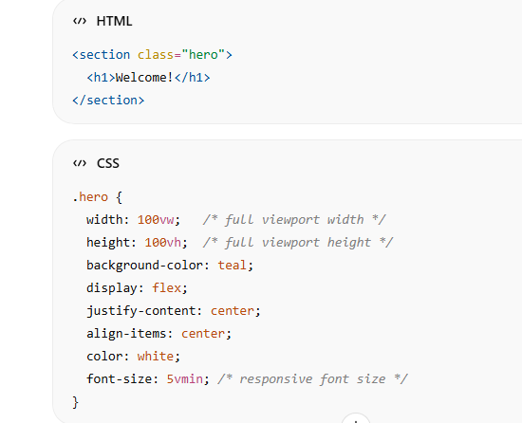
Example: Fullscreen Section

