Slide 1

Presented by: Manal Asghar

Slide 2
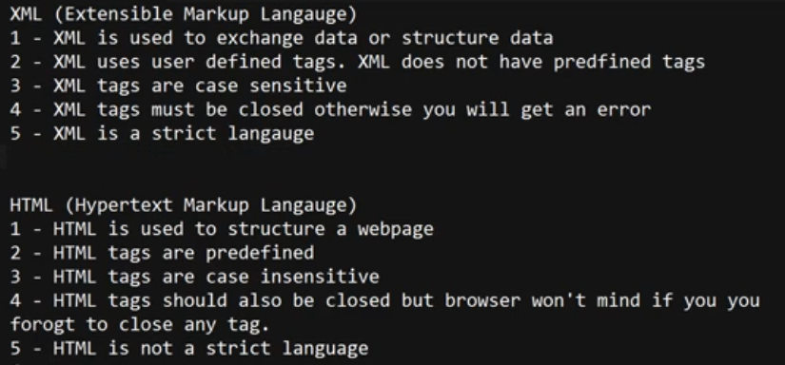
Difference between XML AND HTML

Slide 3
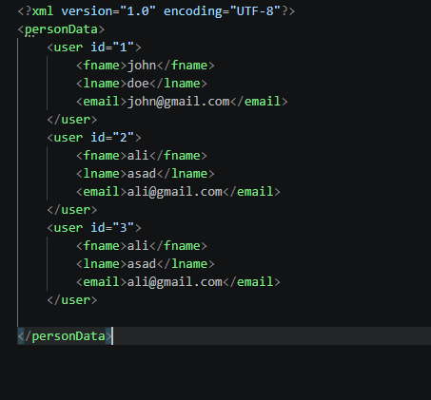

Slide 4
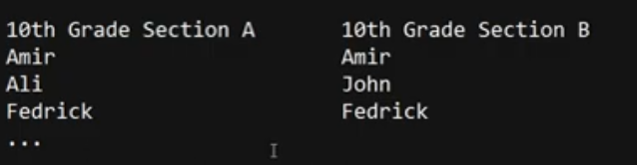
Use of namespace
XML namespace is used to give unique identity to elements with the same name, so confusion can be avoided.
We use namespace to resolve the naming conflict issue.

Slide 5
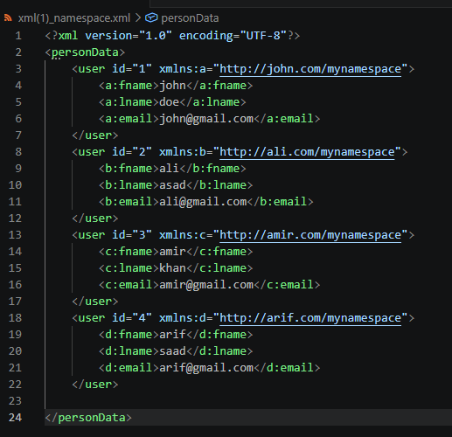
Practical

