Slide 1
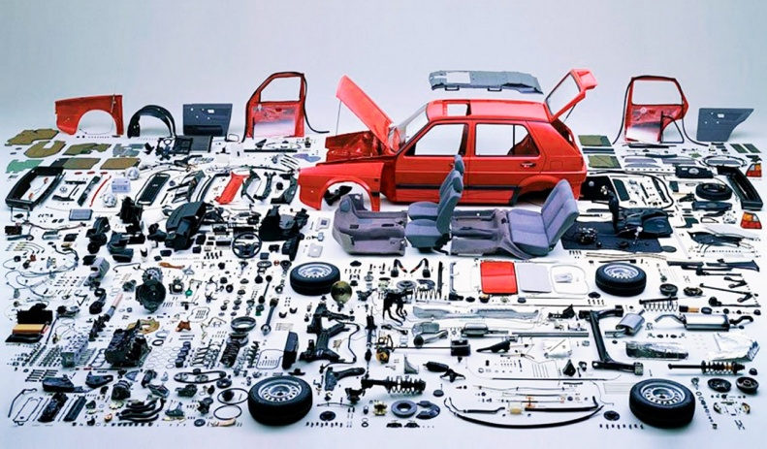
Matab مطـــــــــب
Graduation Project
2018-2019
Information Technology Institute (ITI)
Track: System Development

Slide 2

Supervision
Teacher Assistant :
Eng. Hany Saad

Slide 3
Group Members
NAME
Akram Boktor Ibrahim
Krolos Fawzy Abadeer
Marwa Mohammed Kotb
Ereny Kamal babawey
Manal Khalef Sadek

Slide 4

Outlines
Problem statement and motivation
Goals
Proposed System
User Characteristics
Used Technologies
Demo
References

Slide 5

Problem Statement & Motivation
Some drivers and people who have car need car parts .
Lack of :
Number of suppliers in governorates.
Fast access to suitable spare parts at convenient prices.
Availability of spare parts in one place .

Slide 6

Goals
Facilitate the customer's purchasing process.
Availability of all spare parts from all suppliers.
The ability of the user to choose the suitable spare parts in terms of price, country of manufacture, color and quality.
The supplier's ability to display all spare parts and his competitors' knowledge.

Slide 7

Proposed System
Store
Supplier
User
Control
Panel

Slide 8

Proposed System
Our system is designed to optimize the procurement process and optimize the selection of spare parts for the user and provide the place to display the supplier's products.

Slide 9
Proposed System [continue]
Our system is providing the following services :
Store :
Provide spare parts for the consumer.
Supplier.
User :
Search
Control panel for admin to Manage Supplier and all category in store.
buy

Slide 10

User Characteristics
and Functionality
Root Admin :
Adding and updating Supplier & Admin Accounts ,Category and car brands.
Supplier “added by admin” :
Adding and updating any type of Category
Add product
User :
Monitoring orders
Search about any product, category, car brand, range price ,add to cart and make orders.

Slide 11








Used Technologies
HTML5
CSS3
Java Script
jQuery
Bootstrap
Node.js
Angular 7
SQL

Slide 12
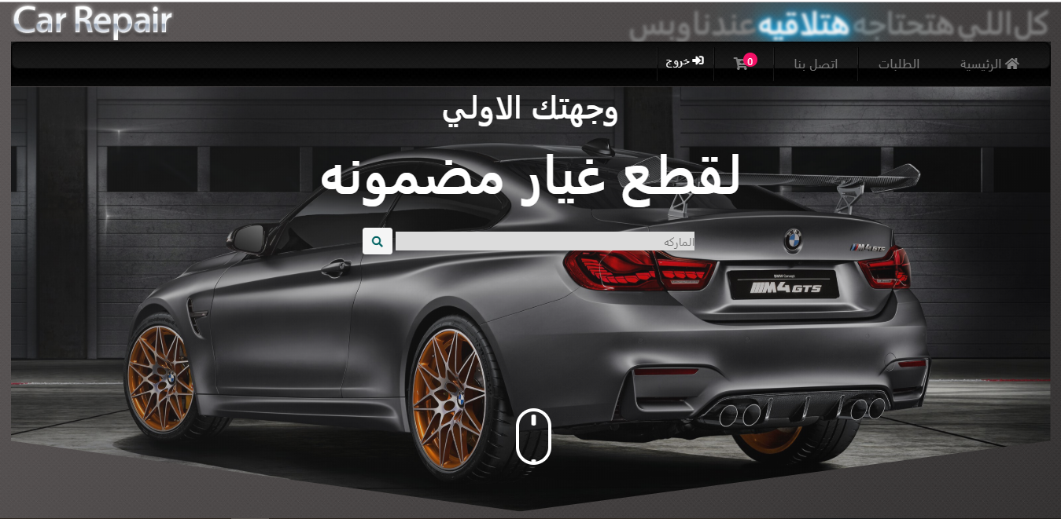
Demo

Slide 13
References
https://socket.io/https://code.org/about
https://nodejs.org/en/
https://angular.io/
https://github.com/
https://egypt.souq.com/eg-en/

