Slide 1

Manal AlShehri

Slide 2

Content
Introduction to the Game
Game Rules
A Game Case
Demo

Slide 3
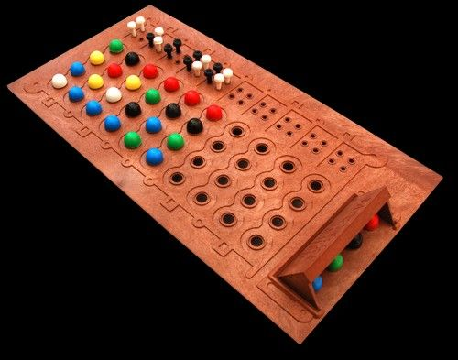
Introduction to the Game
Mastermind is code breaking
game which is played among
two players.

Slide 4
Game Rules
Black => Both colour and position are matched
White => Only colour is matched

Slide 5
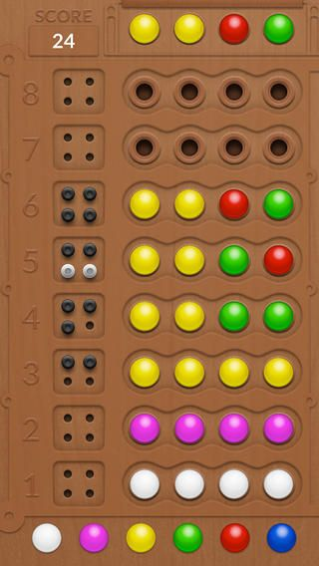
A Game Case

Slide 6
Game Demo

