Slide 1
CMPE281 – Final project
Counter burger application
By
🇺🇸 US-WEST-1A 🇺🇸

Slide 2
US-WEST-1A Team Members
🐼 Arijit Mandal
🧠 Fulbert Jong
🤷‍♀️ Manali Jain
🥑 Rudy Wahjudi
🌊 Varun Jindal

Slide 3
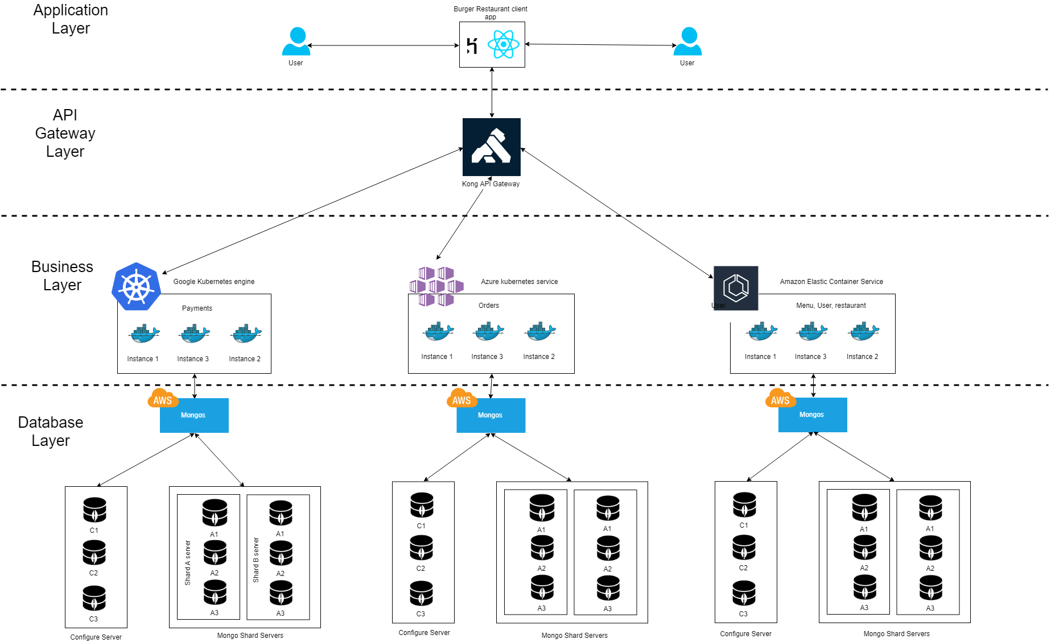
Architecture diagram

Slide 4
🍔 Counter Burger demo

Slide 5
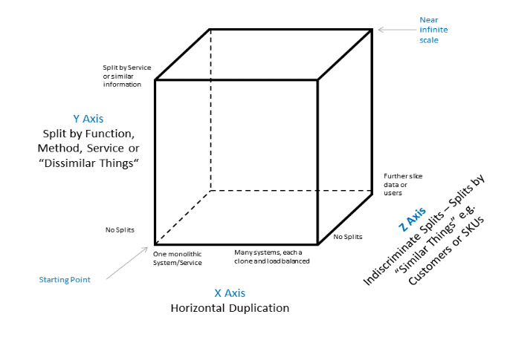
AKF Cube Scaling
X AXIS
Replication through multiple nodes.
No single point of failure.
Y AXIS
Split by service
Z AXIS
Lookup oriented splits (sharding)

Slide 6
Summary
Implementations:
Mongo Sharding
Deployment on Heroku, AWS EC2
Wow Factor:
Amazon AWS ECS
Azure Kubernetes Service
Google Kubernetes Engine
Application Load Balancer

Slide 7
Thank you ✌️

