Slide 1

Group: 23 Project: Be The Donor
TA: Suman Singh
Team Members:
Dharmik Soni
Prachi Raval
Dhairya Shah
Jayashree
Manali Shah
Client Team:
Group 18

Slide 2
Be The Donor
This website is all about bringing the HELPING HANDS together to make this world a better place.
This is to help COVID affected patients to get their essentials.​
Admin – can manage products and rider tips.
Patient – can order required products.
Donor – can donate for orders.
Rider – can delivery the order.
One can also make ANONYMOUS DONATIONS!
Patients can keep TRACK order.
Donors can help multiple patients and CHECK the products ordered by patient.
Riders can select multiple orders to deliver.

Slide 3
Project Dashboard Stats
Total number of tasks: 52
Tasks completed by each individual:
Dharmik Soni: 11
Prachi Raval: 11
Dhairya Shah: 7
Jayashree: 8
Manali Shah: 15

Slide 4
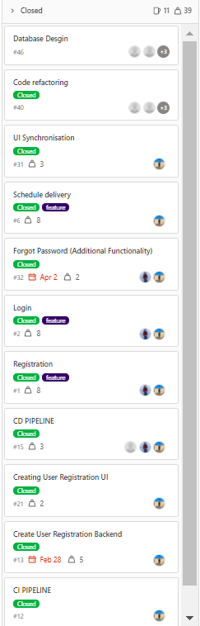
Dharmik Soni
Feature
Registration Bckend
Registration UI
Integrate Front and Backend Registration
Rider Feature UI
Rider Feature Backend
Rider Feature Integrate
Patient Feature UI
Donor Feature UI
CI/CD Pipeline
Code Qaulity Analysis
Database Design
Testing

Slide 5
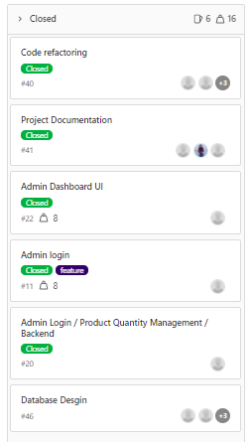
Dhairya Shah
Feature
Admin Backend
Admin Dashboard
Admin Dashboard Integrate
Database Design
Refactoring for smells
Testing
Documentation

Slide 6
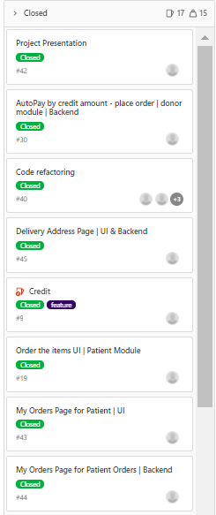
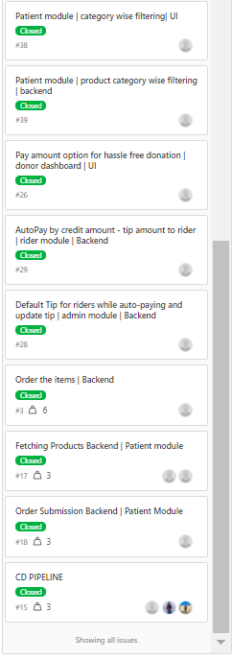
Manali Shah
Feature
Rider Feature Backend
Patient Feature UI
Patient Feature Backend
Anonymous Donation -Auto pay orders UI
Anonymous Donation -Auto pay orders Backend
Integrating Anonymous Donation -Auto pay orders
Database Design
Testing
Presentation Preapration

Slide 7
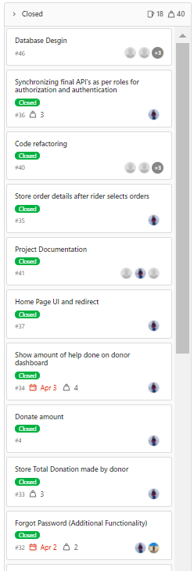
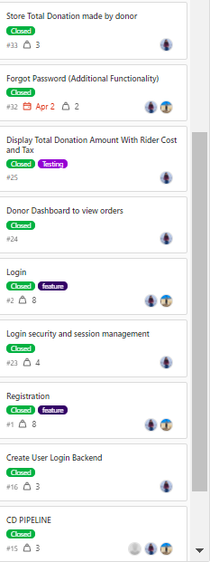
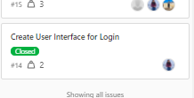
Prachi Raval
Feature
Login UI
Login Authentication and Authorisation Backend
Integrate Front and Backend Login
HomePage UI
Homepage Integration
Rider Feature Backend
Donor Feature UI
Donor Feature Backend
Donor feature integration
Code Qaulity Analysis
Database Design
Refactoring for smells
Testing
Documentation

Slide 8
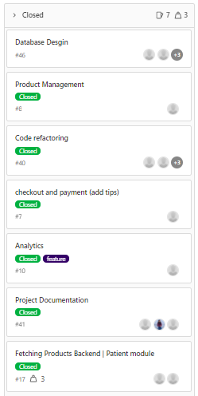
Jayashree
Feature
Analytics Feature UI
Analytics Feature Backend
Analytics feature integration
Payment Gateway UI
Payment Gateway Backend
Database Design
Testing
Documentation

Slide 9
Demo
https://bethedonor-dev.herokuapp.com/homePage

Slide 10
Project Status w.r.t. final goals
Goals | Status
User registration | DONE
Role based login | DONE
Patient dashboard - to view all products and add to order | DONE
Donor dashboard – to view all orders which are pending for payment | DONE
Rider dashboard – to view all orders which are pending for delivery | DONE
Admin dashboard – to add, update, delete products. | DONE
Anonymous donations - Auto Payment by credit amount | DONE
Analytics | DONE

Slide 11
Additional Features Implemented
Goals | Status
Email verification functionality | DONE
Forgot password functionality | DONE
Category wise filtering of products | DONE
Patient order history and track order status | DONE
Show previous donation amount made by donor | DONE
Auto search on cities | DONE
Rider tip management | DONE
Payment Integration | DONE

Slide 12
Learning from the project
SOLID principles
Test Driven Development Approach
Implementing CI/CD Pipeline
Integrating Quality checks and minimizing smells
Working in an Agile Environment
Working in sync with the team
Developing project using different Tech stack
Integrating Frontend and Backend – Spring boot, Thymleaf, JS, jQuery, Ajax

Slide 13
If given a chance to repeat the project
Implement email notification when the order status changes.
Implement download receipt option to donors.
Implement authoring functionality to make all the available texts on website authorable so that no code change is required for what is getting displayed on UI.

Slide 14


