Slide 1
Lung Cancer

Slide 2
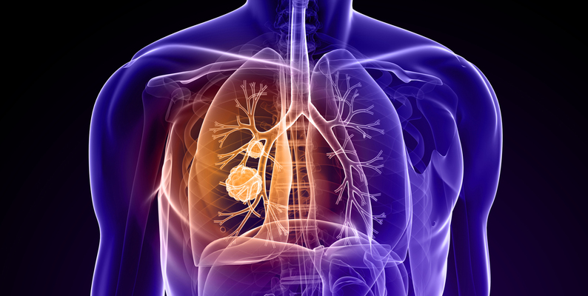
About Dataset
The Lung Cancer Risk Factors Dataset is a comprehensive collection of attributes related to individuals, aiming to explore potential factors associated with the occurrence of lung cancer. The dataset encompasses demographic information, lifestyle choices, and health indicators, providing a valuable resource for researchers and data scientists interested in understanding and predicting lung cancer risks.

Slide 3
the questions
Does it only affect smokers?
Are those infected with it among the elderly?
Does it only affect males?

Slide 4
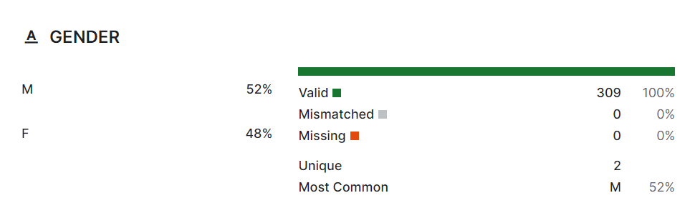
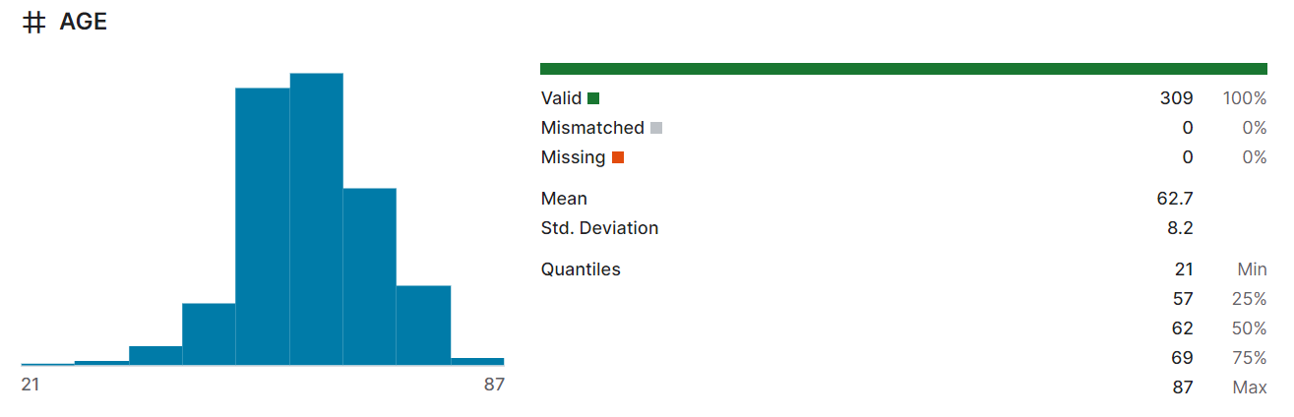
60-62

Slide 5
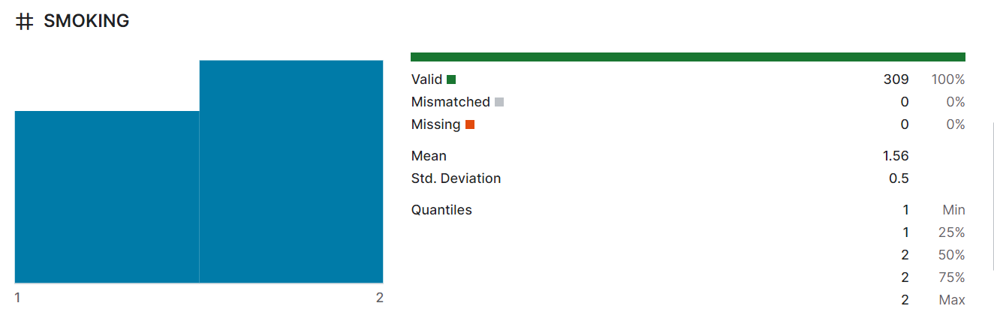
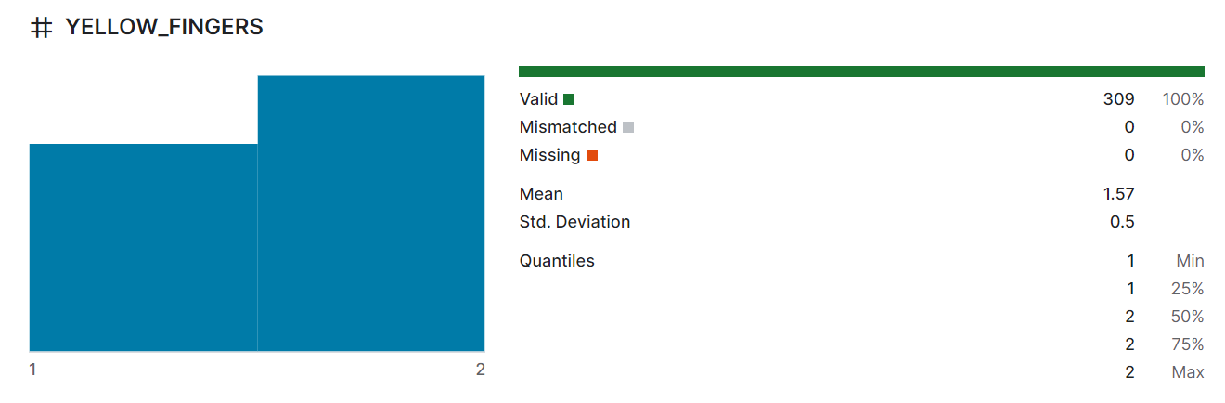
1-135 , 2-174
1-133, 2-176

Slide 6
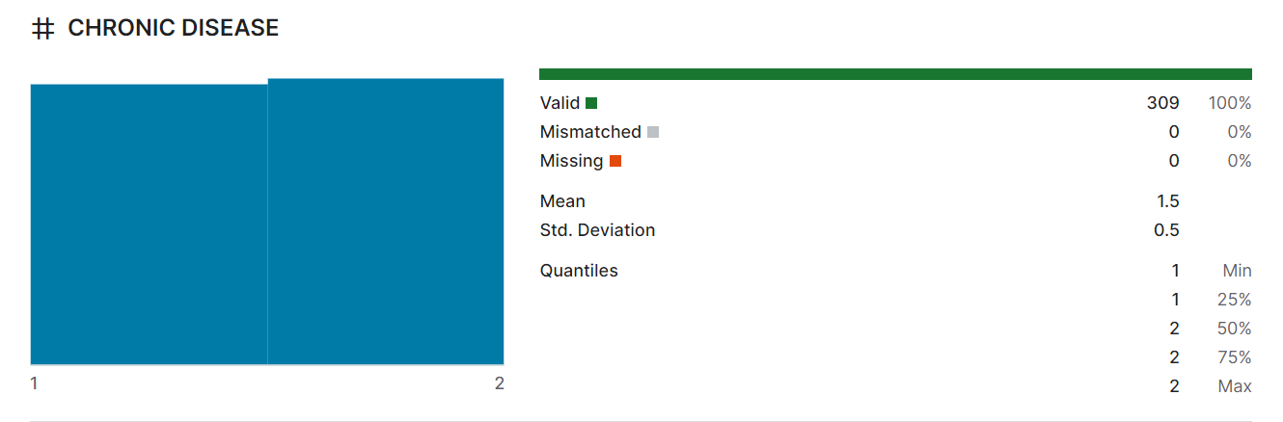
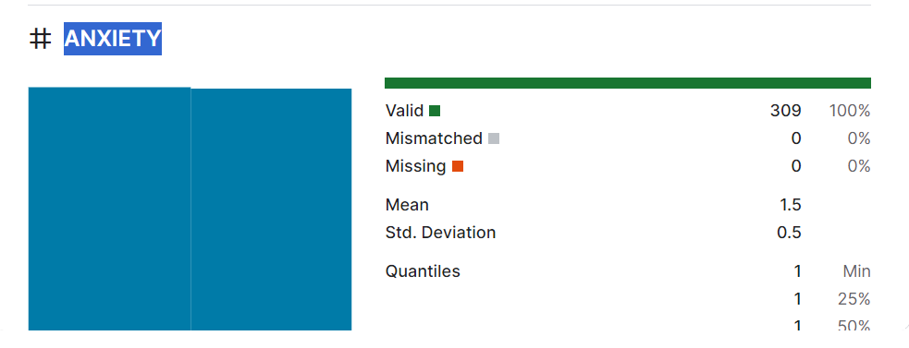
1-153,20156
1-154,2-155

Slide 7
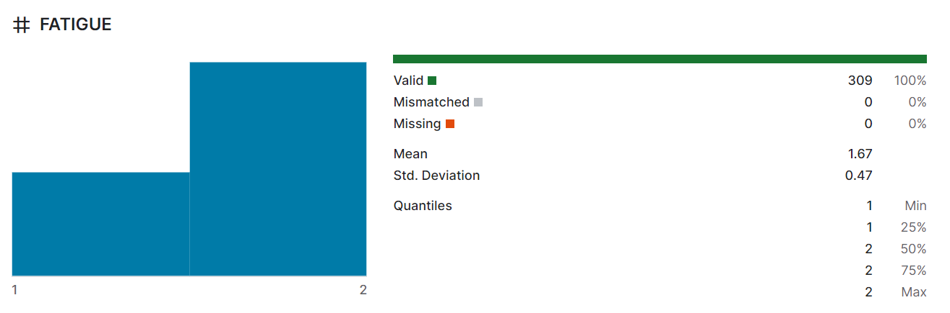
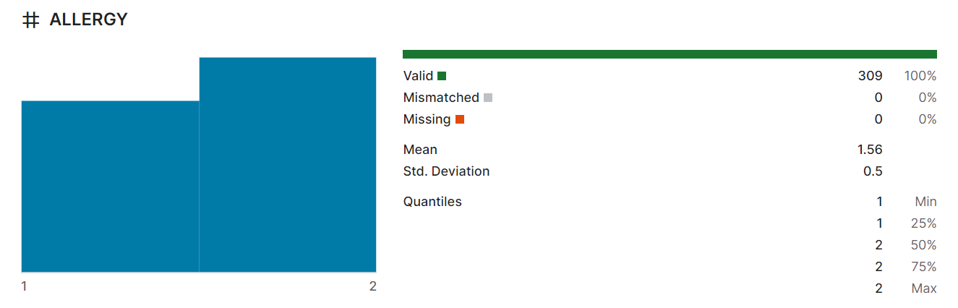
1-101, 2-208
1-137, 2-172

Slide 8
