Slide 1

An Healthcare Internet: Exploring the Construction of Use-Inspired Communication Eco-System for Patient-Centered Care
Deepthi Manam
NEU ID: 001743609
Application & Engineering Development

Slide 2
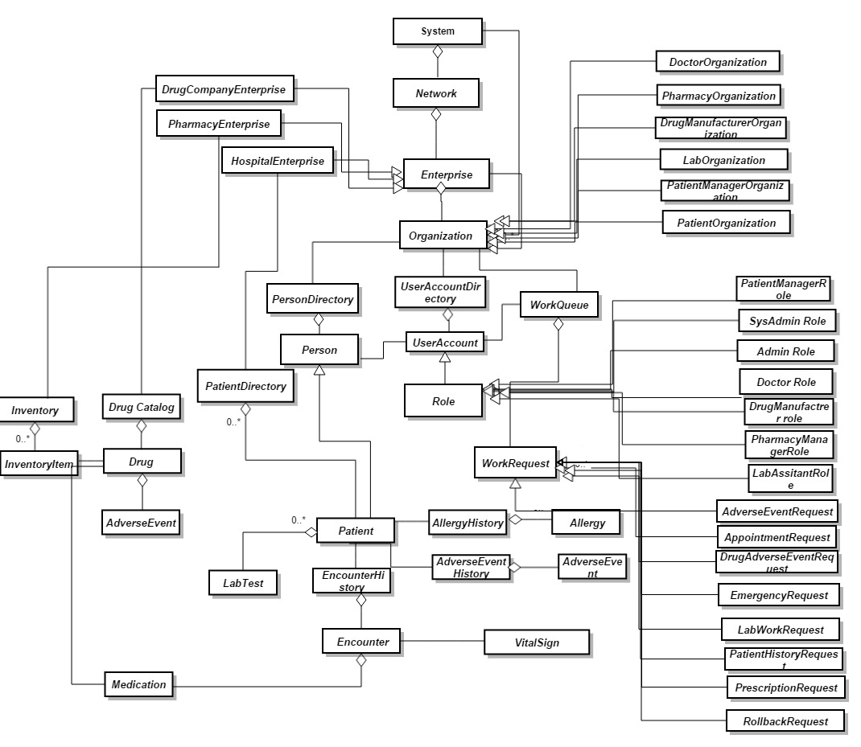
OBJECT MODEL

Slide 3
Security Implemented
If the patient is not interested to disclose the information about the treatment, that he/she taken at a particular hospital, the other hospitals in the network cannot obtain the medical info of the patient in that particular hospital.
Proper evidence has to be provided in case of Emergency Search. Evidences like Image of the patient or Consent Letter from the patient or Scanned copy of SSN are to be provided.
Only the required information is shared to the other hospitals. For example, the doctor can only see the medicines prescribed by the doctor, but not the doctor name and dosage given by the doctor.
A unique code is generated for each patient, based on their First Name, last Name, SSN(last 4 digits), Date Of Birth.

Slide 4
Patient Manager Responsibilities
Manages the patient profile in the hospital.
When a patient comes to the hospital, Patient manager searches for the patient in the hospital and books an appointment with the doctor.
Responds to the patient information requests coming from other hospitals.
Updates the personal information like Phone Number, Email ID etc.
Able to reset the password of the account.

Slide 5
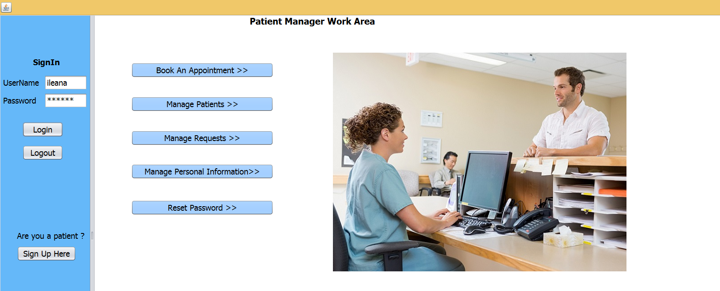

Slide 6
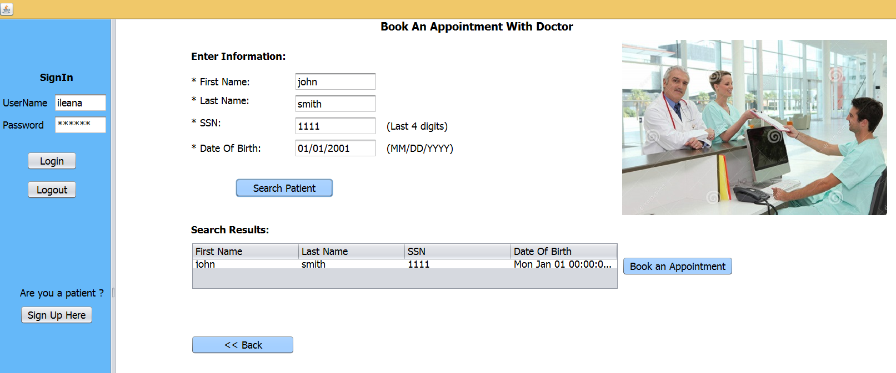

Slide 7
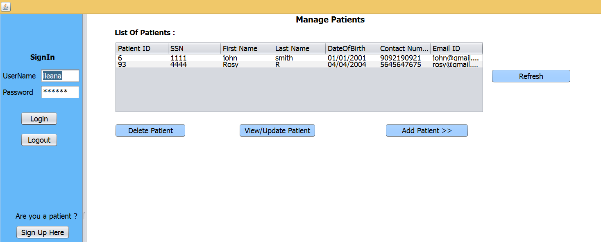

Slide 8
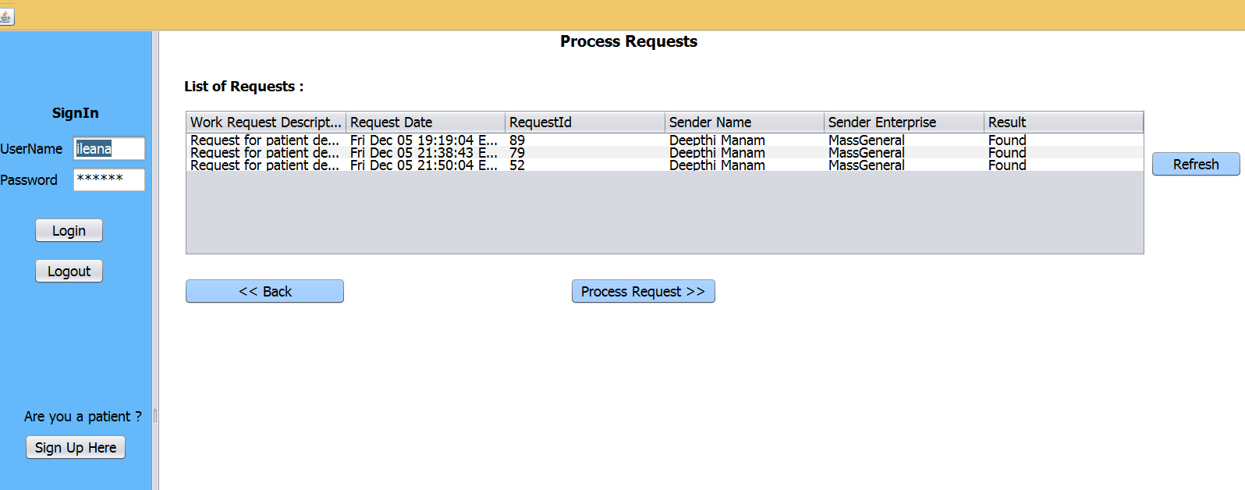

Slide 9
Doctor Responsibilities
Based on the appointments set by the Patient Manager, provides treatment to the patients
Able to search health information of the patient over the network and provide treatment for the patient after viewing the patient history.
Able to provide the treatment, if all the hospitals requested have not responded.
Emergency search of patients, in case of emergency.

Slide 10
Doctor Responsibilities
Able to provide the treatment to the patients in case of emergency.
Report an adverse event associated with the drug to the manufacturers.
Looks into the adverse events raised by the patient and performs needed action on it.
Updates/changes personal information like PhoneNumber , Address etc
Able to reset the password of the account.

Slide 11
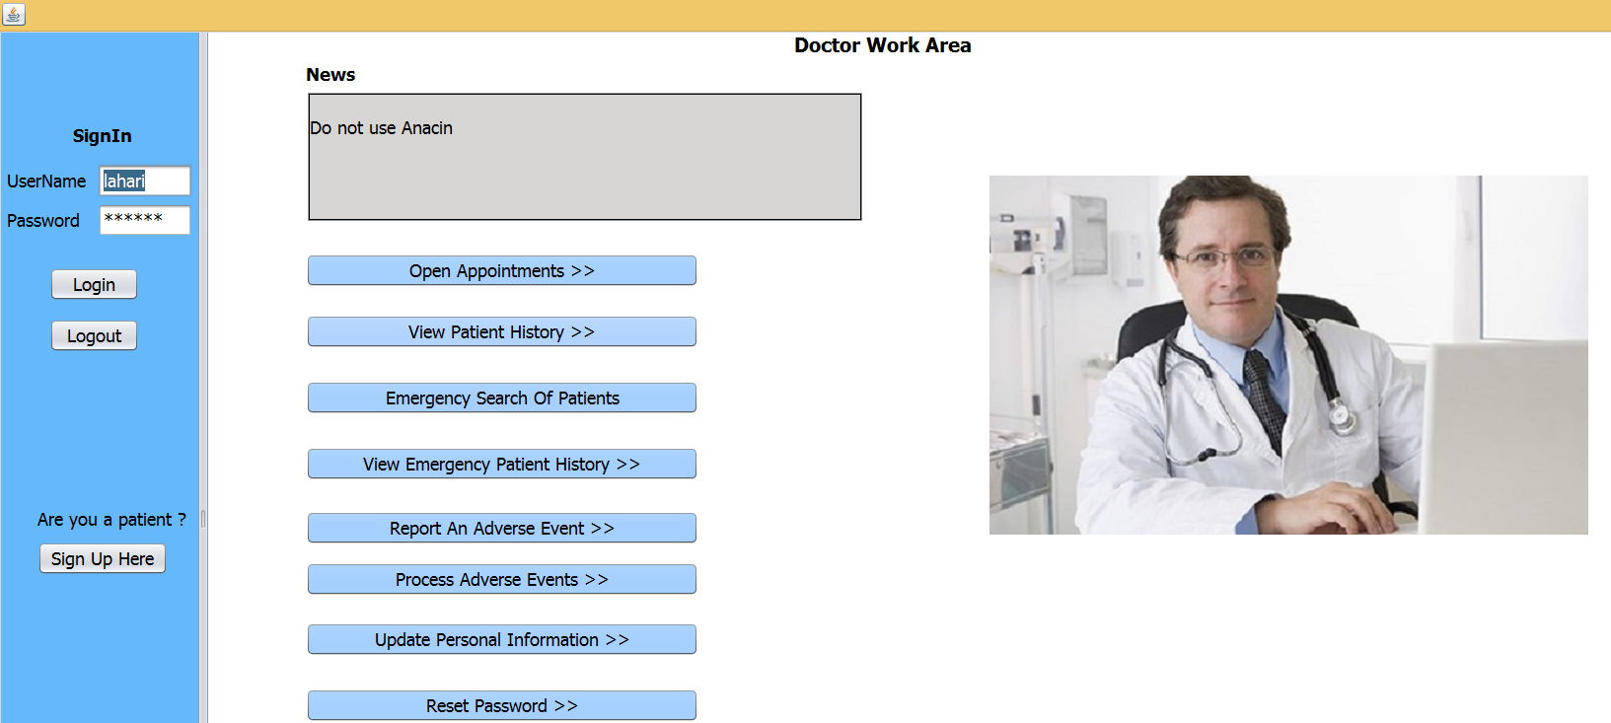

Slide 12
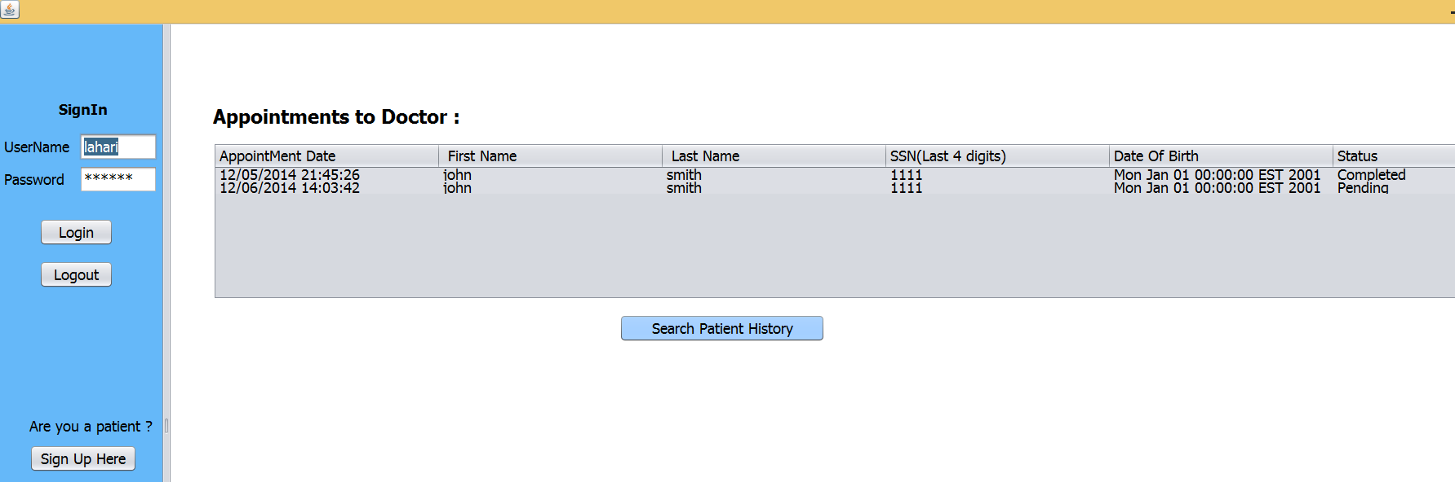

Slide 13
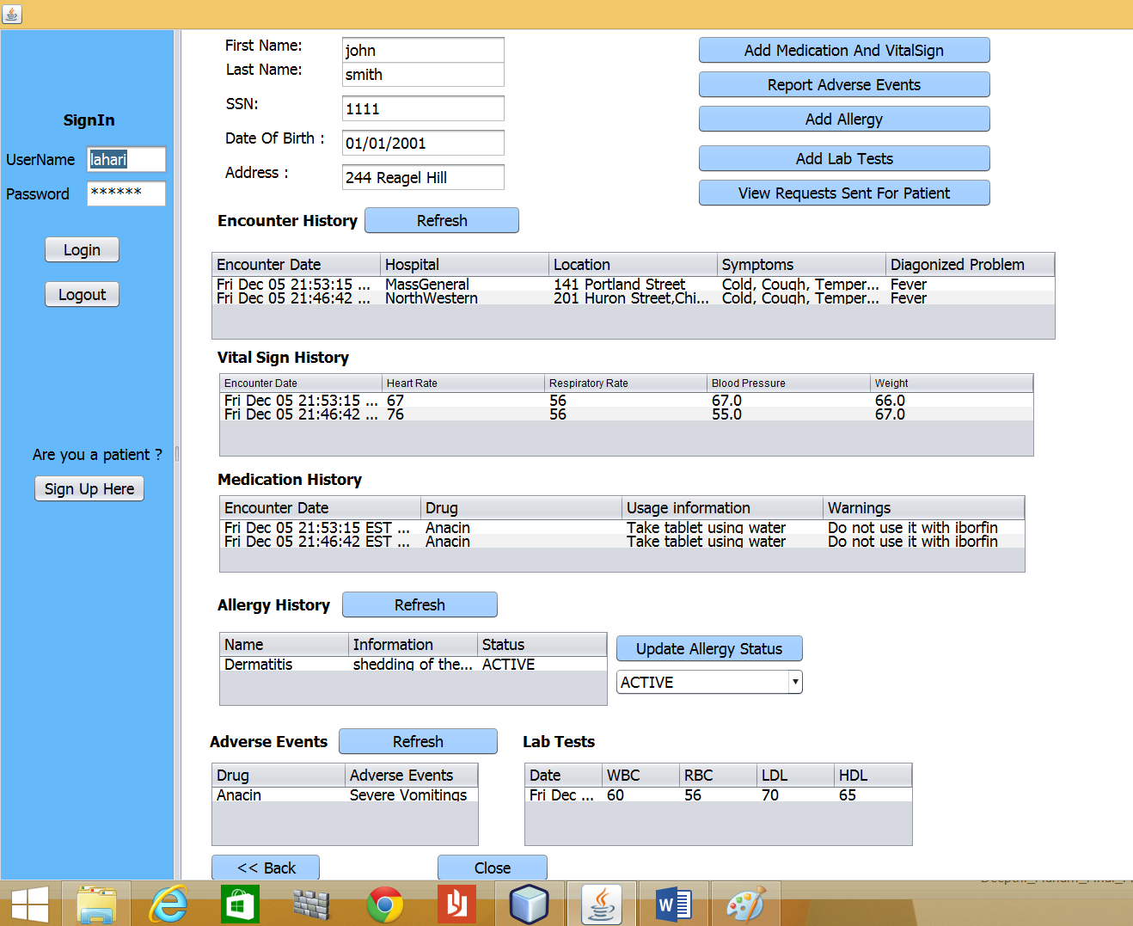

Slide 14
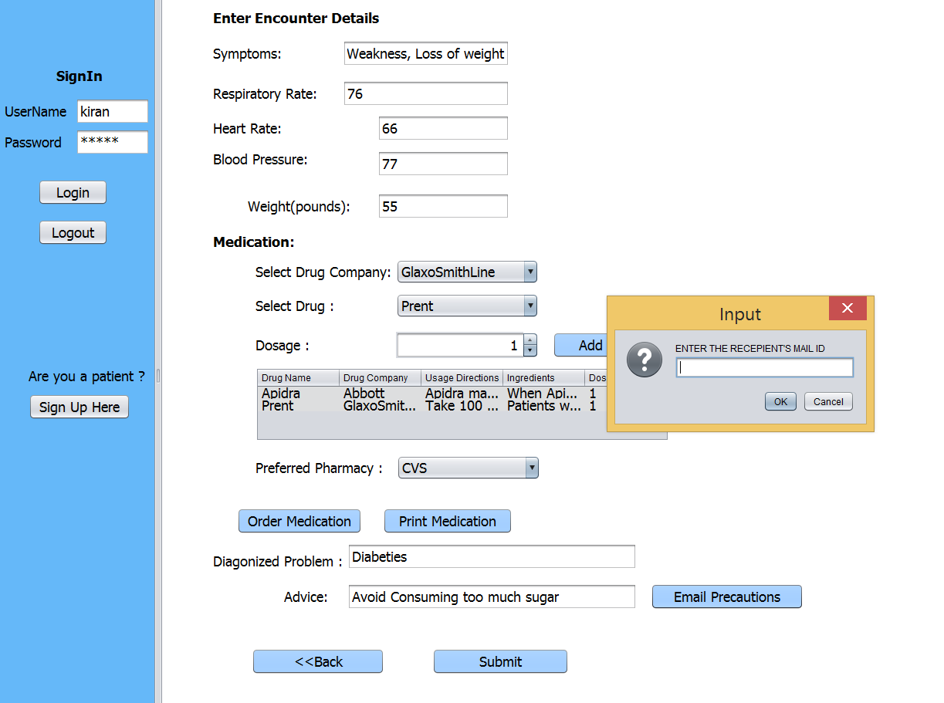

Slide 15
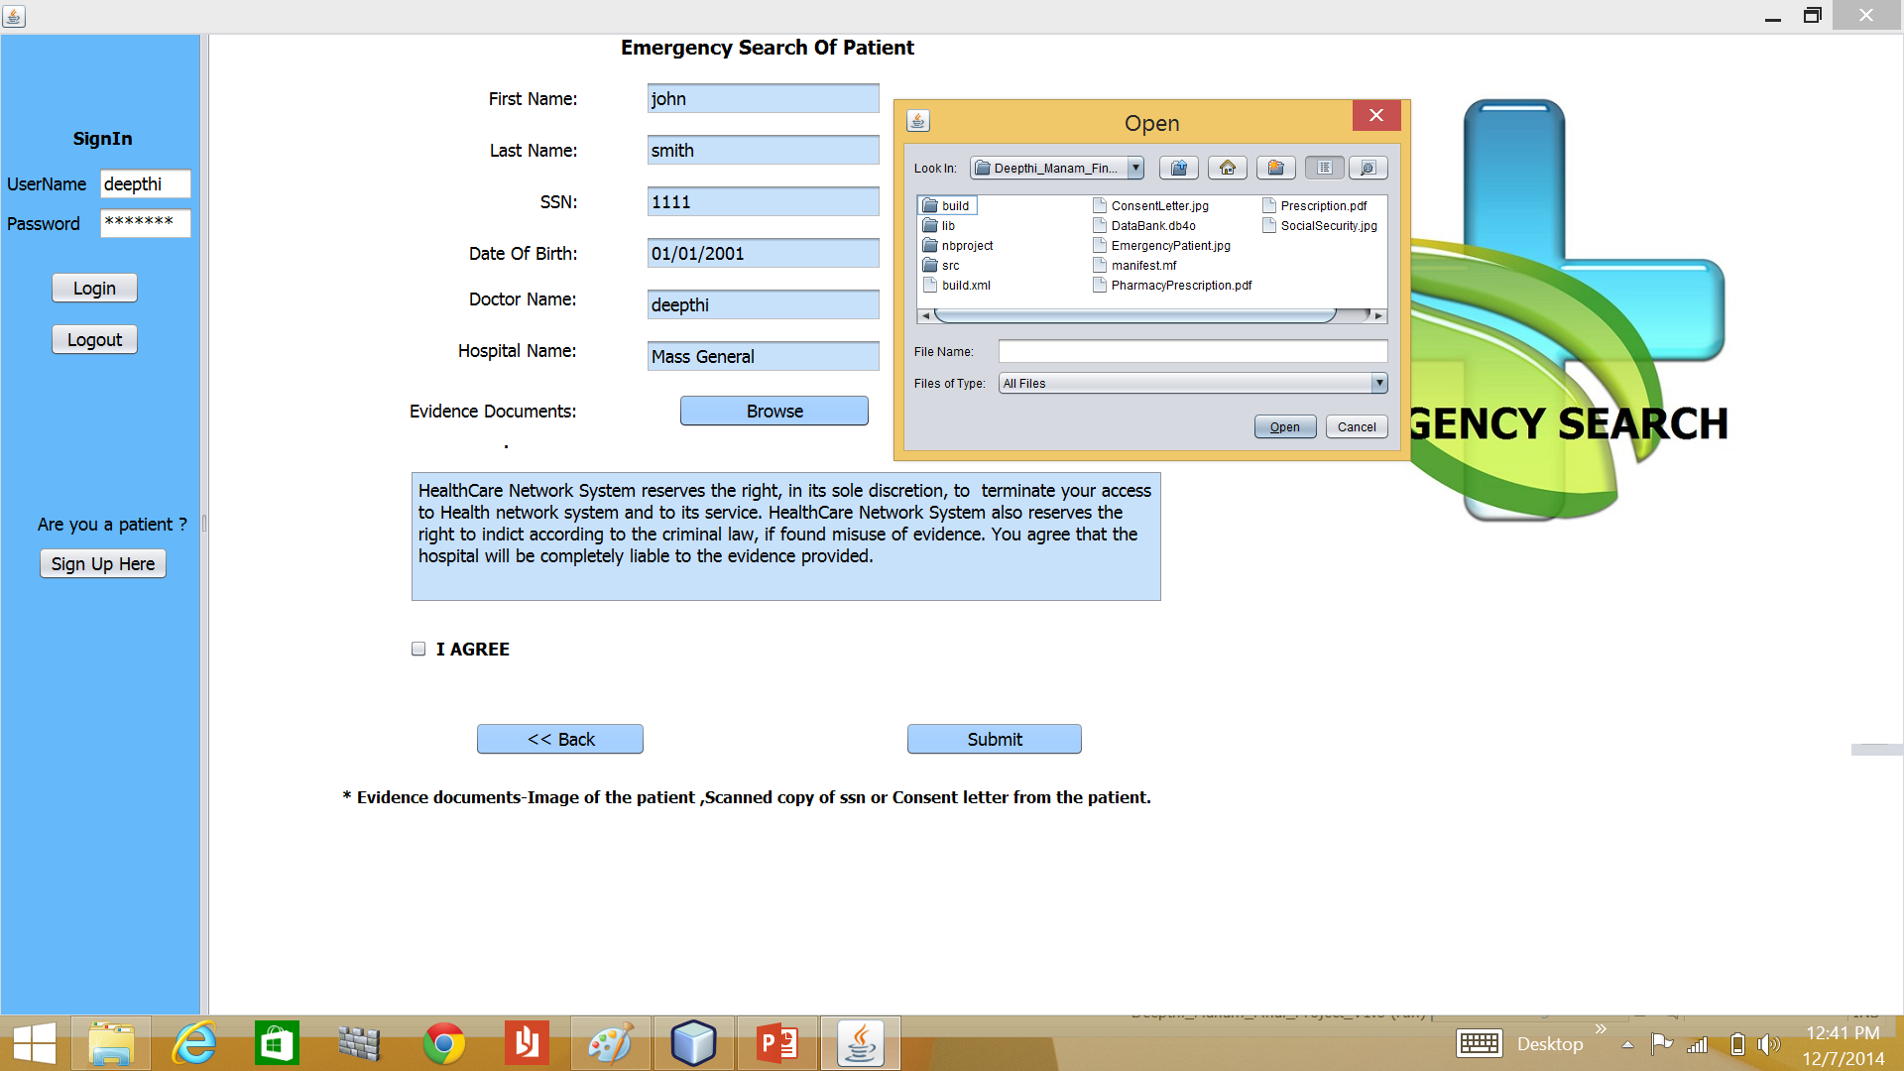

Slide 16
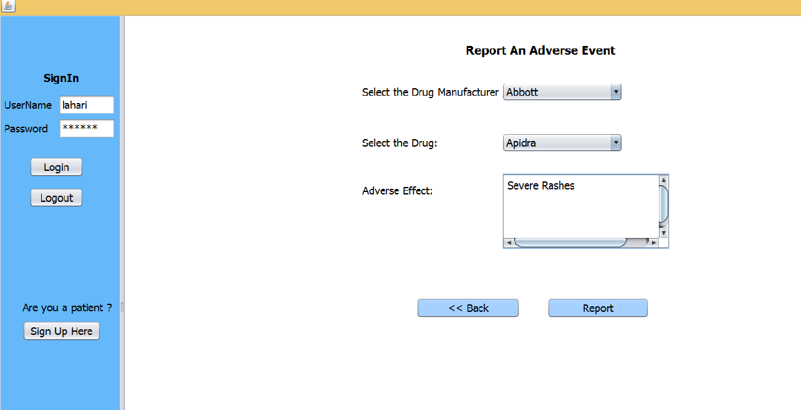

Slide 17
Patient Responsibilities
Patient should be able to view the complete health information associated with the patient
Report an adverse event on a drug to the hospital and able to view the response given by the doctor
View or share the opinion with the other patients having same disease or using the same drugs

Slide 18
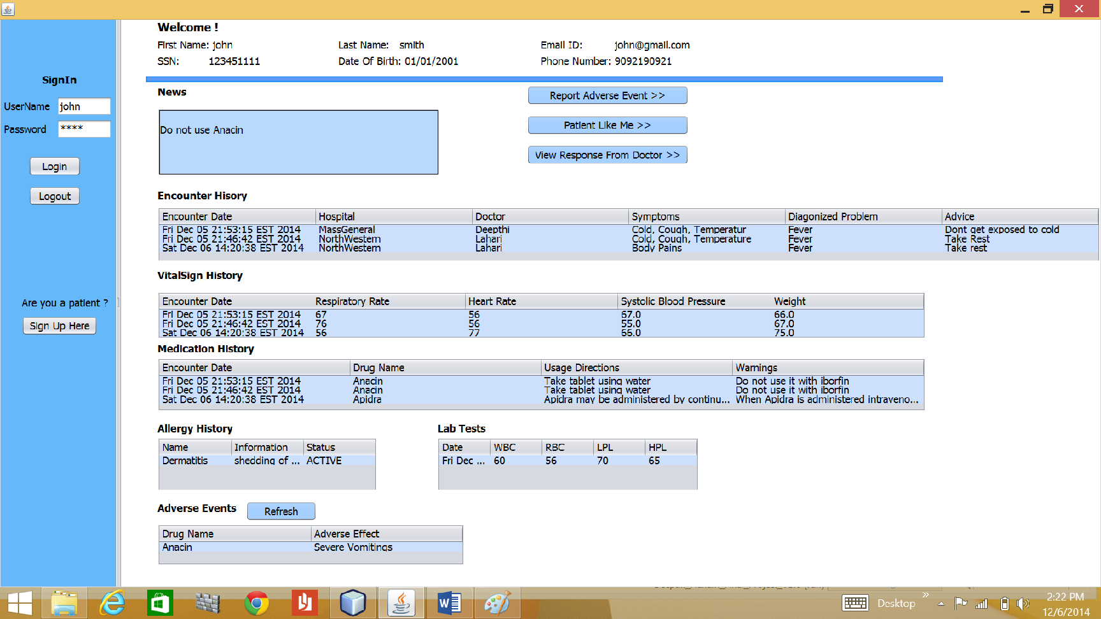

Slide 19
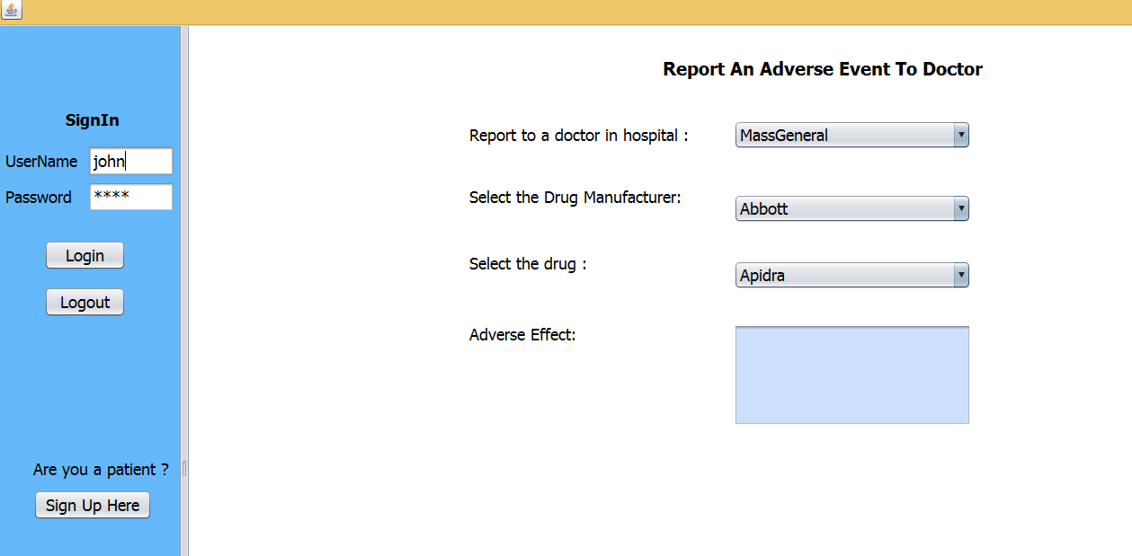

Slide 20
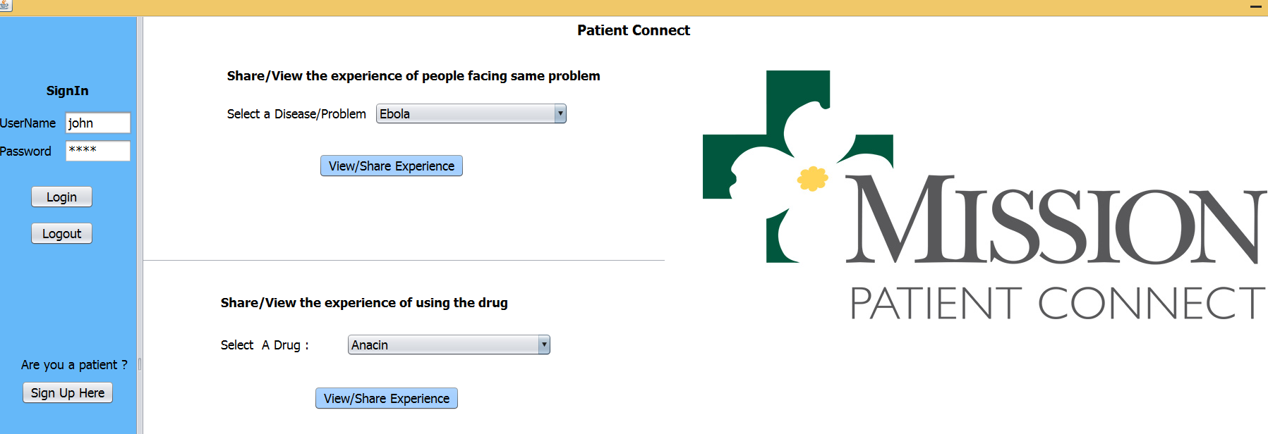

Slide 21
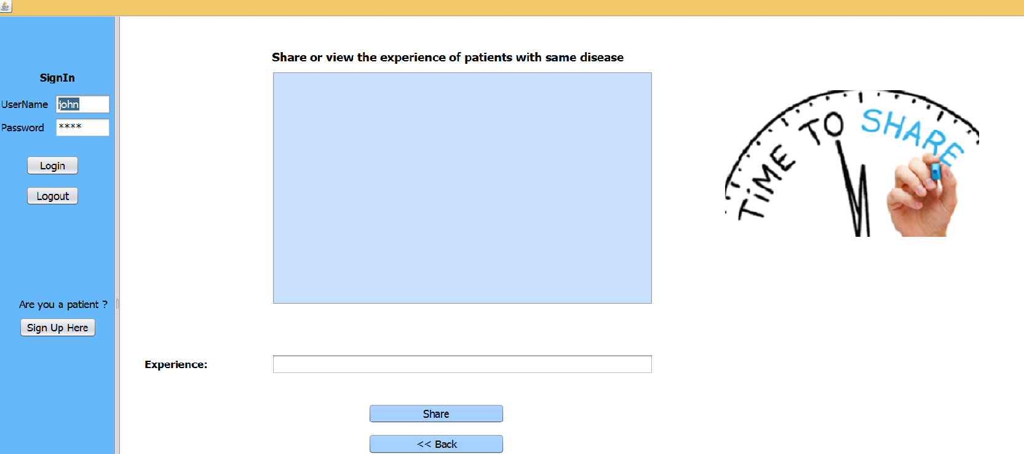

Slide 22
Drug Manufacturer Responsibilities
Adds, Updates and Deletes the drugs
Looks over the adverse events raised by the doctors and patients, performs necessary action accordingly
Broadcast the news for the drugs that have adverse effects
Rollbacks the drug having the adverse effects from the pharmacies
Able to update the personal information
Able to reset the password of the account.

Slide 23
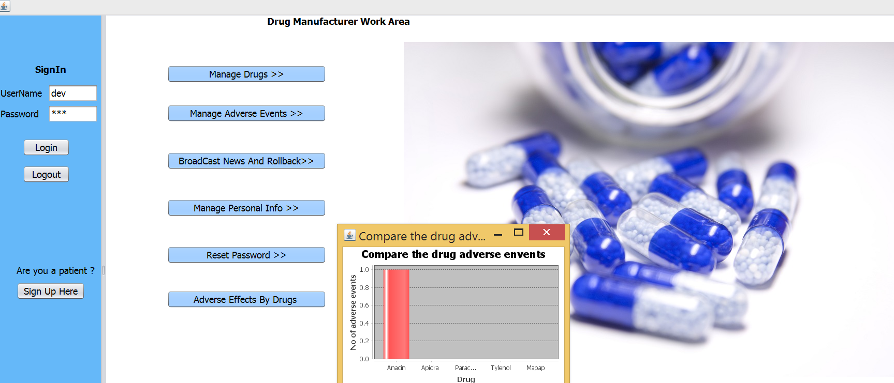

Slide 24
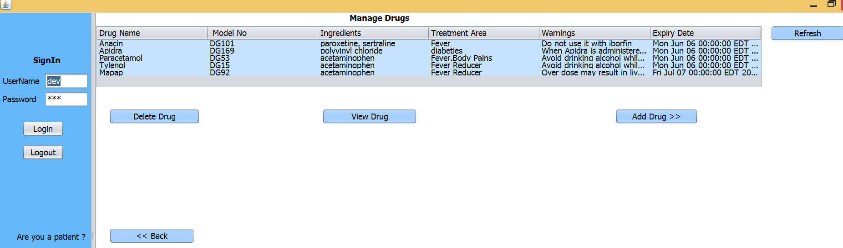

Slide 25
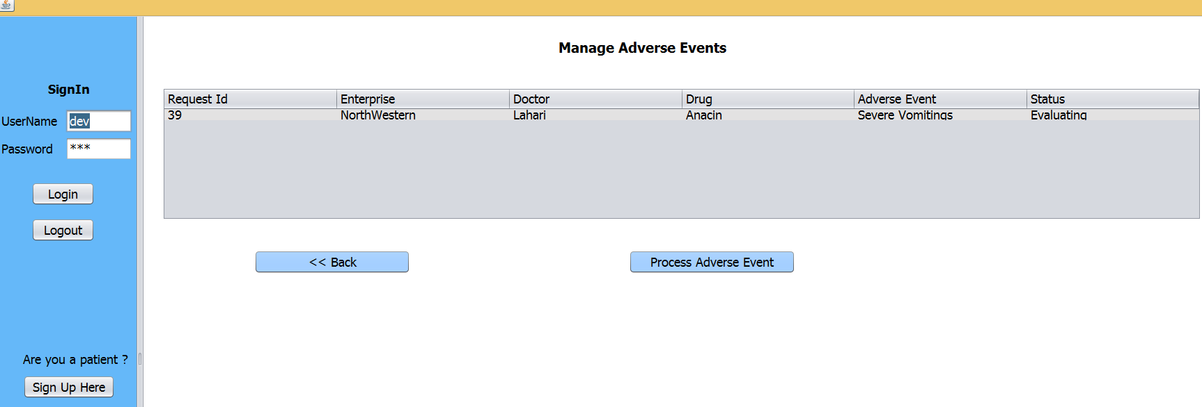

Slide 26
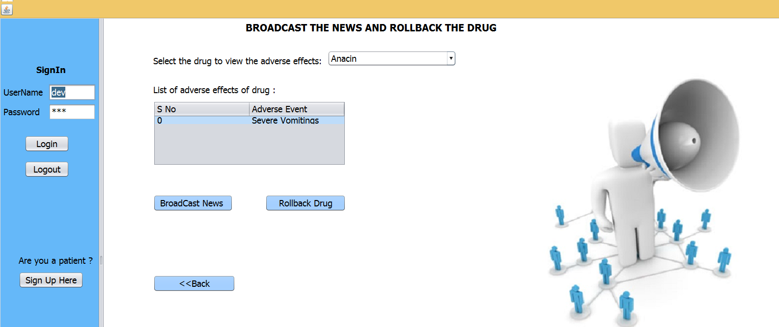

Slide 27
Pharmacy Responsibilities
Manages the inventory of the drugs
Prescriptions sent by the doctor to the pharmacy are processed and the drugs are delivered to the patients
Email the patients when the order is ready
Based on the rollback request from the drug manufacturer, returns the drug to the drug manufacturer.
Able to update the personal information
Able to reset the password of the account.

Slide 28
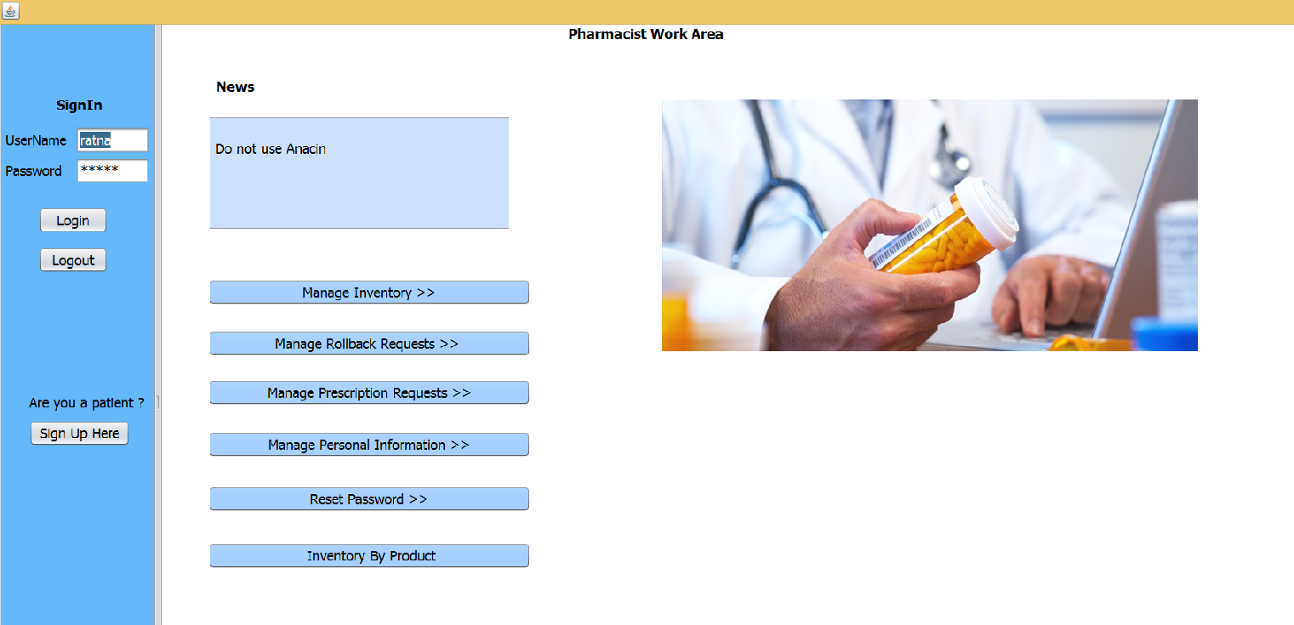

Slide 29
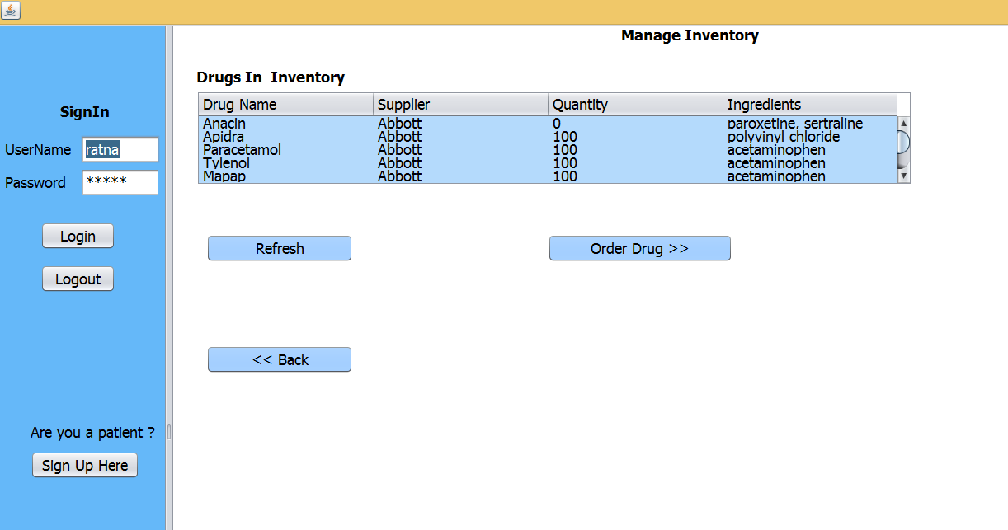

Slide 30
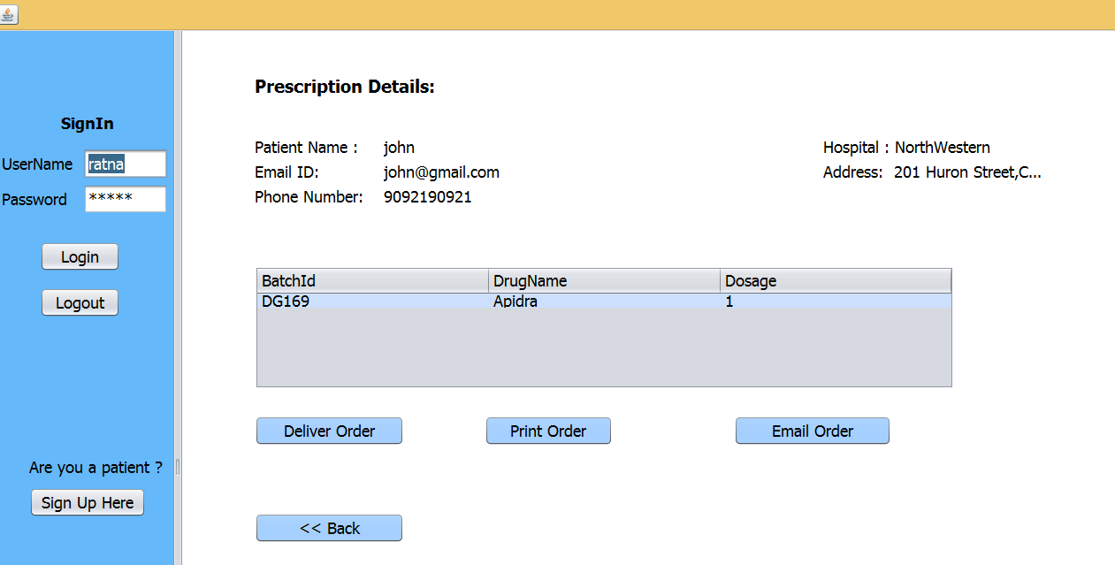

Slide 31
Lab Assistant Responsibilities
Can view the lab test requests coming from the doctors in the hospital
Processes the lab tests requested by the doctor

Slide 32
Additional Features Implemented In the Project
Email Communication
PDF Creation
Uploading of documents like images, files etc.
Graphs

