Slide 1

UPAY PRESENTS · AI DEV FEST 2026 · CPC DIU
CYGNUS AI
Suspicious transaction network detection for upay and Bangladesh's mobile financial services
Mapping money trails like constellations.
Team Sadekunnahar Marufa · Al Amin · Tanvir Hossain Shihab
Notes:
Open with the hook: fraud in digital finance rarely looks like one bad transaction. It looks like a network. Cygnus AI maps those networks and explains them.

Slide 2





Cygnus AI at a glance
AGENDA · CLICK A TILE TO JUMP
01
02
03
04
05
The problem
Our solution
Live demo
Results
Impact for upay
Why mule networks beat rule-based checks
Graph patterns and explainable AI
Follow the Money, AI Investigator, case flow
Precision, recall, F1 and PR-AUC
Savings, pilot plan, roadmap
Tip: every slide has an ◂ Agenda link at the top right to come back here.
Notes:
Use this slide to jump straight to any part of the story. Each tile is a link; the Agenda link on every slide brings you back.

Slide 3
Every criterion, built, measured and shown.
BUILT FOR UPAY · CLICK A ROW TO JUMP
◂ Agenda
CRITERION
WHAT CYGNUS AI DELIVERS
SLIDE
Problem relevance
20%
Public Bangladesh MFS figures, plus two upay detectors: risk-area account takeover and agent hundi
05 ▸
AI/ML depth
20%
8 models compared on 423k held-out transactions: best F1 0.89, PR-AUC 0.94, false positives 0.12%
16 ▸
Business impact
20%
73.6% fewer alerts at equal recall, false alarms 904 → 46, and an 8-week upay pilot to measure real savings
21 ▸
Prototype quality
15%
Working analyst flow: sign in, alert, trace, investigate, open case, escalate, STR/SAR export, audit trail
13 ▸
Innovation
10%
Rules miss 686 of 1,010 suspicious accounts; the graph model catches 561 of those
17 ▸
Scalability
10%
1.06M transactions scored in 18.9 s on one laptop process; API p95 under 6 ms; streaming + graph-DB path
19 ▸
Responsible AI
5%
Two roles, hash-chained audit log, PII masking with logged reveal, bias check by account tier and district
20 ▸
Notes:
This map shows what Cygnus AI delivers for upay against each evaluation criterion, with its weight. Each row links to the slide that proves it. Anything that needs real upay data or a live pilot (analyst validation, a trained GNN at scale) is on the roadmap slide, clearly marked as future work.

Slide 4



Fraud hides in the network, not the transaction
01 · THE PROBLEM
◂ Agenda
Each transfer looks normal
WHAT RULES SEE
WHAT THE GRAPH SEES
Mule networks split money so every single payment passes rule-based checks.
A-214 BDT 9,800
A-377 BDT 9,650
Investigations take hours
A-108 BDT 9,900
Analysts trace multi-hop flows account by account in flat tables.
1 collector
A-652 BDT 9,700
Alerts without reasons
A-590 BDT 9,850
Black-box scores and threshold alerts are hard to defend to auditors.
Five 'clean' transfers are really one fan-in collector account.
Notes:
Explain the core insight. Rules check each payment in isolation, so a structured mule network slips through. Only when you look at the relationships does the collector account appear.

Slide 5
Bangladesh MFS: huge volume, real laundering
02 · THE SIZE OF THE PROBLEM
◂ Agenda
239.3M
~22M
30,199
Tk 75,000 cr
MFS accounts
MFS transfers a day
STRs / SARs to BFIU
moved by digital hundi
January 2025 [1]
678.6M in Oct 2025, worth Tk 1.58 trillion [2]
FY2024-25, up 74% in one year [3]
in one year, via ~5,000 MFS agents (bKash, Nagad, upay, Rocket) [4]
BANGLADESH TYPOLOGIES IN OUR SYNTHETIC DATA
21,725 MFS accounts
suspended by BFIU in nine months of 2023 for online gambling and hundi [5].
At ~22M transfers a day, nobody can read rows. The network has to surface itself.
Digital hundi via agents: an agent wallet funded every month pays the same local wallets
Gambling collection: hundreds of small deposits into a few collector wallets
Mule rings: recruited wallets forward money within minutes and cash out
Structuring: repeated transfers just under a reporting threshold
Circular layering: money loops through 3 to 6 wallets back to its origin
Stolen-device takeover: a wallet suddenly used from an unfamiliar risk area on a new device
[1] Bangladesh Bank via Financial Express, 23 Mar 2025 [2] Bangladesh Bank via Financial Express, 3 Jan 2026 [3] BFIU via Financial Express, 15 Jul 2026 [4] CID via Business Standard, 8 Sep 2022 [5] BFIU via Business Standard, 27 Sep 2023
Notes:
These are public figures, with sources at the bottom. Bangladesh MFS runs about 22 million transfers a day. BFIU received 30,199 suspicious transaction and activity reports in FY25, a 74% jump. CID found that hundi rings laundered Tk 75,000 crore in one year through about 5,000 agents of bKash, Nagad, upay and Rocket, and BFIU suspended 21,725 MFS accounts for gambling and hundi in nine months of 2023. Our synthetic data plants exactly these typologies.

Slide 6
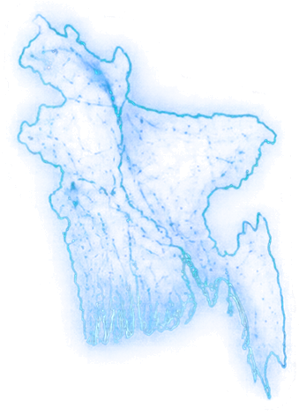
One mule ring, one trail across Bangladesh
03 · WHY IT MATTERS FOR UPAY
◂ Agenda
1
Feeders pay in FAN-IN + STRUCTURING
Eight upay wallets send deposits just under BDT 10,000 to one hub wallet in Dhaka.
Rangpur
Moved on in minutes RAPID MOVEMENT
Mymensingh
Sylhet
2
Rajshahi
Within 1 to 3 minutes the hub forwards each deposit to four mule wallets.
Dhaka
3
Cash-out and loop back CIRCULAR FLOW
The mules pay a cash-out agent in Chattogram, and 90% flows back to the hub.
Khulna
Chattogram
4
Cygnus AI flags the ring 92.3 CRITICAL
Every transfer looked normal on its own. The graph scores the hub 92.3 CRITICAL, with evidence and next steps.
Click to reveal each step
Notes:
Click-driven: each click adds the next step on the map. This is our MFS money-mule ring demo scenario drawn on a map of Bangladesh. The city placement is illustrative; the transfers, timings and the hub's score come from our synthetic demo data. No real upay data is used.

Slide 7

Seven suspicious shapes money leaves behind
04 · WHAT WE DETECT
◂ Agenda
3
accounts flagged
2
accounts flagged
13
accounts flagged
19
accounts flagged
< minutes
Fan-In
Fan-Out
Rapid Movement
Transaction Chain
Many wallets funnel money into one collector within 2 hours.
One wallet sprays funds across many receivers in a burst.
Incoming money is forwarded onward within minutes.
Funds hop through three or more intermediaries.
9
accounts flagged
4
accounts flagged
4
accounts flagged
9
accounts flagged
Circular Flow
≈ 9.5k each
Structuring
Coordinated Network
ML Anomaly
Money loops back to its origin within 6 hours.
3+ transfers just under the BDT 10,000 limit in 24 h.
A dense cluster of 4+ accounts trading internally.
Isolation Forest flags outliers, no fraud labels needed.
Notes:
Seven graph detectors run on the NetworkX transaction graph, plus the Isolation Forest model. The counts are real outputs from our synthetic demo dataset of 239 transactions; no normal account is flagged by any pattern.

Slide 8


Location risk and agent hundi, built for upay
05 · BUILT FOR UPAY
◂ Agenda
Risk-area account takeover
Agent hundi operator
Risk judged against each customer's own baseline
Recurring foreign-linked money through one agent
Learns each wallet's usual areas and handsets from its own history
Risk areas come from upay's fraud team (demo uses placeholders Zone-13, Zone-14)
Alert needs at least two signals: area new for this customer, new handset, unusually fast outflow, new receivers
Also flags the collector wallet that gathers money from several taken-over accounts
Agent funded informally (no licensed inward-remittance or distributor source)
Pays out to five or more beneficiaries soon after funding
The same beneficiaries are paid again in two or more cycles
Also flags the funders who keep topping the agent up
No hassle for legit users Customers who regularly transact from a risk zone are not flagged. A first-time hit triggers step-up checks (PIN / OTP) or analyst review, never an automatic block.
No hassle for legit users Agents doing licensed remittance payout are not flagged (0 of 117), and families who simply receive money are scored on their own history.
Measured Precision 93.1%, recall 84.4%, false-positive rate 0.02%. Residents of risk areas flagged: 0 of 5,136. Visitors: 8 of 1,027. Collector wallets: 24 of 24.
Measured Operator: precision 100%, recall 91.7%. Funders: 100% / 92.9%. Licensed remittance agents flagged: 0 of 117.
Notes:
Shihab's two Bangladesh detectors, tested on 423,042 held-out synthetic transactions. Takeover: an area only adds risk when it is new for that customer, and an alert needs at least two signals, so 0 of 5,136 residents and 8 of 1,027 visitors were flagged. The risk areas in the demo are placeholders (Zone-13, Zone-14); upay's fraud team would supply the real list. Hundi: CID found Tk 75,000 crore moved by digital hundi in a year through about 5,000 MFS agents, upay's included. The detector needs informal funding, a payout to five or more beneficiaries and repeat payments over two or more cycles; 0 of 117 licensed remittance agents were flagged. Both simulations are clean, so present these as upper bounds.

Slide 9




From raw transfers to an explained risk score
06 · HOW IT WORKS
◂ Agenda
01
02
03
04
05
06
Validate
Build graph
Detect
Featurise
Score
Explain
Reject bad data: negatives, NaN, duplicates, self-transfers
Accounts become nodes, transfers become directed edges
Network, hundi and takeover detectors scan the graph
Graph and behavioural features per account
Isolation Forest finds outliers, no labels needed
0–100 risk score with grounded evidence
Accounts become nodes. Transactions become edges. Suspicious shapes become evidence.
Notes:
Walk the pipeline left to right. Stress that everything is unsupervised: Isolation Forest does not need labelled fraud data, which banks rarely have.

Slide 10
Every risk score shows its working
07 · EXPLAINABLE AI
◂ Agenda
Risk = 0.40 × ML + 0.40 × Graph + 0.20 × Behaviour
0–100
composite score
WORKED EXAMPLE ACC_MULE_HUB · money-mule collection hub
ML anomaly
99.8
92.3
CRITICAL RISK
Graph pattern
100.0
Behaviour
62.0
40% ML
40% Graph
20% Behaviour
LOW
MEDIUM
HIGH
CRITICAL
0
40
70
90
100
Notes:
This is our answer to black-box AI. The score is a transparent weighted sum. Walk through the worked example: each component is shown, and the weighted sum gives the final score and tier.

Slide 11
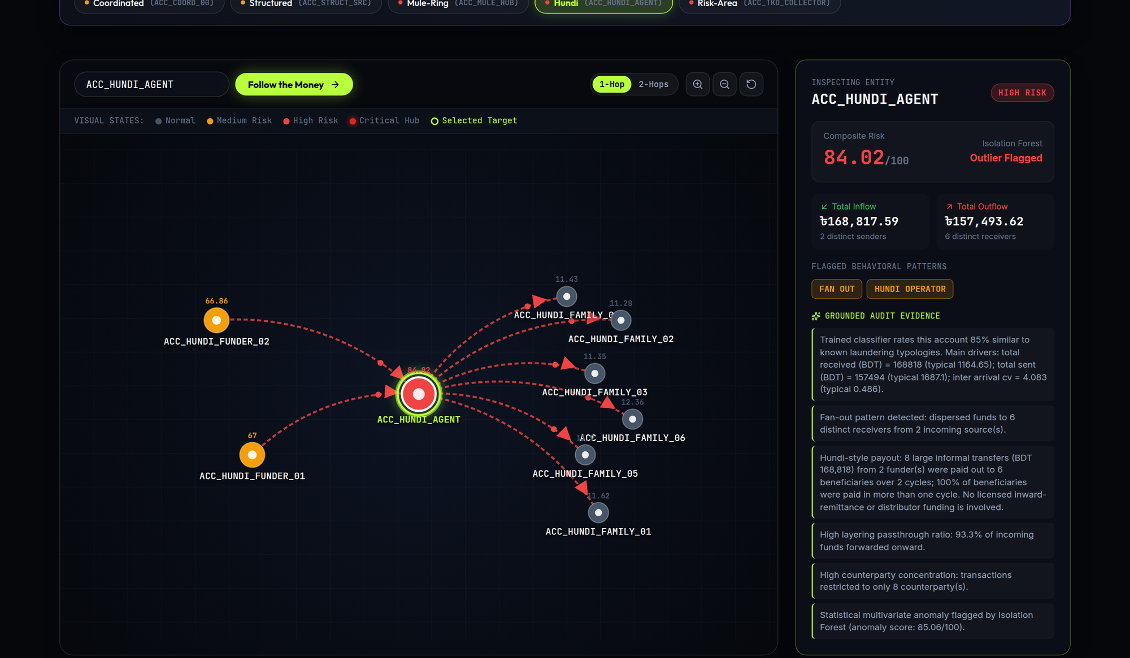



Follow the Money, one hop at a time
08 · LIVE DEMO
◂ Agenda
Pick a flagged account
Jump to any of 11 demo scenarios in one click.
Expand 1 or 2 hops
Directed edges show exactly where the money went next.
Read the evidence
Score, inflow, outflow and patterns for every account.
Open live dashboard
Graph API docs · ML API docs
Notes:
Switch to the live dashboard on the laptop (localhost:3001). The screenshot shows the hundi agent: two funders top up ACC_HUNDI_AGENT, which pays the same six family wallets every cycle. The mule ring (ACC_MULE_HUB, CRITICAL) and the account-takeover collector are one click away in the scenario bar.

Slide 12
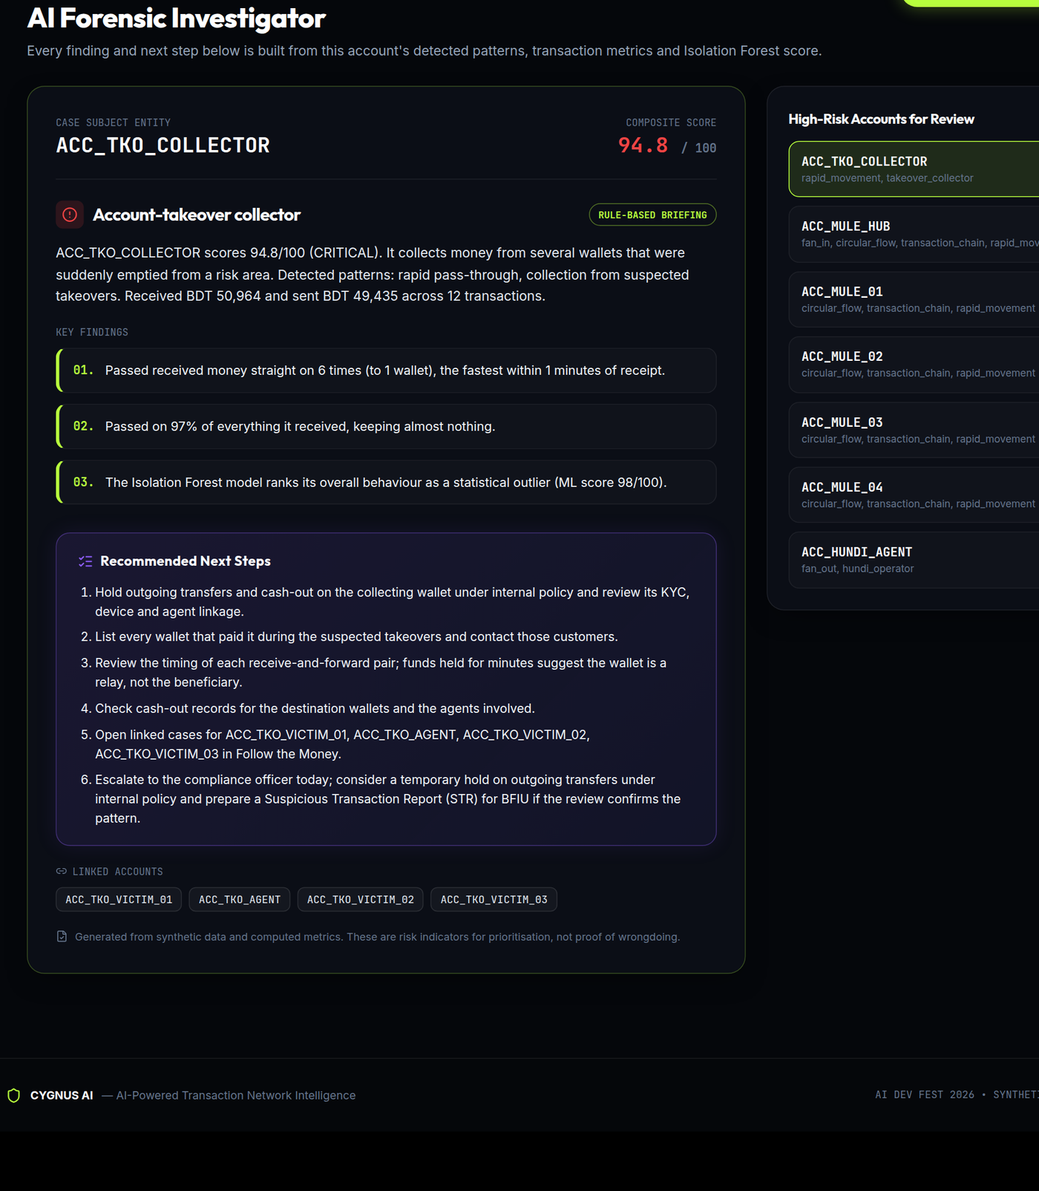



From alert to next step in seconds
09 · AI INVESTIGATOR
◂ Agenda
Names the typology
Money-mule hub, layering loop, smurfing: each case gets a plain-language label and summary.
Explains with real numbers
Key findings quote the pipeline's own metrics, so every sentence can be audited.
Recommends MFS next steps
Check NID, SIM and device links, review agent cash-outs, and for CRITICAL cases prepare an STR for BFIU.
Works fully offline. An optional Claude narrative rewrites the briefing using only the pipeline's facts.
Notes:
The investigator panel answers the two questions an analyst asks: why was this flagged, and what should I check next. The briefing is built from each account's real evidence; the optional Claude narrative only rephrases those facts.

Slide 13




One flow, from alert to STR draft, all in the product
10 · ANALYST WORKFLOW
◂ Agenda
01
BUILT
02
BUILT
03
BUILT
04
BUILT
05
BUILT
06
BUILT
Alert queue
Follow the Money
AI Investigator
Open a case
STR / SAR draft
Audit trail
Sign in as AML analyst; accounts ranked by risk tier
Expand 1 or 2 hops of the money network
Typology, evidence and next steps
Notes, status and escalation to the compliance officer
Exportable report built from the case evidence
Hash-chained log of case actions and PII reveals
90-SECOND LIVE DEMO
Sign in as an AML analyst, open the top CRITICAL alert, follow the money two hops, read the AI Investigator, open a case and add a note, escalate it, export the STR/SAR draft, then show the audit log and the Model Evaluation tab.
Open the live demo
Runs on our laptop today. The public server gets this version once the PR is merged.
Notes:
This is the slide where we switch to the live product. Walk the six steps on screen: pick an alert, trace the money, read the AI Investigator, open a case, export the STR draft, and show the audit trail. Every step on this slide is built and tested (71 Python and 10 API tests). Two roles exist: AML analyst and compliance officer.

Slide 14
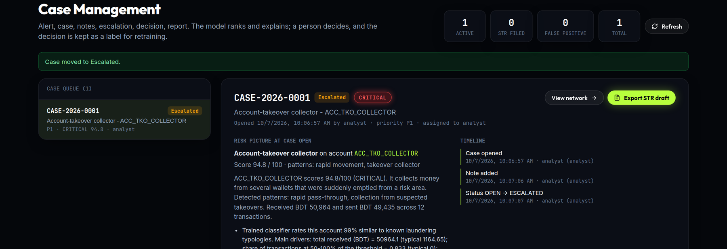
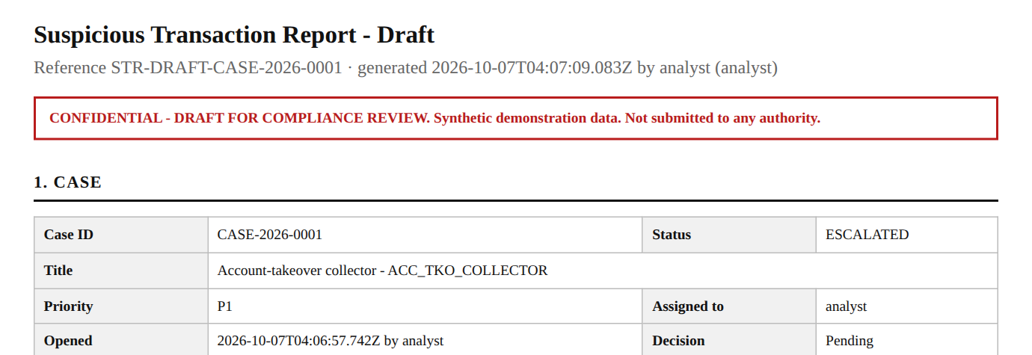
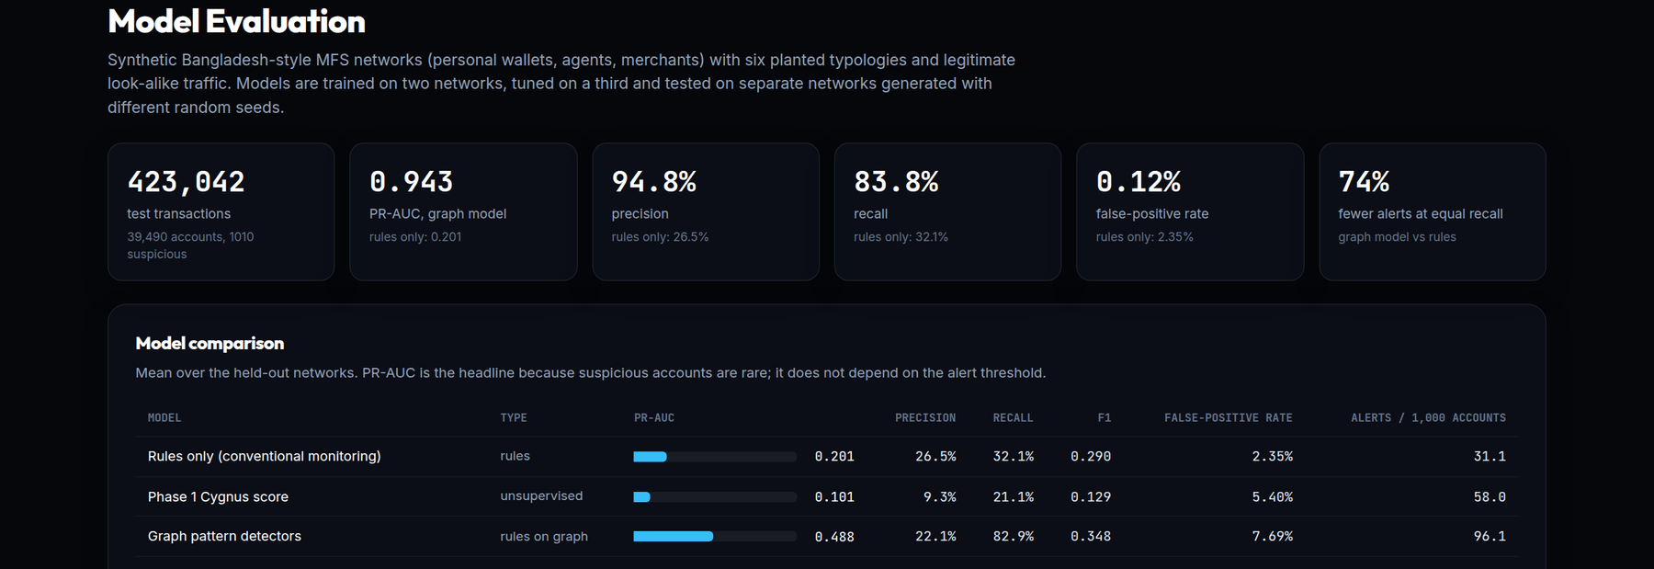
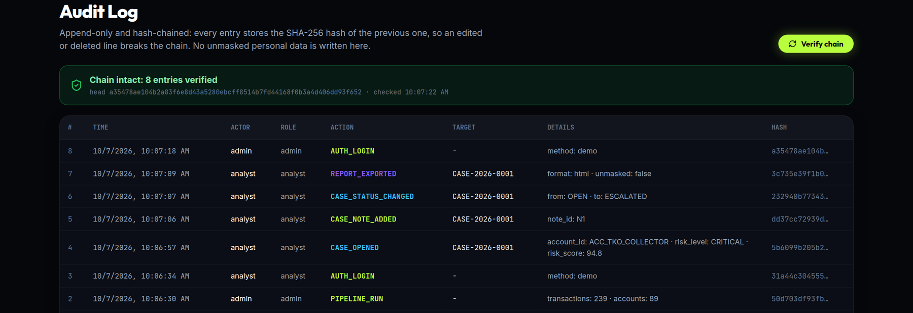
Cases, STR drafts and a tamper-evident audit log
11 · IN THE PRODUCT TODAY
◂ Agenda
Case management Open, note, escalate to the compliance officer
STR / SAR draft Exported from the case, personal data masked
Model Evaluation tab The benchmark numbers, live in the dashboard
Audit log SHA-256 hash chain; one click verifies it
Notes:
Screens from the running product on our laptop. Case management: the analyst opens a case from an alert, adds notes and escalates it to the compliance officer. The STR draft is generated from the case with personal data masked; revealing it is logged. The Model Evaluation tab shows the benchmark numbers. The audit log is append-only and hash-chained, so an edited or deleted entry breaks the chain, and the Verify button checks it.

Slide 15
Every planted scenario, scored by the live product
12 · DEMO DATASET
◂ Agenda
239
89
11 / 11
71 + 10
transactions analysed
accounts mapped as a graph
patterns detected
automated tests passing
Accounts flagged per pattern (demo dataset)
11 benchmark scenarios
Normal
Fan-In
Fan-Out
Rapid
Chain
Circular
Coordinated
Structuring
Mule ring
Hundi
Takeover
9 of the 10 planted fraud targets score MEDIUM or above; the rapid pass-through scores 28.3 (LOW) but is still flagged by its pattern. No normal account is flagged by any pattern.
Fixed random seeds: same input, same score.
Notes:
All numbers here come from the project: 239 synthetic transactions, 89 accounts, every detector firing, and 71 + 10 unit, integration, benchmark and security tests passing.

Slide 16
Measured on 423,042 held-out transactions
13 · MODEL EVALUATION
◂ Agenda
423,042
39,490
1,010
2 train · 1 tune · 3 test
labelled transactions
accounts
planted suspicious accounts
evaluation split
Model | Precision | Recall | F1 | PR-AUC | False-positive rate
Rules only (conventional monitoring) | 26.5% | 32.1% | 0.29 | 0.20 | 2.35%
First prototype score (unsupervised) | 9.3% | 21.1% | 0.13 | 0.10 | 5.40%
Isolation Forest (unsupervised) | 8.2% | 9.6% | 0.09 | 0.09 | 2.83%
Graph pattern detectors | 22.1% | 82.9% | 0.35 | 0.49 | 7.69%
Cygnus composite (current product) | 69.8% | 88.0% | 0.78 | 0.84 | 1.00%
Gradient boosting, no graph features | 80.3% | 63.4% | 0.71 | 0.76 | 0.41%
Random forest + graph features | 90.7% | 80.6% | 0.85 | 0.92 | 0.22%
Gradient boosting + graph features ★ | 94.8% | 83.8% | 0.89 | 0.94 | 0.12%
848,752 synthetic Bangladesh-style MFS transactions with seven planted typologies and legitimate look-alikes. Trained on 2 networks, tuned on 1, tested on 3 unseen networks with different seeds (mean shown). Labels are exact by construction, so treat these as upper bounds for real upay data.
Notes:
Read the bottom row: gradient boosting with graph features reaches precision 94.8%, recall 83.8%, F1 0.890, PR-AUC 0.943 and a 0.12% false-positive rate, against 26.5% / 32.1% / 0.290 / 0.201 / 2.35% for conventional rules. Be honest about our first prototype: on this realistic large network its unsupervised score did badly (PR-AUC 0.101), which is why we rebuilt the scoring. The current product score reaches 0.838. All data is synthetic and suspicious accounts are about 2.5% of each network, far more than in production, so real precision will be lower at the same threshold.

Slide 17
What the network catches that transaction rules miss
14 · WHY GRAPH INTELLIGENCE
◂ Agenda
3 HELD-OUT NETWORKS · 1,010 SUSPICIOUS ACCOUNTS
FEATURE IMPORTANCE · PR-AUC DROP WHEN SHUFFLED
Transaction rules only 324 of 1,010 suspicious accounts caught
Cygnus (graph + ML) 846 of 1,010 suspicious accounts caught
561 missed by rules, caught via the network
Of the 686 accounts the rules miss, the graph model catches 561. On evasive variants built to stay under rule thresholds, rules catch 9.1%, the model without graph features 66.1%, with graph features 82.6%. False alarms fall from 904 to 46.
Adding feature families, PR-AUC: transactional 0.66 → + temporal 0.82 → + graph and flow tracing 0.93 → + 2-hop neighbourhood 0.94
Graph / network
Transactional
Notes:
This answers 'show a materially different result from rules'. Same three held-out networks, 1,010 suspicious accounts. Rules catch 324, the graph model 846. Of the 686 the rules miss, the model catches 561, because it sees the network: long fast chains, money forwarded on, neighbours that forward. The ablation shows each family adds value: temporal features lift PR-AUC from 0.66 to 0.82 and graph features to 0.93.

Slide 18





Four services, one Docker Compose stack
15 · ARCHITECTURE
◂ Agenda
DOCKER COMPOSE
Graph engine
FastAPI · NetworkX
Dashboard
API gateway
Graph build and pattern detectors
Data
React · Vite · Recharts
Node.js · Express
Generator
Follow the Money, AI Investigator, analytics
Routes requests, caches pipeline results
239 txns, 11 scenarios
ML engine
FastAPI · scikit-learn
Isolation Forest, risk score, AI Investigator
React 19
Vite
Tailwind
Recharts
Node.js
Express
Python
FastAPI
NetworkX
pandas
scikit-learn
pytest
Docker
Notes:
Modular by design: each team member owned one layer behind a documented API contract. The whole stack is deployed with Docker Compose and is live for the judges.

Slide 19




Measured today, with a clear path to upay volume
16 · SCALABILITY & INTEGRATION
◂ Agenda
MEASURED ON A LAPTOP TODAY
upay-scale target All Bangladesh MFS together average ~250 transfers a second [2]. Our batch scoring already runs ~56,000 a second on one laptop process; the streaming layers below make it real-time for upay.
1,061,510
transactions scored in 18.9 s
~56,000 / s
TARGET ARCHITECTURE · ROADMAP
scoring throughput, one process
< 6 ms
Stream in
Window
Graph store
Score
Integrate
API response time, p95 (every endpoint)
Kafka topic fed by upay's core ledger / AML feed (CDC)
Incremental graph features over sliding 1h / 24h / 7d windows
Neo4j or TigerGraph for multi-hop queries at scale
Current models + temporal GNN, served behind the same API
Cases and STR drafts pushed to upay's AML / case system
0.21 s
re-score the last 24 hours (9,508 tx)
8-core laptop, Python 3.11, one process in Docker, no GPU, peak 1.9 GB. Full pipeline with graph and evidence text: ~8,600 tx/s.
Notes:
Measured: the scoring path (feature store, flow tracing, trained model) scores 1,061,510 transactions in 18.9 seconds on one laptop process, about 56,000 a second, and re-scores the last 24 hours in 0.21 seconds. Every API endpoint answers in under 6 ms at p95. The full product pipeline, which also builds the NetworkX graph and writes evidence text, runs about 8,600 a second. Kafka and Neo4j are the planned next step and are not part of this measurement; say so if asked.

Slide 20







Safeguards built today, and what production adds
17 · RESPONSIBLE AI & SECURITY
◂ Agenda
BUILT AND TESTED IN THE PROTOTYPE
PRODUCTION ROADMAP
Strict input validation bad amounts, NaN/Inf, bad timestamps, self-transfers, duplicates rejected
SSO with upay identity and MFA for analysts
TLS everywhere and encryption at rest for case data
Write-once audit storage and regular external penetration tests
Model-drift and alert-volume monitoring with monthly threshold review
Privacy governance: data minimisation, retention limits, access reviews
Fairness review on real data across regions, account types and agent tiers
Cross-provider analytics without sharing raw PII (federated learning or secure aggregation)
Role-based access sign-in as AML analyst or compliance officer
Hash-chained audit log case actions and data reveals are chained, so tampering shows
PII masking personal details masked by default; every reveal is logged
Bias check legit agents flagged 98.7% (first prototype) → 0.57% now; no district effect (p = 0.30)
Grounded explanations every sentence quotes a computed metric; the optional LLM only rephrases
Human in the loop scores prioritise review; analysts decide and file STRs
Notes:
Built and tested: sign-in with two roles, a hash-chained audit log, PII masking with logged reveal, and a bias check. The bias check found a real problem: our first prototype score flagged 98.7% of legitimate agents, because collecting from many customers is what an agent does. The score is now tier-aware and that is down to 0.57%. District is never a model input, and false-positive rates by district show no dependence (chi-square p = 0.30). Everything on the right is roadmap.

Slide 21
What it saves an AML team, and how a pilot proves it
18 · BUSINESS IMPACT
◂ Agenda
73.6%
904 → 46
32% → 84%
76 → 21 min
fewer alerts at equal recall
false alarms
suspicious accounts caught
analyst time per true case
324 alerts instead of 1,228 to find the same 324 accounts
on 39,490 held-out accounts
rules vs graph model, same networks
at 20 minutes per alert (assumed)
MODELLED SAVINGS · 20 MIN PER ALERT, ASSUMED
PROPOSED 8-WEEK PILOT WITH UPAY
Assumption: 20 minutes of analyst review per alert. The pilot replaces it with upay's measured time.
Rules: 1,228 alerts = 409 analyst hours, finding 324 suspicious accounts.
Graph model: 892 alerts = 297 analyst hours, finding 846.
Same 324 accounts with the graph model: 324 alerts, 108 hours instead of 409.
Synthetic networks are ~2.5% suspicious, far above production, so real precision will be lower.
Shadow mode on governed upay data: Cygnus scores, analysts work as usual
Analysts label every alert; we measure precision@100 and recall on confirmed cases
Time each case with and without Cygnus to get real minutes saved
Calibrate thresholds and tiers with upay's AML team
Exit report: ROI, false-positive cost and a go / no-go for production
Notes:
Lead with measured numbers: 73.6% fewer alerts to find the same suspicious accounts, false alarms down from 904 to 46, recall from 32% to 84%. The hours use one stated assumption, 20 minutes per alert; the pilot replaces it with upay's real time per case. The right-hand box is the controlled pilot we propose to upay.

Slide 22



From prototype to a upay pilot to MFS scale
19 · ROADMAP
◂ Agenda
STAGE 1 DONE
STAGE 2 DONE
STAGE 3 NEXT
STAGE 4 FUTURE
Prototype
Analyst platform
upay pilot
MFS scale
Seven detectors, Isolation Forest, explainable score, AI Investigator
849k-transaction labelled benchmark, trained model, cases, roles, audit log, takeover and hundi detectors
Governed upay data in shadow mode, analyst feedback, calibrated tiers
Streaming ingest, graph database, temporal GNN, cross-provider privacy-preserving analytics
MFS providers like upay
Compliance teams
Account holders
Spot mule networks before funds are cashed out.
Trace a multi-hop flow in seconds instead of hours.
Fewer recruited mules and victims, more trust in digital money.
Notes:
Close the business story: banks and MFS providers must run AML controls and report suspicious activity. Cygnus AI cuts the cost of investigation and protects ordinary users.

Slide 23
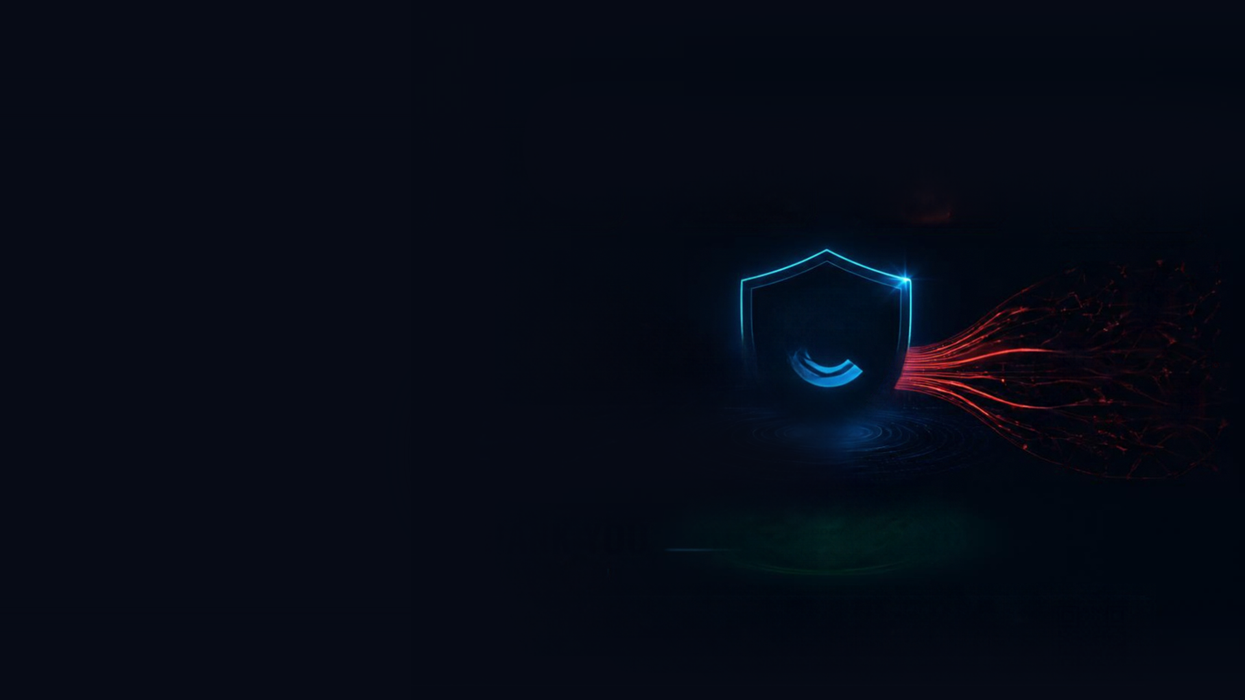
Don't just flag transactions.
Follow the money.
CYGNUS AI
Graph intelligence and explainable AI for safer mobile money in Bangladesh.
Thank you
Built for upay · AI Dev Fest 2026
github.com/ManamiMayoki/CPC_DIU_HACKATHON_2026
Notes:
End on the line: don't just flag transactions, follow the money. Then invite questions and offer to drive the live demo.

