Slide 1

Clean Code Principles Key Concepts and Best Practices By : Mohamed Rashad & Yasser Eltayeb
SoftTrend

Slide 2

Introduction
Key Concepts of Clean Code
What Prevents Clean Code
Best Practices for Writing Clean Code
what you can achieve with clean code
Question
Agenda

Slide 3

Headline

Slide 4
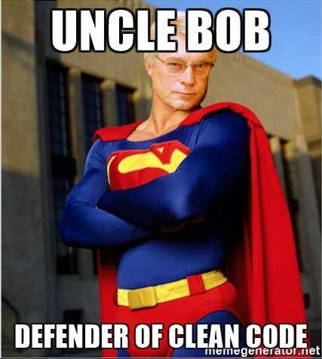
Headline
Example
Example
Example

Slide 5
What Is Clean Code?
Definition: Code that is easy to read, understand, and maintain.
Core Idea: Clean code focuses on readability and simplicity, ensuring it’s easier for others (and yourself) to work with later.
Why It Matters: Enhances collaboration, reduces bugs, and improves long-term project success.
Headline

Slide 6
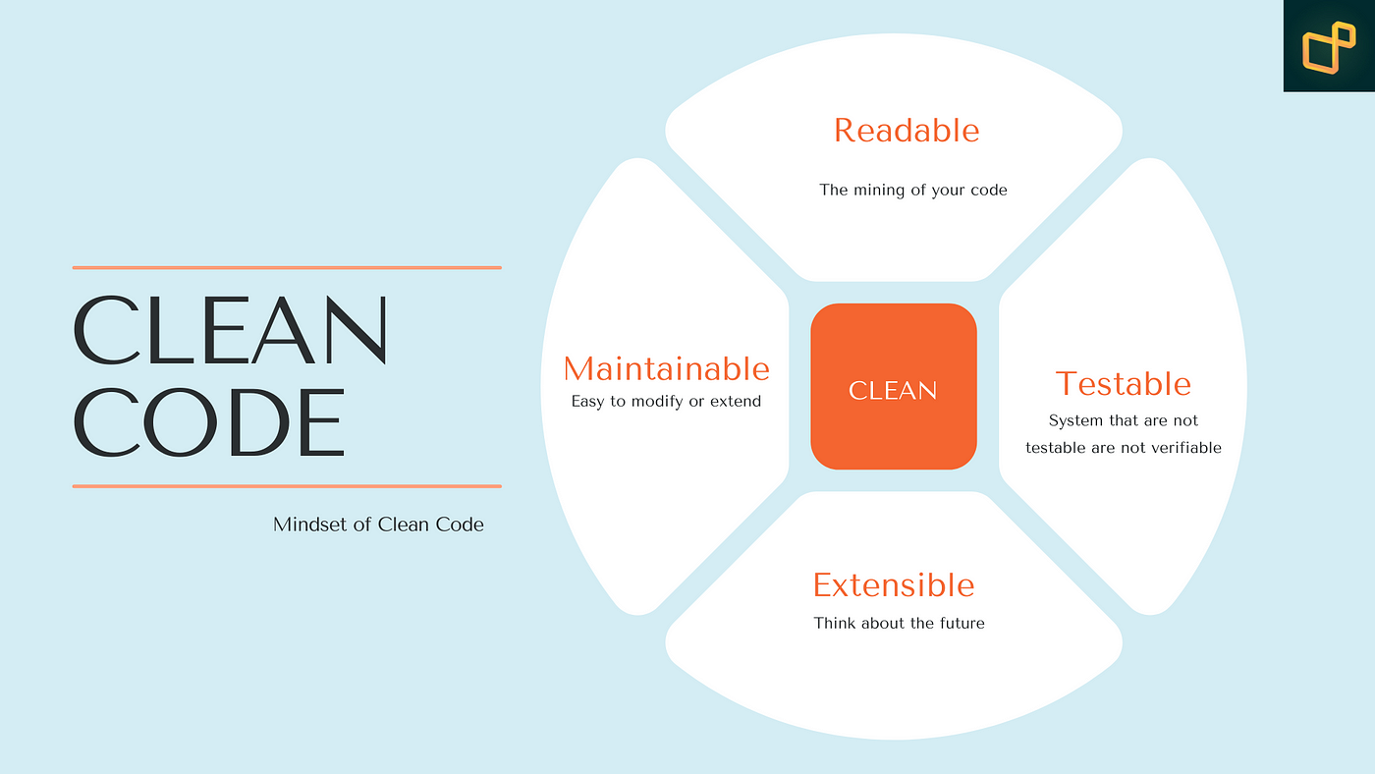
Headline
Example
Example
Example

Slide 7
What Prevents Clean Code
Number one reason:
“I’ll clean it up later.”
Headline
“I’ll clean it up later.”
“Later” Never Comes.

Slide 8
Best Practices for Writing Clean Code:
1. Meaningful Names
2. Small Functions
3. Use Comments Wisely
4. Avoid Global Variables
5. Error Handling
6. Refactor Often
Headline

Slide 9
Key Principles of Clean Code
Simplicity: Avoid over-complication; prioritize clarity over cleverness.
Consistency: Follow conventions and be consistent in style and structure.
Modularity: Break code into small, reusable, and self-contained components.
Naming Conventions: Use meaningful and descriptive names for variables, functions, and classes.
Headline

Slide 10
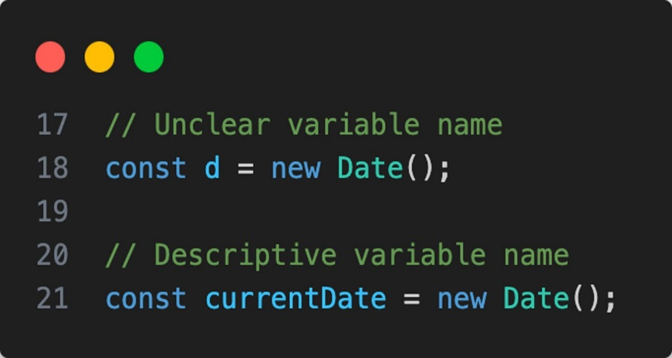
Key Principles of Clean Code
Use Meaningful Names:
Use descriptive names Nouns for Variables, Verbs for
Methods.
Avoid Magic Numbers:
Replace hard-coded values with named
constants.
const TAX_RATE = 0.15 instead of 0.15.
Headline

Slide 11
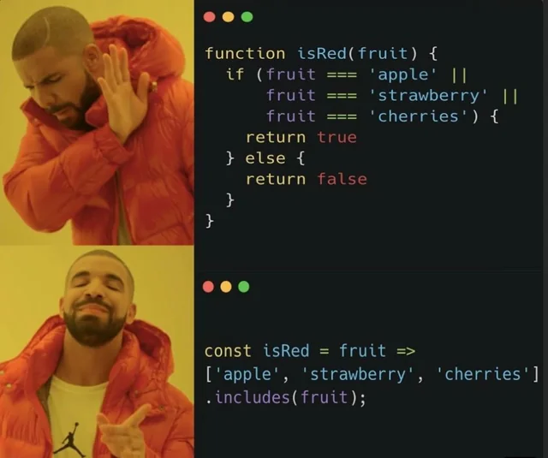
Key Principles of Clean Code
Functions rules:
Small.
Do one thing.
Have no side effects.
Don't use flag arguments
Headline

Slide 12
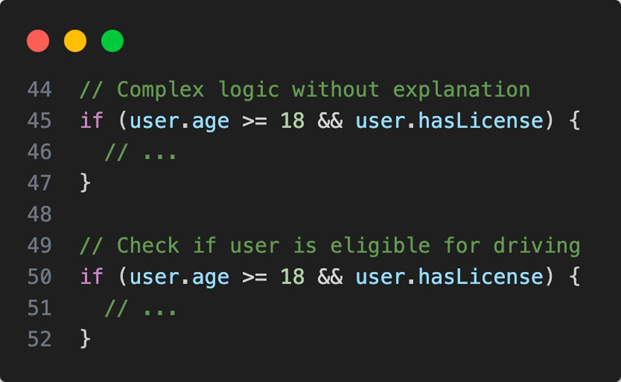
Key Principles of Clean Code
Comments rules:
Always try to explain yourself in code.
Don't be redundant.
Don't comment out code. Just remove.
Use as clarification of code.
Use as warning of consequences
Headline

Slide 13
Techniques for Clean Code
Refactoring: Regularly improve the structure of existing code without changing its behavior.
Code Reviews: Peer reviews help ensure code quality.
Test-Driven Development (TDD): Write tests before writing the code itself to ensure code works as expected.
Consistent Formatting: Enforce a standard format across all code.
Headline

Slide 14
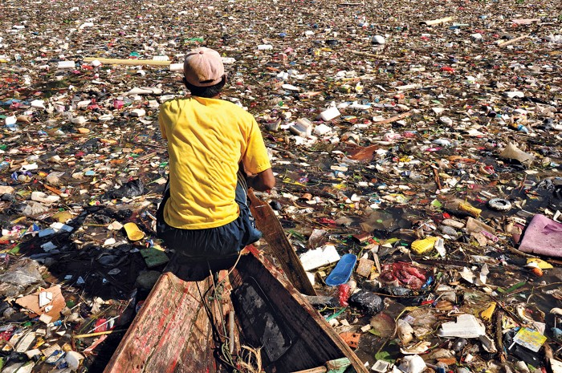
“Your Code if you back after a while without apply Clean Code Principle”
Headline
Questions?

Slide 15
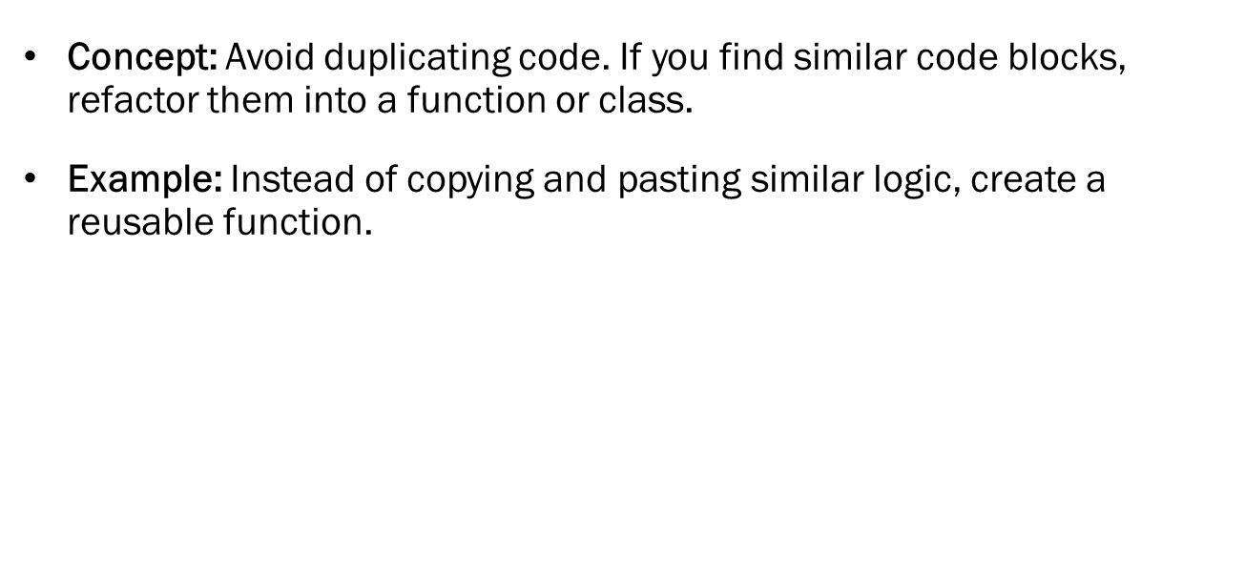
Don’t Repeat Yourself (DRY)
Headline

Slide 16
Keep It Simple (KISS)
Concept: Don’t over-engineer or add unnecessary complexity.
Practical Application: Write code that solves the problem efficiently but without additional layers or unnecessary features.
Headline

Slide 17
Single Responsibility Principle (SRP)
Concept: Each class or function should have only one responsibility.
Example: A user class should only handle user-related operations, not database management or UI logic.
Headline

Slide 18
Avoid Premature Optimization
Tip: Focus on writing clean, readable code first; optimize performance only when necessary.
Common Pitfall: Sacrificing clarity for a minor performance gain.
Headline

Slide 19
Practical Example – Refactoring for Clean Code
Show a piece of code that has been refactored to be cleaner.
Before: Messy, hard-to-read code with multiple responsibilities.
After: Clear, modular code with proper naming, single responsibility, and reduced duplication.
Headline

Slide 20
what you can achieve with clean code
Fewer Bugs: Easier to spot issues in simple, clear code.
Maintainability: Code that is easier to maintain and extend.
Clean Code saves time.
Improved Team Efficiency: Readable code helps new developers onboard quickly.
Higher Quality Projects: Overall, better code leads to better outcomes.
Review your code easily.
Headline

Slide 21
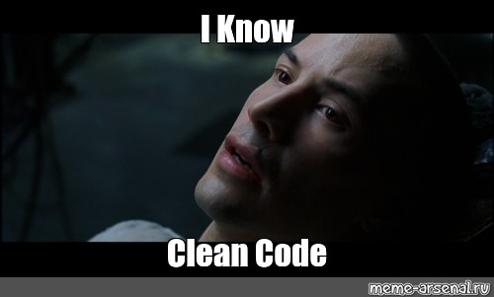
Practical Example – Refactoring for Clean Code
Show a piece of code that has been refactored to be cleaner.
Before: Messy, hard-to-read code with multiple responsibilities.
After: Clear, modular code with proper naming, single responsibility, and reduced duplication.
Headline

Slide 22

Questions

Slide 23

Thanks!

