Slide 1


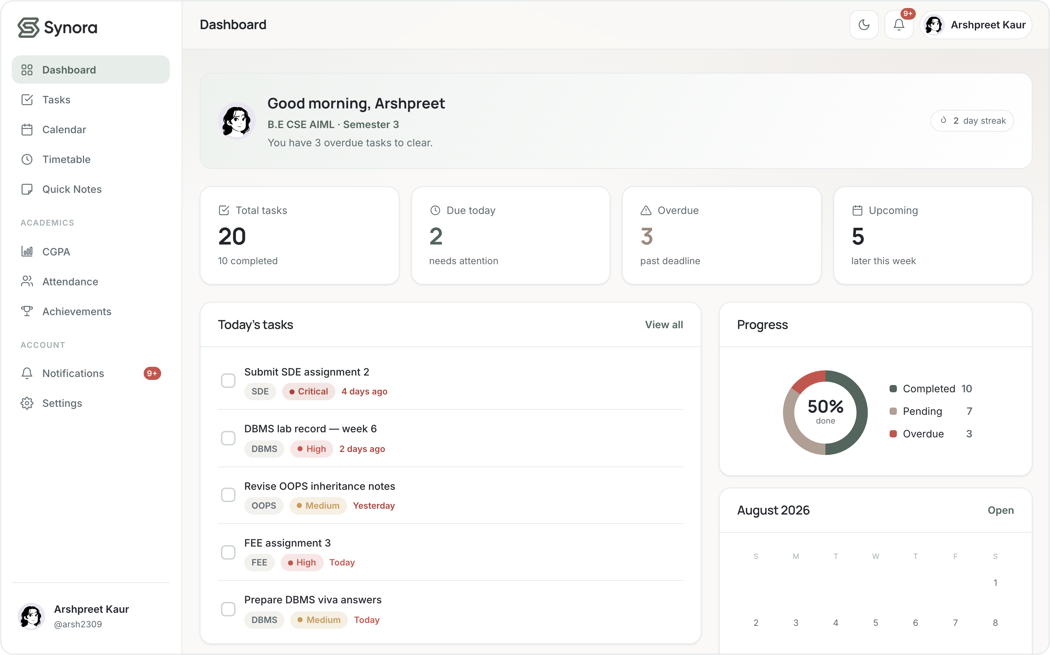
One calm home
for everything
you're studying.
Student Productivity & Academic Management Workspace
HTML5
CSS3
JavaScript
DOM
Events
The Synora dashboard — a live, working product.
SUBMITTED BY
Manan Kochhar · Arshpreet Kaur · Atharv Bains
Notes:
Synora is a real, working student-productivity web app built only with HTML5, CSS3 and vanilla JavaScript. This deck tells the whole story — problem, product, how it's built, which syllabus concepts it uses, and what we added beyond them. Submitted by Manan Kochhar, Arshpreet Kaur and Atharv Bains.

Slide 2








01 · THE PROBLEM
A student's semester is scattered across apps that never talk.
Sticky notes
To-do app
Attendance sheet
Wall calendar
Grades sheet
Reminders
Six apps. Zero that talk to each other — so deadlines slip through the gaps and nothing sees the whole week.
Notes:
The problem is fragmentation. Six disconnected tools, none sharing data — deadlines slip, attendance is done by hand, grades live in fragile spreadsheets. The scattered cards and red warning badges make the pain visible; the red band drives it home.

Slide 3









01 · THE SOLUTION
Eight tools, gathered into one calm workspace.
Tasks
Calendar
Notes
Timetable
Attendance
Synora
CGPA
Achievements
One dashboard for the whole semester.
Notifications
One account. One quiet home — personal to each student, on every device.
Notes:
The relief beat: the eight scattered tools converge into one calm, personalized workspace. Same colour language as the app (sage), ordered and quiet — deliberately the opposite of the previous slide. The dashboard is the payoff.

Slide 4










01 · THE PRODUCT
What is Synora?
A personalized student productivity workspace — academic planning, task management and performance tracking in one interface. Its features fall into four groups:
Productivity
Academic
Progress
Personalization
Tasks
Timetable
Achievements
Profile
Calendar
Attendance
Notifications
Subjects
Quick Notes
CGPA
Avatar & Theme
Notes:
Four feature families: Productivity (tasks/calendar/notes), Academic (timetable/attendance/CGPA), Progress (achievements/notifications), Personalization (profile/subjects/avatar/theme). Everything is per-user and saved on-device.

Slide 5







01 · THE PRODUCT
Technology stack
Core web technologies only — no frameworks, no build step.
HTML5
Structure & semantics
CSS3
Design system + responsive layout
JavaScript
Logic, state & interactivity
DOM APIs
A live, dynamic interface
localStorage
Per-user persistence in the browser
HTML → CSS → JS → DOM → Events
Git & GitHub
Version control
Notes:
Deliberately minimal stack: HTML5, CSS3, vanilla JS, localStorage for persistence, Git/GitHub for version control. No React, no bundler — the syllabus building blocks are the whole toolkit. localStorage is genuinely used (16 call-sites).

Slide 6
02 · ARCHITECTURE
How the project is structured
No framework, no build step — files a browser opens directly. One page and one module per feature.
14
HTML pages
Synora/
├── index.html Landing page
├── notes.html Project & viva doc
├── README.md Documentation
├── app/ the signed-in workspace
│ ├── dashboard.html Home overview
│ ├── tasks.html Task manager
│ ├── cgpa.html CGPA calculator
│ └── … 10 more timetable, attendance …
├── scripts/ 18 vanilla-JS modules
│ ├── app.js Shared core + helpers
│ ├── storage.js localStorage layer
│ └── … 16 more auth, theme, tasks …
├── styles/ 7 stylesheets
│ ├── tokens.css Design tokens
│ └── … 6 more base, components …
└── assets/ logos · avatars · icons
7
CSS files
18
JS modules
0
frameworks
Notes:
Real project tree with headline counts: 14 HTML pages (index + 13 app pages), 7 stylesheets, 18 JS modules, and ZERO frameworks. One page + one module per feature, no build step — the browser opens the files directly.

Slide 7






02 · ARCHITECTURE
Data flow
User
Sign in
Personalize
Profile + Subjects
SUBJECTS ARE THE SOURCE OF TRUTH
every academic feature references a subject by its id
Tasks
Notes
Timetable
Attendance
CGPA
Achievements
Dashboard — one live view of everything
Notes:
Data flows from sign-in through personalization into a per-user profile and subject list. Subjects are the single source of truth — attendance, CGPA and timetable all reference a subject by id, so renaming it once renames it everywhere. Everything rolls up to the dashboard.

Slide 8

03 · HTML5
The structure behind Synora
Every page is written with semantic HTML5 — elements that describe what each region means, not just how it looks. The browser, assistive tech and our own JavaScript all read that same structure.
index.html — landing structure
<header class="site-header">
<nav aria-label="Primary"> … </nav>
</header>
<main id="main">
<section class="hero">…</section>
<section aria-labelledby="features">…
</section>
</main>
<footer class="site-footer">…</footer>
<header> site header + nav
<main> ×14 primary content
<section> ×11 labelled regions
<aside> ×12 sidebar
<footer> landing footer
<figure> ×3 media
Real markup from index.html — trimmed.
Notes:
Semantic tags carry meaning: header/nav/main/section/aside/footer, with aria-labelledby tying a heading to its region. Viva: why semantic HTML? Accessibility, SEO, and a structure our JS can target reliably.

Slide 9
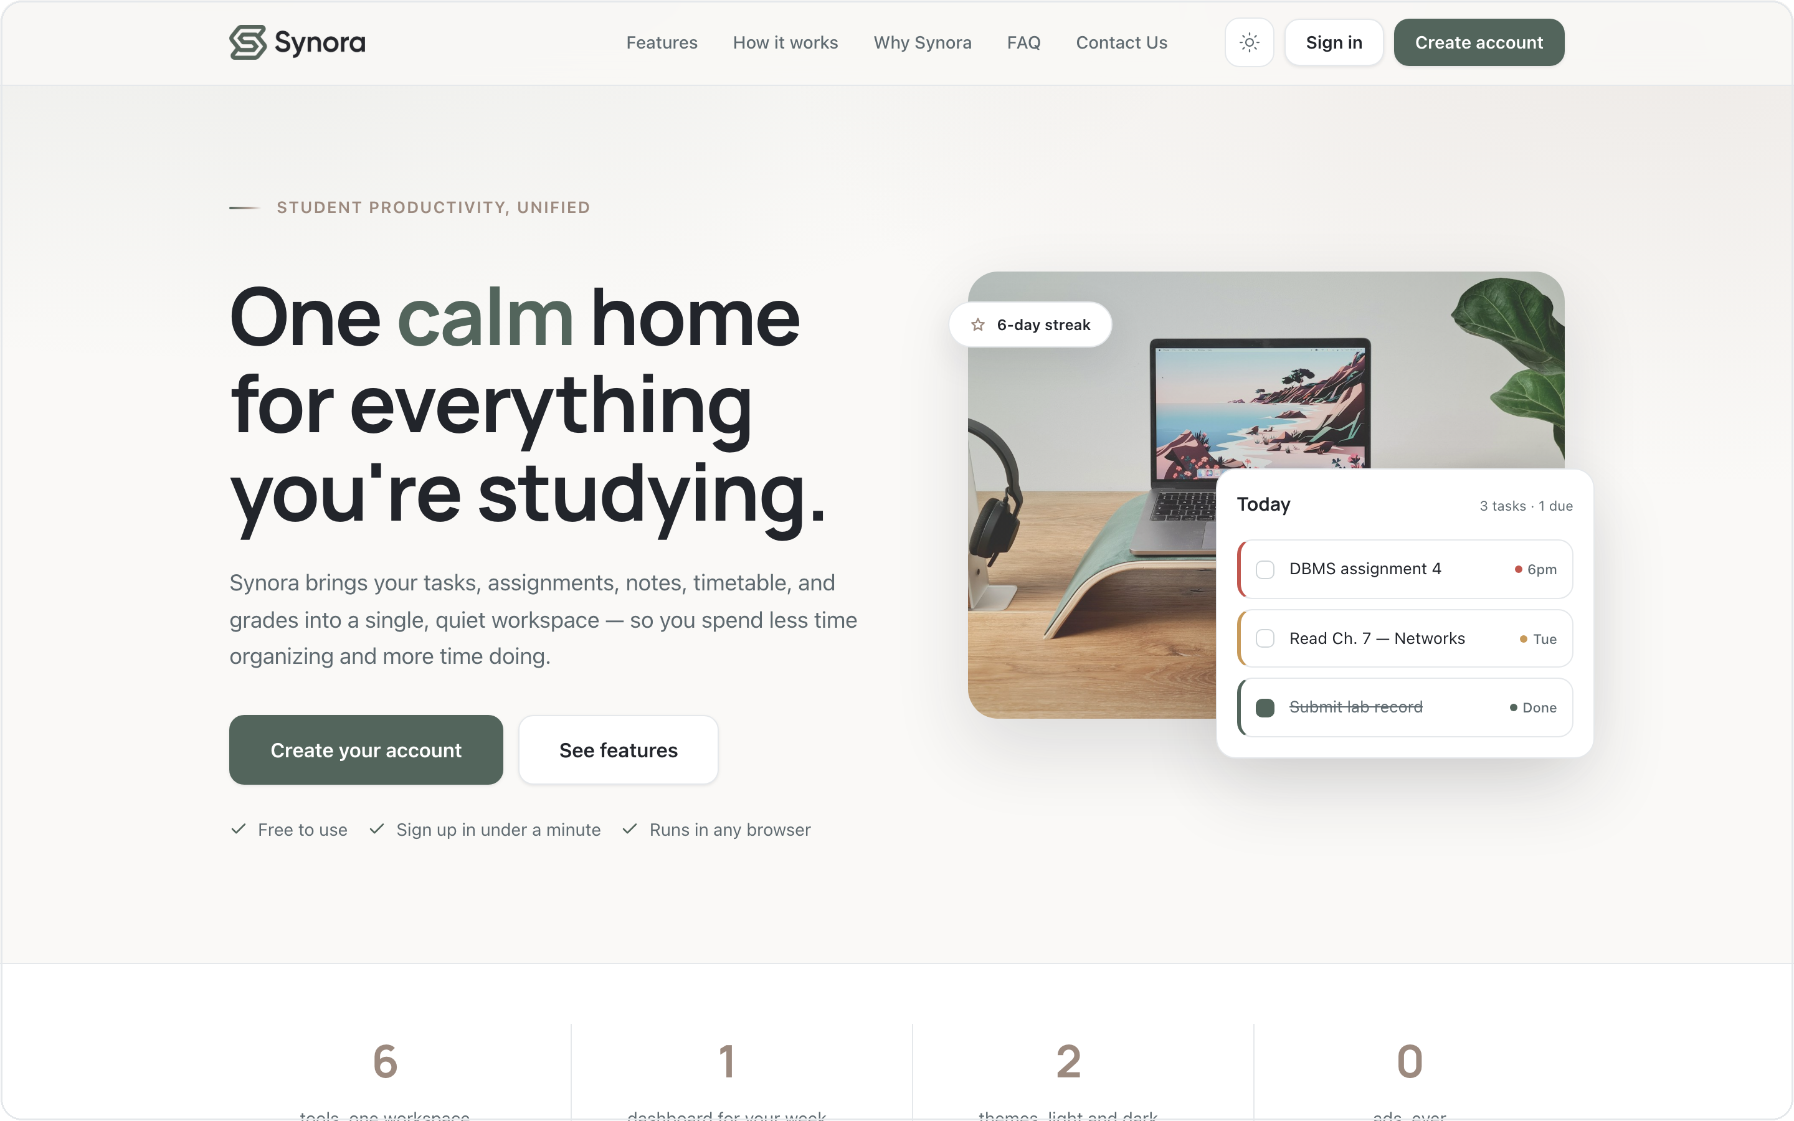
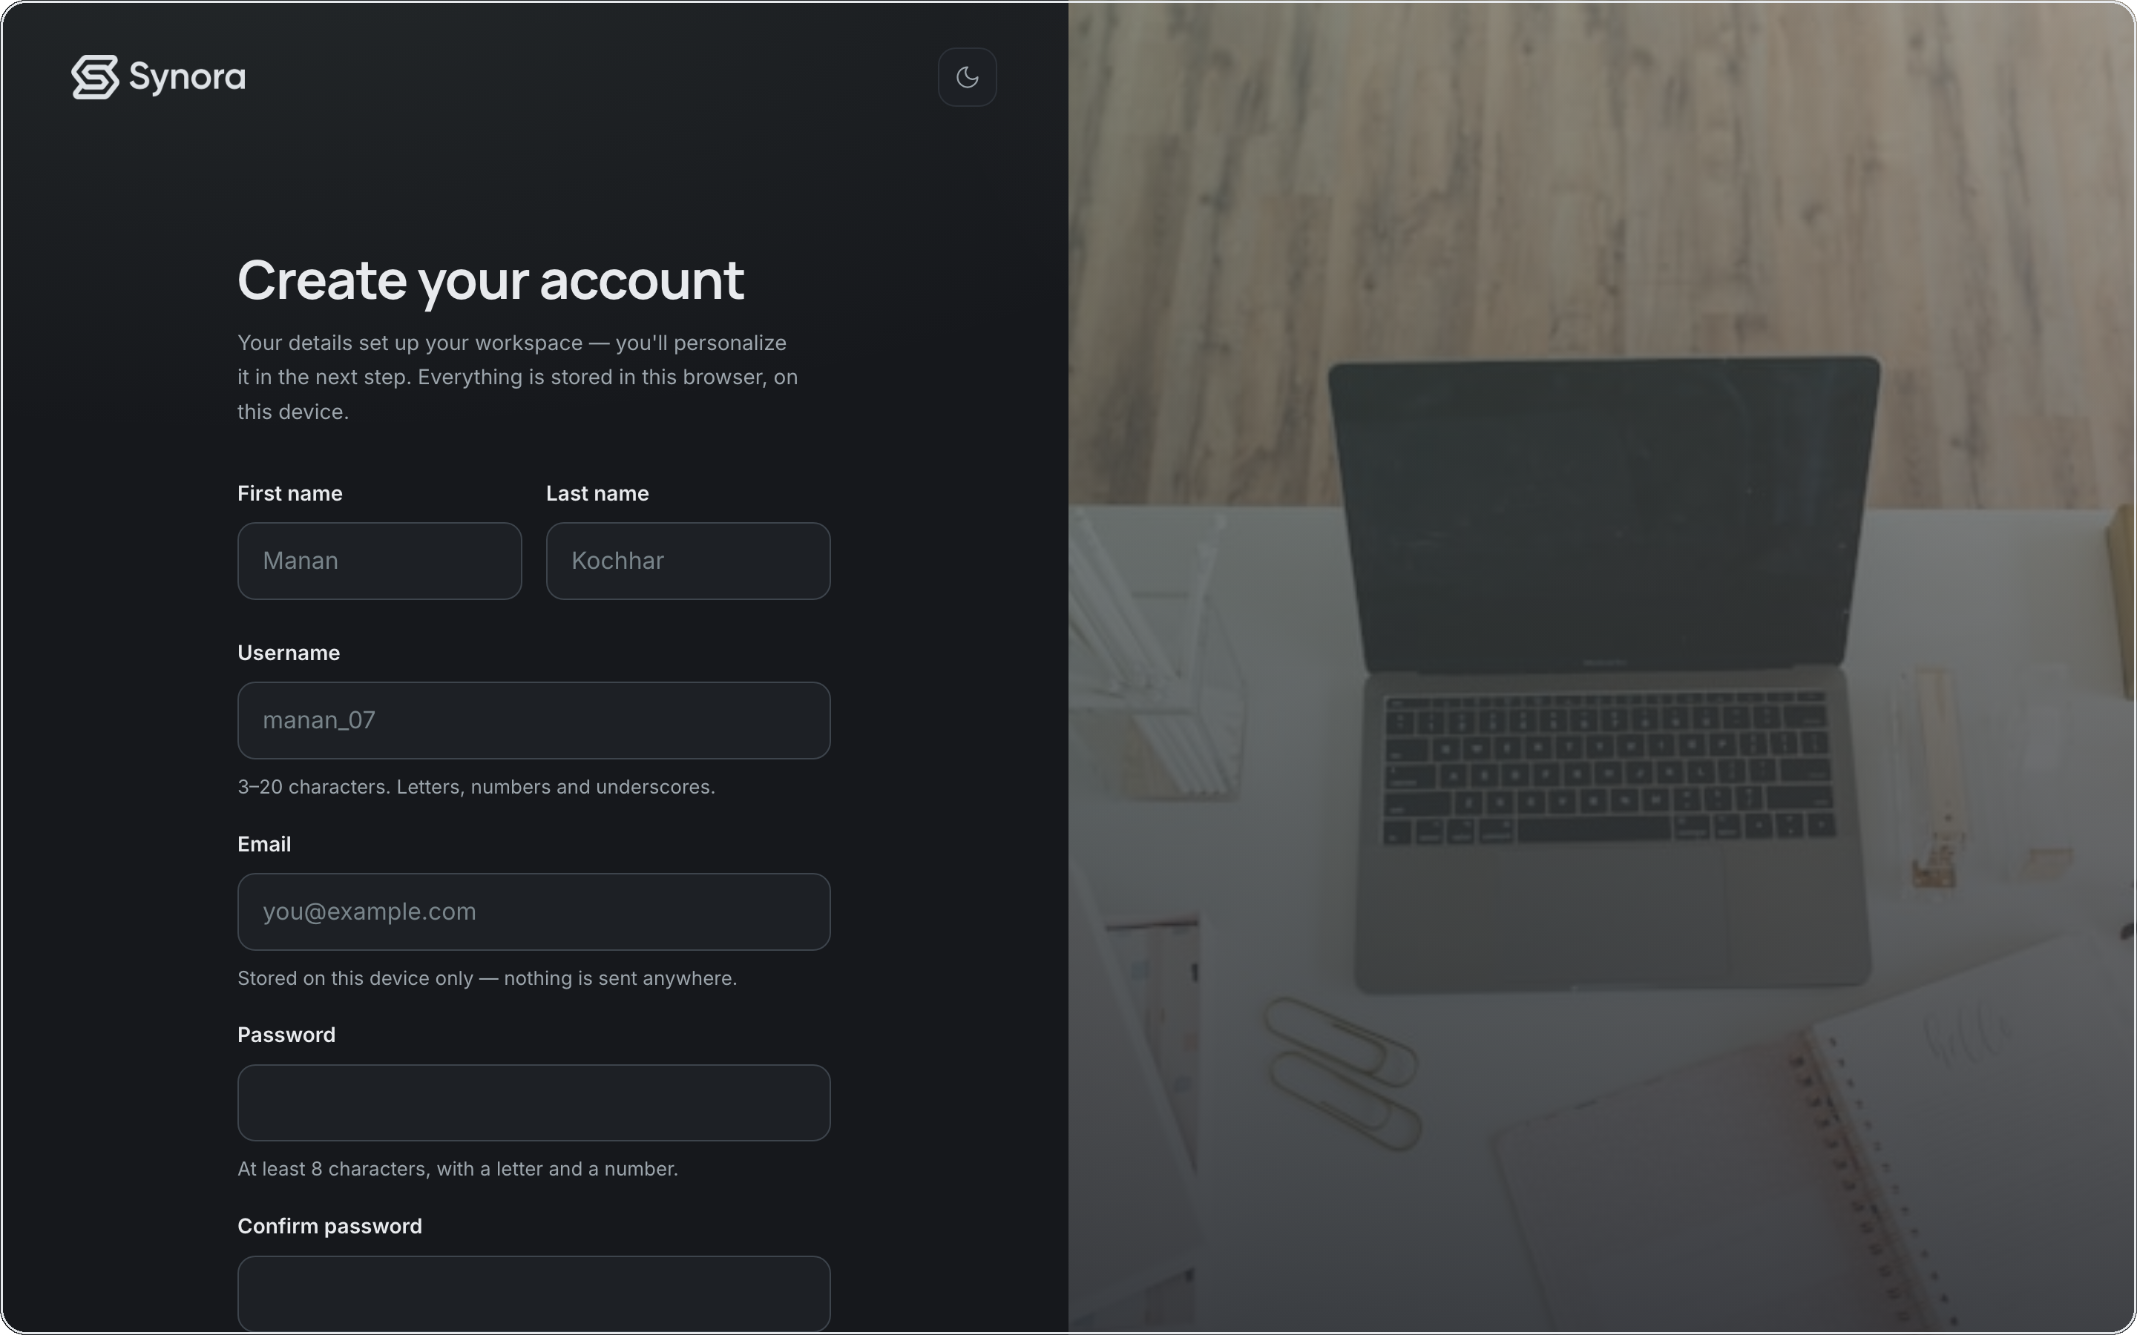
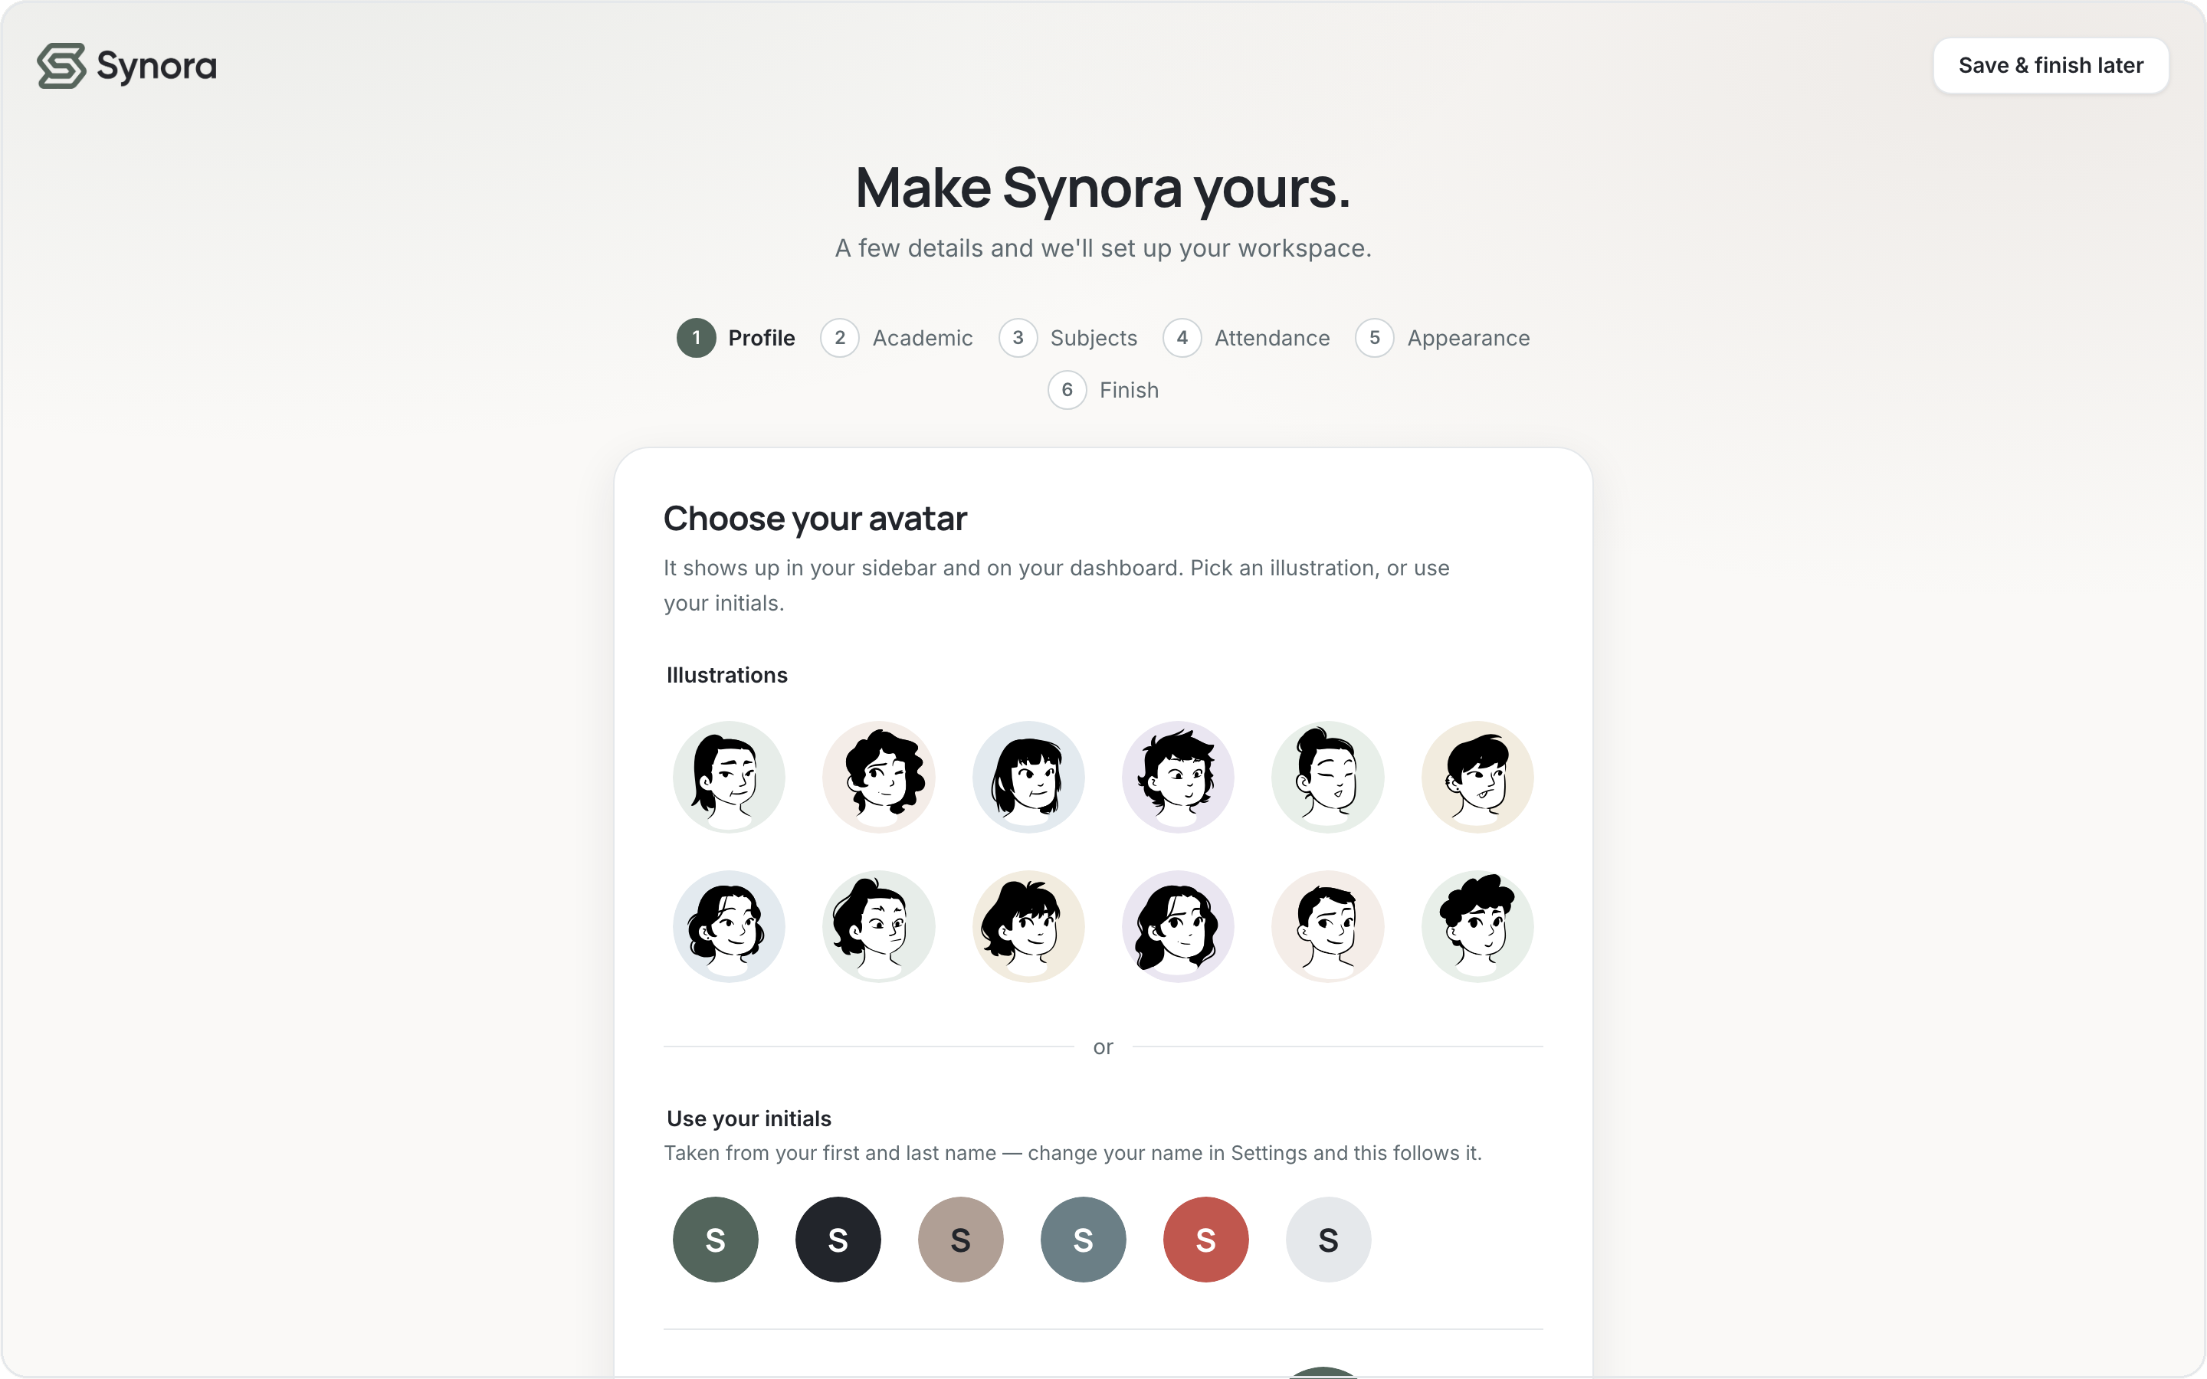
03 · HTML5
User journey: landing to workspace
Five HTML pages, one continuous flow — structure and links carry the user through.
index.html
signup.html
onboarding.html
dashboard.html
Landing
Sign up
Personalize
Dashboard
Each page is a self-contained HTML document; anchors and links move between them, and the same navigation structure repeats so the product feels like one continuous space.
Notes:
Walk the flow: landing → sign up → personalize → dashboard. Emphasise that HTML provides the page structure and navigation that stitches the journey together.

Slide 10





03 · HTML5
The landing page
index.html
Hero
headline + product preview
Navbar
centred links + theme + auth
Features / How it works
semantic sections with IDs
FAQ (CSS-only)
accordion, no JavaScript
Contact
a real, validated form
Hero, navigation and marketing sections.
Footer
links + sitemap
Notes:
The landing page is built from labelled <section> blocks with anchor navigation. Notably the FAQ accordion and mobile menu are pure CSS (a hidden checkbox) — no JS. Contact is a real validated form. Viva: which parts need no JavaScript? The menu and FAQ.

Slide 11
03 · HTML5
The account flow
1. Sign up
first & last name, username, email, password
│
2. Confirmation
account created, stored on this device
│
3. Personalize
the onboarding wizard sets up the workspace
│
4. Dashboard
the populated product
app/signup.html — one form, the right input type per field.
Input types — text, email, password — give the right keyboard and the browser's first layer of validation.
Notes:
Sign up collects first/last name, username, email, password + confirm. Each field uses the correct input type (email/password), which sets the keyboard and gives the browser's native validation. Then confirmation → personalization → dashboard.

Slide 12

03 · HTML5
Personalization: building the workspace
Profile
avatar illustration or initials
Academic
program + semester
Subjects
name, credits, track attendance?
Attendance
target percentage
Appearance
app/onboarding.html — a six-step wizard of HTML form controls.
light or dark theme
Notes:
Onboarding is a wizard of HTML form controls — radio-style avatar picker, selects for program/semester, repeatable subject rows with a checkbox for attendance tracking, a number input for the target, and a theme choice. This is where each user's workspace is shaped.

Slide 13
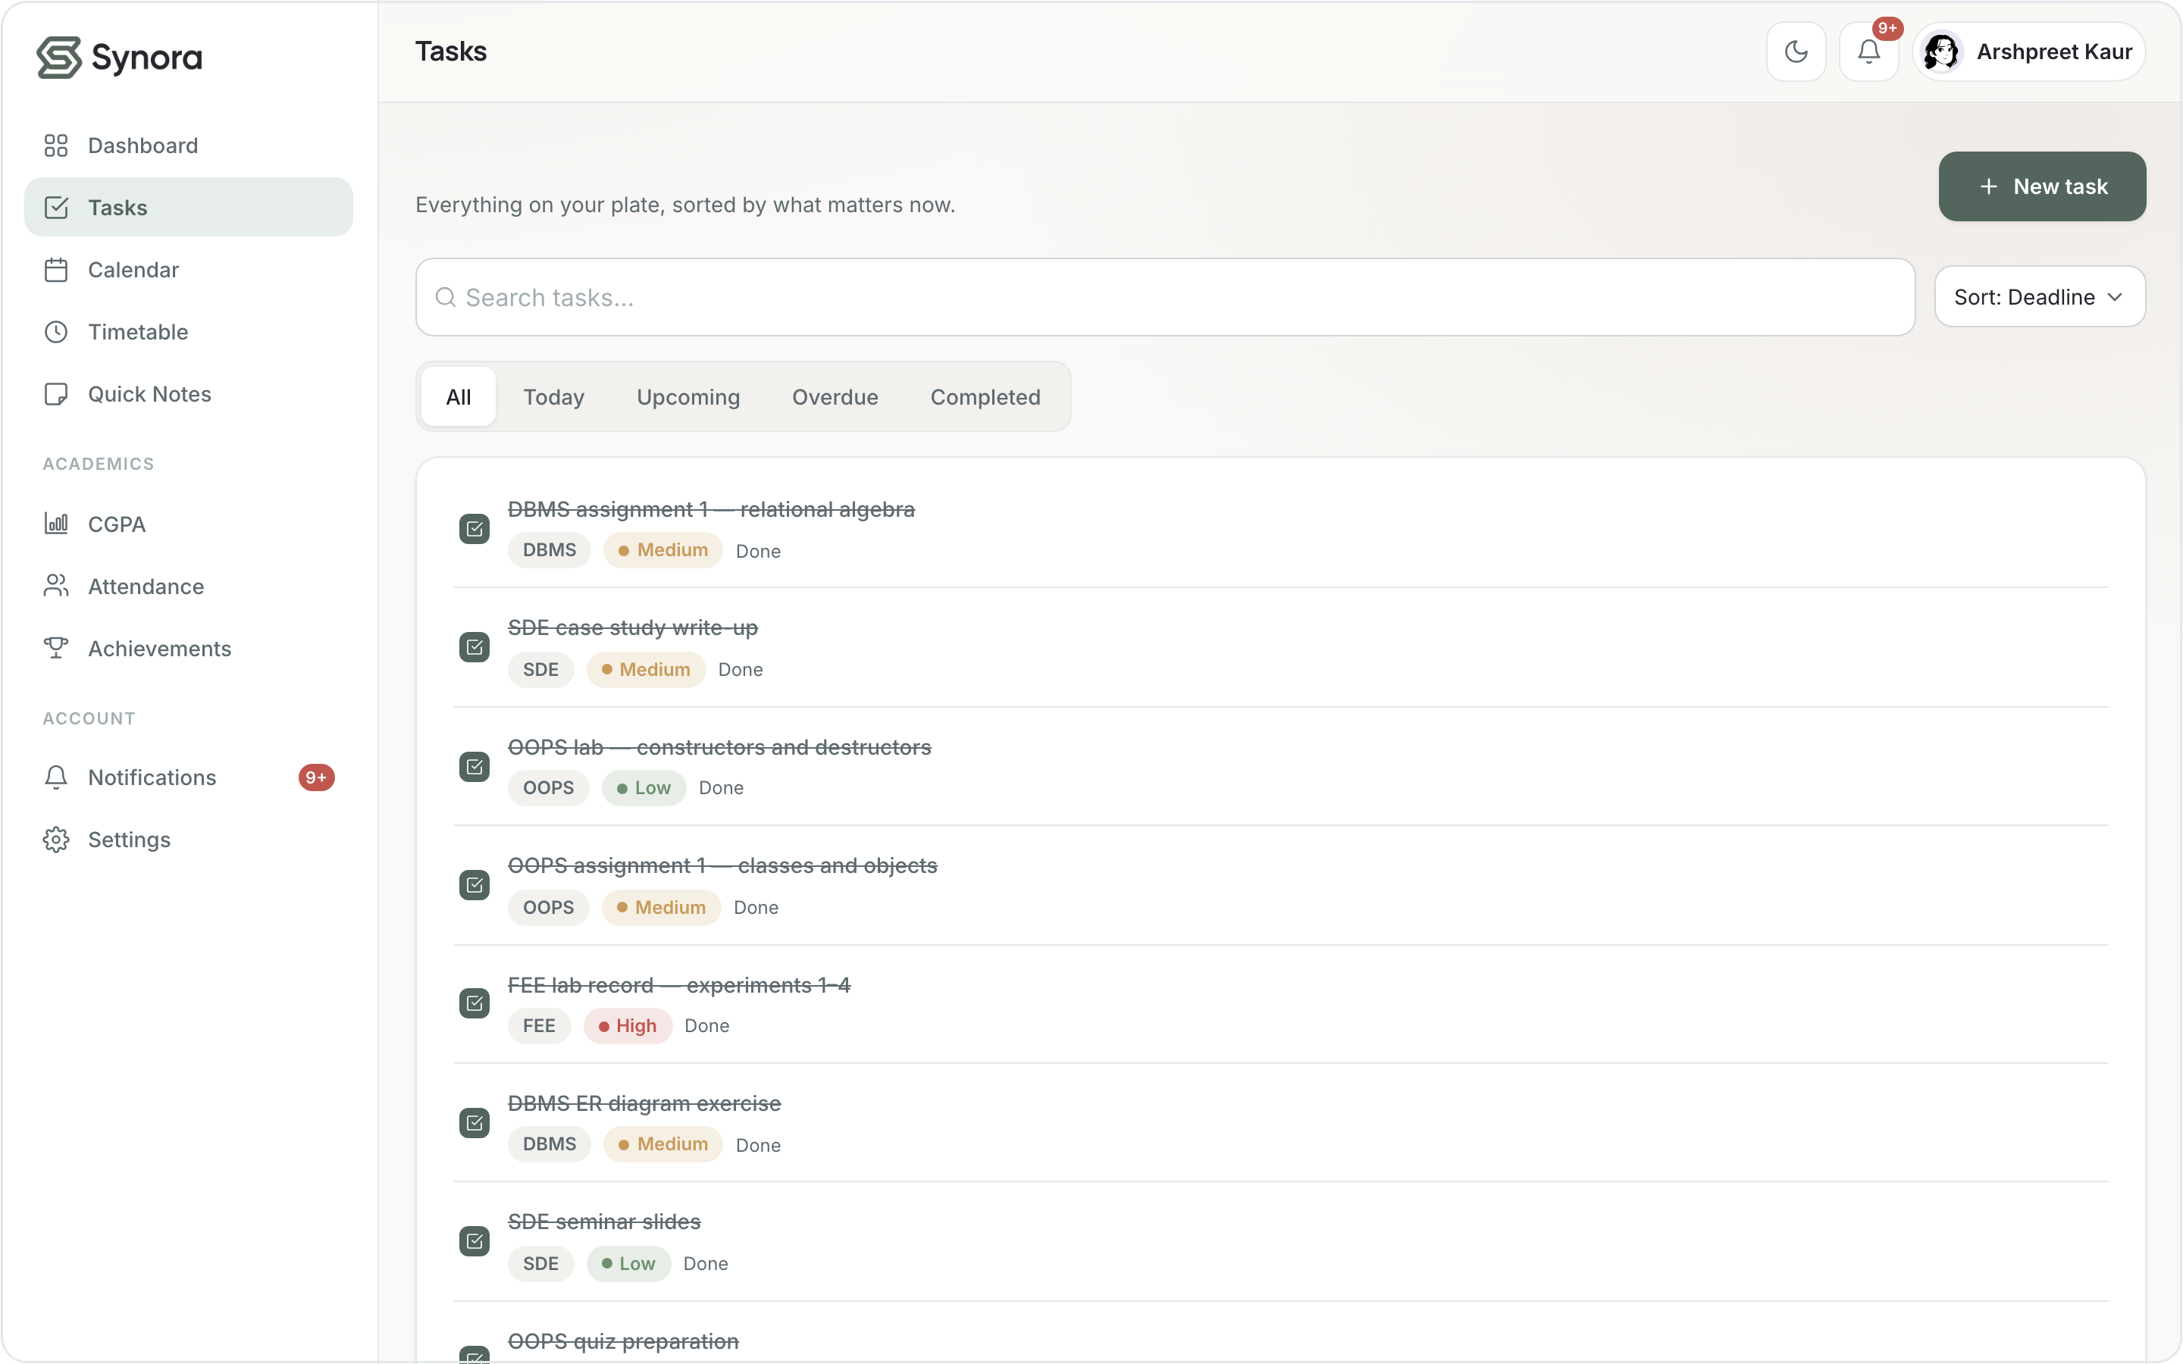
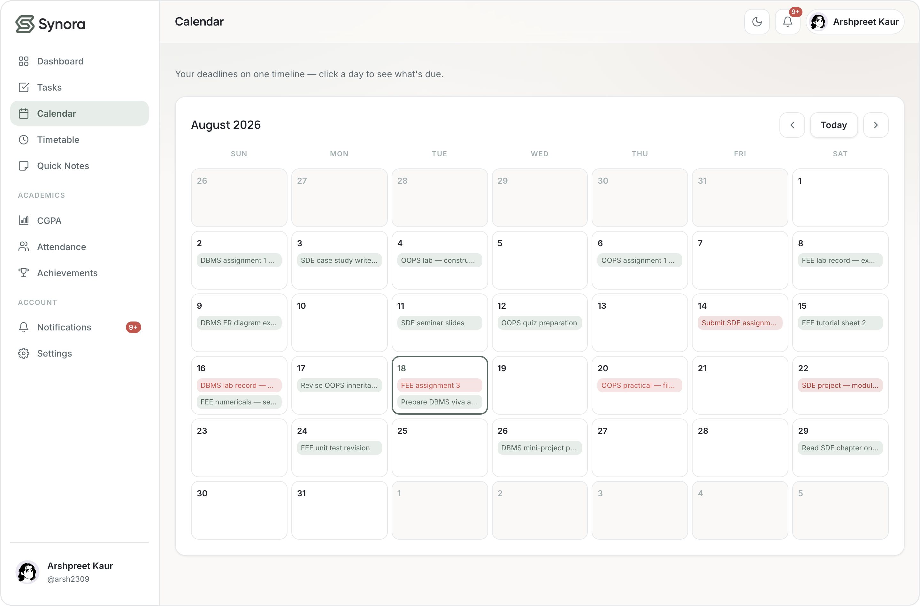
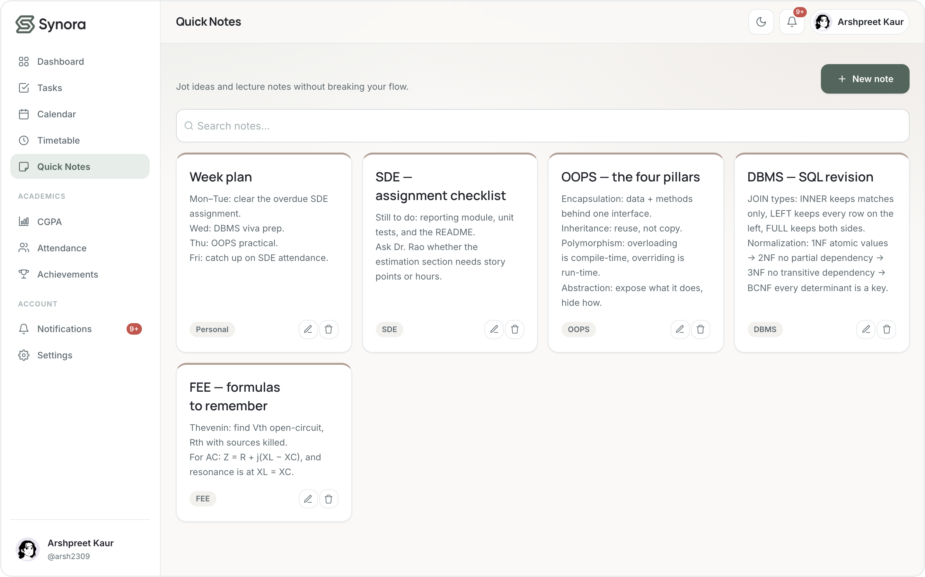

03 · HTML5
Feature walkthrough — Productivity
tasks.html
calendar.html
notes.html
Tasks
Calendar
Quick Notes
Create, prioritise, complete — filtered by today / upcoming / overdue
Every deadline on one timeline; click a day to see what's due
Jot lecture notes as cards, tagged by subject
Structured HTML — lists, cards, forms and controls — gives each feature its shape.
Notes:
Productivity trio: Tasks (priorities + filters), Calendar (deadline timeline), Quick Notes (subject-tagged cards). Each is structured HTML — lists, cards, forms — before any styling or scripting.

Slide 14
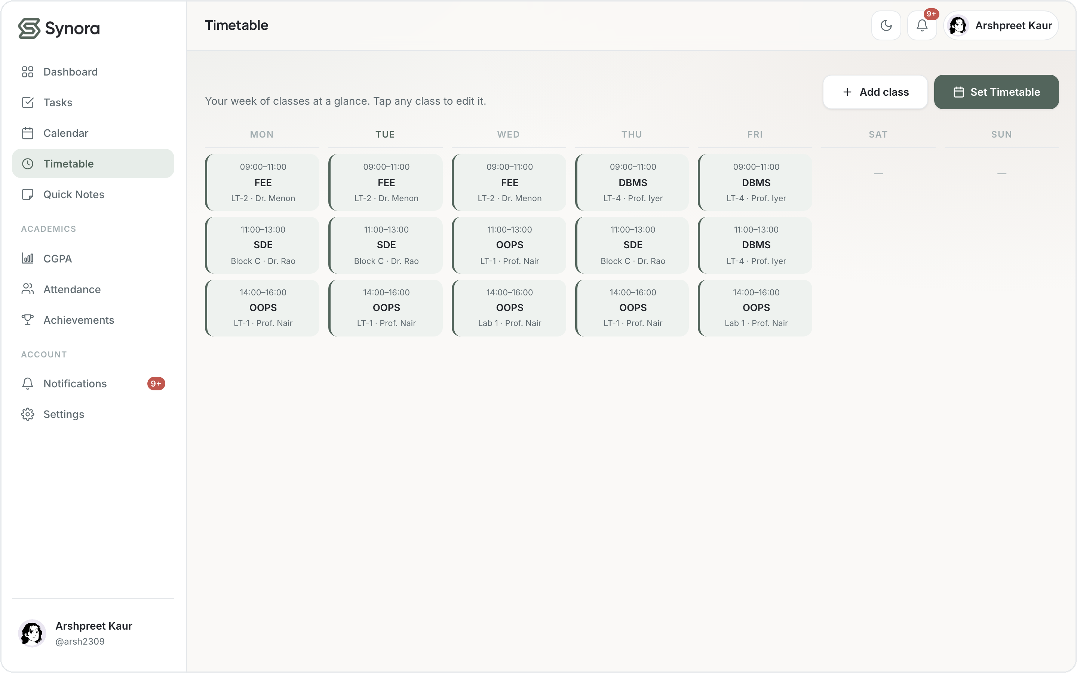
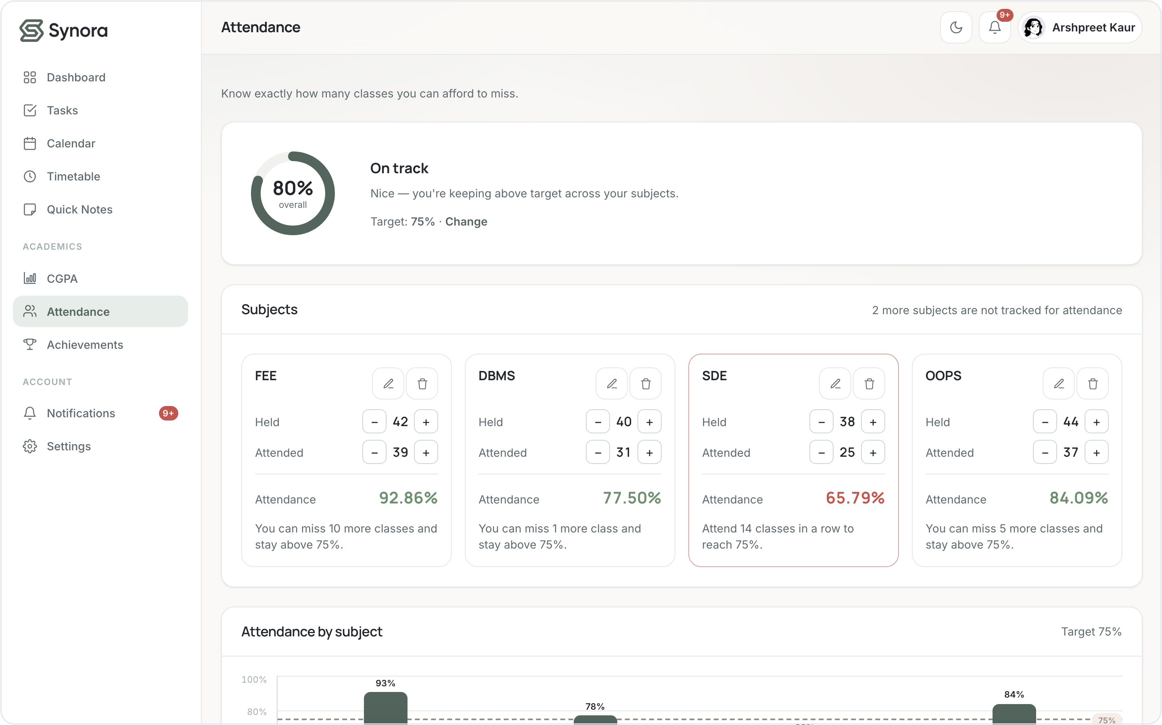
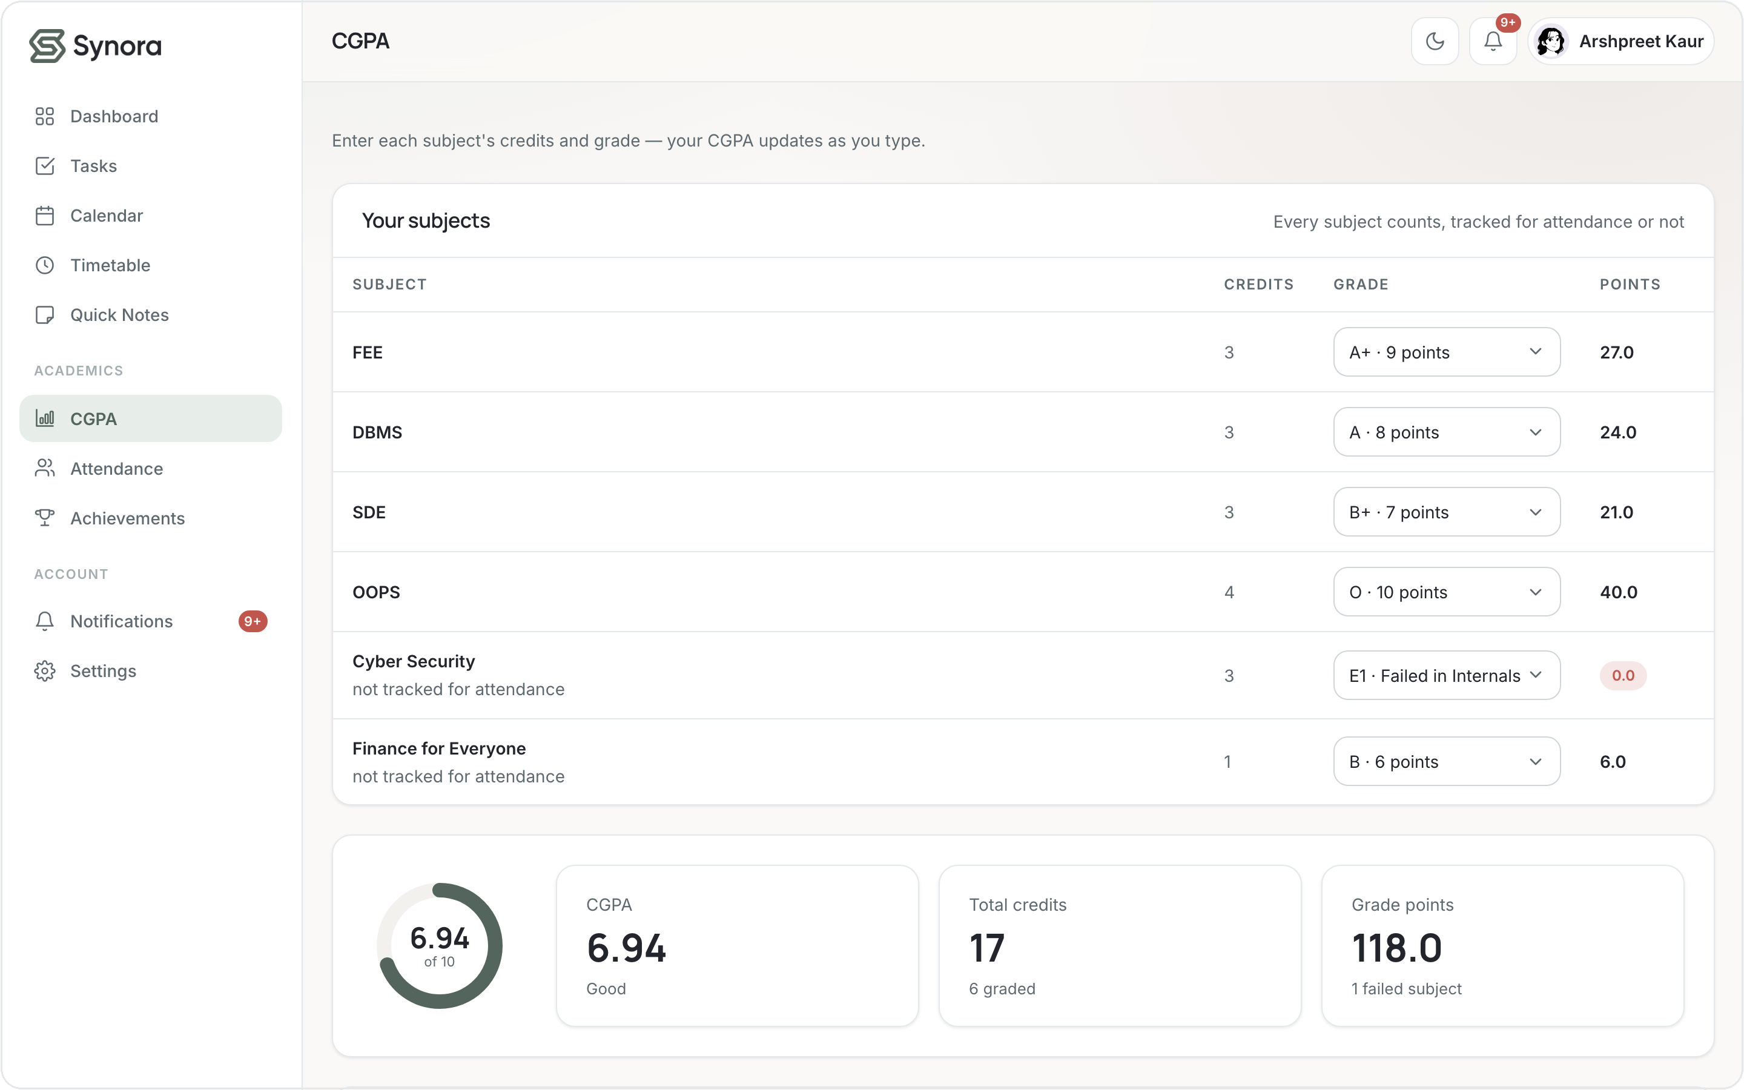
03 · HTML5
Feature walkthrough — Academic tools
timetable.html
attendance.html
cgpa.html
Timetable
Attendance
CGPA
Your week of classes as an editable grid
How many classes you can still miss, per subject
Live 10-point GPA as you enter credits and grades
Cards, labels, form controls and chart containers structure the academic data.
Notes:
Academic trio: Timetable (weekly grid), Attendance (how many classes you can skip and stay above target), CGPA (live 10-point calculator). Note the labelled cards and the chart containers that JS later fills.

Slide 15
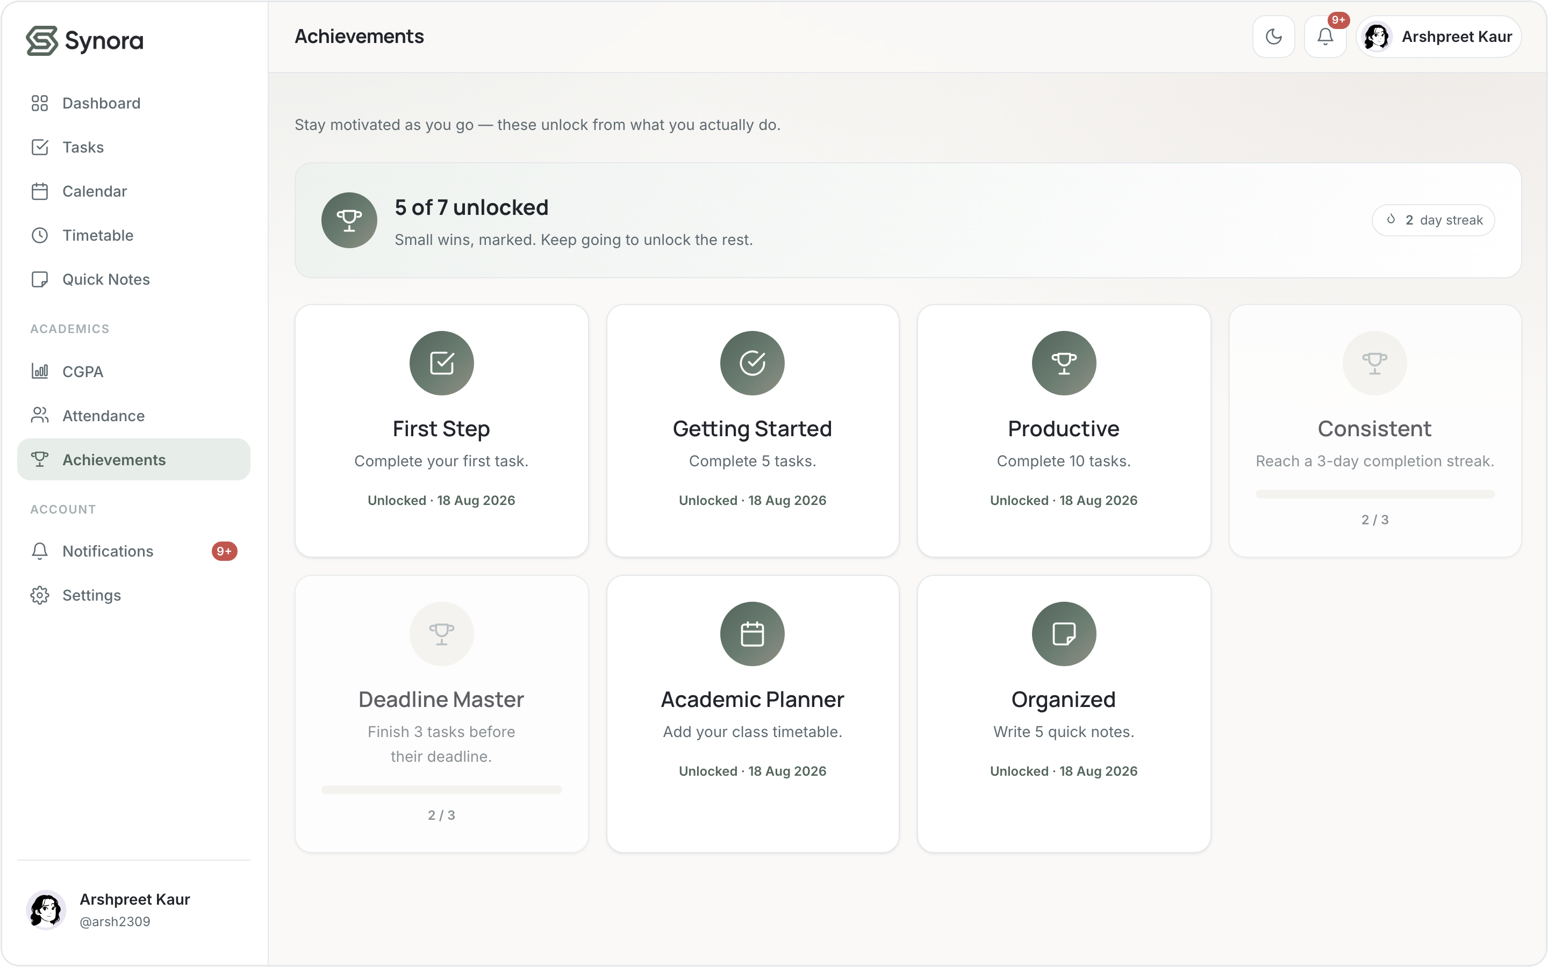
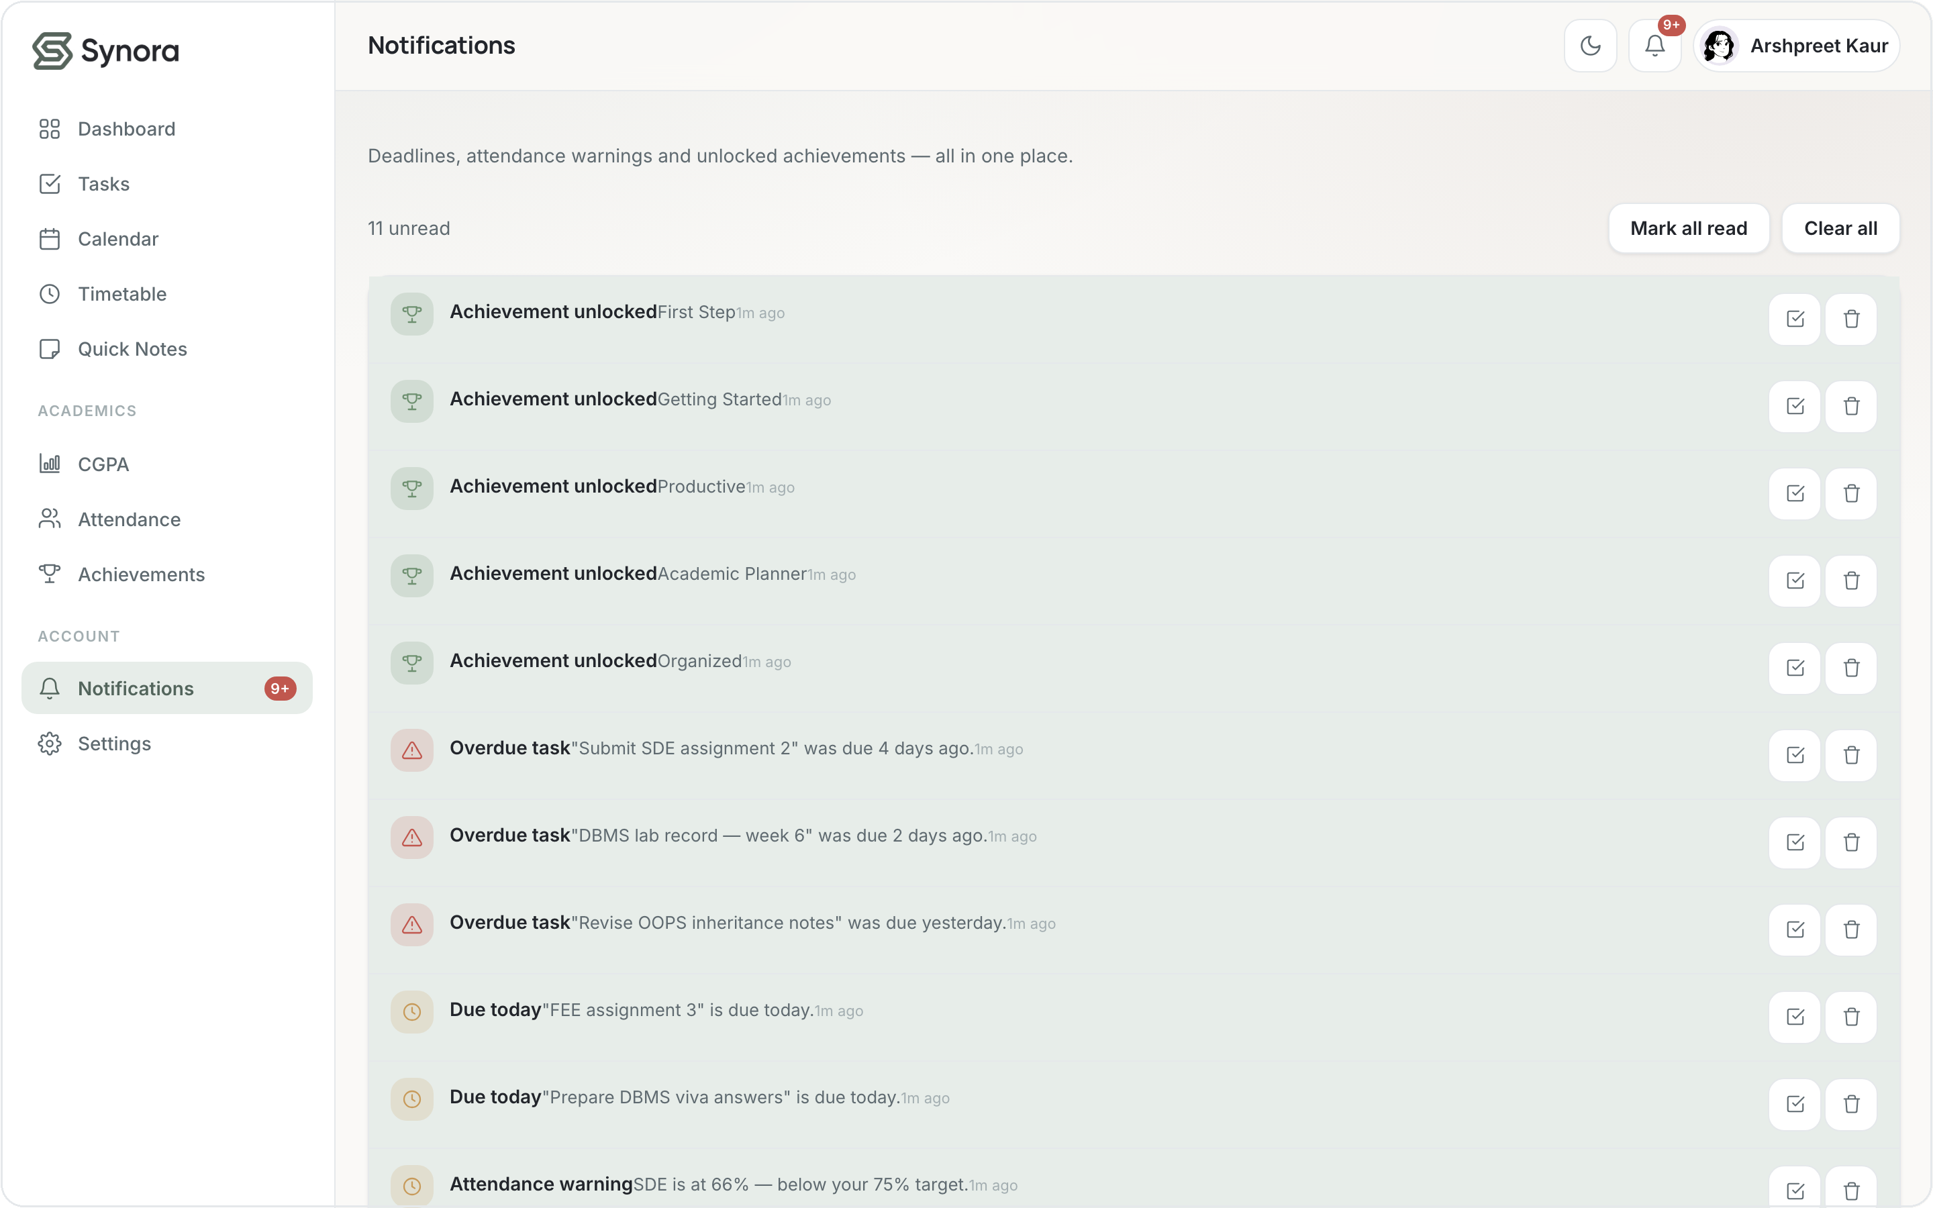
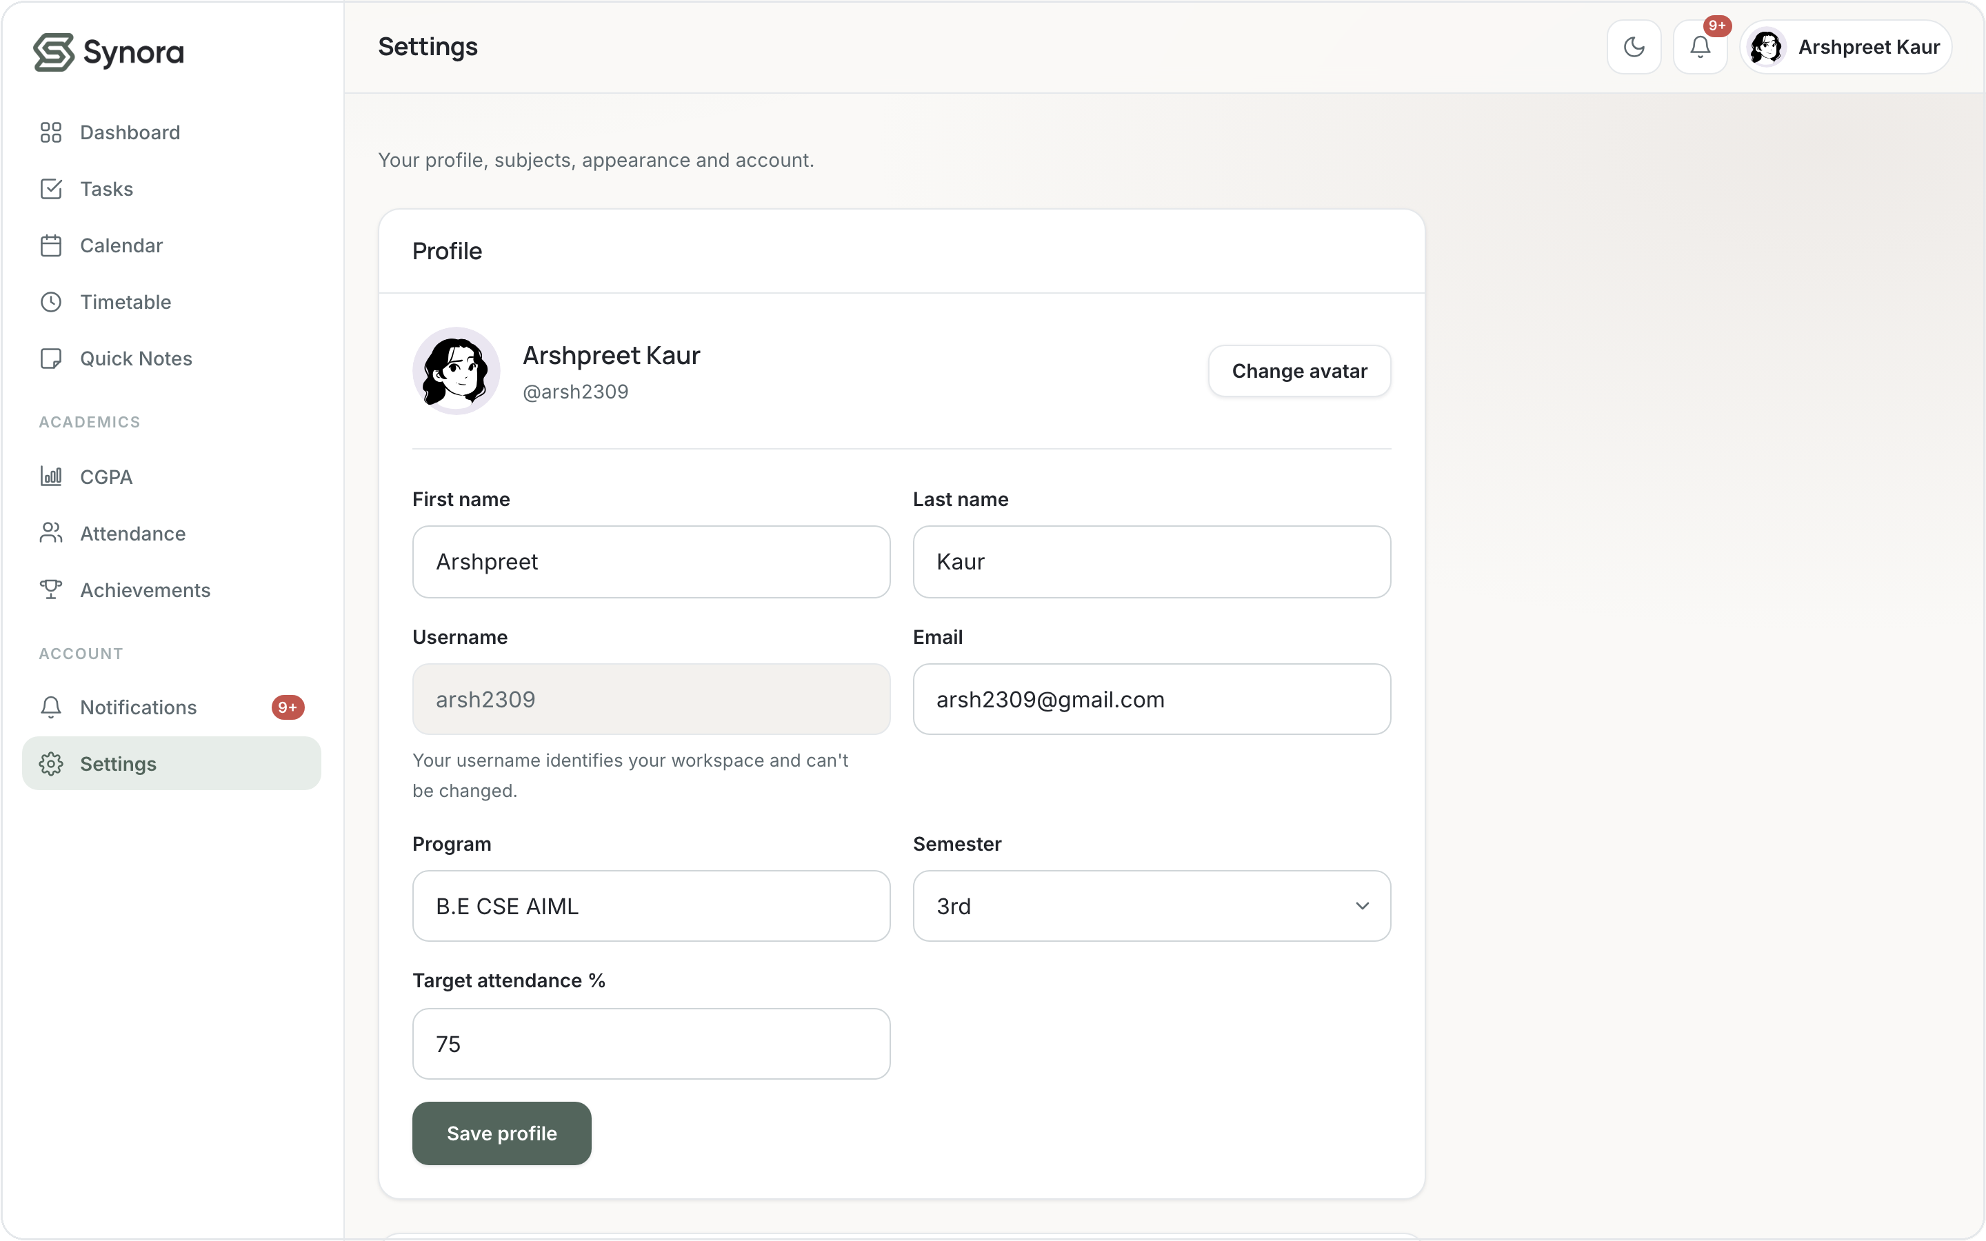


03 · HTML5
Feature walkthrough — Progress & account
achievements.html
notifications.html
settings.html
Achievements
Notifications
Settings
Small wins unlock as you actually use Synora
Deadlines, attendance warnings and unlocks in one place
Profile, subjects, appearance and account
Status indicators, controls and structured lists — all built from semantic HTML.
Notes:
Progress + account trio: Achievements (gamified milestones), Notifications (reconciled deadline/attendance alerts), Settings (edit profile/subjects/theme). Structured lists and controls throughout.

Slide 16


03 · HTML5
Forms & accessibility
Labelled inputs
16 <label> elements — clicking a label focuses its field
ARIA where it helps
91 aria-* attributes — labels, live regions
Right input types
email, number, date, password adapt the keyboard
Alt text
18 alt attributes; decorative art marked aria-hidden
Keyboard-friendly
Settings — every field has a real <label> and the right input type.
a skip-link and a .visually-hidden pattern
Notes:
Honest framing: accessibility BASICS, not certified WCAG. Genuinely present: 16 labels, 91 aria-*, correct input types, 18 alt attributes, a skip-link and a visually-hidden utility. Viva: what makes a form accessible? Programmatic label-to-input association and correct types.

Slide 17
04 · CSS3
One design system, not many pages
CSS custom properties define the visual language once — 120+ design tokens (85 unique) for colour, type, spacing, radius and shadow, reused across every page so the product feels like one system.
Ink
Sage
Slate
Mist
Taupe
Same cards, buttons and
spacing tokens on every page.
#22252B
#53655C
#A3AEB1
#E5E8EB
#B09F95
TYPOGRAPHY
REUSED COMPONENTS
Manrope
.btn .card .field .chip
headings · Inter for body
defined once, used everywhere
Notes:
CSS built a design SYSTEM, not per-page styling. tokens.css holds 120+ token definitions (85 unique names); light/dark themes swap the same tokens. Viva: why CSS variables? Single source of truth — change a token, the whole app updates.

Slide 18
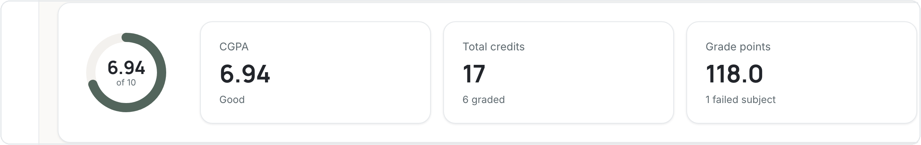
04 · CSS3
The box model behind the interface
margin
styles/app.css — a dashboard stat card
border
.stat-card {
padding: 20px 24px; /* space inside */
background: var(--color-surface);
border: 1px solid var(--color-border);
border-radius: var(--radius-lg);
box-shadow: var(--shadow-sm);
}
padding
content
content → padding → border → margin
Those same tokens build every card — here, the CGPA summary row:
Notes:
Every card is a box. .stat-card sets padding (space inside), a 1px border, rounded corners and a soft shadow — all via tokens. Viva: name the four box-model layers inside out — content, padding, border, margin.

Slide 19

04 · CSS3
Flexbox — alignment & flow
One-dimensional layout
display: flex
lay children out in a row
align-items: center
vertically centre them
gap
even spacing without margins
flex-wrap: wrap
fold onto the next line when tight
The Tasks toolbar — search, sort and view controls in a flex row.
Used in ~116 rules — top bar, toolbars, button groups, list rows.
Notes:
Flexbox handles one-dimensional rows: the sticky top bar, toolbars, button groups (116 rules). Properties actually used: display:flex, align-items, gap, flex-wrap. Viva: flex vs grid? Flex = one axis, grid = two.

Slide 20
04 · CSS3
Grid — structuring the layouts
Two-dimensional layout
Rows & columns
the calendar is 7 columns × N weeks
Dashboard cards
auto-fitting stat grid
Notes masonry
cards flow into a responsive grid
styles/app.css
The calendar — a true two-dimensional grid of seven columns.
.cal-grid {
display: grid;
grid-template-columns:
repeat(7, minmax(0,1fr));
}
Used in ~51 rules for every structured, two-dimensional layout.
Notes:
Grid handles two-dimensional structure (51 rules): the 7-column calendar, the dashboard's auto-fit stat cards, the notes masonry. Viva: why Grid for the calendar? It's a genuine rows × columns arrangement.

Slide 21
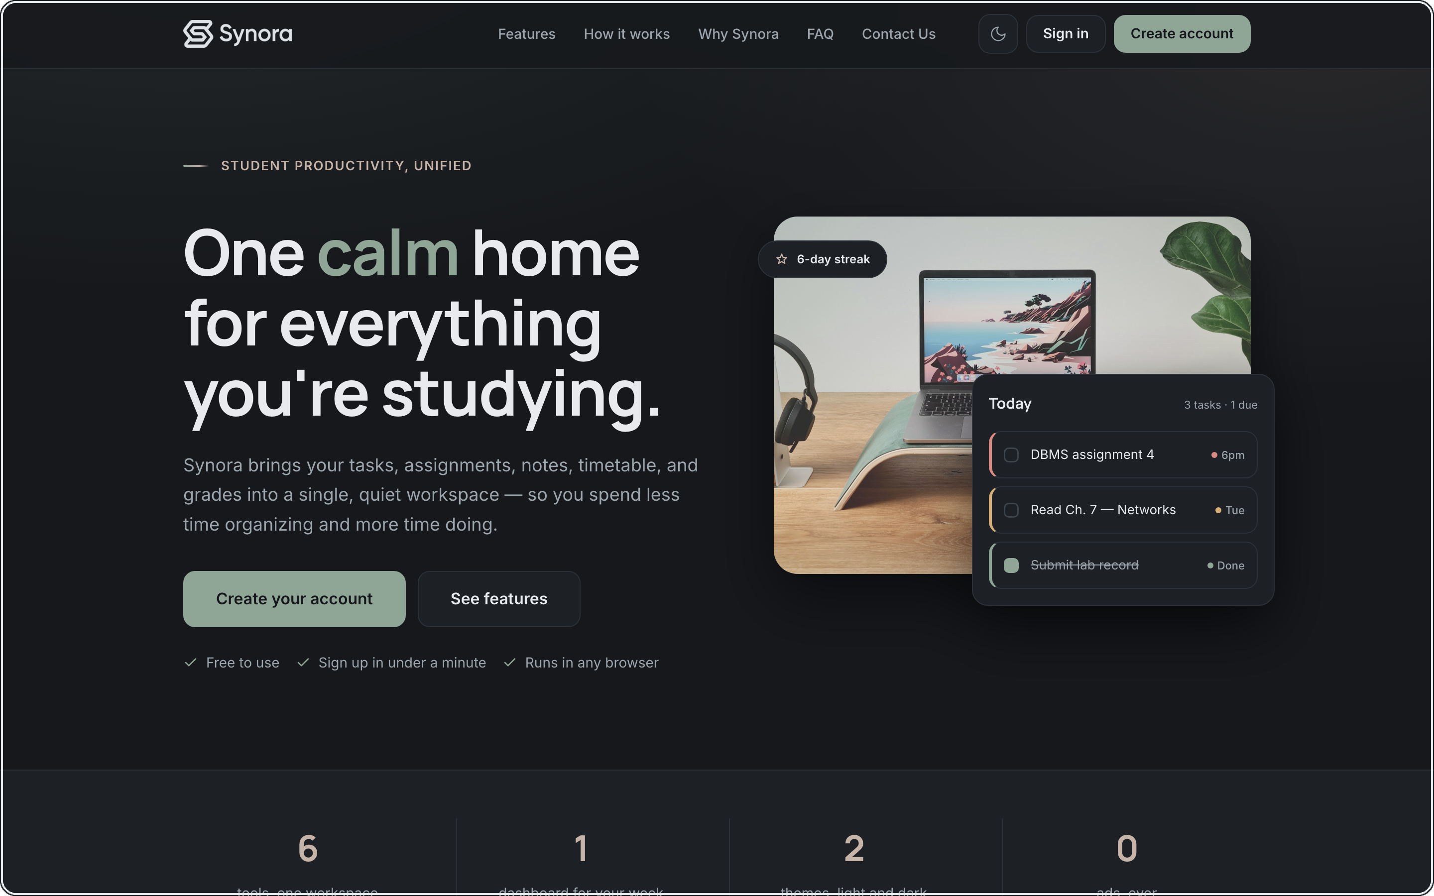
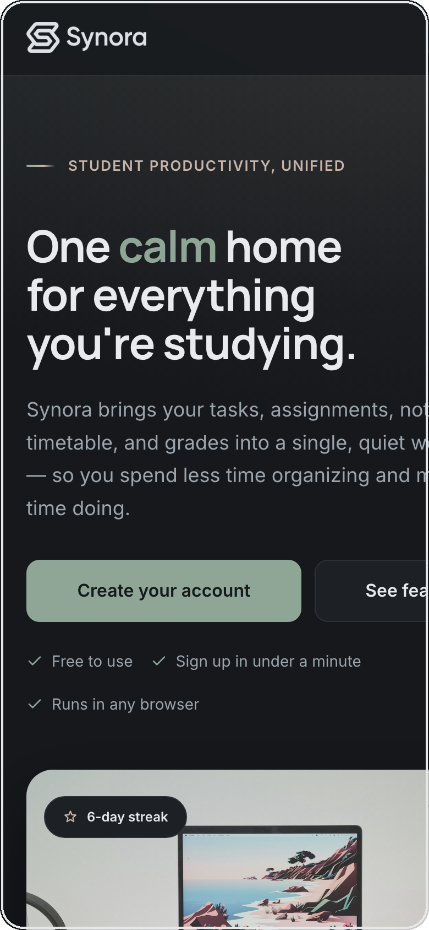
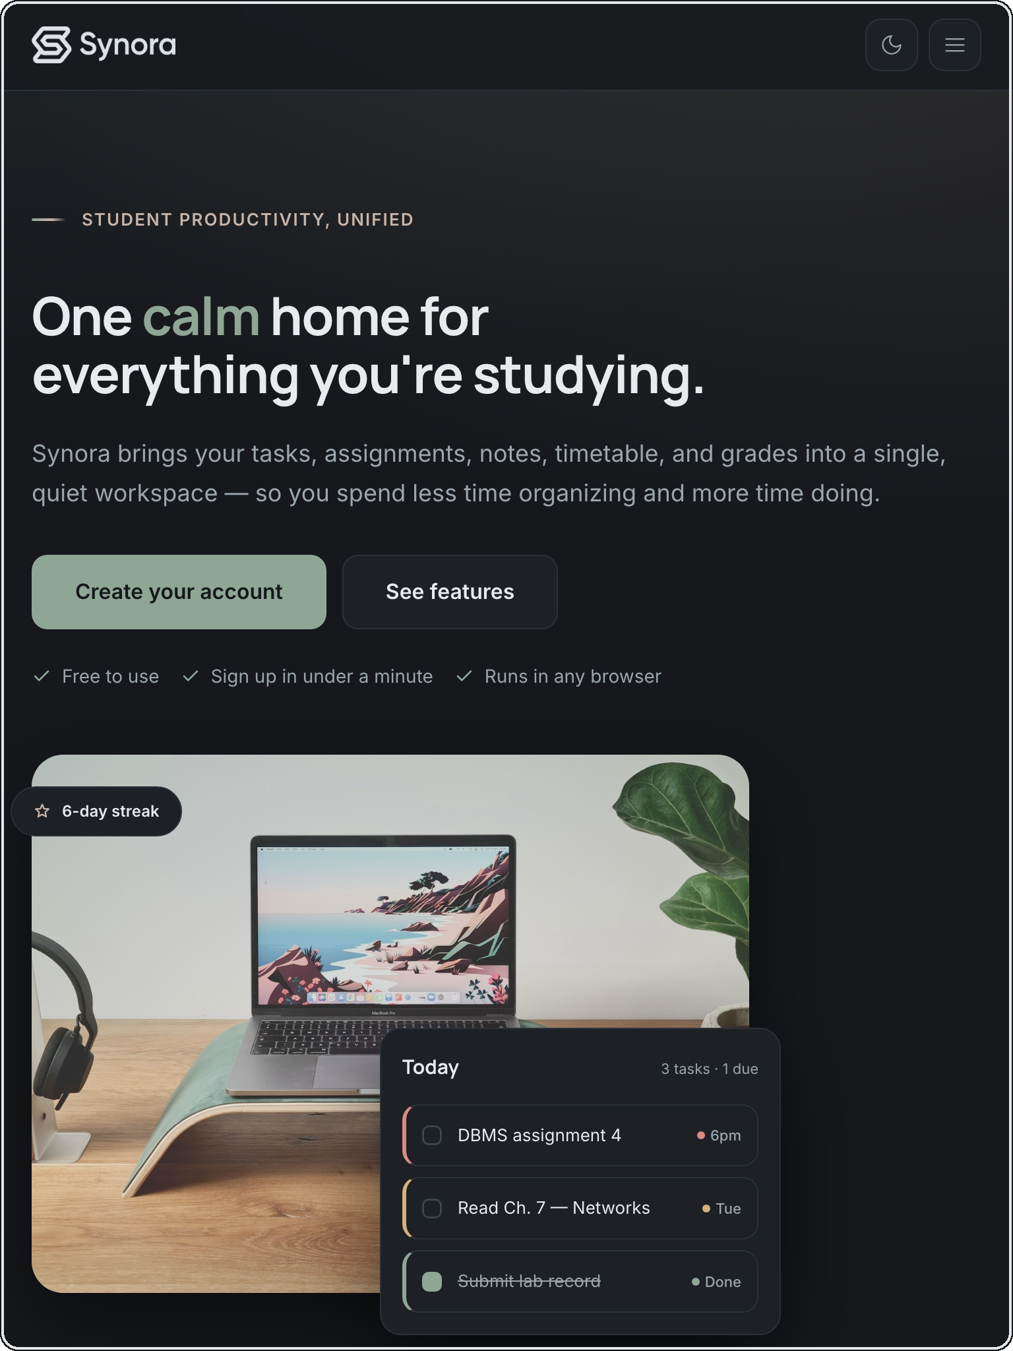
04 · CSS3 · RESPONSIVE DESIGN
One Synora, every screen
1440px · Desktop
768px · Tablet
390px · Mobile
Same landing page — Flexbox + Grid reflow, 23 media-query blocks adapt down, and the nav collapses to a CSS-only menu.
Notes:
Mandatory responsive proof — the SAME landing page at 1440/768/390. The grid hero collapses to one column, buttons go full-width, the navbar becomes a hamburger. Strategy is desktop-first: 23 media-query blocks adapting DOWN. The menu is pure CSS.

Slide 22
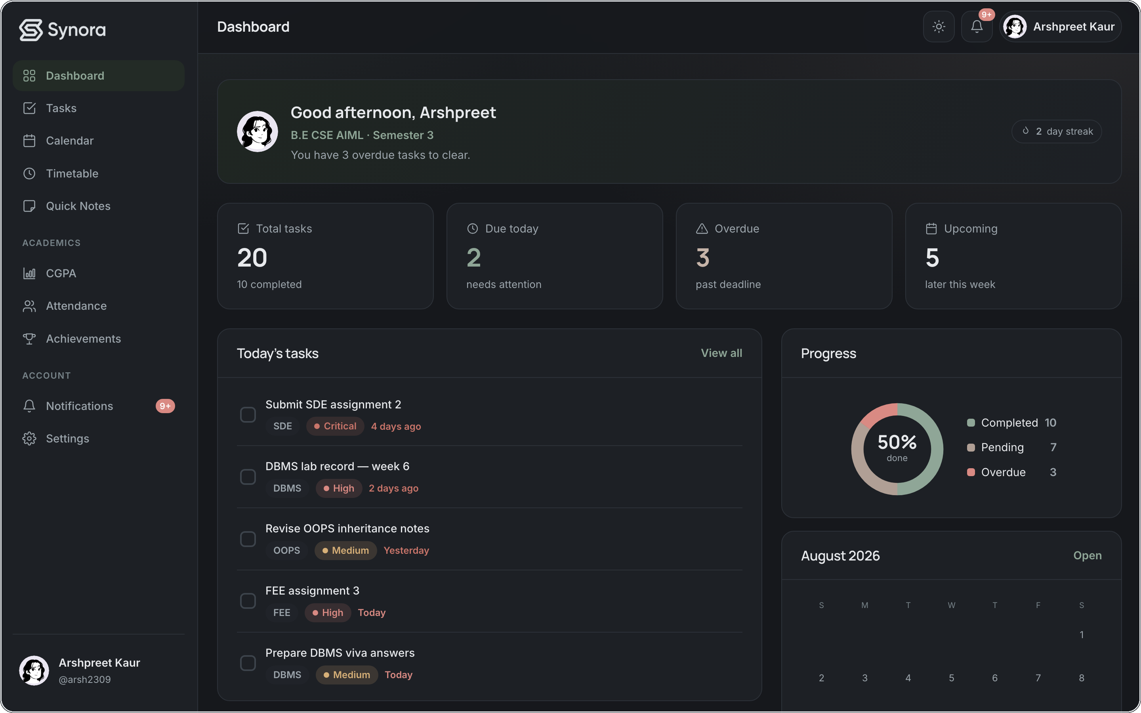
04 · CSS3
Dark mode & theming
Light
Dark
scripts/theme.js
Same tokens, two themes.
data-theme on <html> swaps every token; the choice is saved to localStorage and applied before first paint — no flash.
var saved = localStorage.getItem("synora-theme");
root.setAttribute("data-theme", theme); // CSS reacts
Notes:
Theming = one attribute. theme.js reads matchMedia for the system preference, lets the saved choice win, sets data-theme on <html>, and the CSS custom properties do the rest. It runs in <head> before first paint so dark-mode users never see a white flash. Persisted in localStorage.

Slide 23
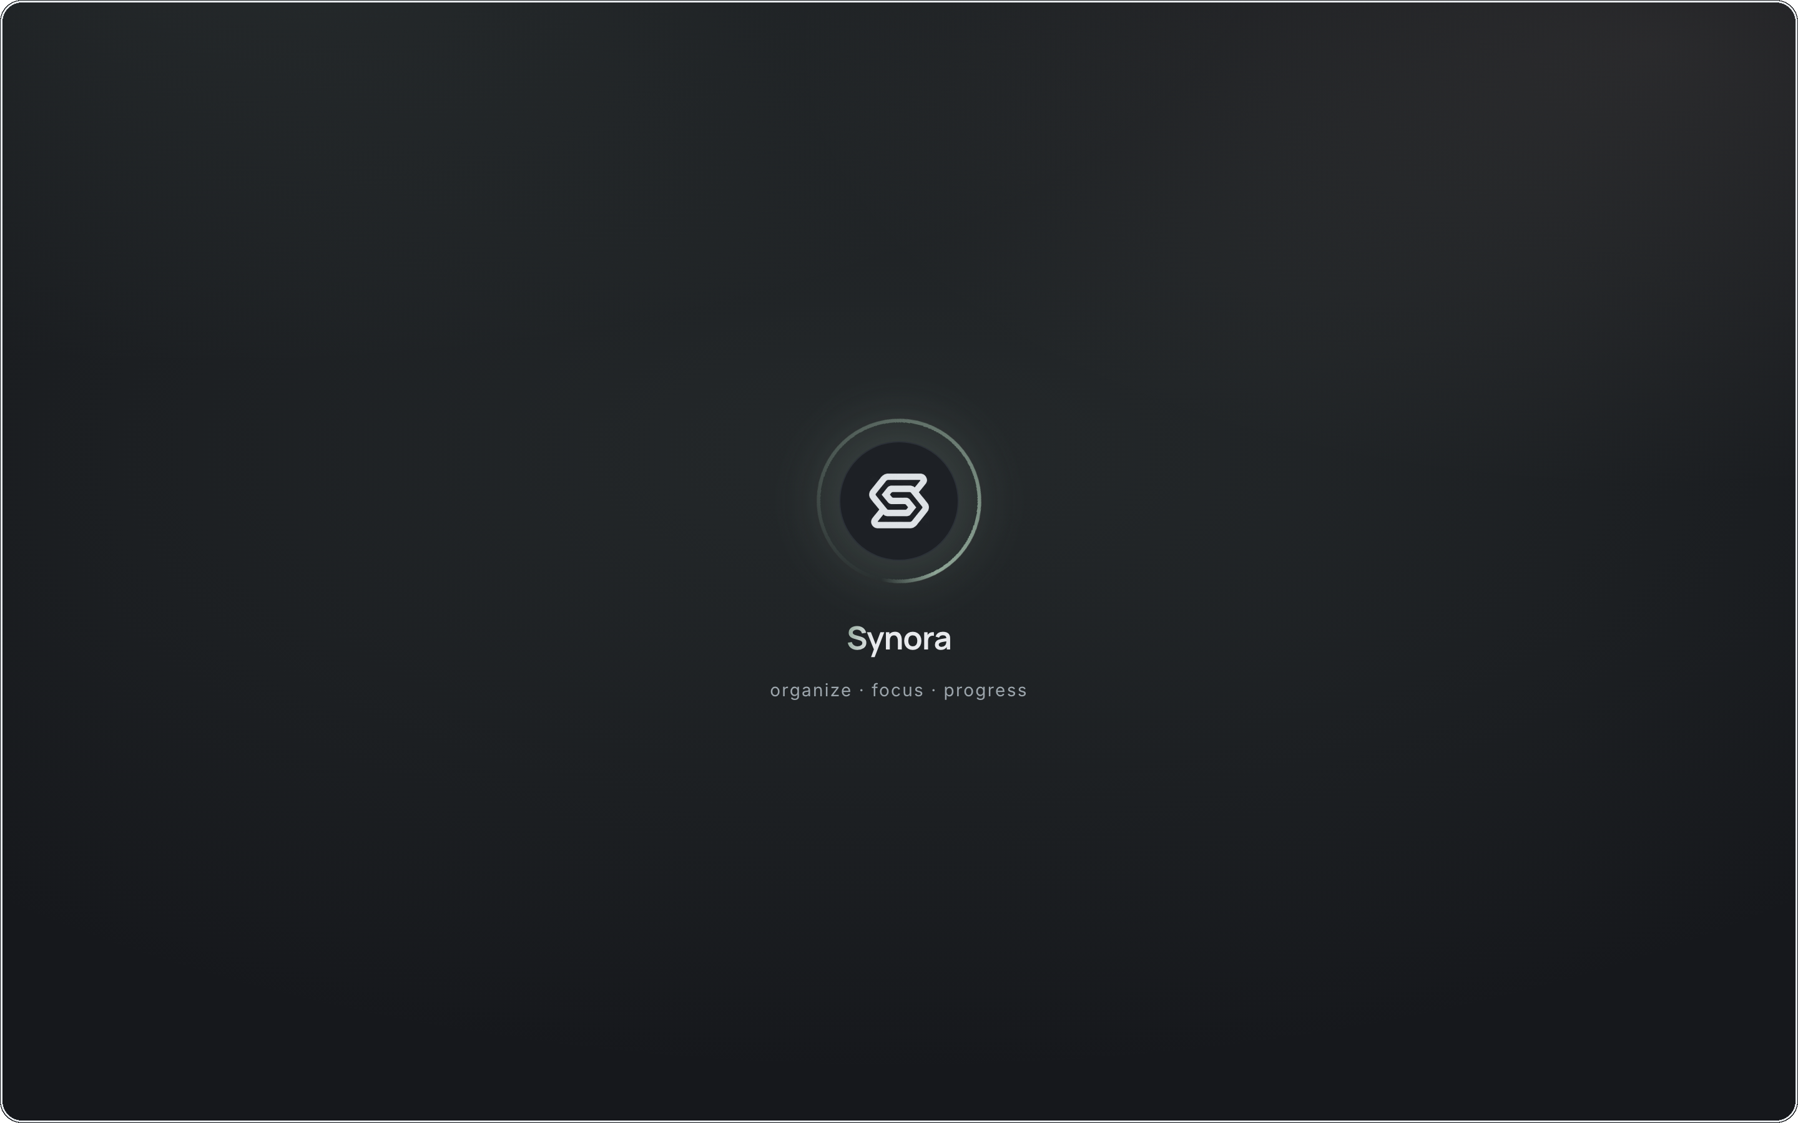

04 · CSS3 · USER EXPERIENCE
Before Synora appears
THE FLOW
Splash
logo, ring & wordmark animate in
Handover
the splash fades and lifts away
Landing
the hero arrives underneath
HOW IT WORKS
CSS @keyframes — pure-CSS animation
The Synora splash — logo, ring and wordmark.
JavaScript timing — shows ≥ 2000ms, then loader.remove()
Reduced motion — honoured — 600ms, no animation
Notes:
The splash is a real UX feature. Three states — splash, handover, landing. Honest mechanism: the animation is pure CSS @keyframes; JavaScript only controls timing (shows ≥ 2000ms, then removes the node); prefers-reduced-motion is honoured.

Slide 24
05 · JAVASCRIPT
Making Synora interactive
HTML and CSS render the page — JavaScript is what makes it respond. Every click, keystroke and toggle runs code that updates the screen:
You act
Event fires
JS runs
DOM updates
You see it
Tick a task → it completes and the counts drop
Tap +/− → every percentage recomputes live
Toggle the theme → the whole app repaints
Notes:
One clear message: without JS the page is frozen; JavaScript makes it respond. The loop is always the same — you act, an event fires, a handler runs, the DOM updates, you see it change. Three concrete examples: completing a task, recomputing attendance, flipping the theme.

Slide 25


05 · JAVASCRIPT
Fundamentals, mapped to Synora
Variables
hold application state
state = { view, sort, query }
ALL FIVE, ONE FUNCTION
Functions
reusable operations
render() · toggleComplete()
tasks.js
function filtered(){
items = all().slice();
items = items.filter(fn)
.sort(byDate);
return items;
}
Arrays
lists of things
tasks · subjects · notifications
Objects
structured records
{ id, title, priority, deadline }
Loops
render each item
.map() · .filter() · .forEach()
Variables, functions, arrays, objects and loops — together in a few lines.
Notes:
Each fundamental maps to something concrete: state in variables; render/toggleComplete functions; tasks/subjects arrays; each task an object; .map/.filter/.forEach loops. Viva: array vs object? Ordered list vs keyed record.

Slide 26
05 · JAVASCRIPT
The DOM — bridge between JS and UI
The page is a live tree of nodes:
JavaScript selects, reads and writes
document
└── main.page
├── section.toolbar
│ └── input[data-search]
└── div[data-list]
└── div.trow one node per task
scripts/tasks.js
var root = document.querySelector("[data-tasks-page]");
root.querySelectorAll("[data-view]").forEach(…);
el.classList.toggle("is-active", on); // write CSS
el.textContent = value; // write text
Select an element, then read or change its text, its classes (classList toggled ~35×) or its attributes — and the browser repaints instantly. The DOM is the object tree JavaScript reaches through to change what you see.
SELECTORS ACTUALLY USED
querySelector() ×161
querySelectorAll() ×23
getElementById() ×9
Notes:
DOM = the browser's live object tree of the HTML. We select nodes (querySelector 161×, querySelectorAll 23×, getElementById 9×) and read/write text, classes (35×) and attributes. Viva: what is the DOM? A tree of objects representing the document that JS changes live.

Slide 27
05 · JAVASCRIPT
Building the interface dynamically
Data
JavaScript
createElement
appendChild
Rendered UI
scripts/app.js — a node, born and removed
var el = document.createElement("div"); // 1 create
el.className = "toast";
el.setAttribute("role", "status"); // 2 config
region.appendChild(el); // 3 insert
… el.remove(); // 4 delete
Every task row is built from data and rendered into the list the same way — createElement ×18, appendChild ×11, element.remove() ×17.
Tasks — a list rendered node by node.
Notes:
Dynamic UI: data → JS builds nodes → inserts them → removes when done. The toast shows the full lifecycle: createElement → configure → appendChild → remove. Task rows render the same way. Real counts: createElement 18, appendChild 11, remove 17.

Slide 28

05 · JAVASCRIPT
Event handling & delegation
You act
Event fires
addEventListener
Handler runs
DOM updates
addEventListener used ~93× across the app
scripts/tasks.js — event delegation
Event delegation used — .closest() in ~28 handlers
// ONE listener handles every task row (delegation)
container.addEventListener("click", function(e){
var t = e.target.closest("[data-toggle]");
if (t) { toggleComplete(t…); rerender(); }
});
Bubbling used — clicks bubble to the parent list
preventDefault used — forms & links (~11)
Explicit capturing concept only — not a pattern we use
Rows re-render constantly, so one durable listener on the parent beats binding one per button.
Notes:
Honesty slide. USED: addEventListener (93×), delegation via closest (28), bubbling, preventDefault (11). NOT used as a pattern: explicit capturing — say so. Why delegation? Rows re-render, so one parent listener is more robust than per-button ones. Viva: bubbling vs capturing — child→parent vs parent→child.

Slide 29
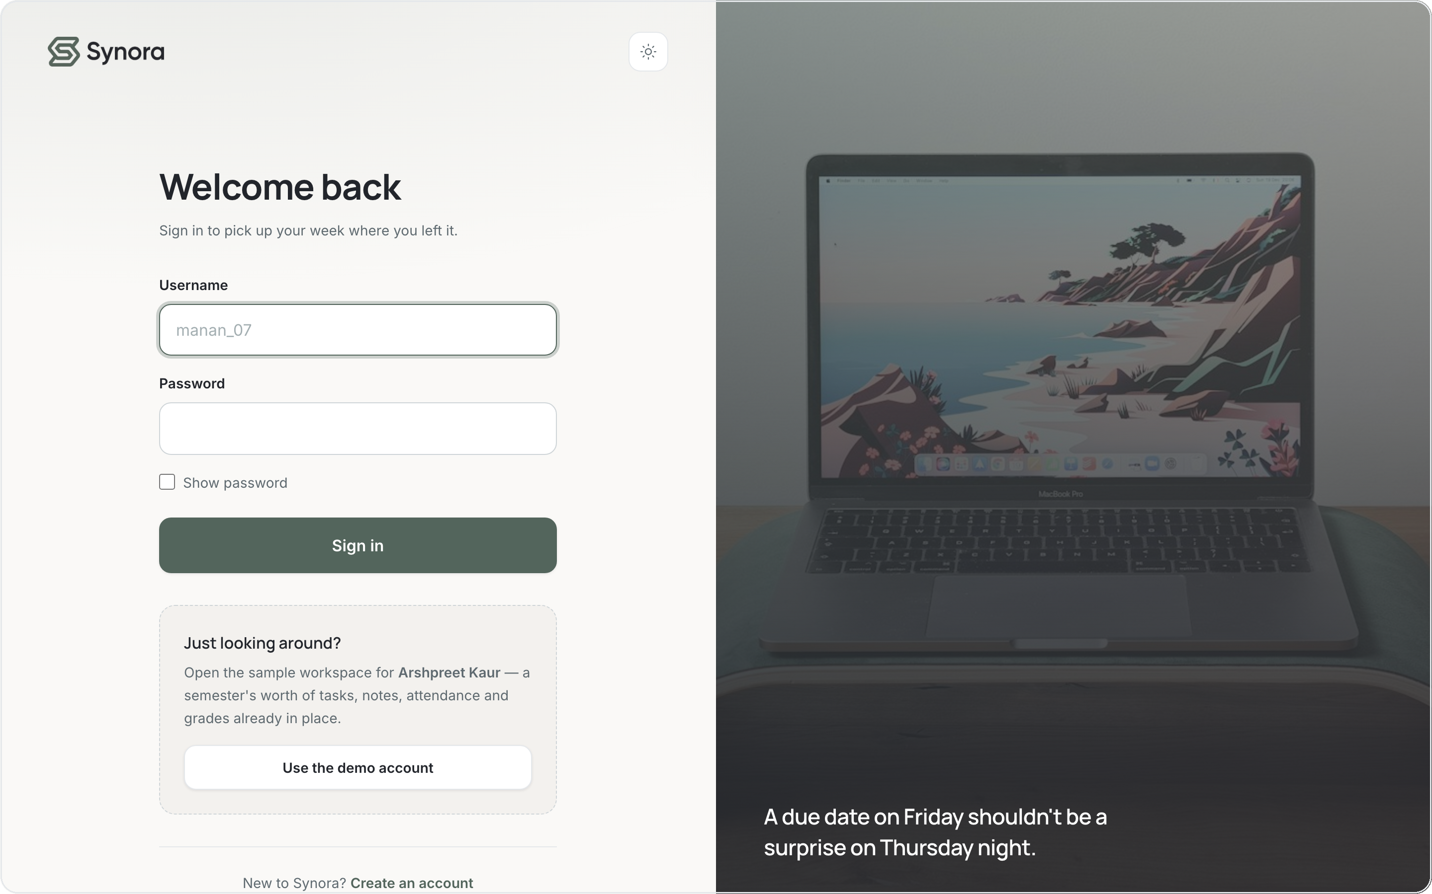

05 · JAVASCRIPT
Forms, validation & interaction
HTML attributes
required, type=email, minlength — the browser's first check
JavaScript on submit
preventDefault(), trim, regex, friendly inline errors
Live error clearing
the message clears the moment the field is fixed
scripts/auth.js
form.addEventListener("submit", function(e){
e.preventDefault(); // stop native submit
if (!EMAIL_RE.test(email))
setError("email", "Check your email.");
});
Sign-in / sign-up validate on submit and clear errors as you type.
Notes:
Validation is layered: HTML attributes first (required/type/minlength), then JS on submit — preventDefault, trim, regex, friendly inline errors that clear live. Viva: why validate in JS if HTML does? Custom messages, cross-field checks (password confirm), UX control.

Slide 30
05 · JAVASCRIPT
Data & persistence
…restored on every refresh
User data
JS objects
JSON
localStorage
scripts/storage.js
WHAT IS STORED — PER USER
store.set("tasks", tasks);
→ localStorage.setItem(key, JSON.stringify(v));
store.get("tasks")
→ JSON.parse(localStorage.getItem(key));
synora-users · synora-session · synora-theme
synora:<user>:subjects (source of truth)
…:tasks · notes · timetable · attendance
…:cgpa · achievements · notifications · profile
Every account gets its own namespaced workspace. Limitation: data is per-browser, not synced across devices.
Notes:
Persistence: JS objects are serialised with JSON.stringify into localStorage and read back with JSON.parse (3 each). Global keys (users/session/theme) plus per-user namespaced keys so accounts don't collide. Limitation: per-device only, no server sync.

Slide 31
05 · JAVASCRIPT
The logic we coded
The academic numbers aren't stored — JavaScript computes them live from your subjects. The real formulas behind the screens:
Attendance %
CGPA
attended / held × 100
Σ(credits × grade point) / Σ(credits)
how much of each subject you've attended
weighted by each subject's credits
Classes you can safely miss
Classes to attend in a row
floor(attended × 100 / target) − held
ceil((target × held − 100 × attended) / (100 − target))
when you're already above target
to climb back above target
Subjects are the source of truth — attendance, CGPA, timetable and tasks all reference a subject by id, in each user's own workspace.
Notes:
The engineering pay-off, shown as the actual formulas we coded. Attendance % = attended/held×100. CGPA = Σ(credits×gradePoint)/Σ(credits), fails score 0 but keep their credits. 'Can miss' and 'catch up' are derived from the target inequality. Nothing is stored — it's all computed live from the subject list, per user.

Slide 32




SUMMARY
What we built beyond the syllabus
Authentication
Personalized onboarding
SYLLABUS
HTML5
Avatar system
Task management
CSS3
Calendar
Quick Notes
JavaScript
DOM
Timetable
Attendance logic
Events
CGPA logic
Achievements
Notifications
Light / dark mode
Notes:
The pay-off slide. The syllabus gave five building blocks; on top we engineered authentication, personalized onboarding, an avatar system, task/calendar/notes, timetable, attendance and CGPA logic, achievements, notifications, theming, and a per-user data architecture.

Slide 33
THE PRODUCT
Synora in one view
Tasks
Timetable
Attendance
CGPA
Landing
Notes:
A polished showcase — the dashboard plus the core academic screens. This is the visual proof that Synora is a complete, working product, not a demo of isolated concepts.

Slide 34

Synora
Thank
you.
Scan for the live demo
Synora — one calm home for everything you're studying.
synora.vercel.app
SUBMITTED BY
Manan Kochhar · Arshpreet Kaur · Atharv Bains
Notes:
Close big — 'Thank you' is the hero. Restate the thesis: we used the web-development syllabus as the foundation and built Synora into a complete, responsive, personalized student-productivity platform. The QR links to the live deployment (sample URL — replace before final).

