Slide 1



HTML5 + CSS3 Implementation
Building a responsive student productivity workspace with modern web fundamentals.
HTML5
CSS3
Web Development · Semester 3 · Syllabus: HTML5 & CSS3 (Lectures 1–6)
Manan Kochhar
Notes:
This deck is the HTML5 + CSS3 case study for Synora — how the semester's markup and styling concepts were used to build a real, responsive product. It deliberately excludes JavaScript, which is covered in the main project presentation.

Slide 2
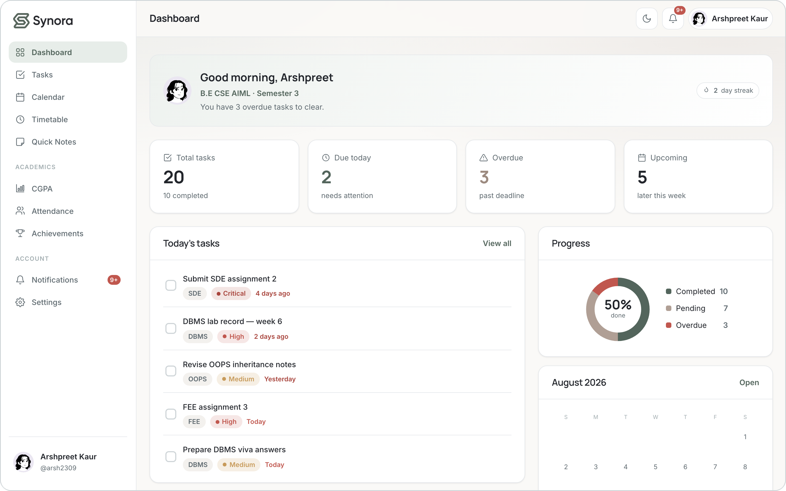




01 · OVERVIEW
From markup to interface
HTML5
Structure — what the content is
CSS3
Presentation — how it looks
Responsive
Adapts to every screen
Synora UI
The finished interface
HTML gives the page meaning; CSS gives it the calm, consistent look of the Synora dashboard.
Together HTML5 + CSS3 form the entire foundation of Synora’s interface.
SYNORA · HTML + CSS
02
Notes:
HTML5 defines what the content IS; CSS3 defines how it LOOKS and behaves visually. The screenshot is the real running app. Viva Q: What is the difference between HTML and CSS? A: HTML is structure and meaning; CSS is presentation and layout.

Slide 3
02 · HTML5
The document foundation
● ● ●
index.html
<!DOCTYPE html>
declares HTML5 — standards mode
1
2
3
4
5
6
7
8
9
10
11
12
13
14
15
<!DOCTYPE html>
<html lang="en">
<head>
<meta charset="UTF-8">
<meta name="viewport"
content="width=device-width, initial-scale=1">
<title>Synora — One calm home…</title>
<meta name="color-scheme" content="light dark">
<link rel="stylesheet" href="styles/tokens.css">
<link rel="stylesheet" href="styles/app.css">
</head>
<body class="app" data-page="dashboard">
…
</body>
</html>
lang="en"
document language for screen readers
meta charset
UTF-8 text encoding
meta viewport
the key to responsive design
link stylesheet
external CSS, loaded in order
Why? The <meta viewport> tag tells mobile browsers to use the device width — without it, media queries and mobile layouts don’t work.
SYNORA · HTML + CSS
03
Notes:
Every Synora page opens with the same HTML5 skeleton. Highlight the viewport meta — it is the single line that makes the whole responsive strategy possible. Viva Q: What does the viewport meta tag do? A: It maps the CSS pixel width to the device width so mobile layouts and media queries behave correctly.

Slide 4
03 · HTML5
Semantic structure
● ● ●
index.html — landing structure
THE TAGS SYNORA USES
1
2
3
4
5
6
7
8
9
10
<header class="site-header">
<nav aria-label="Primary"> … </nav>
</header>
<main id="main">
<section class="hero"> … </section>
<section id="features"> … </section>
</main>
<footer class="site-footer">
<nav aria-label="Footer"> … </nav>
</footer>
<header>
<nav>
<main>
<section>
<article>
<footer>
Why? Semantic tags give the document a meaningful hierarchy — better accessibility, easier maintenance, and clear DOM targeting — instead of a wall of <div>s.
Also used: <article> wraps each attendance subject card — a self-contained unit of content.
SYNORA · HTML + CSS
04
Notes:
Synora uses real landmark elements — header, nav, main, section, article, footer — not generic divs. Viva Q: Why use semantic HTML instead of divs? A: Semantic elements describe the role of the content, which improves accessibility, SEO and maintainability, and makes the structure self-documenting.

Slide 5
04 · HTML5
Accessibility & forms
● ● ●
index.html — Get in Touch
ACCESSIBILITY PRACTICES IN SYNORA
1
2
3
4
5
6
7
8
9
<form class="contact-form" novalidate>
<div class="field">
<label for="contact-email">Email</label>
<input type="email" id="contact-email"
name="email" autocomplete="email"
placeholder="you@example.com" required>
</div>
<button type="submit">Send Message</button>
</form>
<label for> tied to every input id
Real <button>s, never clickable <div>s
Typed inputs — email, tel — aid entry & keyboards
Decorative SVGs marked aria-hidden
aria-label on icon-only controls; aria-live toasts
Visible keyboard focus rings
HTML Form → User input → Validation attributes (required, type) → handed to JavaScript
Honest scope Synora follows solid accessibility fundamentals (semantics, labels, focus, contrast) — it has not been formally WCAG-audited, so it is described as accessible-by-construction, not certified.
SYNORA · HTML + CSS
05
Notes:
Forms use HTML5 features: typed inputs (email/tel), required, placeholder, autocomplete, and novalidate (validation is themed in JS). Accessibility begins with meaningful HTML. Be honest: no formal WCAG audit. Viva Q: How is the form accessible? A: Each input has a <label for> bound to its id, controls are real buttons, inputs are correctly typed, and decorative graphics are hidden from assistive tech.

Slide 6
05 · CSS3
Building a design system
● ● ●
tokens.css + components.css
ONE LANGUAGE, EVERY SCREEN
1
2
3
4
5
6
7
8
9
10
11
12
13
:root {
--color-brand: #53655C; /* sage */
--color-accent: #B09F95; /* taupe */
--color-bg: #FAF9F7;
--color-text: #22252B;
--space-24: 24px;
--radius-lg: 16px;
}
.btn--primary {
background: var(--color-brand);
padding: 0 var(--space-24);
border-radius: var(--radius-lg);
}
Ink
Sage
Slate
Mist
Taupe
#22252B
#53655C
#A3AEB1
#E5E8EB
#B09F95
Why? CSS custom properties centralise every colour, space and radius as one reusable token set — so buttons, cards, forms and the dashboard all share one visual language, and dark mode is a single re-declaration.
SYNORA · HTML + CSS
06
Notes:
Every colour, spacing step and radius is a CSS variable in tokens.css. Components reference them with var(). This is the cascade + custom properties in action. Viva Q: Why use CSS variables? A: They centralise design decisions, keep the UI consistent, and make theming (light/dark) a one-line change instead of editing every rule.

Slide 7
06 · CSS3
The Box Model
margin
● ● ●
base.css + app.css
border
1
2
3
4
5
6
7
8
9
*, *::before, *::after {
box-sizing: border-box; /* base.css */
}
.att-card {
padding: var(--space-16);
border: 1px solid var(--color-border);
border-radius: var(--radius-lg);
gap: var(--space-12);
}
padding
content
Why? box-sizing: border-box makes width include padding and border — so a card is exactly the size you set, and layouts never break from added padding. Margin is space outside the element; padding is space inside, around the content.
SYNORA · HTML + CSS
07
Notes:
Synora sets box-sizing: border-box globally, then every card, field and button is built from padding, border, radius and margin. Viva Q: Difference between margin and padding? A: Padding is space inside the element between its content and border; margin is space outside the border, between elements. Viva Q: What does border-box do? A: It includes padding and border inside the declared width/height, making sizing predictable.

Slide 8
07 · CSS3
Flexbox — one-dimensional layout
● ● ●
app.css
MAIN AXIS →
1
2
3
4
5
6
7
8
9
10
11
.topbar {
display: flex;
align-items: center;
gap: var(--space-16);
}
.card__header {
display: flex;
align-items: center;
justify-content: space-between;
flex-wrap: wrap;
}
Logo
Title
Actions
justify-content spreads · align-items centres · gap spaces
Used for the top bar, card headers, button groups, steppers — anything laid out along a single row or column.
Why? Flexbox aligns and distributes items along one axis with almost no math — ideal for toolbars and headers where content sizes vary.
SYNORA · HTML + CSS
08
Notes:
Flexbox handles Synora's one-dimensional rows: the sticky top bar and every card header (justify-content: space-between pushes the title and its control apart, flex-wrap lets them stack when narrow). Viva Q: When do you reach for Flexbox? A: For a single row or column of items that need alignment and spacing — navbars, headers, button groups.

Slide 9
08 · CSS3
CSS Grid — two-dimensional layout
● ● ●
app.css — dashboard
1
2
3
4
5
6
7
8
9
10
11
12
13
14
.dash-cols {
display: grid;
grid-template-columns: 1fr; /* stacked */
}
@media (min-width: 1000px) {
.dash-cols {
grid-template-columns:
minmax(0,1.6fr) minmax(0,1fr);
}
}
.stat-grid {
grid-template-columns:
repeat(auto-fit, minmax(150px, 1fr));
}
The dashboard: a grid of cards that reflow by column.
Why? Grid controls rows and columns at once — perfect for the dashboard. repeat(auto-fit, minmax()) even reflows the stat cards responsively with no media query.
SYNORA · HTML + CSS
09
Notes:
Grid builds Synora's two-dimensional layouts. The dashboard columns start stacked and become a 1.6fr/1fr split at 1000px; the stat cards use repeat(auto-fit, minmax(150px,1fr)) to reflow automatically. Viva Q: Why Grid over Flexbox for the dashboard? A: The dashboard is a genuine two-dimensional arrangement of cards across rows and columns, which Grid expresses directly.

Slide 10

09 · CSS3
Choosing the right layout
Flexbox
CSS Grid
One-dimensional — a row OR a column
Two-dimensional — rows AND columns
Direction
Align along one axis
Structure across two axes
Best for
Navbars, headers, controls
Dashboards, card layouts, pages
In Synora
.topbar · .card__header
.dash-cols · .stat-grid
Content flow
Sizes to its content
Defines the track structure first
Rule of thumb: content in a line → Flexbox; a structured grid of things → Grid.
SYNORA · HTML + CSS
10
Notes:
The classic viva question. Flexbox is one-dimensional (align a line of items); Grid is two-dimensional (define rows and columns). Synora uses Flexbox for the top bar and card headers, and Grid for the dashboard and stat cards. Viva Q: Why Flexbox here but Grid there? A: The navbar is a single row needing alignment (Flexbox); the dashboard is a 2-D arrangement of cards (Grid).

Slide 11
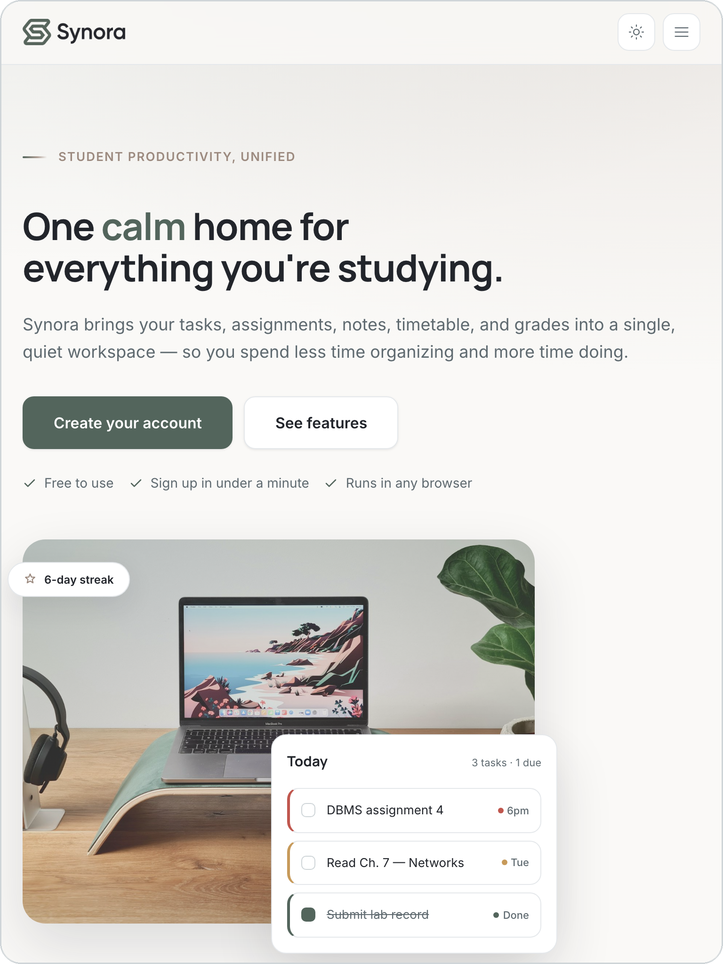
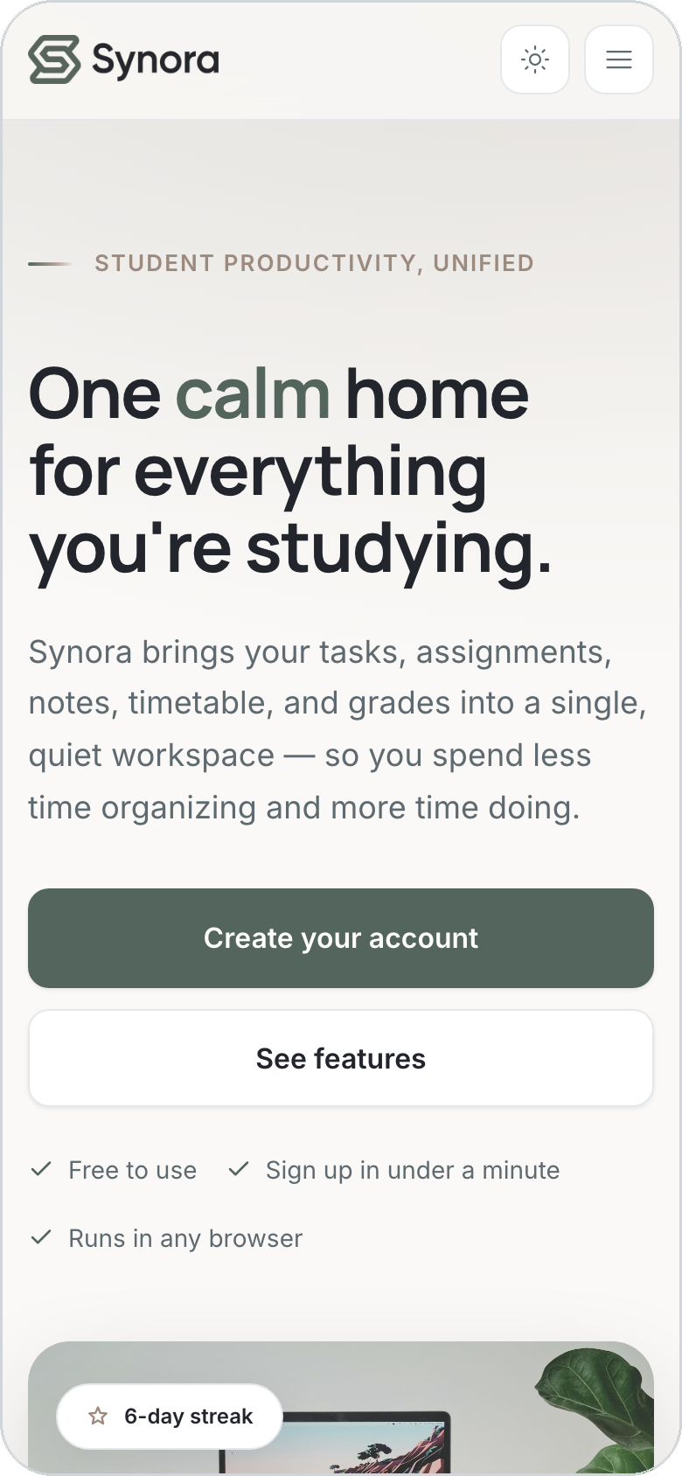
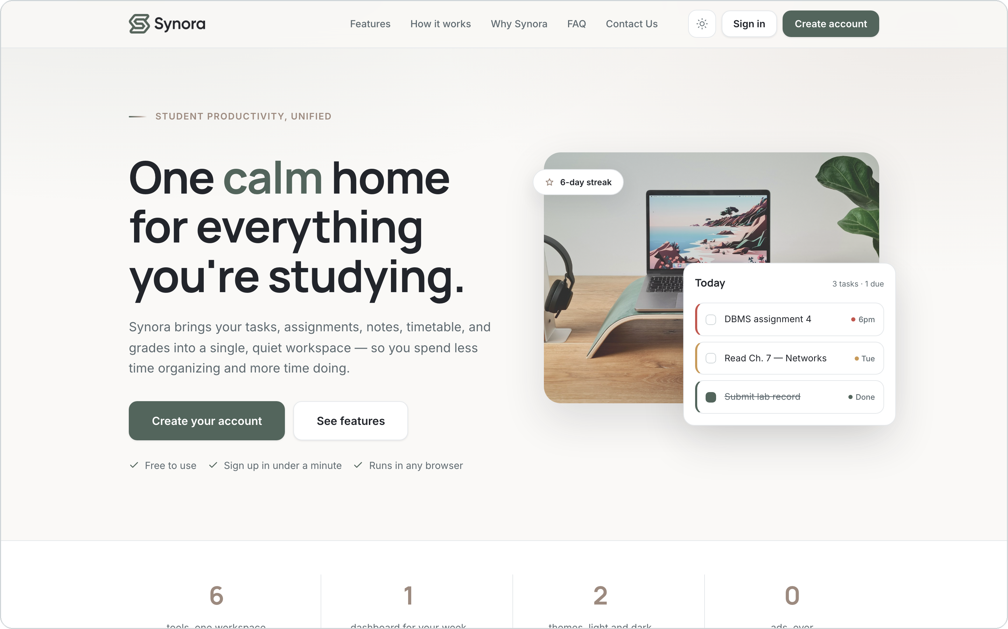
10 · CSS3
One workspace, every screen
The same landing page at three real viewports. The full navbar collapses into a CSS-only hamburger menu, the two-column hero stacks into one, and every section reflows to a single column.
1440px · Desktop
768px · Tablet
390px · Mobile
Fluid units
Flexbox
CSS Grid
Media queries
SYNORA · HTML + CSS
11
Notes:
The mandatory responsive slide: the same landing page at 1440 / 768 / 390 px, identical content. Point out the concrete changes — the full navbar collapses into a CSS-only hamburger menu (a checkbox + label, no JavaScript), the two-column hero stacks into one, and the multi-column sections reflow to a single column. This is the syllabus' static responsive landing page, built with fluid units, Flexbox, Grid and media queries.

Slide 12
11 · CSS3
Media queries — adapting the layout
● ● ●
REAL BREAKPOINTS IN SYNORA
app.css
1
2
3
4
5
6
7
8
9
10
11
12
13
14
15
/* below 900px: sidebar becomes a drawer */
@media (max-width: 900px) {
.sidebar {
position: fixed;
transform: translateX(-100%);
}
.app.nav-open .sidebar {
transform: translateX(0);
}
.menu-btn { display: inline-flex; }
}
/* below 560px: 7-col timetable stacks */
@media (max-width: 560px) {
.tt-grid { grid-template-columns: 1fr; }
}
1024 / 940 / 720px
Landing sections reflow to fewer columns
900px
App sidebar → off-canvas drawer + hamburger
560px
Timetable grid → stacked day cards
1000px (min)
Dashboard gains its two-column split
SYNORA · HTML + CSS
12
Notes:
Media queries are where the adaptation happens. Synora's real breakpoints: landing at 1024/940/860/720/400, the app sidebar→drawer at 900, the timetable stacks at 560, and the dashboard adds a column at min-width 1000. Do not invent values — these are the actual ones. Viva Q: What is a media query? A: A CSS rule that applies styles only when the viewport meets a condition, such as max-width: 900px.

Slide 13


12 · CSS3
The responsive strategy — honestly
Predominantly desktop-first
With mobile-first components
Base (unqualified) styles describe the full desktop layout; max-width media queries progressively adapt it down.
Several parts are authored the other way — stacked by default, expanding upward — or reflow with no query at all.
Desktop base → @media (max-width: 900px) → @media (max-width: 560px)
.dash-cols — 1 column, then min-width: 1000px
.stat-grid — repeat(auto-fit, minmax()) reflows freely
Fluid type with clamp() in the tokens
44 of Synora’s media queries use max-width — the graceful-degradation pattern.
Why? Stating this correctly is a viva safeguard: Synora is not a pure mobile-first cascade — it is breakpoint-based adaptation from a desktop base, with intrinsically-responsive components layered in. Naming it accurately shows you understand the difference.
SYNORA · HTML + CSS
13
Notes:
IMPORTANT viva point. Synora's CSS is predominantly desktop-first: base styles are the desktop layout and max-width queries adapt down (graceful degradation). Some components are mobile-first (.dash-cols starts stacked and expands at min-width: 1000px) or intrinsically responsive (.stat-grid auto-fit). Do not claim pure mobile-first. Viva Q: Is your project mobile-first? A: Predominantly desktop-first with max-width breakpoints, plus a few mobile-first/intrinsically-responsive components — I'd describe it as breakpoint-based responsive adaptation.

Slide 14

13 · MINI PROJECT
The Synora landing page
HTML5
Semantic header / nav / main / section / footer
CSS3
Design tokens, typography & the box model
Flexbox
Nav actions, hero and footer rows
CSS Grid
Centered navbar & the feature sections
Media queries
Reflows at 1024 / 940 / 720 / 400px
The real landing page — the syllabus’ “static responsive landing page”, grown into a product’s marketing entry point.
SYNORA · HTML + CSS
14
Notes:
The landing page is the syllabus mini-project made real: a static, responsive marketing page demonstrating semantic HTML, CSS typography and box model, Flexbox, Grid and media queries — all in one artefact. Its navbar is actually a 3-track grid that keeps the links viewport-centred, and the feature sections are grid layouts that reflow at the landing breakpoints.

Slide 15



14 · CONCLUSION
What we learned
HTML5
Semantic HTML
CSS3
Structure & meaning
Accessible, maintainable markup
A token-driven design system
Flexbox + Grid
Media queries
Responsive design
One- & two-dimensional layout
Adapting to every screen
One workspace, any device
One calm home for everything you’re studying.
Notes:
Recap: HTML5 gave structure and meaning, CSS3 gave a token-driven design system, Flexbox and Grid handled layout, and media queries made it responsive. Synora turns the HTML5 + CSS3 syllabus into a real, polished product. Close on the tagline.

