Slide 1

One calm home for everything you’re studying.
A personalized student productivity & academic management workspace.
HTML5 · CSS3 · VANILLA JAVASCRIPT
Web Development · Semester 3 Project
Presented by Manan Kochhar
Notes:
Title slide. Synora — a student productivity and academic management workspace built entirely in HTML5, CSS3 and vanilla JavaScript. Open by stating the one-line promise: one calm home for everything you're studying. The whole deck shows how the Web Development syllabus was turned into a real, working product.

Slide 2
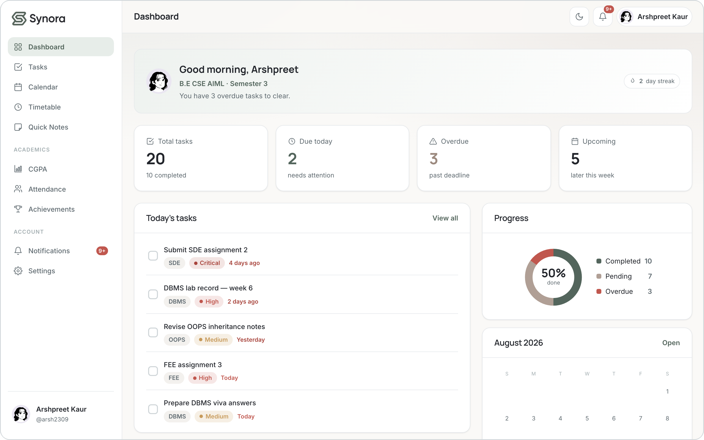








01 · OVERVIEW
What is Synora?
Synora brings a student’s entire academic workflow into one calm workspace — instead of juggling six notebooks, three apps and a group chat, everything a student actually tracks lives in a single dashboard.
Dashboard
Tasks
Calendar
Quick Notes
Timetable
Attendance
CGPA
Achievements
The Synora dashboard — the demo workspace, signed in as Arshpreet Kaur.
One dashboard that answers “what do I need to do today?” at a glance.
SYNORA
02
Notes:
Synora is a single workspace for a student's academic life: tasks, calendar, notes, timetable, attendance, CGPA, achievements and notifications. The screenshot on the right is the real running app (the demo account), not a mock-up. Core message: instead of scattered tools, one personalized dashboard.

Slide 3






02 · THE PROBLEM
The student workflow is scattered
Deadlines
Notes
Timetable
scattered across chats and sticky notes
spread over three different apps
a photo of the board, somewhere
Attendance
CGPA
Tasks
recalculated by hand every week
a spreadsheet you forget to open
remembered a little too late
The result Students spend more time managing their academic information than actually focusing on it.
SYNORA
03
Notes:
The problem is fragmentation. Each piece of a student's academic life lives in a different place, and the mental overhead of stitching them together is the real cost. Synora targets that fragmentation directly.

Slide 4

03 · THE SOLUTION
One workspace. Every academic workflow.
SYNORA
Productivity
Planning
Academics
Tasks
Quick Notes
Calendar
Timetable
Notifications
Attendance
CGPA
Achievements
Synora unifies productivity and academic tracking into a single, personalized interface.
SYNORA
04
Notes:
The solution groups every feature under three intentions — Productivity, Planning and Academics — all feeding one interface. This is the mental model behind the whole product.

Slide 5





04 · ADVANTAGES
Why Synora?
Unified
Personalized
Student-centric
One workspace instead of six disconnected tools.
Every user configures their own subjects & workspace.
Designed around real student workflows, not generic to-dos.
Lightweight
Responsive
Extensible
Core web tech — no framework, no build step, no bundler.
Works from a 320px phone to a large monitor.
Architecture ready to grow into a cloud platform.
SYNORA
05
Notes:
Six product-specific advantages. Emphasise Lightweight (this is genuinely a no-framework, no-build project) and Extensible (the data model is deliberately structured so a backend could be added without rewriting the UI).

Slide 6

05 · FEATURES
Everything a student needs
Productivity
Academics
Motivation
Personalization
Communication
Tasks (full CRUD)
Calendar
Quick Notes
Attendance
CGPA calculator
Timetable
Achievements
Progress ring
Completion streak
Profile & avatars
Light / dark theme
Subjects & credits
Notifications
Due / overdue alerts
Attendance warnings
Twelve features, one visual language — every screen shares the same tokens, components and dashboard.
SYNORA
06
Notes:
The full feature surface, grouped. Note that Progress, streaks and warnings are derived automatically from the underlying data — the student never maintains them by hand.

Slide 7





06 · USER JOURNEY
From sign up to study
Landing
Sign up
Confirmation
Personalize
Dashboard
PERSONALIZE SYNORA — 6 STEPS
1 Avatar
2 Program & Semester
3 Subjects & Credits
4 Attendance target
5 Appearance
6 Review & finish
Daily workspace
Academic tracking
Tasks · Calendar · Quick Notes · Timetable
Attendance · CGPA · Achievements · Progress
Everything you touch every day, in one place.
The numbers that decide your semester, kept current.
SYNORA
07
Notes:
The journey: land, sign up, a confirmation screen that waits for you (no timed redirect), then an optional six-step personalization, and into the dashboard. Onboarding is offered, never forced — the app guard only checks that you're signed in.

Slide 8





07 · TECHNOLOGY
Built on core web technologies
HTML5
CSS3
JavaScript
Browser Storage
Git & GitHub
Semantic structure & forms
Design tokens, Flexbox & Grid
Logic, DOM & all calculations
Per-user localStorage
Version control
No framework. No build step. No bundler. The only external resource is the Google Fonts stylesheet (Inter + Manrope) — it degrades to system fonts without it.
DEVELOPMENT WORKFLOW
Plan
Design
HTML
CSS
JavaScript
Test in DevTools
Git commit
GitHub
Written in VS Code · debugged and responsive-tested with Chrome DevTools · versioned with Git & hosted on GitHub.
SYNORA
08
Notes:
The stack is deliberately minimal — three core web technologies plus the browser's own storage. The bottom strip maps the Module 2 tooling (VS Code, DevTools, Git/GitHub) onto the actual development workflow used to build Synora.

Slide 9
08 · SYLLABUS → PRODUCT
From the syllabus to a real product
HTML5 & CSS3 | In Synora
Semantic HTML | header / nav / main / section / footer
Forms & inputs | sign-up, sign-in, contact, task forms
Accessibility | labels, real buttons, focus, aria-live
Box model | cards, fields, steppers, tiles
Flexbox | navbar, toolbars, card headers
CSS Grid | dashboard, timetable, feature grids
Media queries | sidebar → drawer, 7-col → stacked
Mobile-first | ~320px up to large monitors
JavaScript & Tooling | In Synora
Variables & functions | app state, reusable feature logic
Arrays & objects | subjects, tasks, users, records
Loops | dynamic rendering (map / forEach)
DOM manipulation | sidebar, charts, live lists
Events | clicks, forms, event delegation
JSON | JSON.stringify / JSON.parse
Browser storage | per-user namespaced localStorage
Git & GitHub | commits & version history
Every row is demonstrated by working code in this project — the following slides show the actual snippets.
SYNORA
09
Notes:
This is the key slide for the evaluator: a direct mapping from each syllabus topic to exactly where it appears in Synora. Nothing here is aspirational — every row corresponds to real code, shown in the code slides that follow.

Slide 10


09 · ARCHITECTURE
How Synora is structured
HTML pages
ARCHITECTURE IN ONE LINE
index · login · signup · onboarding · dashboard · 9 feature pages
HTML → CSS tokens → storage.js → app.js → per-page script
CSS
tokens · base · components · app · landing · auth · onboarding
One navigation model. app.js builds the sidebar and topbar once from a single NAV list, then feature scripts wait for a synora:ready event before rendering into their page.
JavaScript
theme · storage · avatars · app + 11 feature scripts
Subjects are the source of truth. Attendance, CGPA and the timetable all reference a subject by id — rename or delete once, and every module follows.
Browser storage
synora:<user>:<collection> — per-user localStorage
SYNORA
10
Notes:
Four clean layers with a strict one-way data flow. Two design decisions to highlight in a viva: (1) a single navigation model builds the chrome for every page, and (2) 'subjects' is the single source of truth that attendance, CGPA and timetable all reference by id, so a rename or delete cascades everywhere.

Slide 11
10 · HTML5
Structure & accessibility
● ● ●
index.html
SEMANTIC STRUCTURE
1
2
3
4
5
6
7
8
9
10
11
12
<!-- Landing contact form -->
<form class="contact-form" novalidate>
<div class="field">
<label for="contact-email">Email</label>
<input type="email" id="contact-email"
name="email" autocomplete="email"
placeholder="you@example.com" required>
<p class="field__error"></p>
</div>
<button type="submit"
class="btn btn--primary">Send</button>
</form>
<header>
<nav>
<main>
<section>
<footer>
<form>
<label>
<button>
CONCEPT
Semantic HTML5 + accessible forms.
USED IN
Sign-up, sign-in, personalization, subjects & the contact form.
WHY IT MATTERS
Real <label>s, <button>s, focus states and aria-live make the app usable by keyboard and screen reader.
SYNORA
11
Notes:
HTML5 gives Synora its semantic skeleton. Every input has a real <label> tied by id, every action is a real <button>, and validation is handled in JS (novalidate) so the messages match the rest of the UI. This is the structure CSS and JavaScript then operate on.

Slide 12
11 · CSS3
From structure to interface
● ● ●
tokens.css + app.css
THE BOX MODEL
1
2
3
4
5
6
7
8
9
10
11
12
13
:root {
--color-brand: #53655C; /* sage */
--color-accent: #B09F95; /* taupe */
--space-24: 24px;
--radius-lg: 16px;
}
.dash-cols { display: grid; gap: var(--space-24); }
@media (min-width: 1000px) {
.dash-cols {
grid-template-columns: minmax(0,1.6fr) minmax(0,1fr);
}
}
margin
border
padding
content
USED THROUGHOUT SYNORA
Custom properties
Flexbox
CSS Grid
Media queries
SYNORA
12
Notes:
Every colour, space, radius and shadow is a semantic CSS custom property in tokens.css, so both themes are one edit away. Layout is Flexbox and Grid. Note minmax(0,1fr) rather than 1fr on the dashboard grid — a subtle but real fix so a wide table scrolls inside its card instead of pushing the whole page sideways.

Slide 13
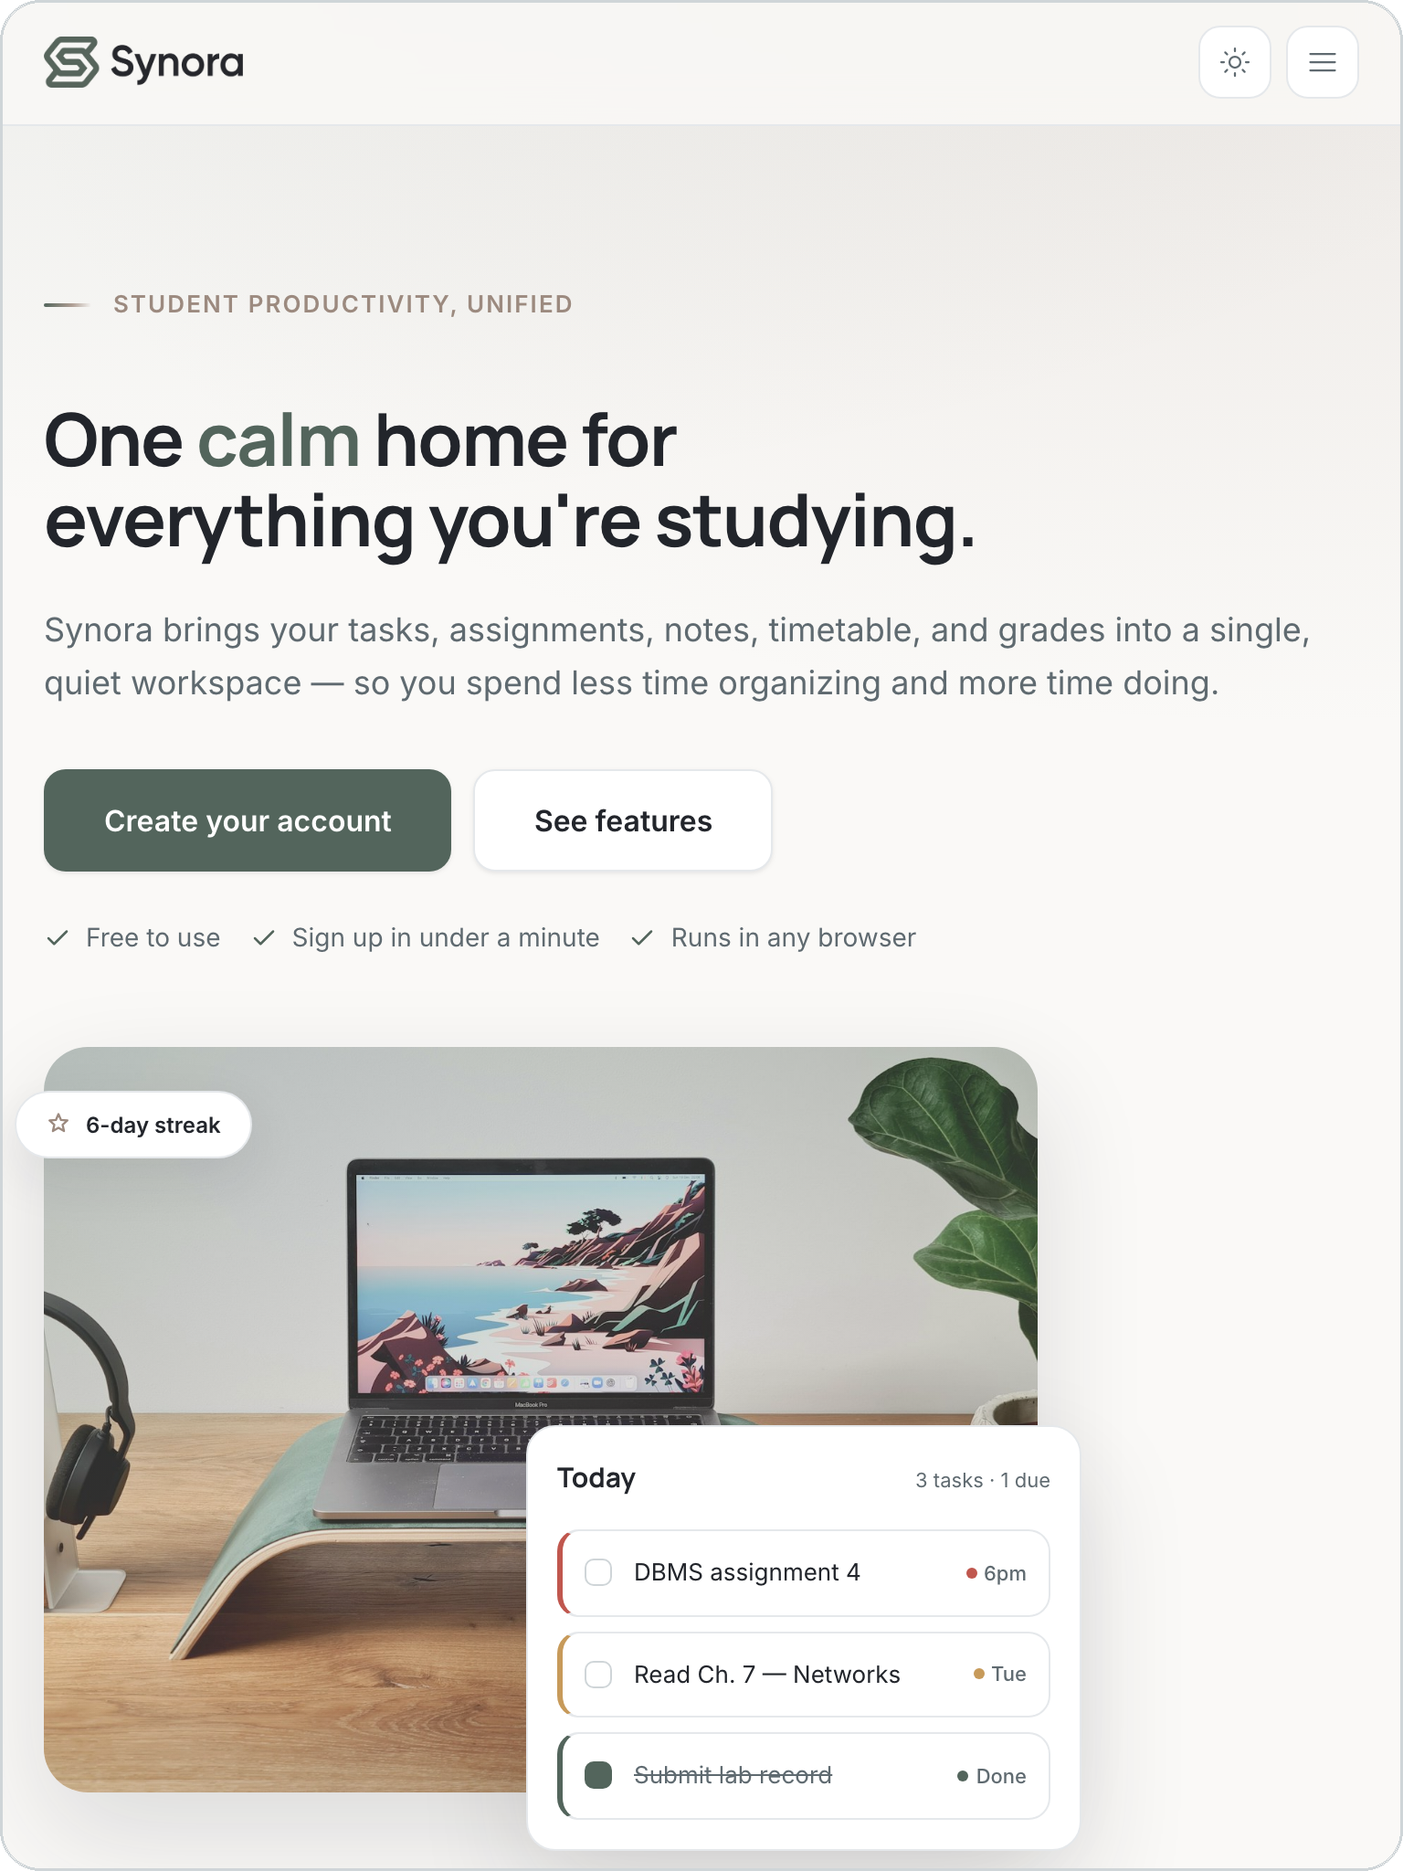
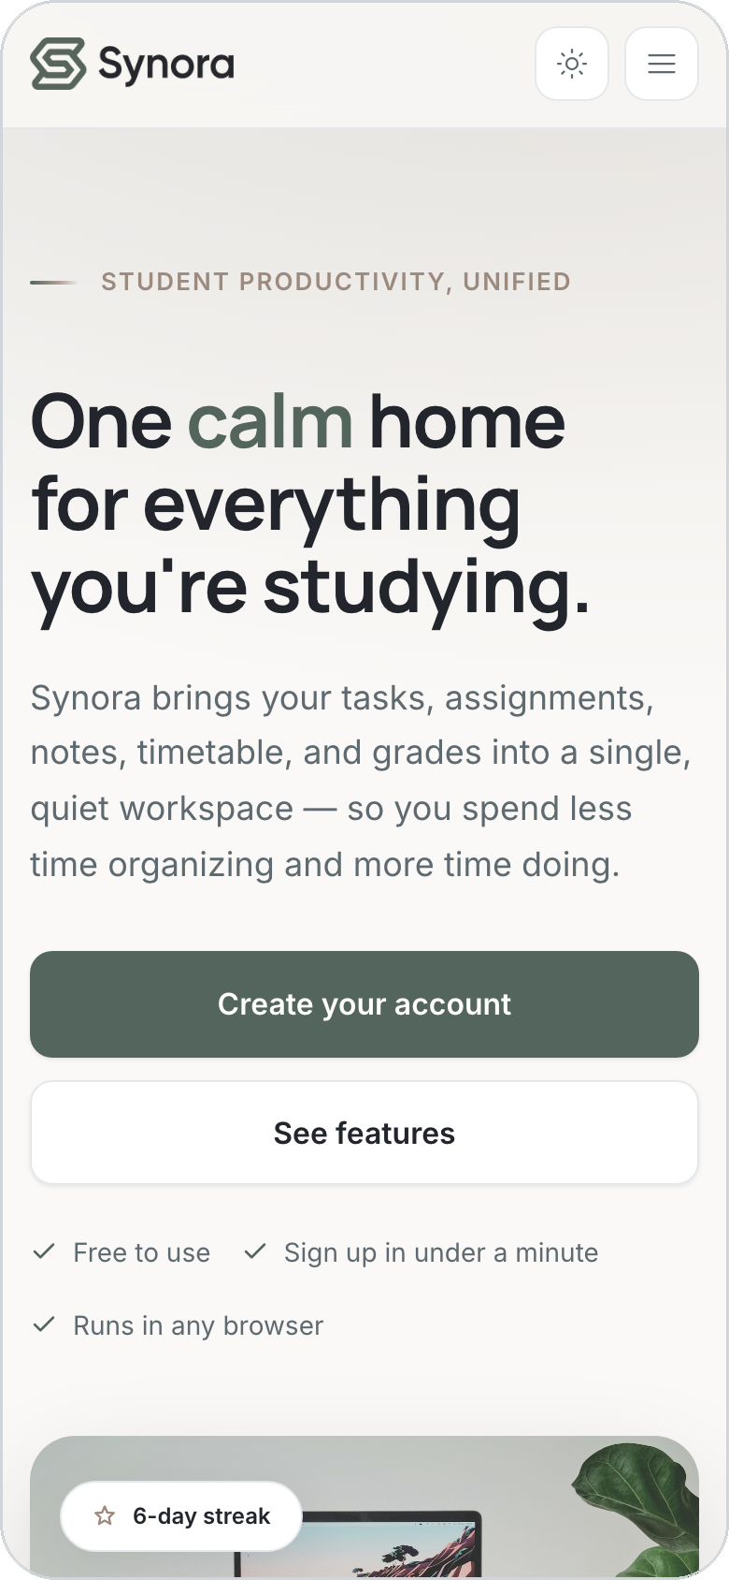
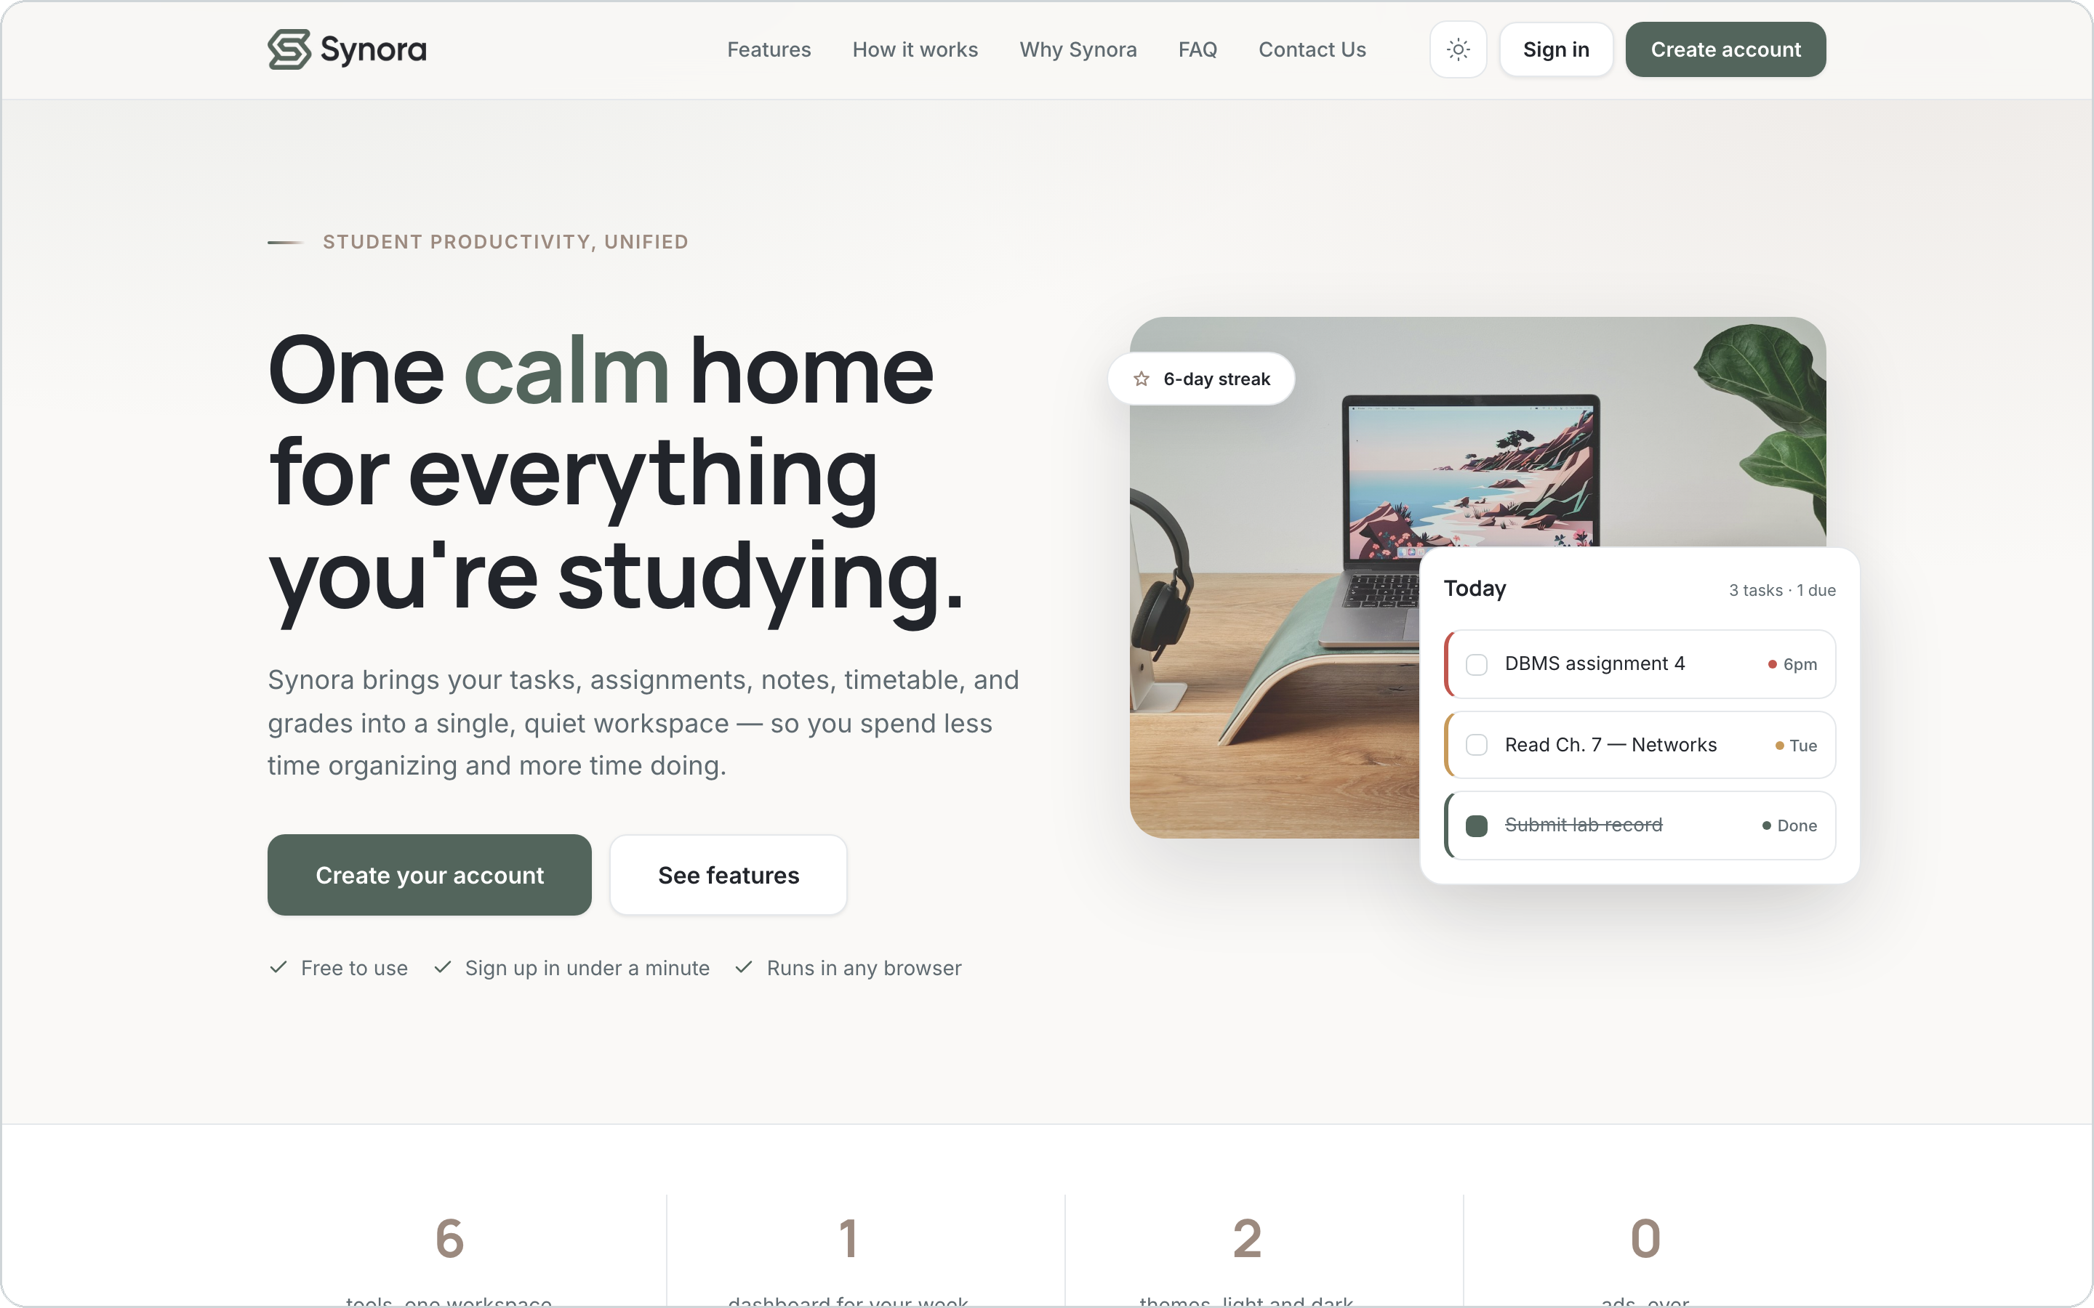
12 · RESPONSIVE DESIGN
One workspace. Every screen.
The same landing page at three real viewports. The full navbar collapses into a CSS-only hamburger menu, the two-column hero stacks into one, and every section reflows to a single column.
1440px · Desktop
768px · Tablet
390px · Mobile
Fluid units
Flexbox
CSS Grid
Media queries
SYNORA
13
Notes:
The mandatory responsiveness slide: the landing page at three real viewports, identical content. The navbar collapses into a CSS-only hamburger menu (a checkbox + label, no JavaScript), the two-column hero stacks, and the multi-column sections reflow to one column. This is the syllabus' static responsive landing page, built with fluid units, Flexbox, Grid and media queries.

Slide 14
13 · JAVASCRIPT
Making the interface interactive
● ● ●
app.js — derive.taskStats
1
Data
1
2
3
4
5
6
7
8
9
10
11
12
13
14
15
function taskStats() {
var tasks = store.get("tasks");
var stats = { total: tasks.length,
completed: 0, overdue: 0, dueToday: 0 };
tasks.forEach(function (t) {
if (t.status === "completed") {
stats.completed++; return;
}
var days = daysUntil(t.deadline);
if (days < 0) stats.overdue++;
else if (days === 0) stats.dueToday++;
});
return stats;
}
tasks in localStorage
2
JS logic
loops, objects, conditions
3
DOM
counts & lists built in code
4
UI
the dashboard updates
Fundamentals in one function: variables, an object, an array, a loop and conditionals — turning stored data into the numbers on the dashboard.
SYNORA
14
Notes:
A single real function shows every JavaScript fundamental from the syllabus: variables (var), an object literal for the stats, an array of tasks, a forEach loop, and conditional logic. The output of this function is exactly what drives the dashboard's Total / Overdue / Due-today numbers.

Slide 15
14 · MODERN JAVASCRIPT
ES6+, used honestly
Synora is written in disciplined ES5-style syntax — var, function, IIFE modules — so it runs directly in the browser with no build step or transpiler. The modern features it uses are platform & library features, not syntax sugar.
✓ USED IN SYNORA
— DELIBERATELY NOT USED
Promises — new Promise for confirm dialogs, consumed with .then()
Arrow functions, let / const
Destructuring, spread / rest
Template literals
ES modules (import / export) — no bundler
async / await, fetch — no backend to call
ES6 array methods — find / findIndex to locate tasks by id
String.padStart — zero-padded local dates (ES2017)
Web Platform APIs — CustomEvent, matchMedia, localStorage, classList, dataset, Intl
A good viva point: the constraints are a deliberate choice, not a gap — the project targets the fundamentals cleanly.
SYNORA
15
Notes:
Honesty matters in a viva. Rather than claim ES6 features that aren't there, this slide states the truth: the code is ES5-style by design so it runs with no build tooling. It genuinely uses Promises (for confirm dialogs), ES6 array methods, padStart, and modern Web Platform APIs. Arrow functions, let/const, destructuring, modules, async/await and fetch are intentionally absent.

Slide 16




15 · DOM & EVENTS
Event-driven UI
● ● ●
Click a task's check button
tasks.js
1
2
3
4
5
6
7
8
9
10
11
12
function toggleComplete(id) {
var t = all().find(function (x) {
return x.id === id; });
if (t.status === "completed") {
t.status = "not-started";
} else {
t.status = "completed";
Synora.streak.recordCompletion();
}
store.set("tasks", list); // persist
Synora.refresh(); // re-render
}
Listener delegated on the list
Function toggleComplete(id)
Data status + streak saved
Re-render list & dashboard update
Feedback a toast confirms it
Event delegation: one listener on the surviving container serves every task row — so re-rendering the list never loses its handlers.
SYNORA
16
Notes:
Task completion is the clearest event-driven example. A single delegated click listener catches the toggle, one function updates the data and the streak, the change is persisted, and Synora.refresh() re-renders the list, the counts, the notifications and the achievements — with a toast for feedback, and no page reload.

Slide 17
16 · DATA IN THE BROWSER
JSON · Storage · Forms
● ● ●
JS object
storage.js
1
2
3
4
5
6
7
8
9
10
11
function writeJSON(key, value) {
localStorage.setItem(key,
JSON.stringify(value));
}
function readJSON(key, fallback) {
var raw = localStorage.getItem(key);
if (raw === null) return fallback;
return JSON.parse(raw);
}
// synora:<user>:<collection>
function key(c) { return "synora:" + user + ":" + c; }
JSON.stringify()
localStorage
JSON.parse()
JS object
UI
Honest limitation Browser storage gives persistence, but it is not a secure backend — anyone with the browser can read it. Passwords are hashed as a courtesy, not as security.
Forms sign-up · sign-in · personalization · subjects · tasks · contact — all validated inline in JavaScript, no browser bubbles.
SYNORA
17
Notes:
All persistence flows through one file. JavaScript objects are serialized with JSON.stringify into localStorage under a per-user namespaced key, and JSON.parse reads them back. Forms are validated in JS. The honest limitation — localStorage is not a database and hashing is obfuscation, not security — is an excellent viva talking point and sets up the future-scope slide.

Slide 18


17 · PRODUCT ENGINEERING
Beyond the syllabus
Attendance engine
CGPA engine
% = attended / held × 100
Σ(credits × grade point) / Σ credits
Plus the real question: how many classes can I miss — or must I attend — to hit my target? The divide is guarded so 0 classes never shows NaN.
A single 10-point scale (O–B, plus E1/E2/E3). A failure scores 0 points but still carries its credits — so a backlog visibly drags the average down.
Subjects as source of truth
User-specific workspace
one list, referenced by id
synora:<user>:<collection>
Attendance, CGPA and the timetable never store a subject name. Rename once and it changes everywhere; delete once and it cascades.
Each account is namespaced, so two students on one browser never see each other's data. Percentages, CGPA and streaks are derived, never stored.
SYNORA
18
Notes:
This is where Synora goes past the classroom mini-projects. Four pieces of genuine product engineering: the attendance maths (including can-miss/must-attend), the credit-weighted CGPA with a documented failure assumption, the subjects-as-source-of-truth data model with cascading deletes, and per-user namespaced storage with everything derived rather than stored.

Slide 19
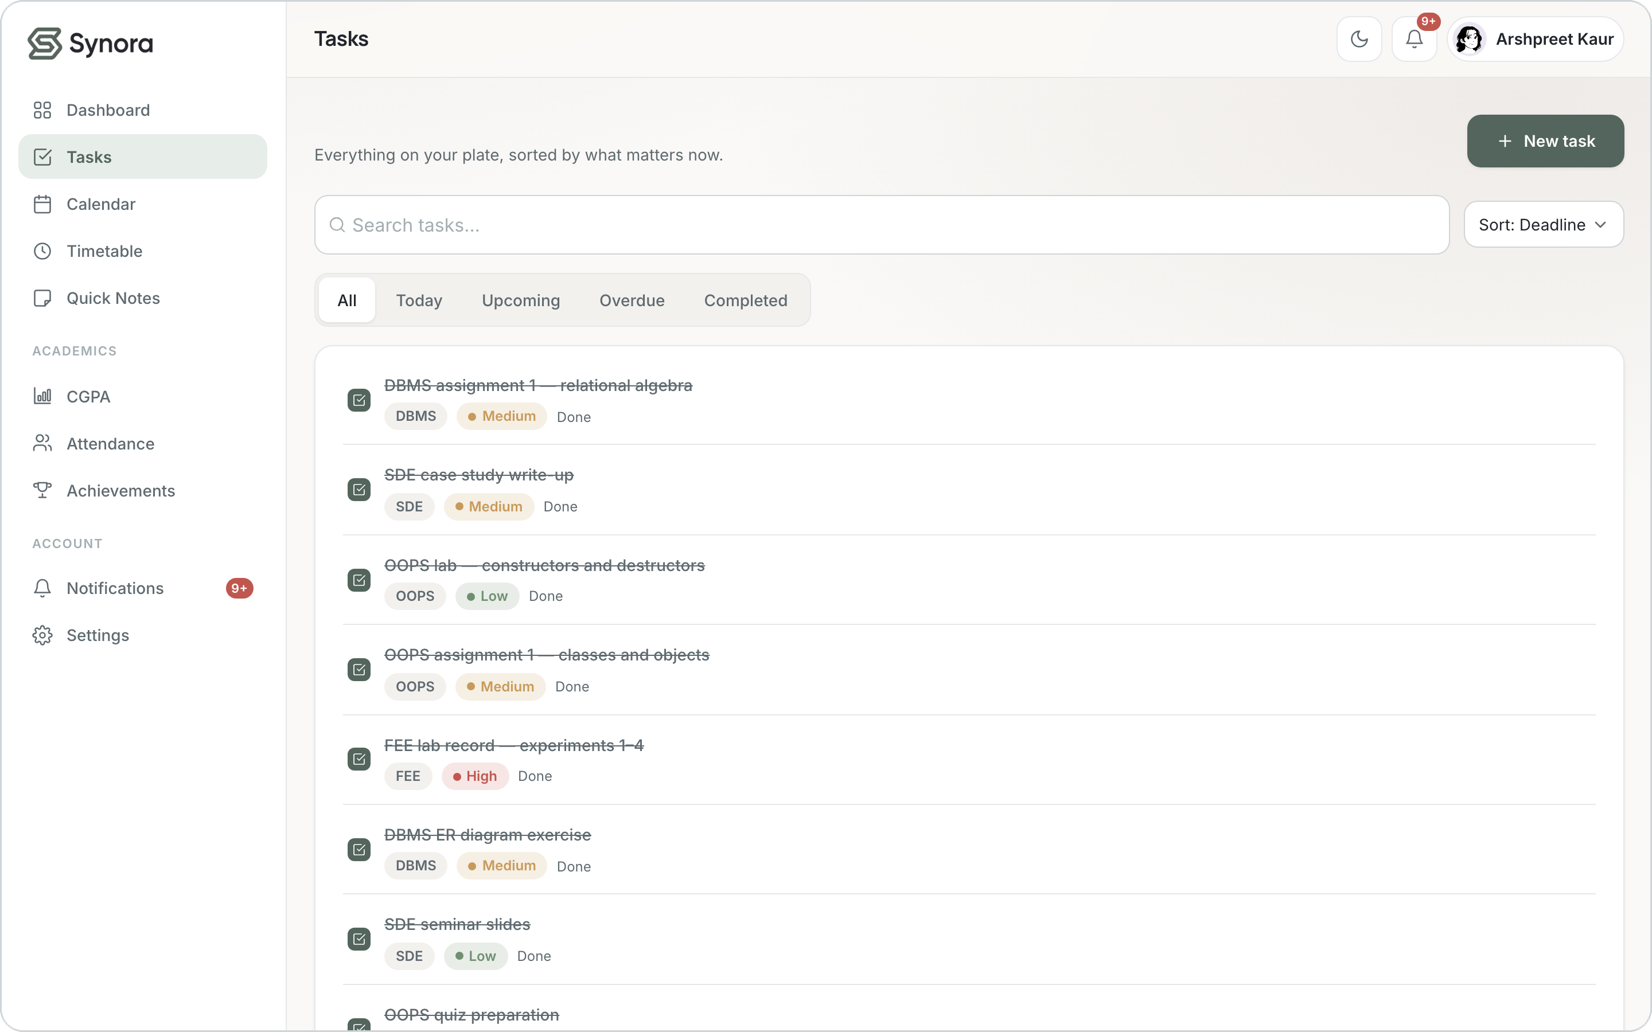
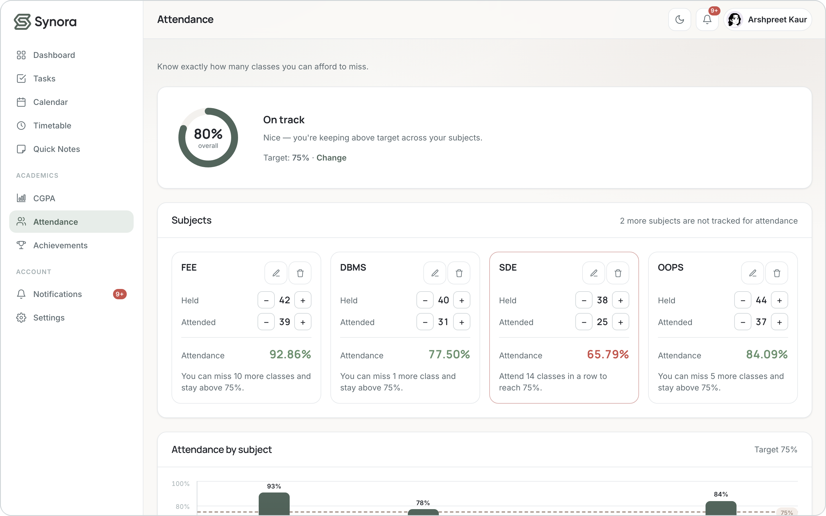
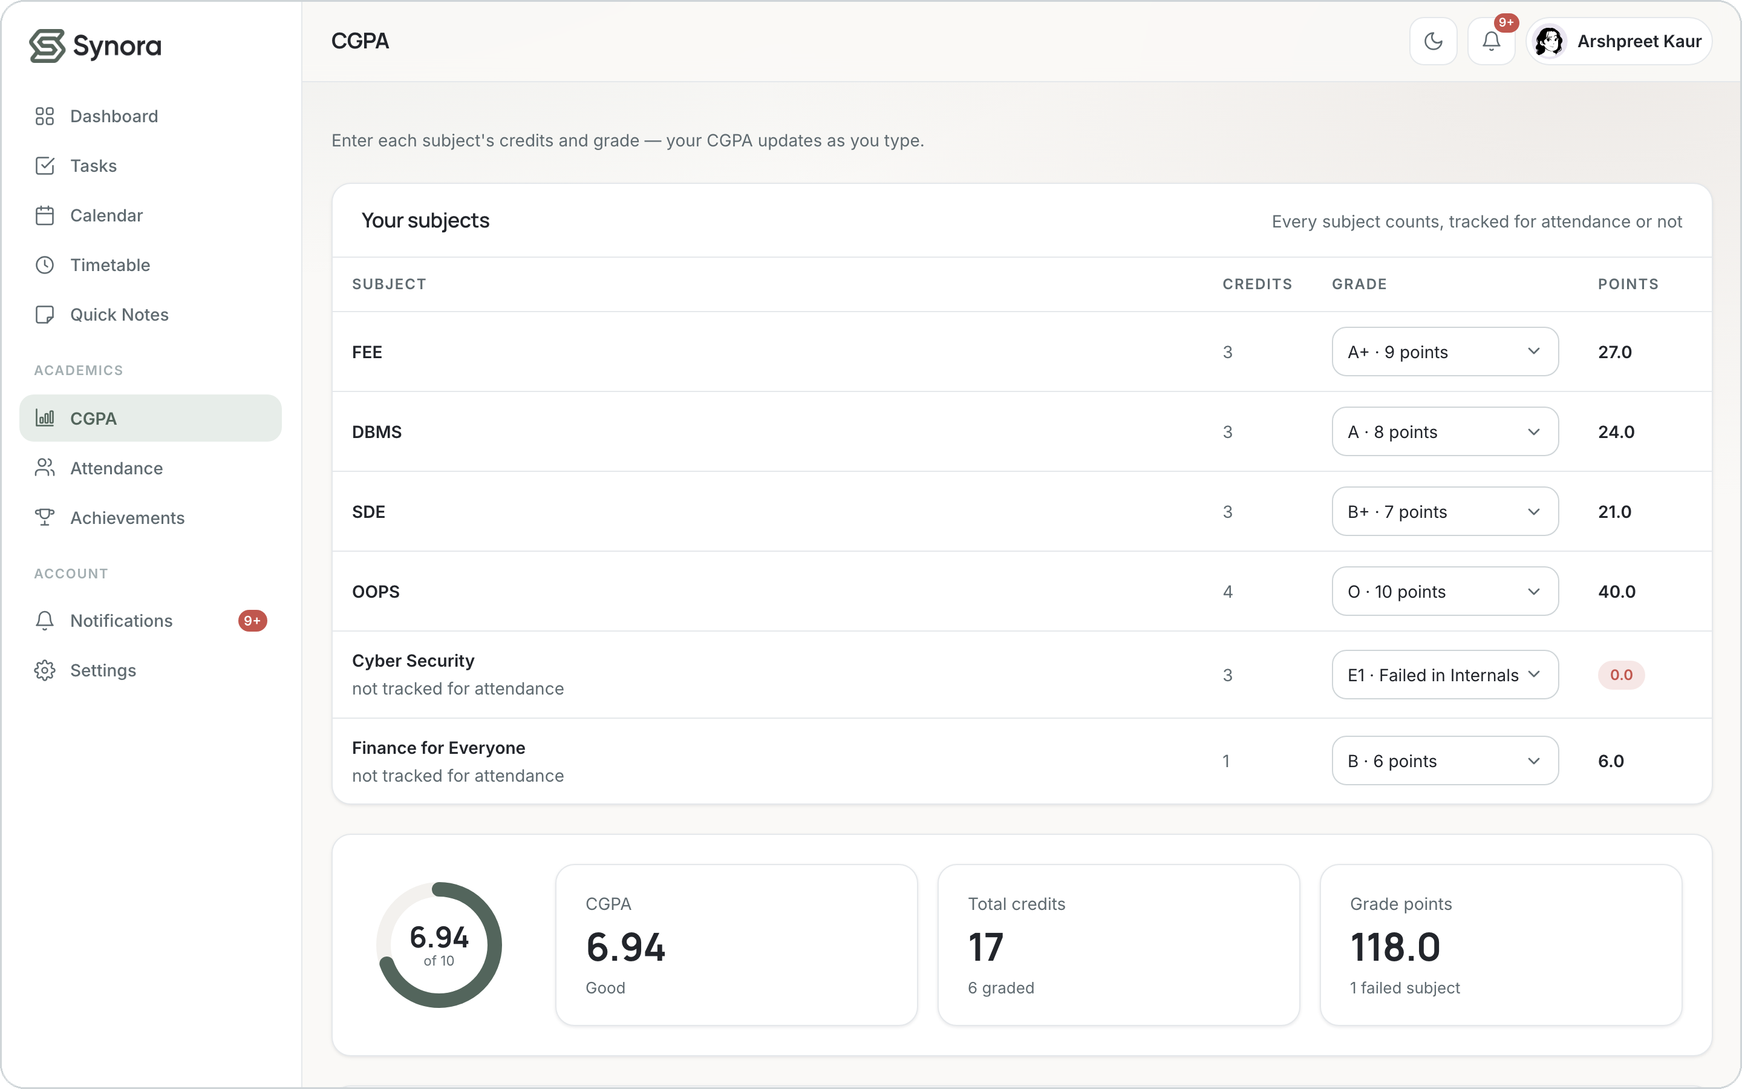
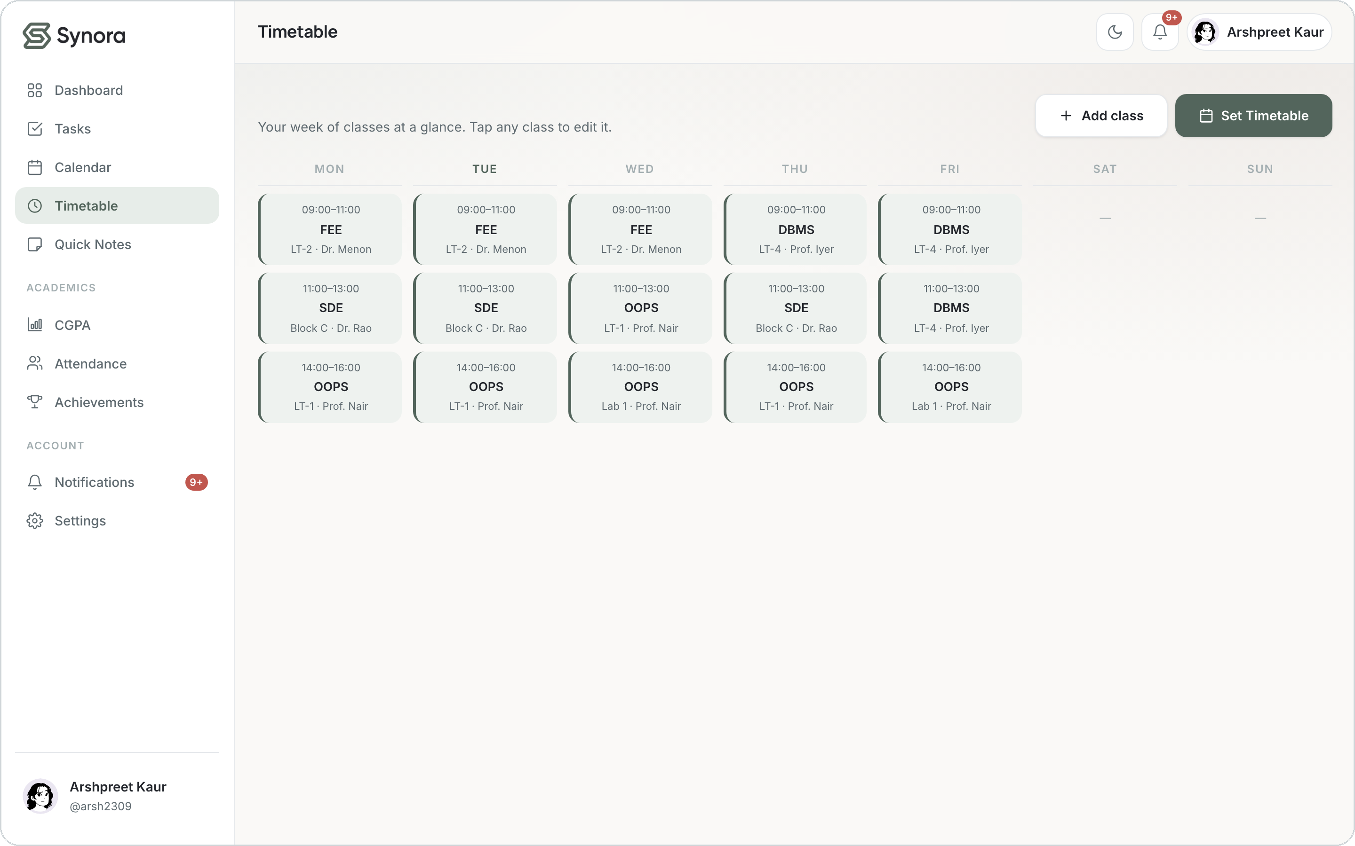
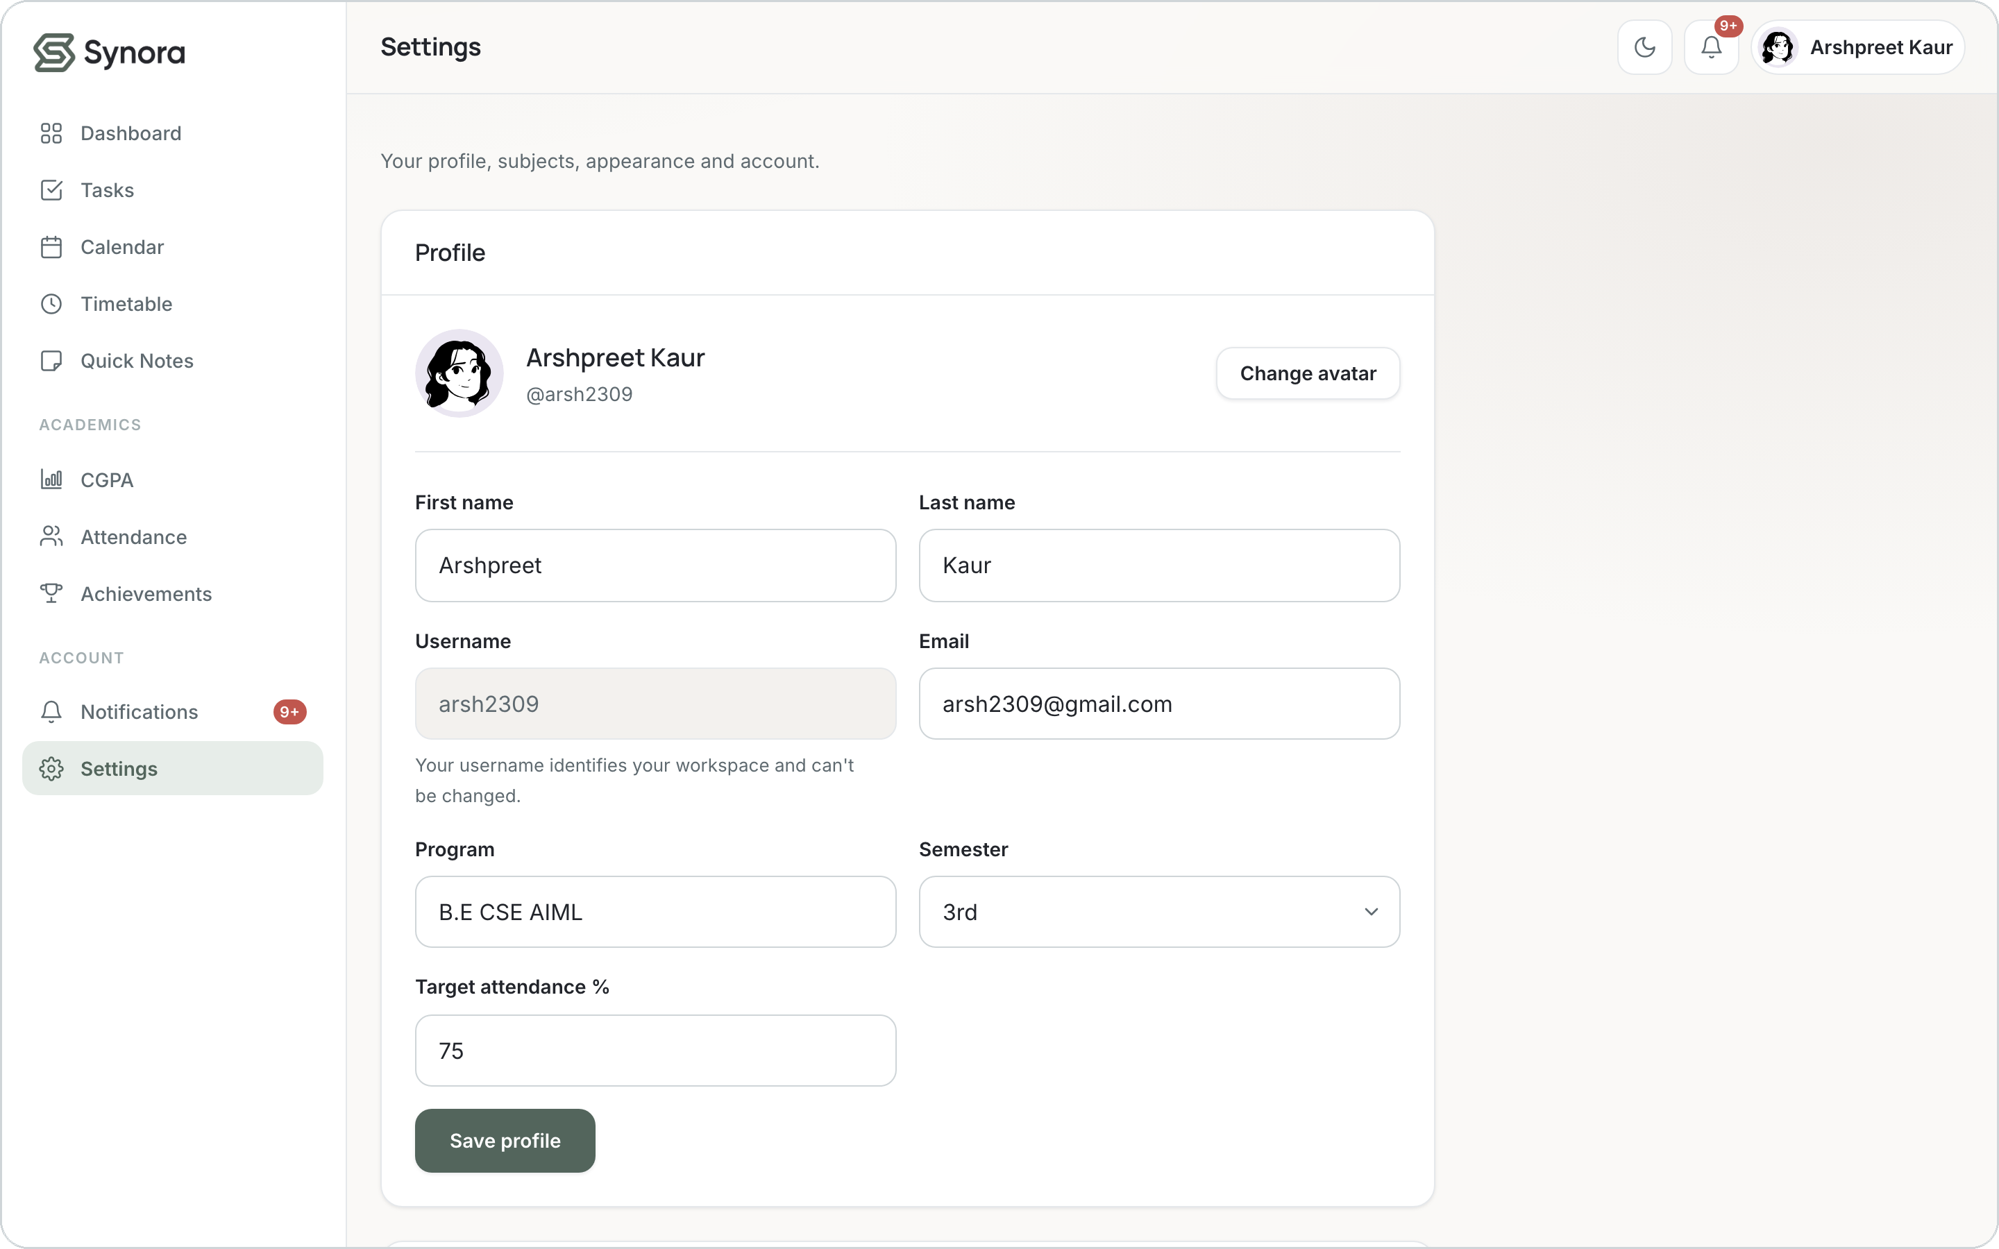
18 · THE PRODUCT
Synora in action
Dashboard
Tasks
Attendance
SYNORA
19
CGPA
Timetable
Personalization
Notes:
Six real screens from the running demo workspace: the dashboard, task list, attendance with its chart and can-miss maths, the credit-weighted CGPA with grades charted above and below the baseline, the weekly timetable, and the personalization/settings page showing the subject data model with tracked vs not-tracked subjects.

Slide 20



19 · WHAT’S NEXT
Where Synora goes next
Today
Backend & Cloud
Smart
Platform
Unified workspace
Personalized data
Responsive UI
Browser persistence
Database + real auth
Cloud sync
A real contact endpoint
AI study planner
Task prioritization
Analytics & trends
Mobile app
Calendar integration
Cross-device ecosystem
Honest limitations Today’s build is frontend-only — localStorage rather than a database, client-side auth, per-device, and a contact form that validates but doesn’t send. A production version moves persistence & auth to a secure backend.
One calm home for everything you’re studying.
Thank you · Questions?
Notes:
Close on the trajectory. Today Synora is a complete, honest frontend product. The roadmap moves persistence and auth to a real backend, adds cloud sync, then AI-assisted planning and analytics, and finally a mobile, cross-device platform. End on the tagline and invite questions. Central message: the syllabus gave the building blocks; Synora turned them into a product.

