Slide 1

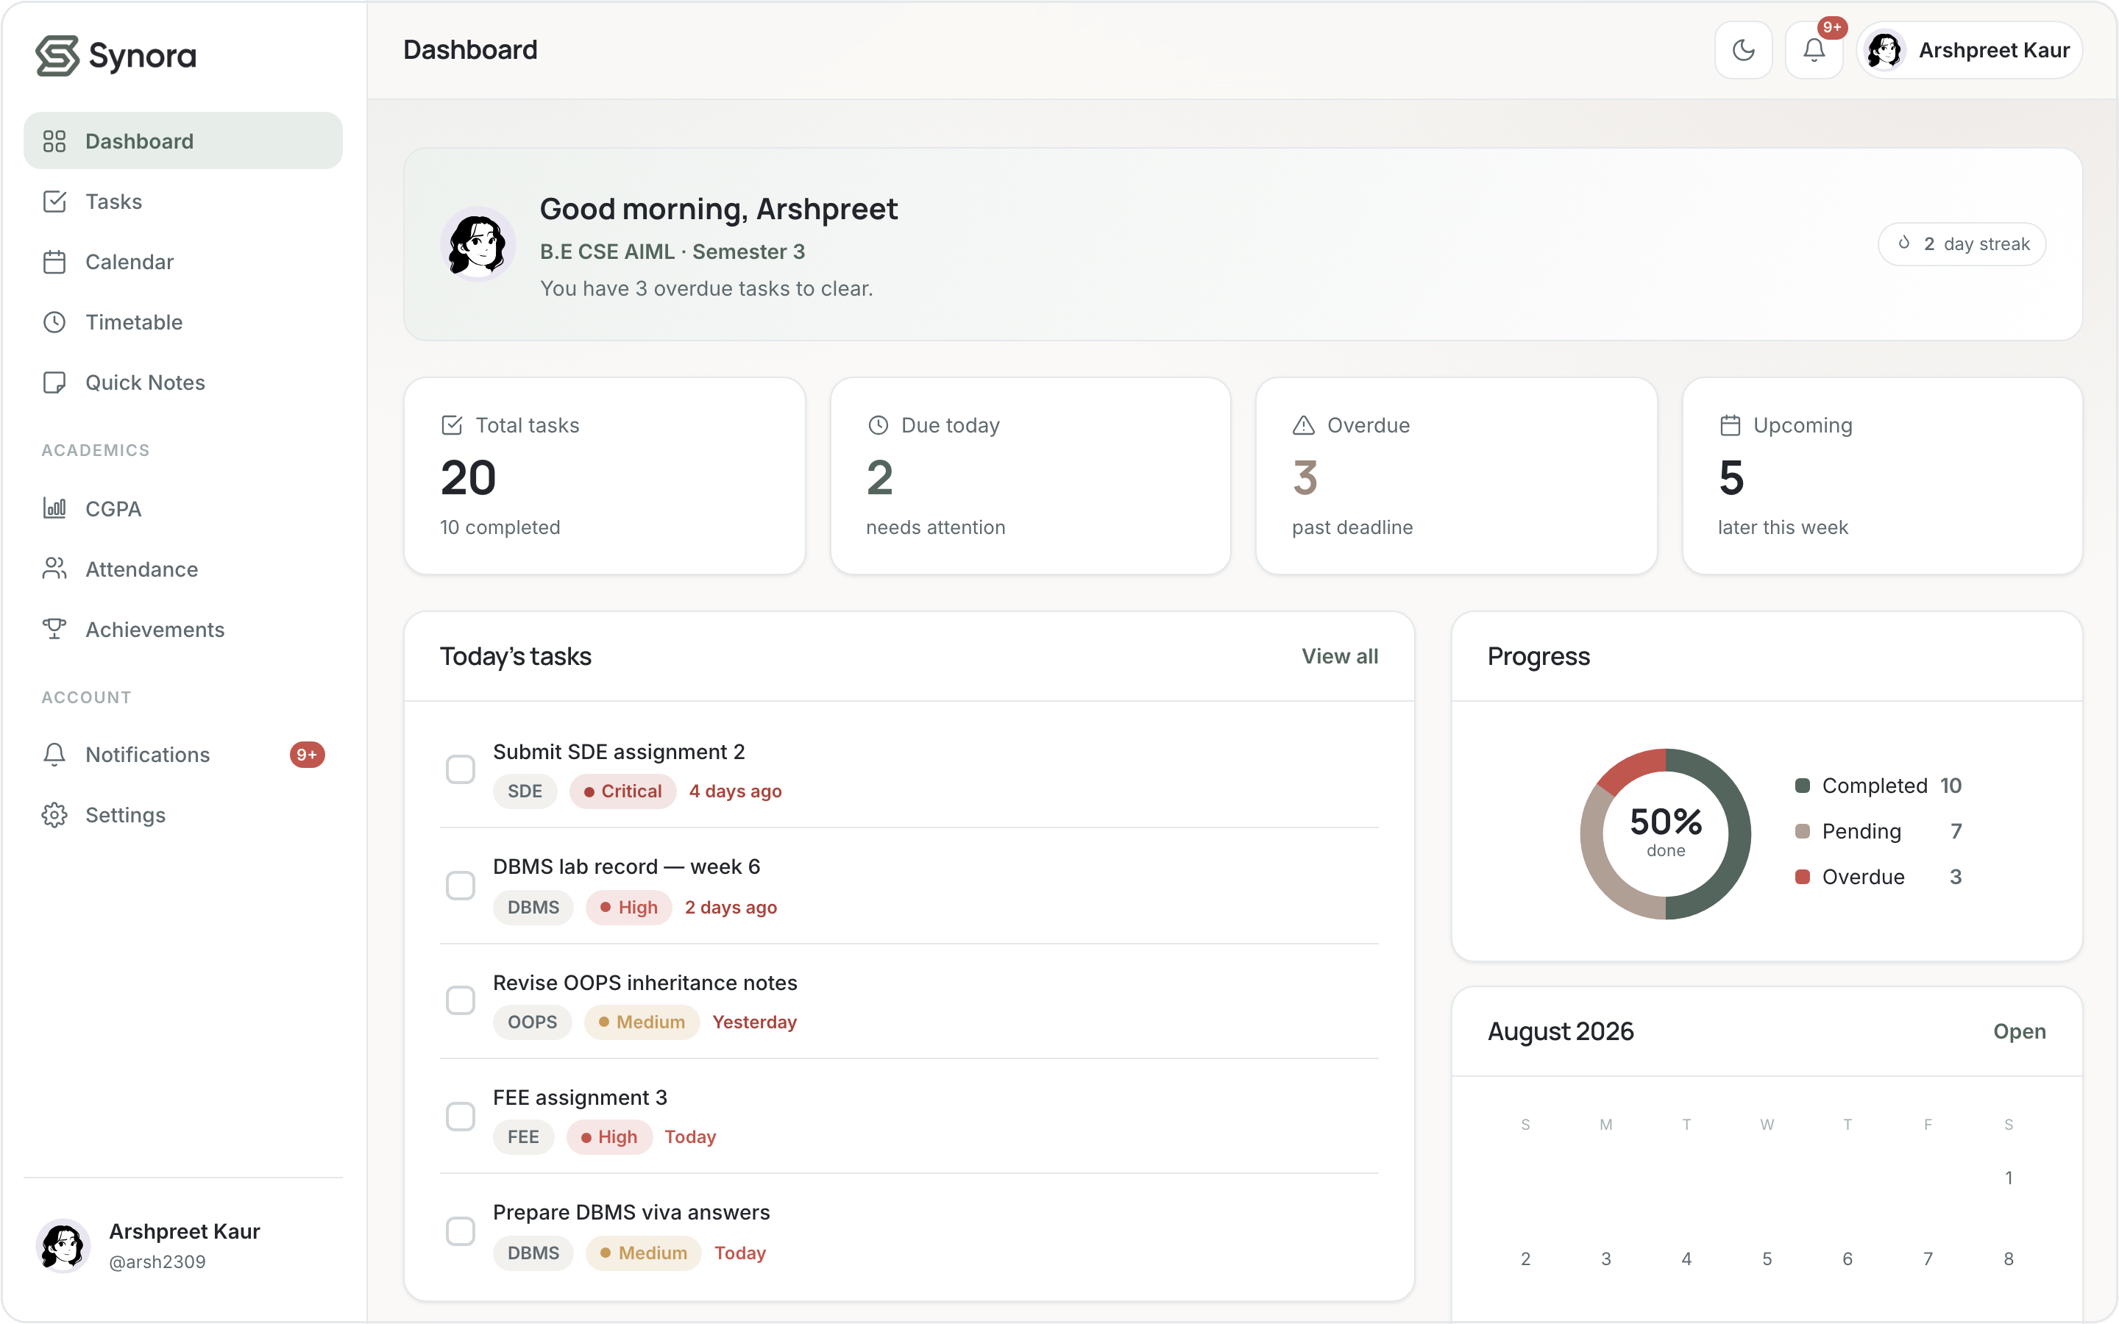
One calm home
for everything
you're studying.
A student productivity & academic management workspace —
built from the HTML5, CSS3 & JavaScript syllabus.
The Synora dashboard — the product this deck is about.
HTML5
CSS3
JavaScript
DOM
Events
Notes:
Open with the product, not the theory. Synora is a real, working student-productivity web app built only with HTML5, CSS3 and vanilla JavaScript — no frameworks. This deck shows how the syllabus concepts became this product, and what we built beyond them.

Slide 2
THE PRODUCT
What is Synora?
Synora brings everything a student juggles into one calm, personal workspace — so time goes to studying, not to organising eight different apps.
Tasks
Calendar
Quick Notes
Timetable
Attendance
CGPA
Achievements
Notifications
Dashboard — today's tasks, weekly progress and a mini-calendar at a glance.
One account. One quiet home for the whole semester.
Synora · Web Development Project
02 / 20
Notes:
Synora is a single workspace for a student's whole semester: tasks, calendar, notes, timetable, attendance, CGPA, achievements and notifications. Everything is per-user and saved in the browser. Viva: it's a single-page-per-feature app, all vanilla JS.

Slide 3

THE PROBLEM
Why we built it
A student's semester is scattered across a to-do app, the class WhatsApp, a notes app, a spreadsheet for attendance and another for grades. Nothing talks to anything.
Synora
To-do app
Sticky notes
ONE CALM WORKSPACE
— Tasks, deadlines & notes in one place
Spreadsheet
Group chat
— Attendance and CGPA that update live
— Timetable, calendar and reminders together
Calendar
Reminders
— Personal to each student, saved on-device
Scattered tools, constant context-switching
Synora · Web Development Project
03 / 20
Notes:
The problem is fragmentation, not a lack of tools. Students already use six apps that don't share anything. Our approach: pull the academic essentials into one quiet, unified workspace. This framing sets up why a single well-structured web app is the right shape.

Slide 4
THE FOUNDATION
How Synora is built
The syllabus building blocks are the whole foundation of the product — each layer does one job.
HTML5
Structure & meaning
Semantic pages, forms, accessible controls
OUR THESIS
CSS3
Design & responsive layout
Design tokens, Flexbox, Grid, media queries
The syllabus gave us the web-development building blocks.
Synora combines those concepts into one complete, responsive student-productivity product.
JavaScript
Logic & interactivity
State, functions, arrays, objects, loops
DOM APIs
A dynamic interface
Select, read, write, create & remove nodes
Events
Response to the user
addEventListener, delegation, validation
localStorage
Persistence
Every user's data saved in the browser
Synora · Web Development Project
04 / 20
Notes:
Frame the stack as layers, each with a single responsibility. This is the deck's thesis slide: we didn't learn the syllabus separately from building Synora — the syllabus IS the foundation, and Synora is what we assembled on top. localStorage is genuinely used (16 call-sites) for persistence.

Slide 5
HOW THE LAYERS WORK TOGETHER
Five questions, one product
HTML5
CSS3
JavaScript
DOM
Events
What exists?
How does it look?
How does it behave?
How does JS change
the page?
How do actions
trigger behaviour?
Structure & content
Design & layout
Logic & state
Live updates
User → response
The five layers combine into Synora — a student productivity workspace.
Synora · Web Development Project
05 / 20
Notes:
This is the key conceptual diagram. Each syllabus layer answers one question: HTML = what exists, CSS = how it looks, JS = how it behaves, DOM = how JS changes the page, Events = how user actions trigger behaviour. Together they produce the product. Likely viva question: 'how do HTML, CSS and JS relate?' — answer with this line-up.

Slide 6
LECTURE 1–6 · HTML5
Building the structure
Every Synora page is written with semantic HTML5 — elements that describe what each region means, not just how it looks. The browser, assistive tech and our own code all read that structure.
index.html — landing structure
<header class="site-header">
<nav aria-label="Primary"> … </nav>
</header>
<main id="main">
<section class="hero">…</section>
<section aria-labelledby="features">…
</section>
</main>
<footer class="site-footer">…</footer>
<header>
<nav> aria-label
<main> ×14
<section> ×11 / aria-labelledby
<aside> ×12 sidebar
<footer>
<figure> ×3
Real markup from index.html — trimmed.
Synora · Web Development Project
06 / 20
Notes:
Semantic tags carry meaning. header/nav/main/section/aside/footer appear across every page — main 14×, section 11×, aside 12×. Sections use aria-labelledby to tie a heading to its region. Viva: why semantic HTML? Accessibility, SEO, and maintainable structure our JS can target reliably.

Slide 7
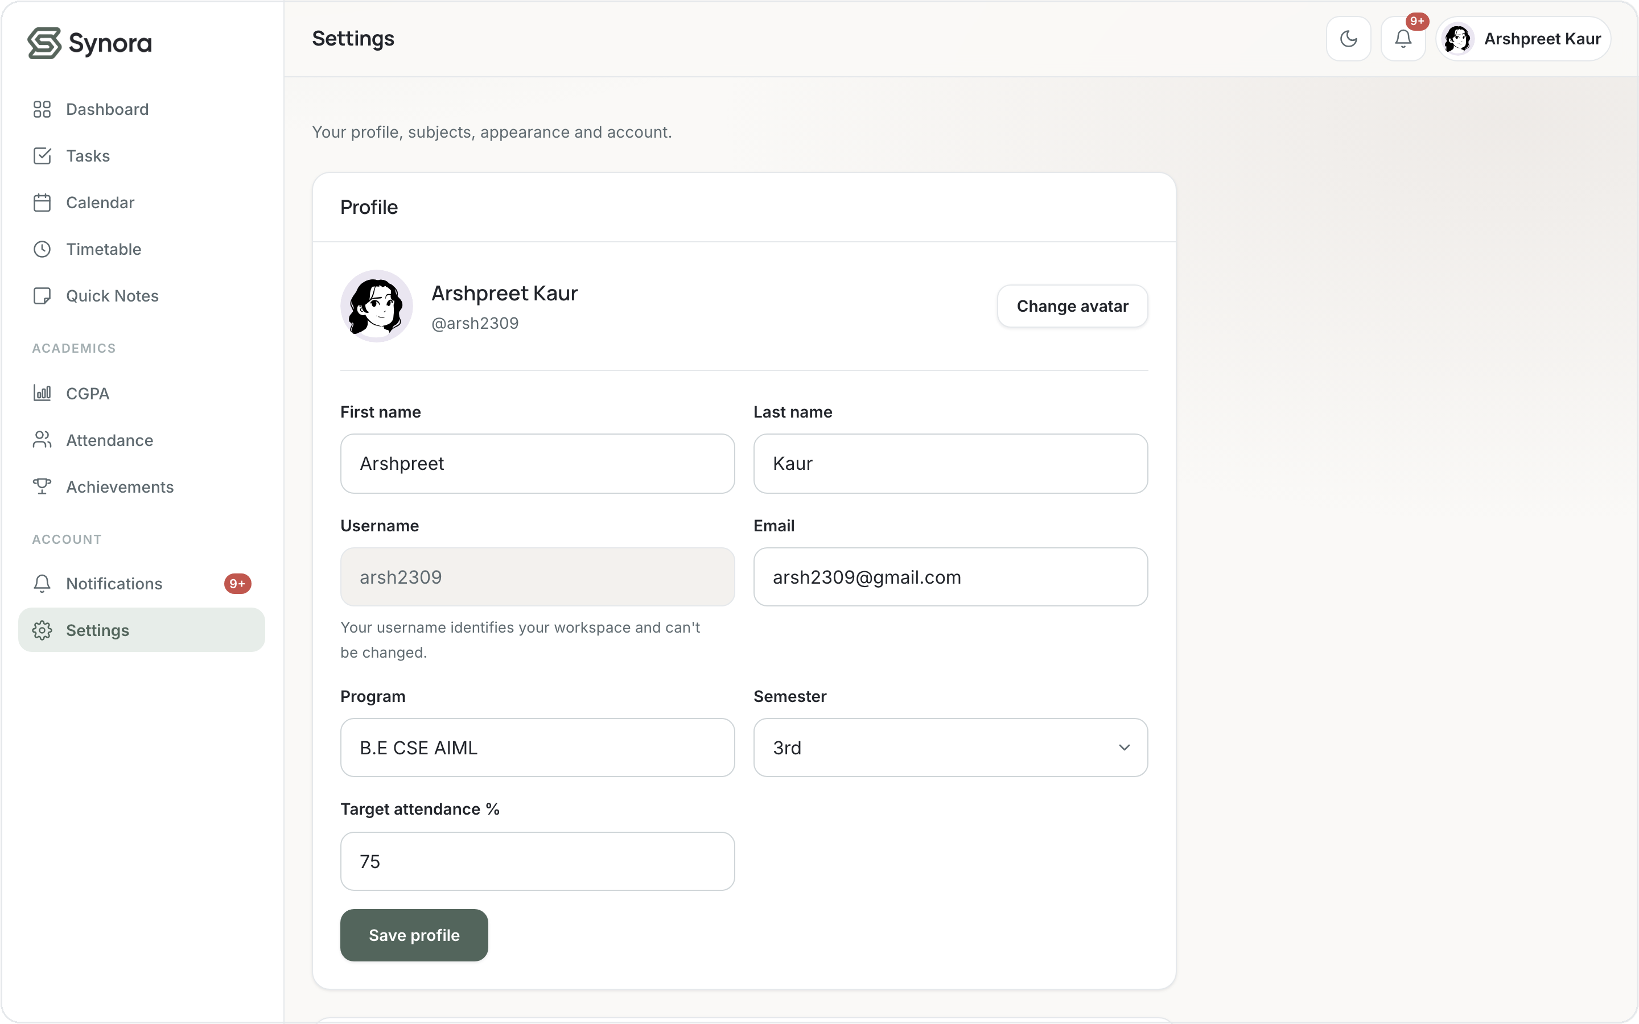
HTML5 · ACCESSIBILITY BASICS
Meaningful, accessible controls
Labels for every input
16 <label> elements — clicking a label focuses its field.
ARIA where it helps
91 aria-* attributes: aria-label, aria-labelledby, aria-live regions.
Right input types
type=email, number, date, password — the keyboard and validation adapt.
Alt text on imagery
18 alt attributes; decorative art is marked aria-hidden.
Settings — every field has a real <label> and input type.
Keyboard-friendly
A skip-link and a .visually-hidden pattern for screen-reader-only text.
Synora · Web Development Project
07 / 20
Notes:
Be honest: this is accessibility BASICS, not certified WCAG compliance. What's genuinely there: labels (16), aria-* (91), correct input types, alt text (18), a skip-link and a visually-hidden utility. Viva: what makes a form accessible? Programmatic label-to-input association and correct input types.

Slide 8
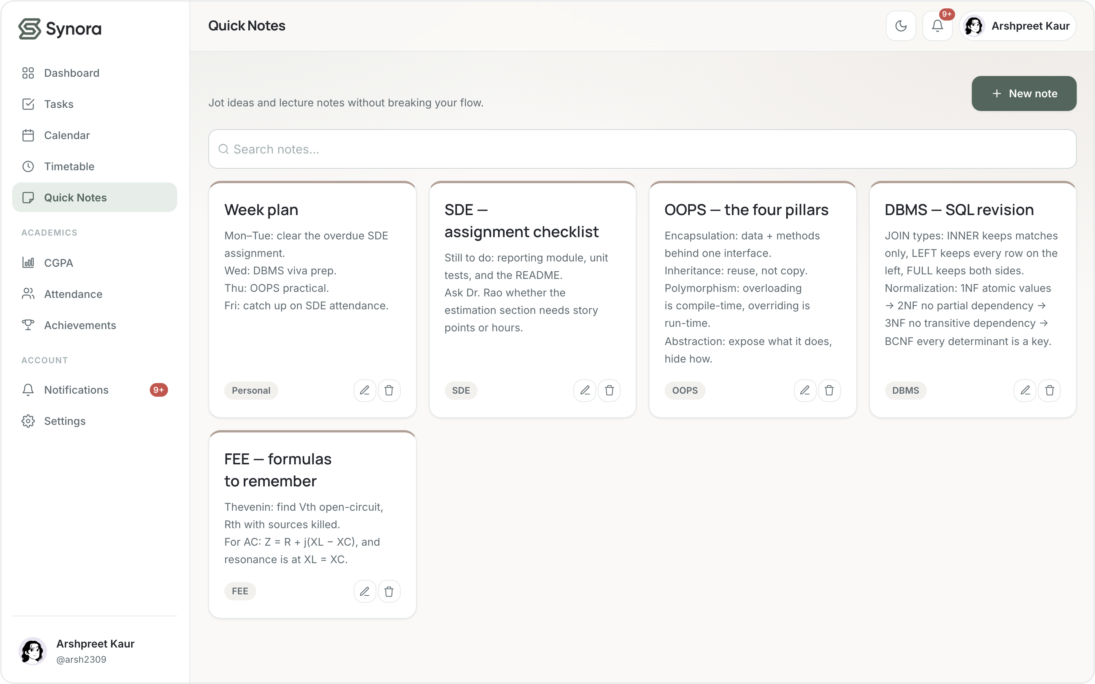
LECTURE 1–6 · CSS3
One design system, not many pages
CSS3 custom properties define the look once — ~142 design tokens for colour, type, spacing, radius and shadow. Every card, button and form reuses them, so the whole app feels like one product.
Ink
Sage
Slate
Mist
Taupe
Quick Notes — same cards,
buttons and spacing tokens.
#22252B
#53655C
#A3AEB1
#E5E8EB
#B09F95
Typography
Reused components
Manrope
.btn .card .field .chip
headings · Inter for body text
defined once, used everywhere
Synora · Web Development Project
08 / 20
Notes:
CSS3 was used to build a design SYSTEM, not to style each page by hand. ~142 custom properties in tokens.css hold the palette, type scale, spacing, radii and shadows; light/dark themes swap the same tokens. Viva: why CSS variables? Single source of truth — change a token, the whole app updates.

Slide 9
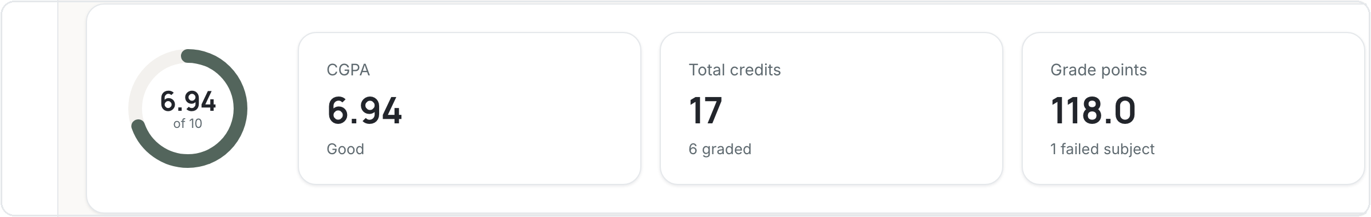
CSS3 · THE BOX MODEL
Every component is a box
margin
styles/app.css — a dashboard stat card
border
.stat-card {
padding: 20px 24px; /* space inside */
background: var(--color-surface);
border: 1px solid var(--color-border);
border-radius: var(--radius-lg);
box-shadow: var(--shadow-sm);
}
padding
content
content → padding → border → margin
Those same tokens build every card — here, the CGPA summary row:
Synora · Web Development Project
09 / 20
Notes:
The box model is not theory here — every card IS a box. .stat-card sets padding (space inside), a 1px border, rounded corners and a soft shadow, all via tokens. Viva: name the four box-model layers from inside out — content, padding, border, margin.

Slide 10
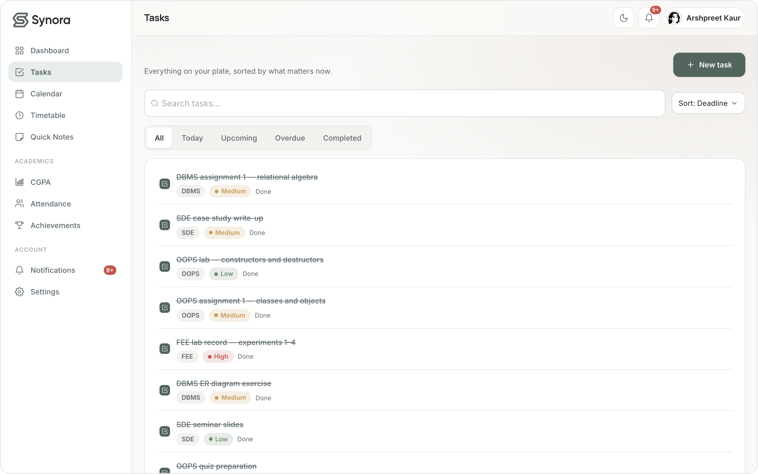
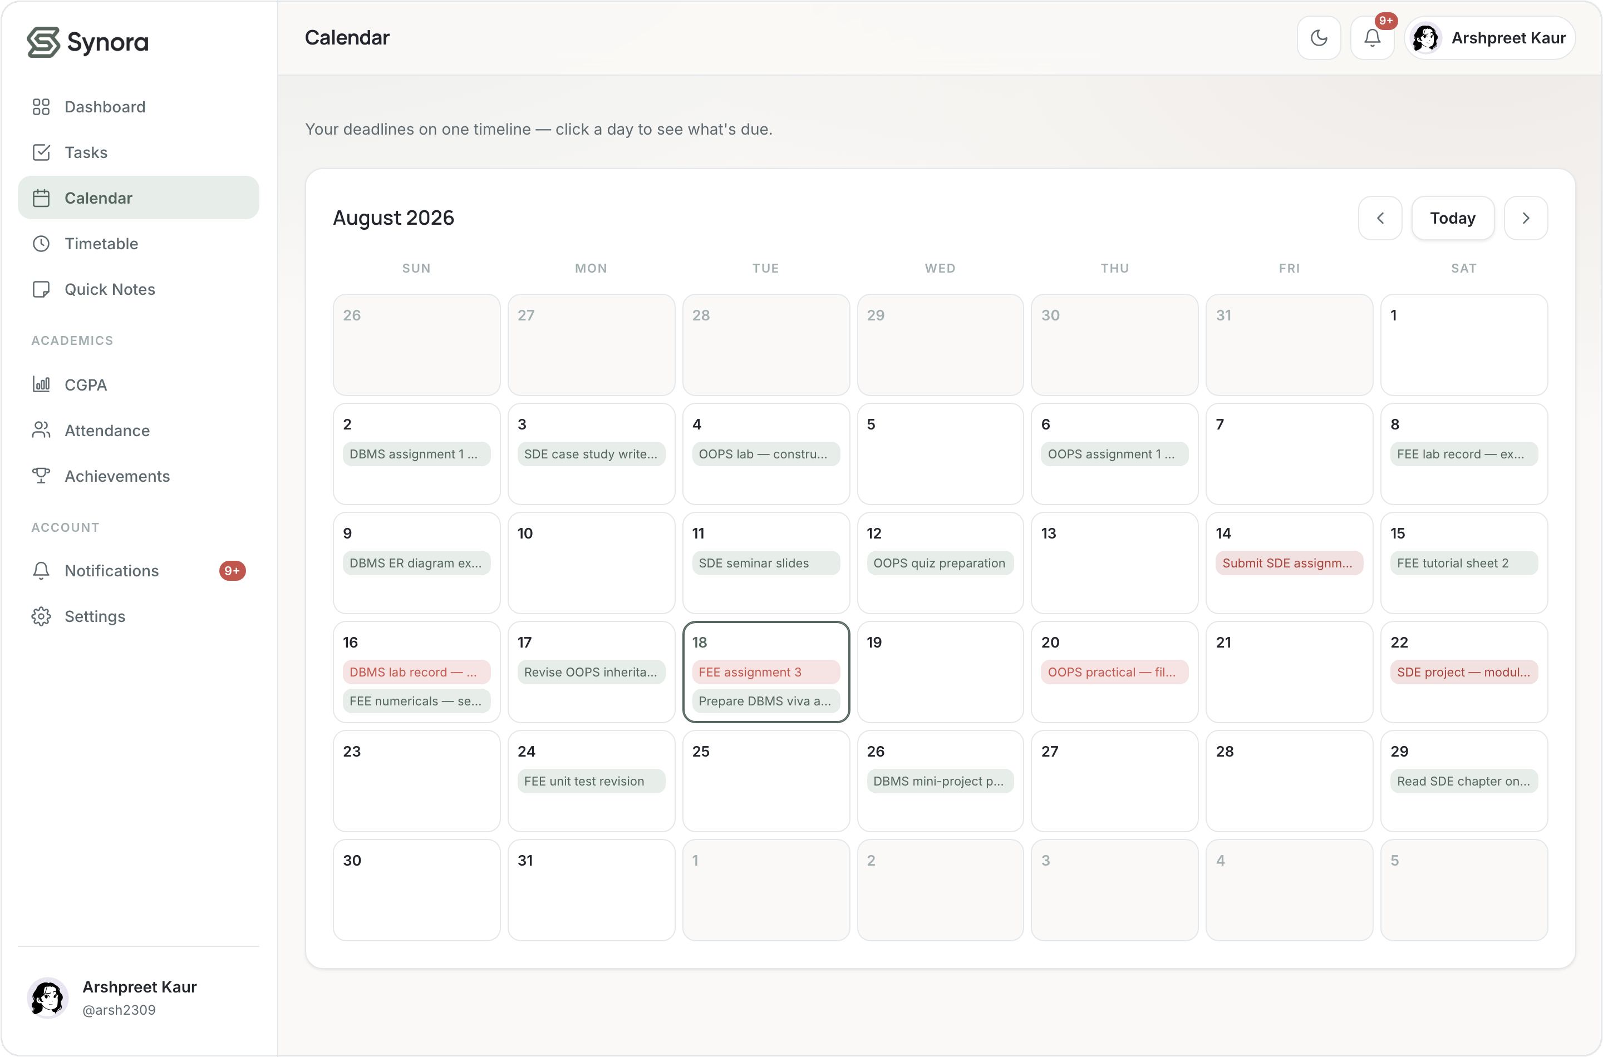
CSS3 · LAYOUT
Flexbox for rows, Grid for structure
Flexbox — one-dimensional rows
Grid — two-dimensional layouts
display: flex aligns the top bar, toolbars and button rows.
display: grid builds the calendar, dashboard & note grids.
Used in ~116 rules — align-items, gap, flex-wrap.
Used in ~51 rules — repeat(7, minmax(0,1fr)), gap.
styles/app.css — the seven-column calendar grid
.cal-grid { display: grid; grid-template-columns: repeat(7, minmax(0, 1fr)); gap: 6px; }
Synora · Web Development Project
10 / 20
Notes:
Flexbox and Grid do different jobs. Flexbox (116 rules) lays out one-dimensional rows — the sticky top bar, toolbars, button groups. Grid (51 rules) handles two-dimensional structure — the calendar's 7 columns, the dashboard cards, the notes masonry. Viva: why Grid for the dashboard? It's a real 2-D arrangement of rows and columns.

Slide 11
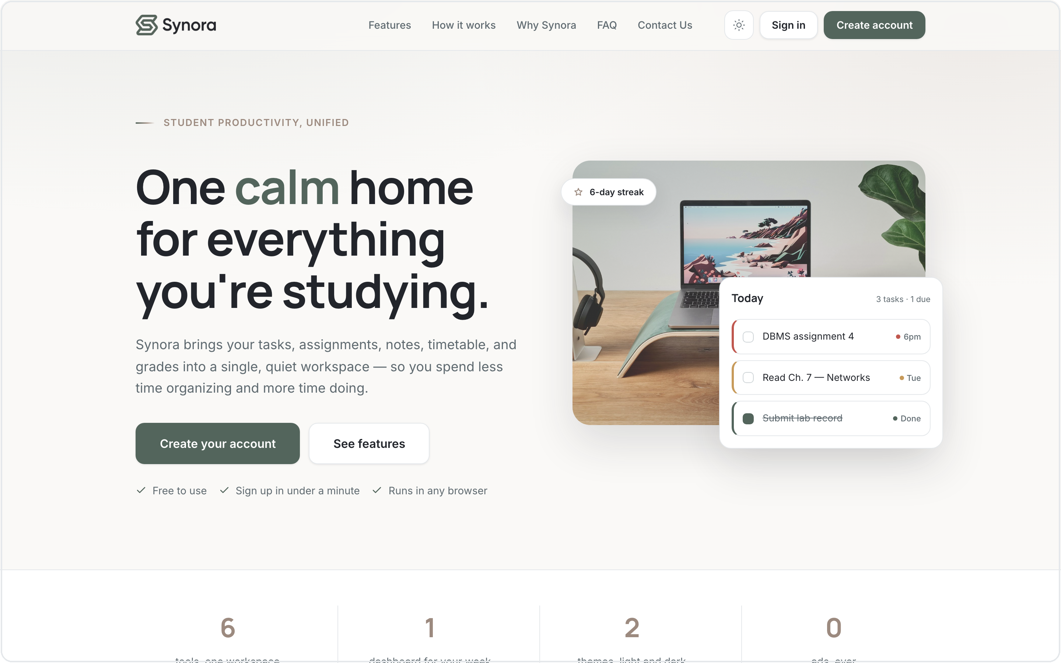
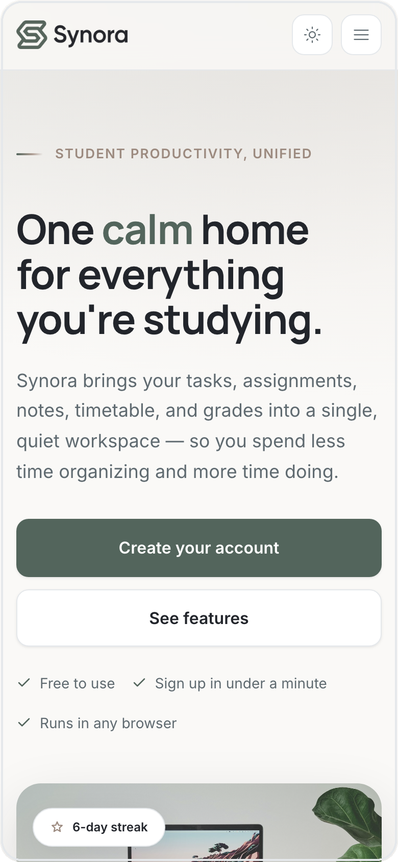
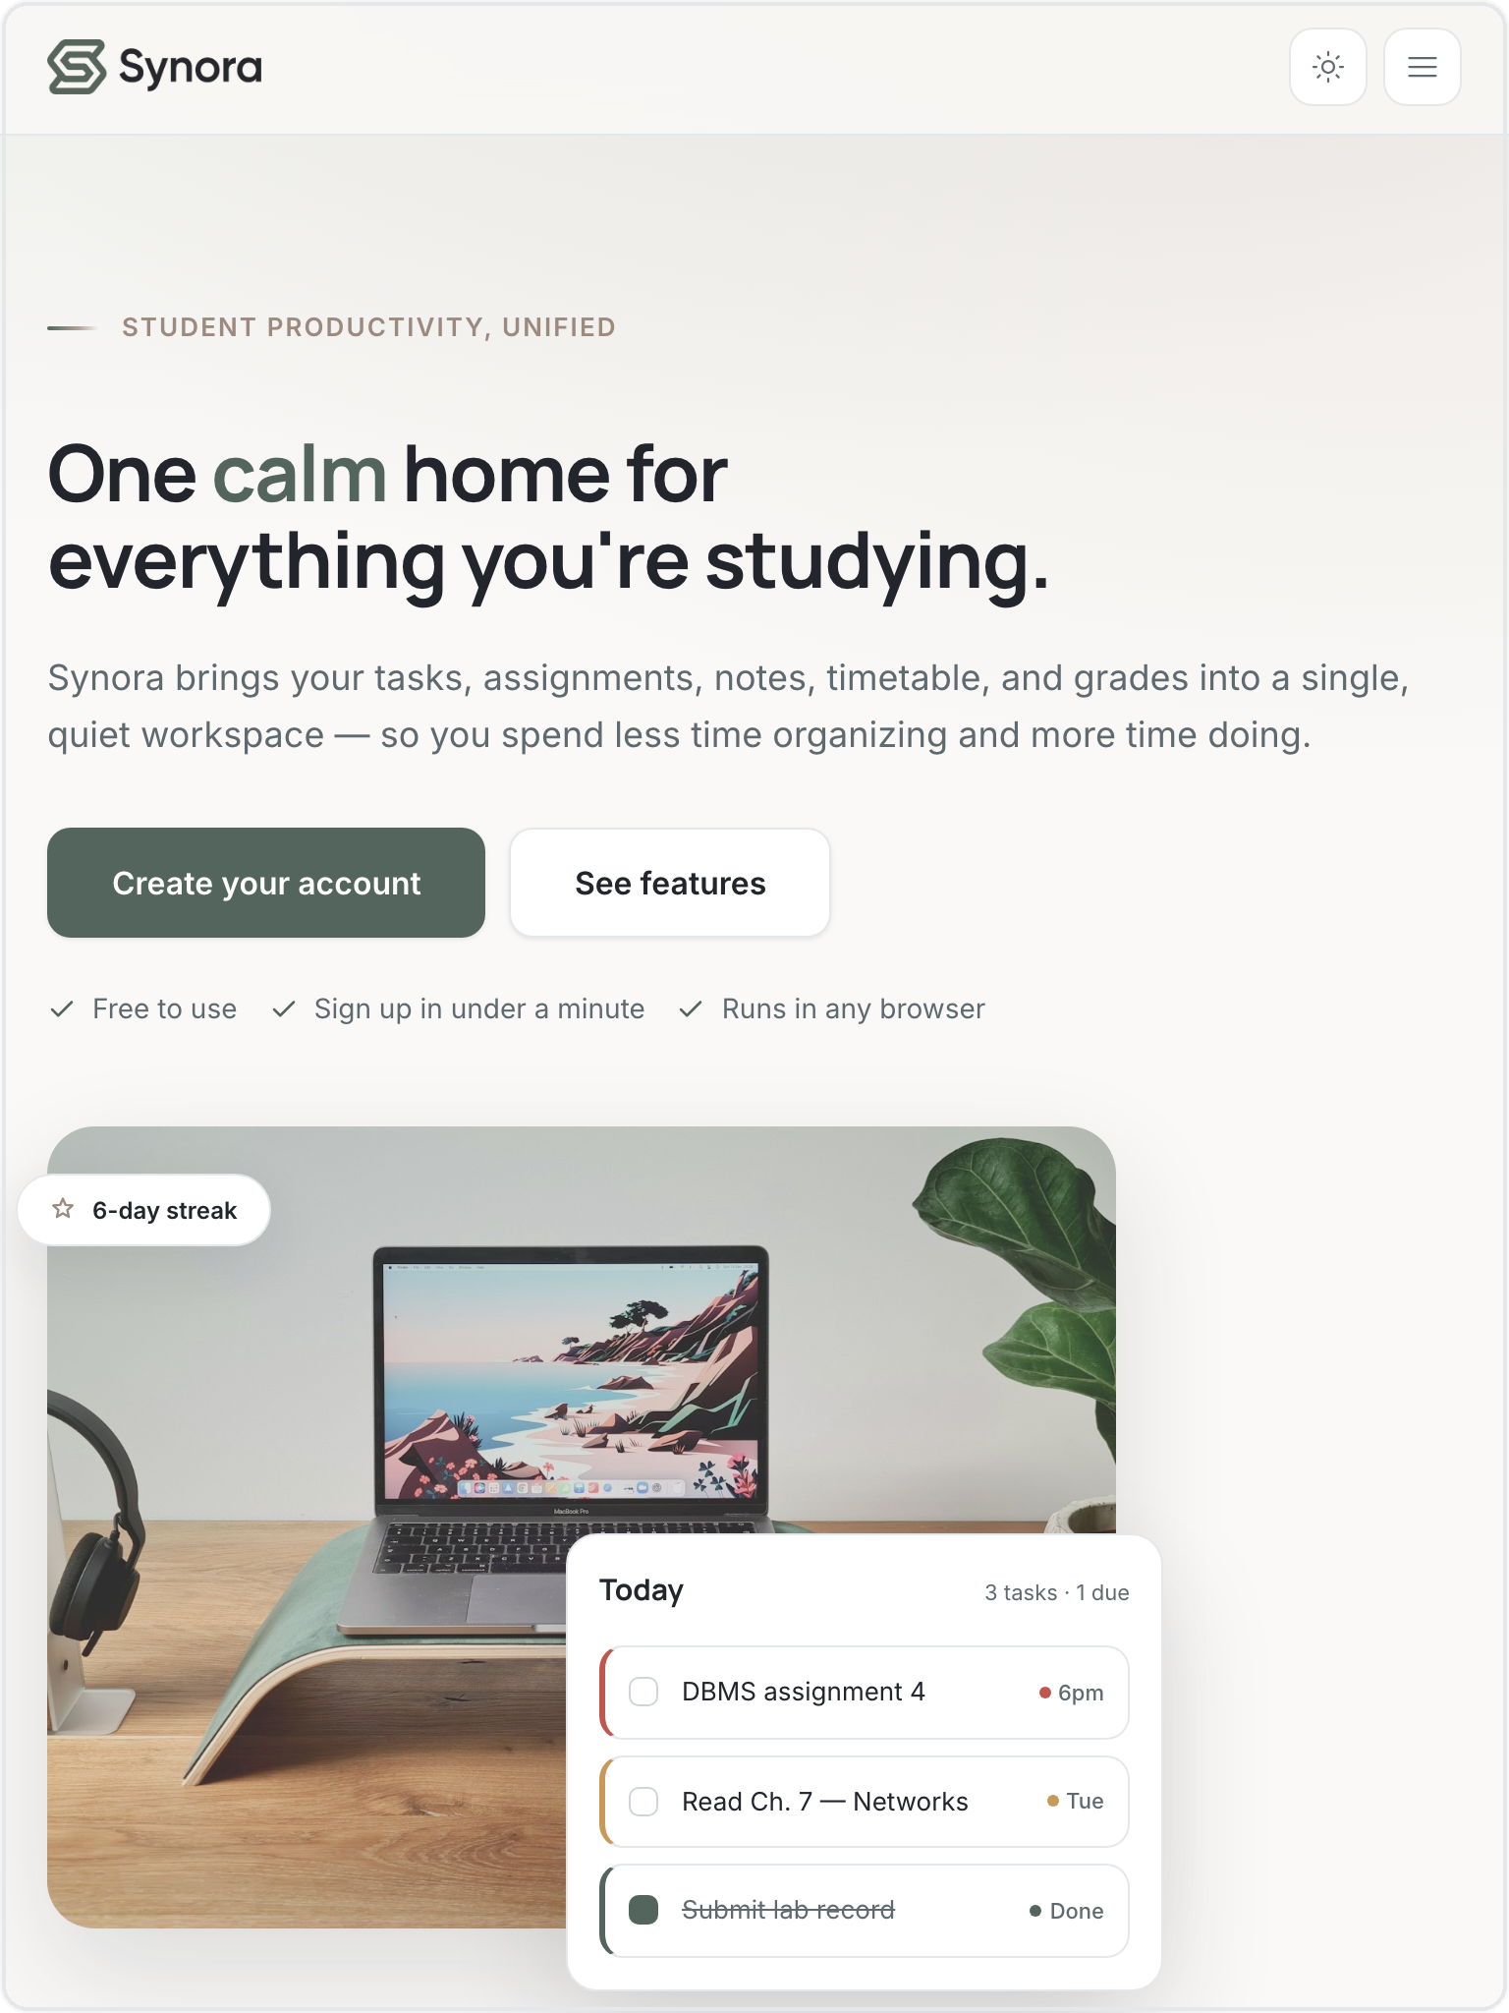
CSS3 · RESPONSIVE DESIGN
One page, every screen
1440px · Desktop
768px · Tablet
390px · Mobile
Desktop-first — Flexbox + Grid reflow, max-width media queries adapt down, and the nav collapses to a CSS-only menu.
Synora · Web Development Project
11 / 20
Notes:
This proves responsiveness rather than claiming it — the SAME landing page at 1440/768/390. Note the grid hero collapses to one column, buttons go full-width, and the navbar becomes a hamburger. Be accurate: the strategy is DESKTOP-FIRST (max-width breakpoints adapting down), not mobile-first. The menu toggle is pure CSS — a hidden checkbox, no JavaScript.

Slide 12
LECTURE 7–12 · JAVASCRIPT
From a static page to a product
HTML and CSS give structure and style; JavaScript adds the behaviour. The five fundamentals map directly onto real parts of Synora:
scripts/tasks.js — arrays, objects & loops
function filtered() {
var items = all().slice();
items = items.filter(function(t) {
return t.title.indexOf(q) >= 0;
});
items.sort(byDeadline);
return items;
}
Variables
hold application state
state = { view, sort, query }
Functions
reusable operations
render() · toggleComplete()
Arrays
lists of things
tasks · subjects · timetable
Objects
structured records
{ id, title, priority, deadline }
One function turns an array of task objects into the filtered, sorted list you see — variables, functions, arrays, objects and loops all in a few lines.
Loops
render each item
.map() · .filter() · .forEach()
Synora · Web Development Project
12 / 20
Notes:
Connect each fundamental to something concrete. State lives in variables; render() and toggleComplete() are reusable functions; tasks/subjects are arrays; each task is an object; .map / .filter / .forEach are the loops. The snippet shows all five working together. Viva: difference between an array and an object? Ordered list vs keyed record.

Slide 13
LECTURE 23–26 · DOM
Making the interface dynamic
The page is a tree of nodes
Create, configure, insert — then remove
document
scripts/app.js — the toast lifecycle
└─ main.page
var el = document.createElement("div"); // 1 create
el.className = "toast";
el.setAttribute("role", "status"); // 2 config
el.textContent = message;
region.appendChild(el); // 3 insert
…
el.remove(); // 4 delete
└─ section.toolbar
└─ input[data-search]
└─ div[data-list]
└─ div.tlist
└─ div.trow ← one per task
SELECTORS ACTUALLY USED
JS reads and writes the page through the DOM: select an element, change its text, classes or attributes, build new nodes, and remove them when done. classList is toggled in ~35 places.
querySelector() ×161
querySelectorAll() ×23
getElementById() ×9
Synora · Web Development Project
13 / 20
Notes:
DOM = the browser's live object model of the HTML. We select nodes (querySelector 161×, querySelectorAll 23×, getElementById 9×), read/write text and classes, and create/remove nodes. The toast shows the full node lifecycle: createElement → configure → appendChild → remove. Viva: what is the DOM? A tree of objects representing the document that JS can change on the fly.

Slide 14
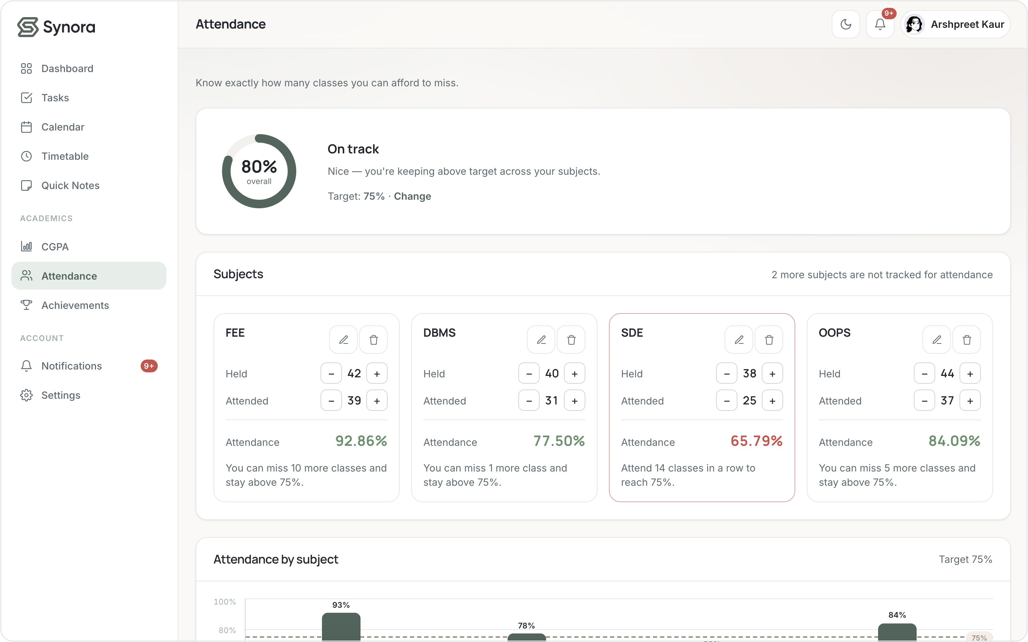
LECTURE 27–30 · EVENTS
From a click to an updated screen
User acts
Event fires
addEventListener
Handler runs
DOM / data update
Screen re-renders
scripts/tasks.js — click & input listeners
var addBtn = document.querySelector("[data-add-task]");
addBtn.addEventListener("click", function() {
openForm(null, render); // click → open the task form
});
search.addEventListener("input", function(e) {
state.query = e.target.value; render(); // each keystroke
});
Attendance +/– buttons fire click events that recompute every percentage instantly. addEventListener is used ~93×.
Synora · Web Development Project
14 / 20
Notes:
Events are the whole interaction model. The flow: user acts → event fires → addEventListener's handler runs → it changes data/DOM → the screen re-renders. Real examples: the add-task click, the search input firing on every keystroke, attendance +/- buttons. addEventListener appears ~93 times; preventDefault ~11.

Slide 15
EVENTS · PROPAGATION & DELEGATION
One listener, many buttons
Events bubble up the tree
scripts/tasks.js — event delegation
container [data-list]
// ONE listener handles every task row
container.addEventListener("click", function(e){
var t = e.target.closest("[data-toggle]");
var d = e.target.closest("[data-del]");
if (t) { toggleComplete(t...); rerender(); }
else if (d) { remove(d...); rerender(); }
});
click on a
button bubbles
up to the list
div.trow
button [data-toggle]
IN SYNORA — HONESTLY
Event bubbling used — clicks bubble to the parent
Task rows are re-rendered constantly, so binding a listener to each button would be fragile. Instead one listener sits on the container and uses e.target.closest() to find which button was clicked — that is event delegation, powered by bubbling.
Event delegation used — .closest() in ~28 handlers
preventDefault used — forms & links (~11)
Explicit capturing concept only — not a pattern we use
Synora · Web Development Project
15 / 20
Notes:
This is the honesty slide the brief demands. USED: bubbling, delegation via closest() (28 handlers), preventDefault. NOT a real pattern: explicit event capturing — say so plainly. Explain why delegation matters here: rows are re-rendered, so one durable listener on the parent is more robust than per-button listeners. Viva: bubbling vs capturing — bubbling goes child→parent, capturing parent→child.

Slide 16
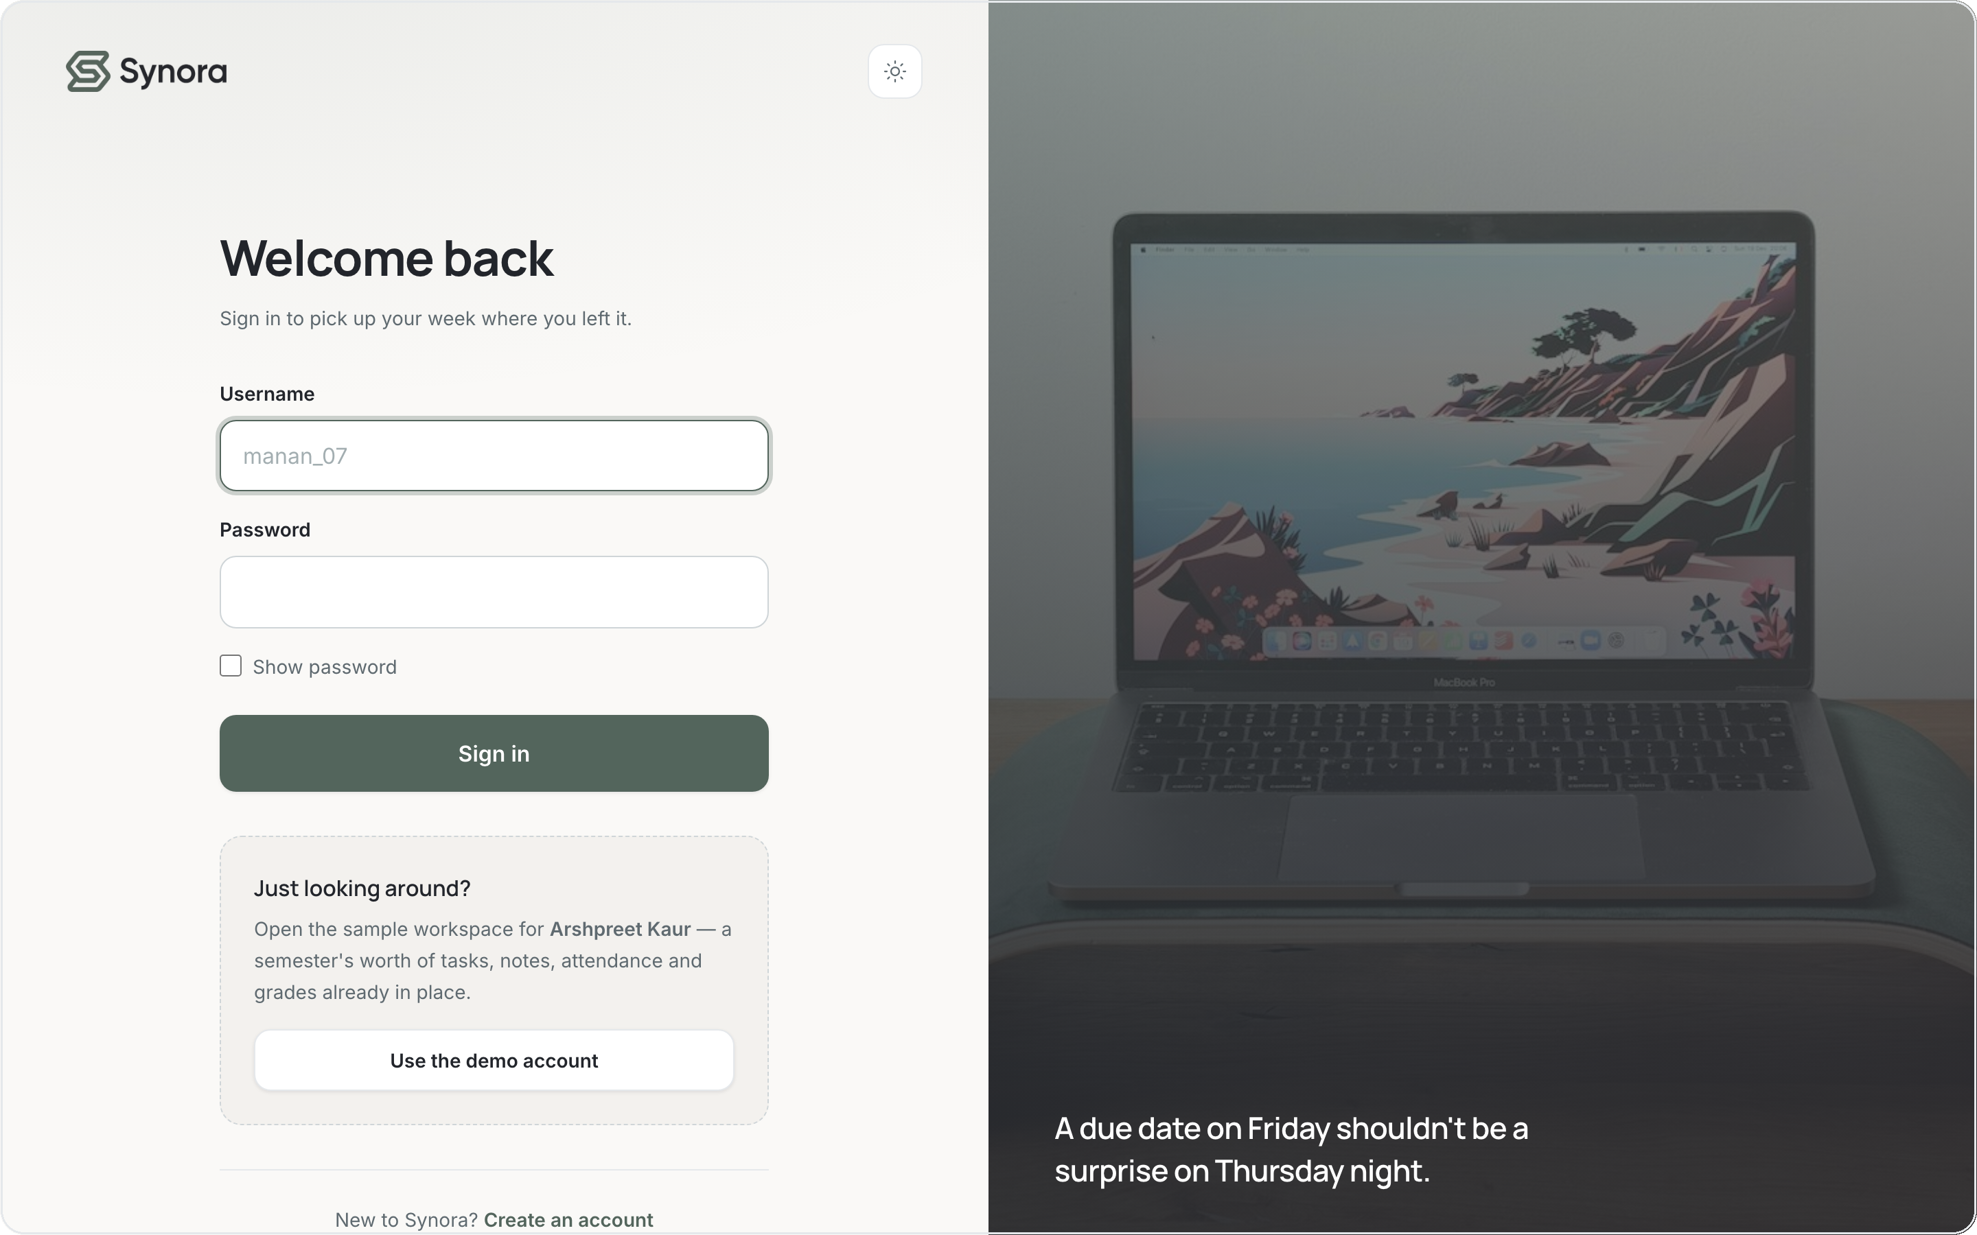
EVENTS · FORMS & VALIDATION
Catching mistakes before they save
Two layers of validation
HTML attributes
required, type=email, minlength — the browser's first check
JavaScript on submit
e.preventDefault(), trim, regex, then friendly inline errors
Live error clearing
the error disappears the moment the field is corrected
scripts/auth.js — sign-up validation
Sign-in and sign-up validate on submit and clear errors as you type.
form.addEventListener("submit", function(e){
e.preventDefault(); // stop native submit
if (!EMAIL_RE.test(email))
setError("email", "Check your email.");
});
Synora · Web Development Project
16 / 20
Notes:
Validation is layered. HTML attributes (required, type=email, minlength) are the first gate. On submit, JS calls preventDefault(), trims input, tests it against regexes, and shows friendly inline errors instead of the browser default. Errors clear live as the user fixes the field. Viva: why validate in JS if HTML already does? Custom messages, cross-field checks like password confirmation, and control over UX.

Slide 17
USER EXPERIENCE · THE LOADING SCREEN
Before you see Synora
Splash
Handover
Landing
logo, ring & wordmark
animate in
splash fades & lifts as the
page arrives underneath
the hero's staggered
entrance begins
HOW IT ACTUALLY WORKS
index.html — the reveal()
CSS @keyframes — spin, breathe, pop & sheen — pure CSS animation
if (!ready || !timeUp) return;
body.classList.add("is-ready");
loader.classList.add("is-hidden");
setTimeout(() => loader.remove(), 800);
A CSS transition — the splash fades + lifts on the .is-hidden class
JavaScript timing — shows for ≥2000ms, waits for DOMContentLoaded
DOM + state — toggles classes, then loader.remove() clears the node
CSS paints and animates; JavaScript only decides when the splash may leave. The two movements overlap, so Synora feels like it opens rather than loads.
Reduced motion — honoured — animation off, wait cut to 600ms
Synora · Web Development Project
17 / 20
Notes:
The splash is a real UX + technical feature. Mechanism, honestly: the animation is pure CSS @keyframes; the exit is a CSS transition on .is-hidden; JavaScript only controls TIMING — it shows the splash for at least 2000ms, waits for DOMContentLoaded, toggles is-ready/is-hidden, then removes the node. prefers-reduced-motion is respected. Viva: is the animation JS or CSS? The motion is CSS; JS just decides when it ends.

Slide 18
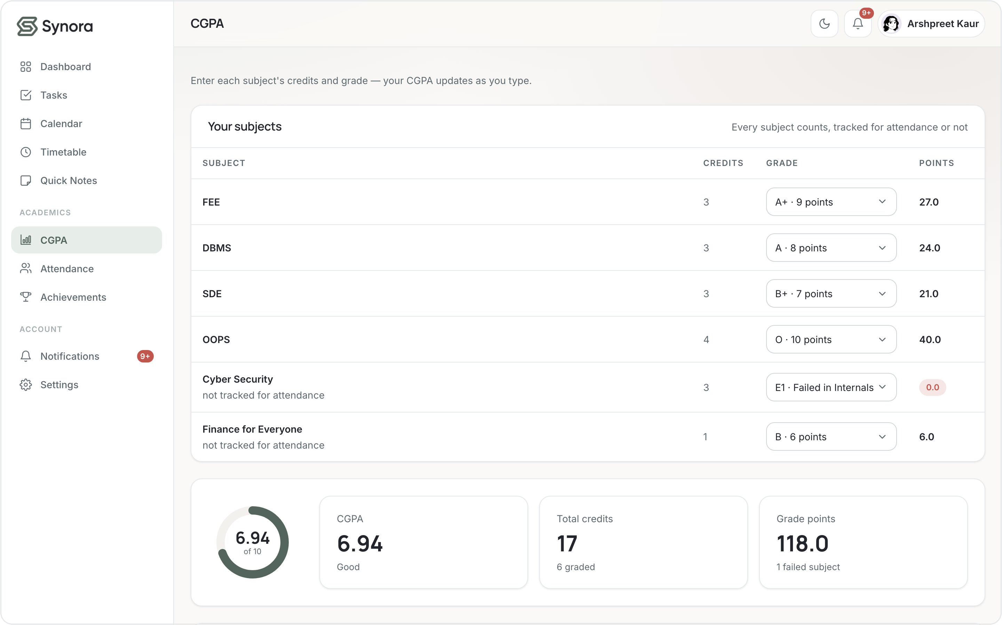
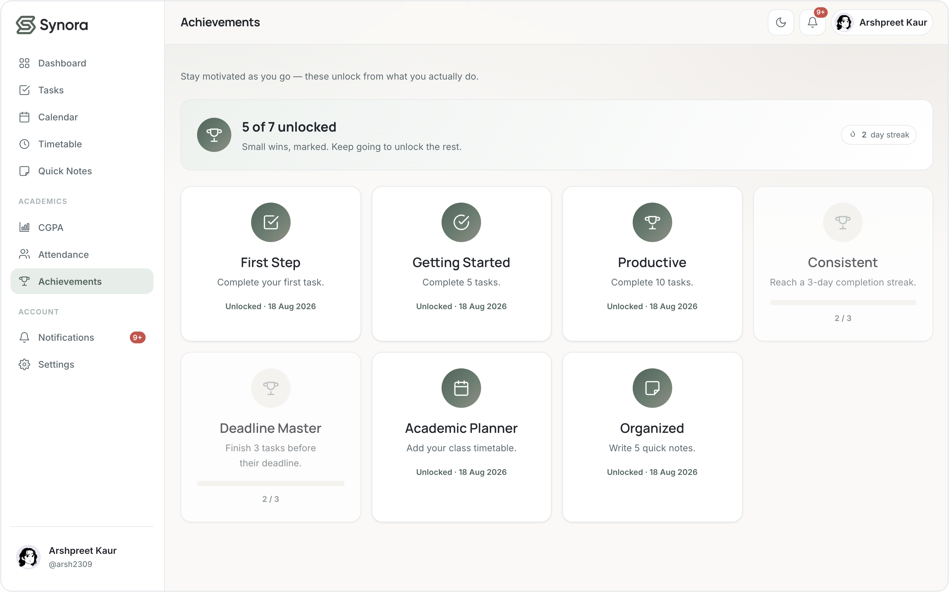
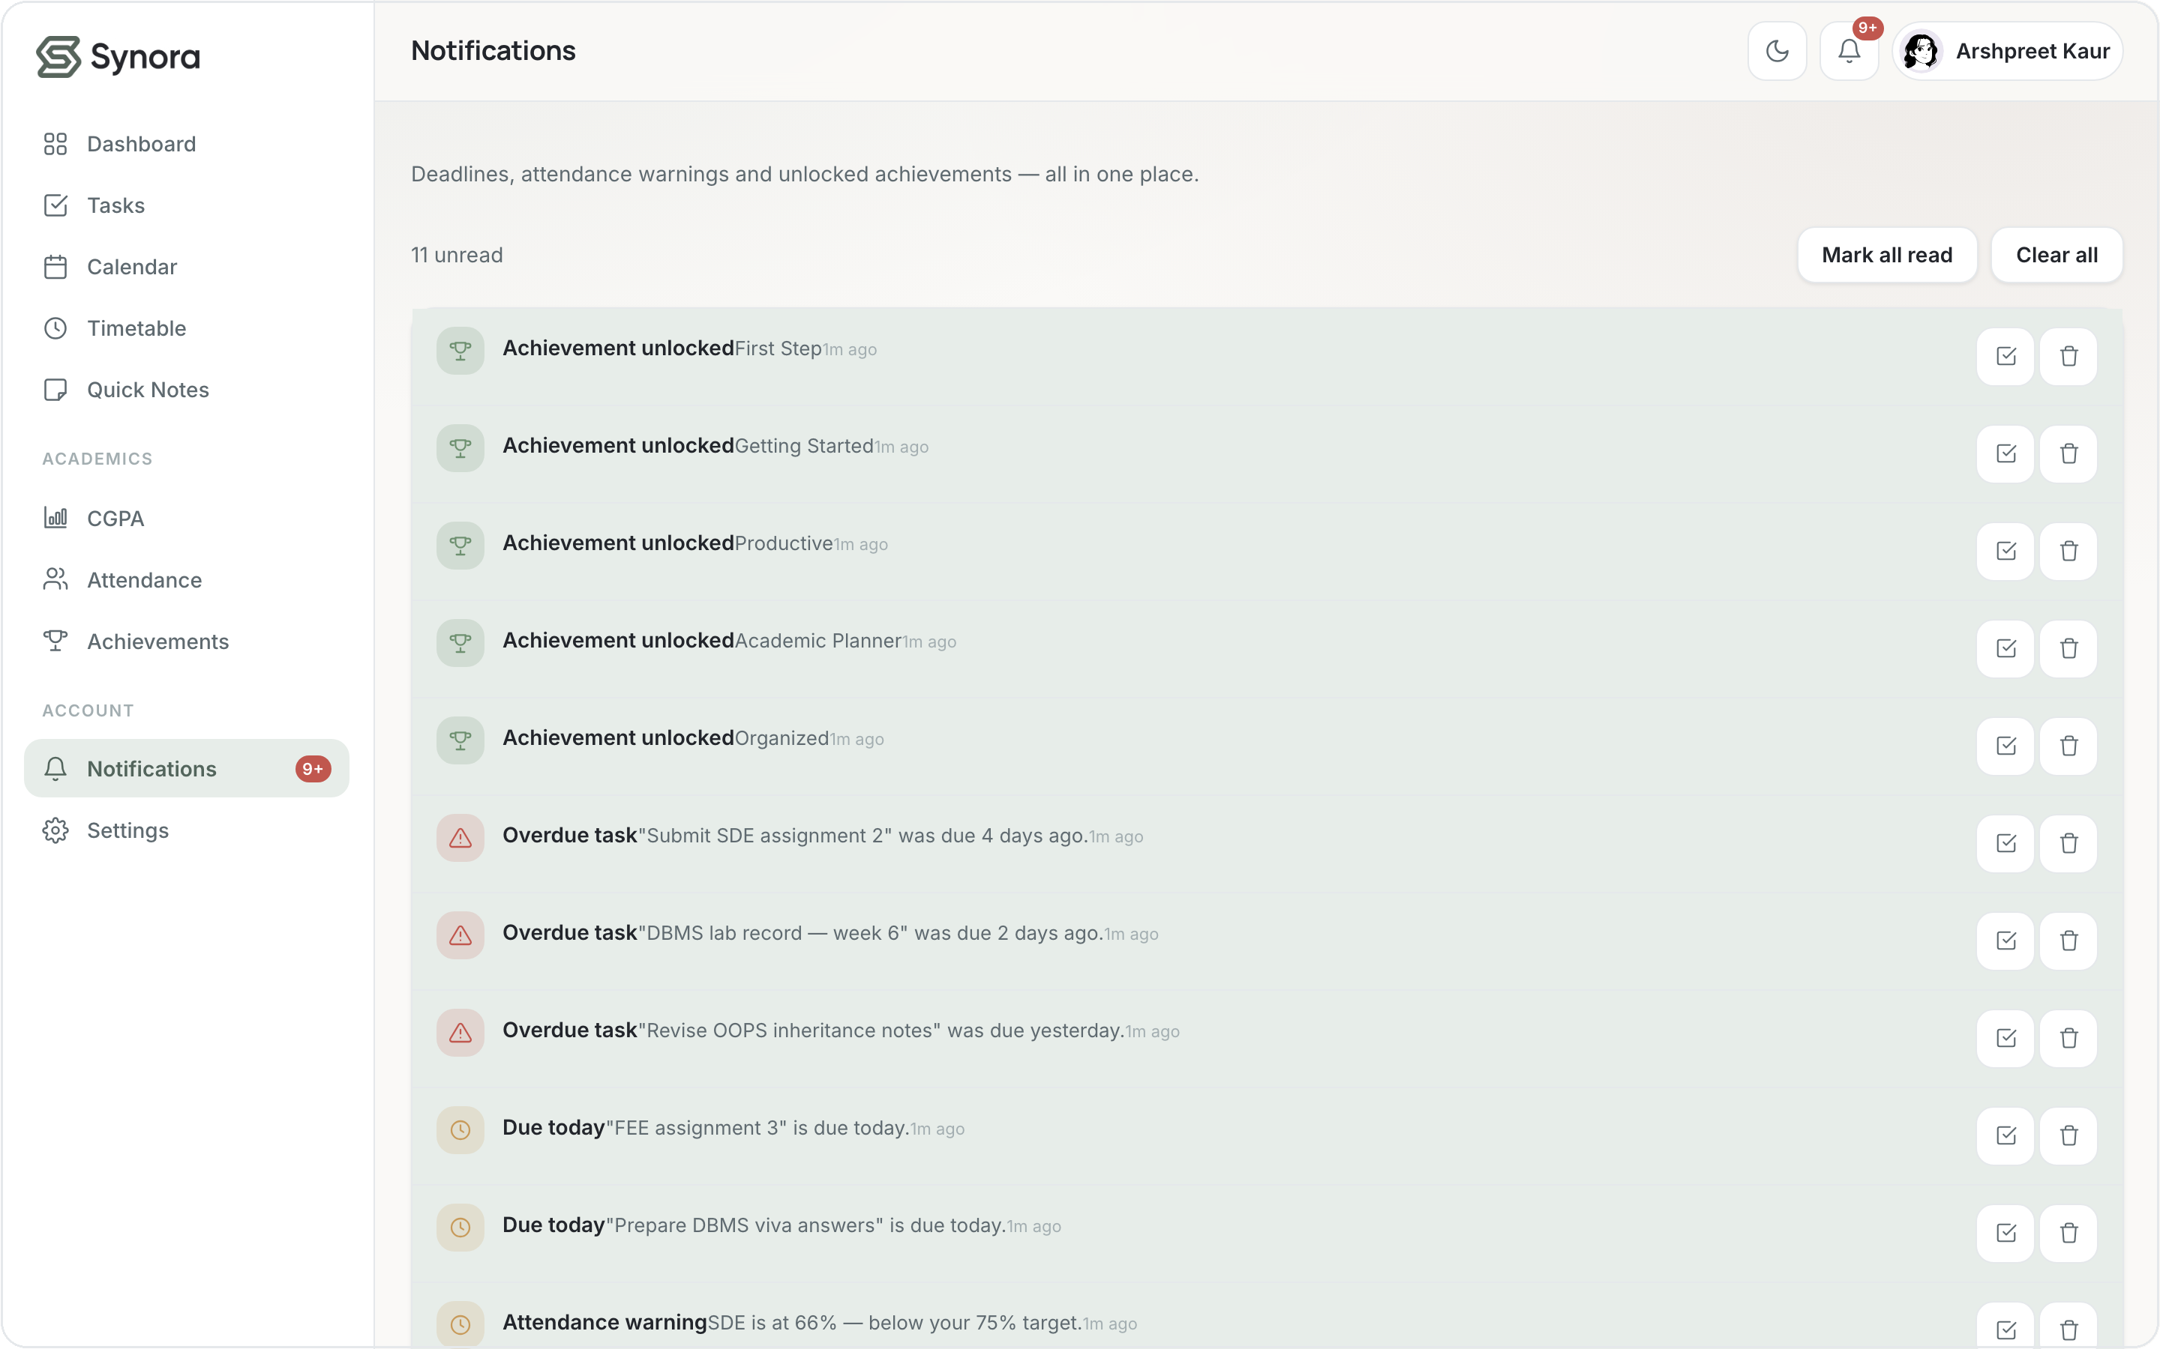
THE PRODUCT WE SHIPPED
Beyond the syllabus
The syllabus gave us the parts — we built complete, connected features, plus personalization & avatars, light / dark themes, per-user workspaces and on-device persistence.
Task management
Smart calendar
Attendance calculator
CGPA calculator
Achievements
Notifications
Synora · Web Development Project
18 / 20
Notes:
This is the pay-off. Beyond the listed concepts we built a full dashboard, task manager, calendar, attendance calculator (tells you how many classes you can miss), a live CGPA calculator, an achievements system, notifications, personalization with avatars, light/dark themes, per-user workspaces and on-device persistence. Subjects are the single source of truth that attendance, CGPA and the timetable all reference.

Slide 19
SYLLABUS MAPPING
What we applied
HTML5
CSS3
JavaScript
DOM
Events
✓
Semantic structure
✓
Box model
✓
Variables & functions
✓
querySelector(All)
✓
addEventListener
✓
Forms & inputs
✓
Flexbox
✓
Arrays & objects
✓
getElementById
✓
Delegation
✓
Accessibility basics
✓
Grid
✓
Loops
✓
create / append
✓
Form validation
✓
Figure / media
✓
Media queries
✓
localStorage
✓
remove nodes
○
Capturing
✓ implemented in Synora ○ learned as a concept, not a primary pattern
Synora · Web Development Project
19 / 20
Notes:
Honest scorecard. Almost everything is ticked and genuinely implemented. The one open circle is explicit event capturing — we understand it but don't use it as a pattern; delegation via bubbling is what the app relies on. Keeping that circle open is what makes every tick credible.

Slide 20
THE TAKEAWAY
Concepts in, product out
SYLLABUS
IMPLEMENTATION
Synora
HTML5
Structure
CSS3
Design system
A real, responsive student-productivity product — built entirely from the syllabus, then taken further.
JavaScript
Logic & state
DOM
Dynamic UI
Events
Interaction
Synora — one calm home for everything you're studying.
Notes:
Close by restating the thesis as a pipeline: syllabus concepts → implementation techniques → the Synora product. We used core web-development concepts to build a real, responsive, interactive student-productivity app, then extended them. End on the tagline.

