Slide 1
1,068
Wikipedia Math Essentials
Mapping math as a knowledge network
math pages connected by
27,079 directed links
Centrality, public attention, soft communities, latent graph structure, and what the model can actually predict.
PageRank
GMM
SVD
Ridge
Manan Kothari | CSCI 4022

Slide 2
PROJECT QUESTION
Can link structure explain what people read?
The proposal framed Wikipedia math as both a graph and a time series.
G = (V, E, w)
|V| = 1,068 pages
|E| = 27,079 directed links
yᵢₜ = visits to page i on day t
Centrality
Which topics are structurally important inside the math link network?
Attention
Do those central pages also attract more daily visits?
Communities
Explanation: each page is a point, each hyperlink is an arrow, and each day adds a visit count for every page.
Do soft clusters reveal pages that belong to several areas at once?
Prediction
How much of public attention is predictable from graph structure?
Source: proposal PDF and notebook research questions.
Wikipedia Math Essentials Network Project

Slide 3
DATASET ANATOMY
The data is one network plus 731 daily snapshots
A strong project shape: static links for structure, daily visits for attention.
1,068
27,079
731
2019-2021
pages / nodes
directed edges
daily snapshots
date range
->
->
Raw JSON
Feature table
Models
edges, weights, node_ids, time_periods, dated y vectors
degree, weighted degree, PageRank, visit mean, visit volatility
PageRank, GMM, SVD embeddings, Ridge regression
The graph is weakly connected as one full system, but every node is its own strongly connected component: links mostly point outward without many return paths.
Source: diagnostic_summary.csv and notebook graph sanity checks.
Wikipedia Math Essentials Network Project

Slide 4
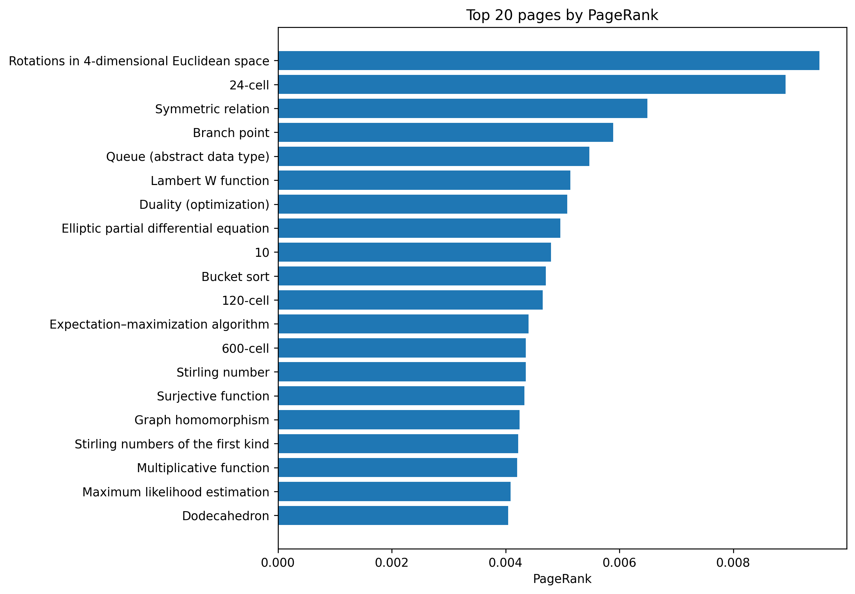
PAGERANK
Central pages are not always the familiar ones
PageRank rewards pages that receive links from other important pages.
PR(i) = (1 − d)/N + d ∑ⱼ→ᵢ PR(j) · wⱼᵢ / ∑ₖ wⱼₖ
d = 0.85
Explanation: a page scores highly when important pages point to it. A vote from a well-connected page counts more than a vote from an isolated one.
Result: specialized pages such as 4D rotations and 24-cell rise to the top because the link graph funnels authority into them, even though their public visits are modest.
Source: 03_top_20_pagerank.png and nodes_enriched_with_diagnostics.csv.
Wikipedia Math Essentials Network Project

Slide 5
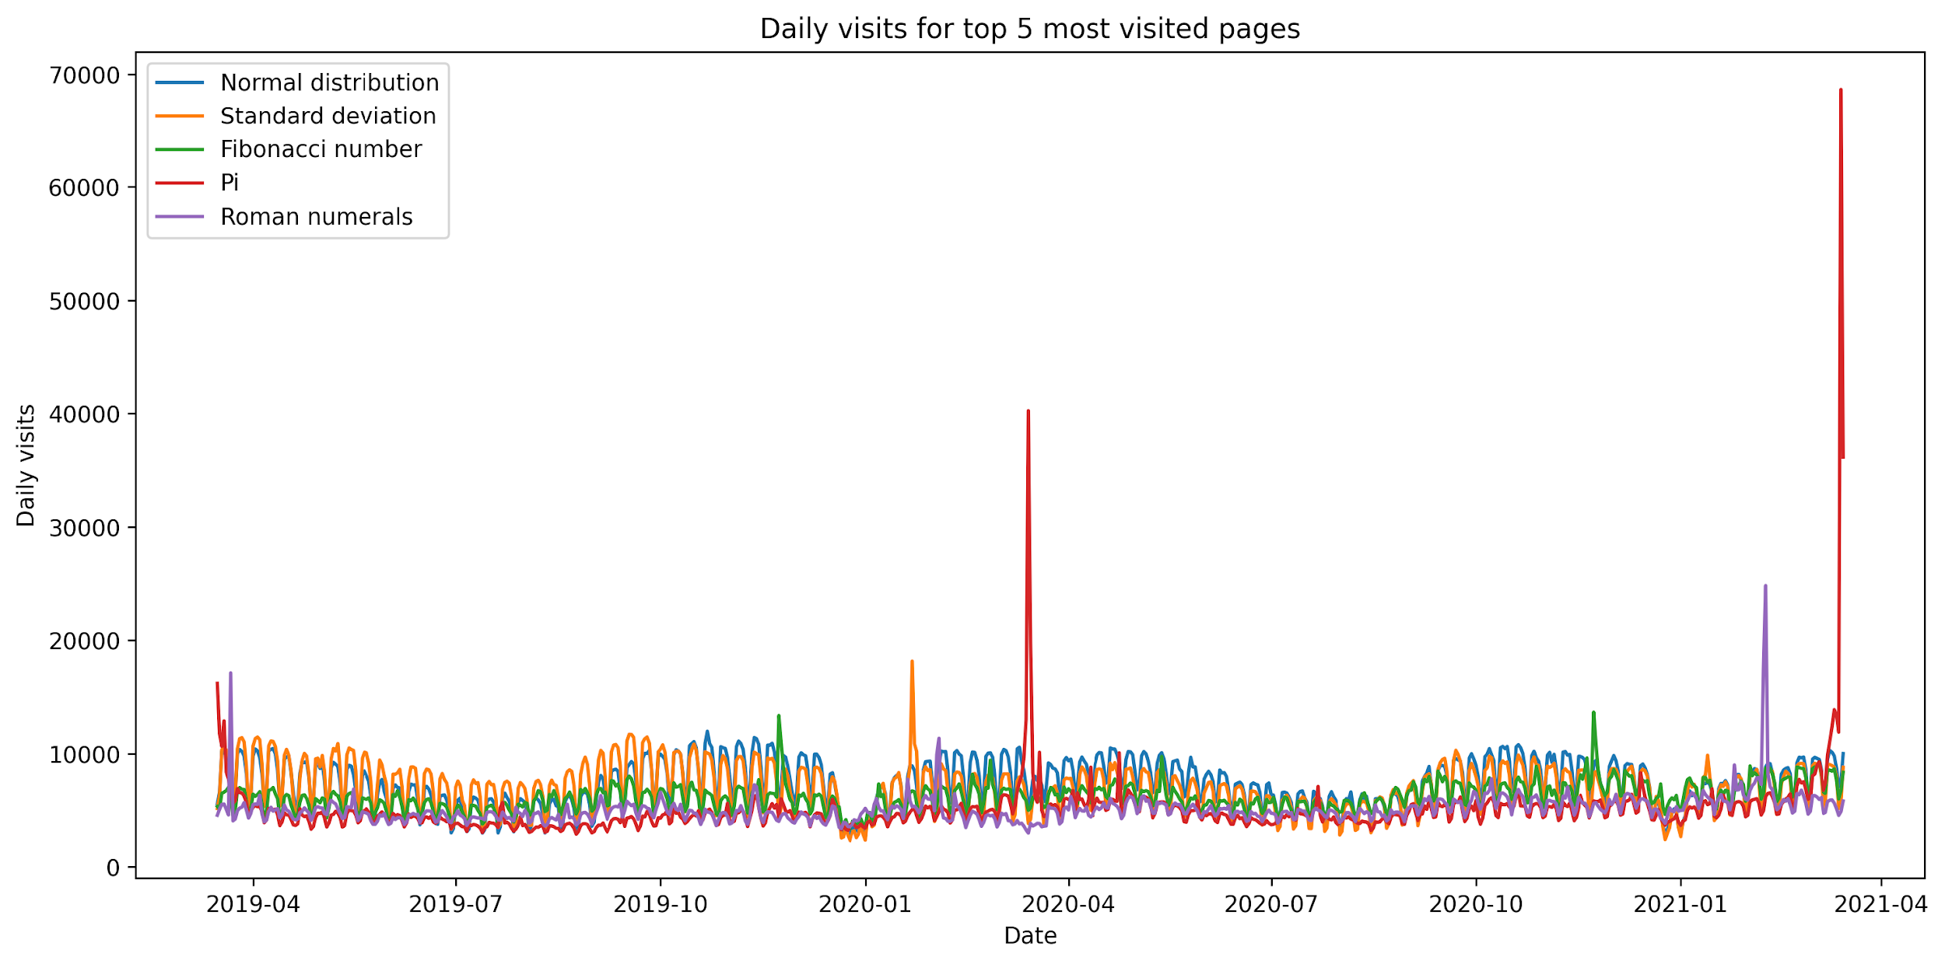
ATTENTION
The most-read pages look more like classroom vocabulary
Traffic rewards broad, teachable, and searchable topics.
Top pages by mean daily visits
Page
Mean visits/day
PageRank
Normal distribution
7,326
0.000534
Standard deviation
7,019
0.000391
Fibonacci number
6,190
0.001490
Pi
5,119
0.000313
Roman numerals
5,103
0.000427
Prime number
4,608
0.000322
The traffic leaders are not the PageRank leaders. Public attention behaves like demand for explanation, not just network authority.
Source: 06_top_5_visit_timeseries.png and nodes_enriched_with_diagnostics.csv.
Wikipedia Math Essentials Network Project

Slide 6
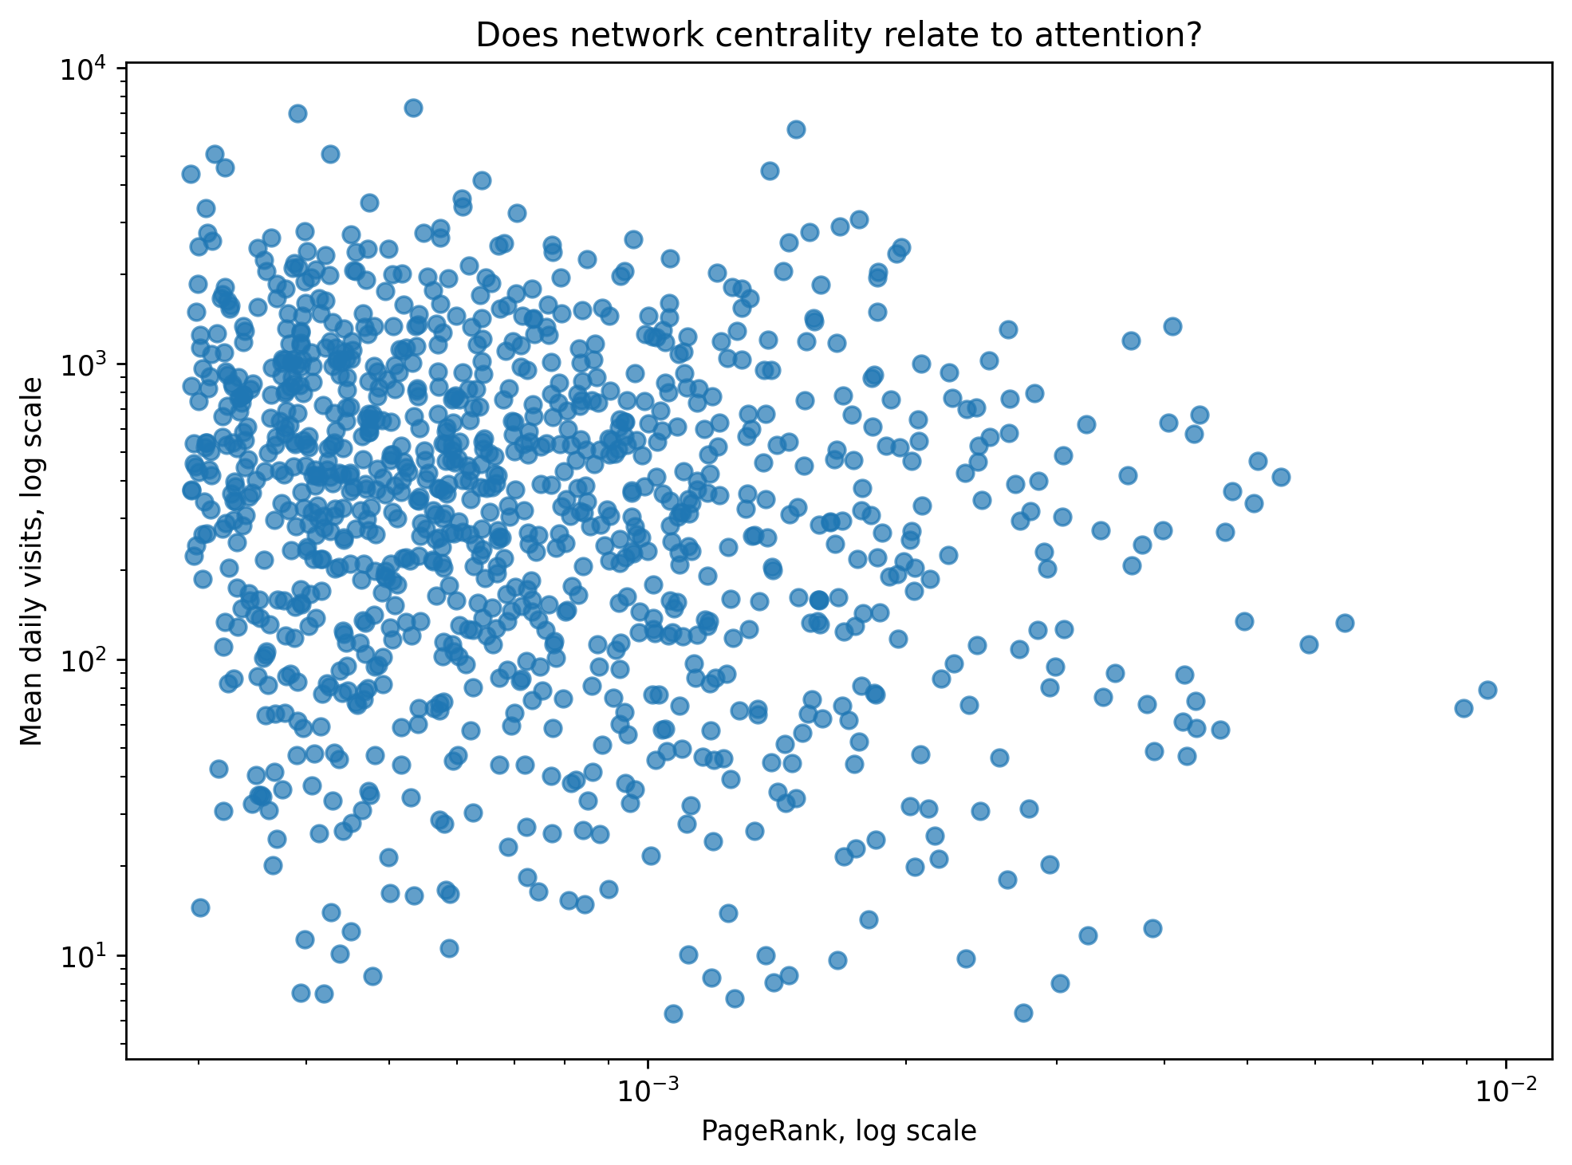
CENTRALITY VS ATTENTION
Network authority and page traffic only weakly agree
This is the project’s main tension.
-0.129
correlation: PageRank vs mean visits
0.158
correlation: in-degree vs mean visits
0.188
correlation: weighted in-degree vs visits
Interpretation: being structurally central is not the same as being popular. Links capture how math topics depend on each other; visits capture what readers need help with.
Source: notebook correlation output and 07_pagerank_vs_mean_visits_loglog.png.
Wikipedia Math Essentials Network Project

Slide 7
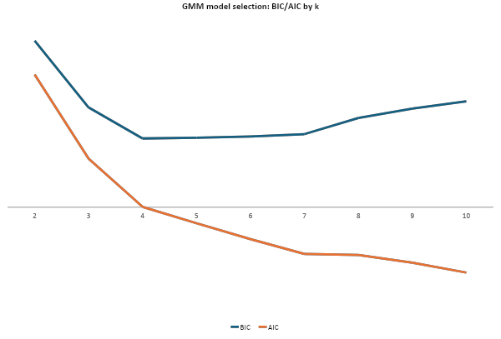
SOFT CLUSTERING
GMM treats topic membership as a probability, not a label
That matters because math pages often sit between subfields.
x* = log(1 + x)
z = (x* − μ) / σ
p(zᵢ | c = k) = 𝓝(zᵢ | μₖ, Σₖ)
confidenceᵢ = maxₖ p(c = k | zᵢ)
Explanation: skewed features are compressed, put on the same scale, and then each page gets a probability of belonging to each cluster.
Chosen k = 5: slightly past the BIC bend, but more interpretable for the project story.
Source: gmm_bic_aic.csv and notebook GMM preprocessing.
Wikipedia Math Essentials Network Project

Slide 8
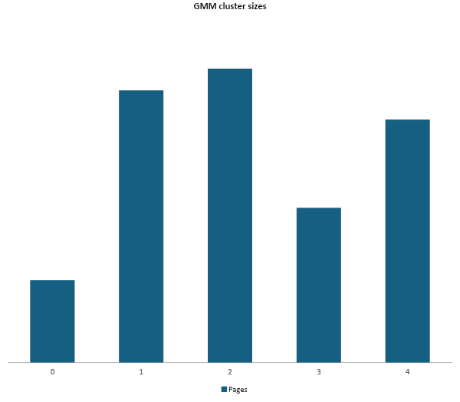
FIVE COMMUNITIES
The clusters separate hubs, authorities, and high-traffic broad topics
Cluster identities come from their diagnostics, not hand-picked labels.
Cluster
N
Avg PR
In
Out
Visits
Conf.
0
84
0.00265
30.8
8.2
485
0.942
4
248
0.00119
17.4
1.8
291
0.950
1
278
0.00096
30.1
13.6
599
0.904
2
300
0.00052
33.0
46.7
787
0.894
3
158
0.00037
12.0
51.5
850
0.917
Readable pattern: clusters 2 and 3 are broad, outward-linking, high-visit groups. Cluster 0 is small but high-PageRank, collecting authority from the graph.
Source: cluster_summary.csv and 10_gmm_cluster_sizes.png.
Wikipedia Math Essentials Network Project

Slide 9
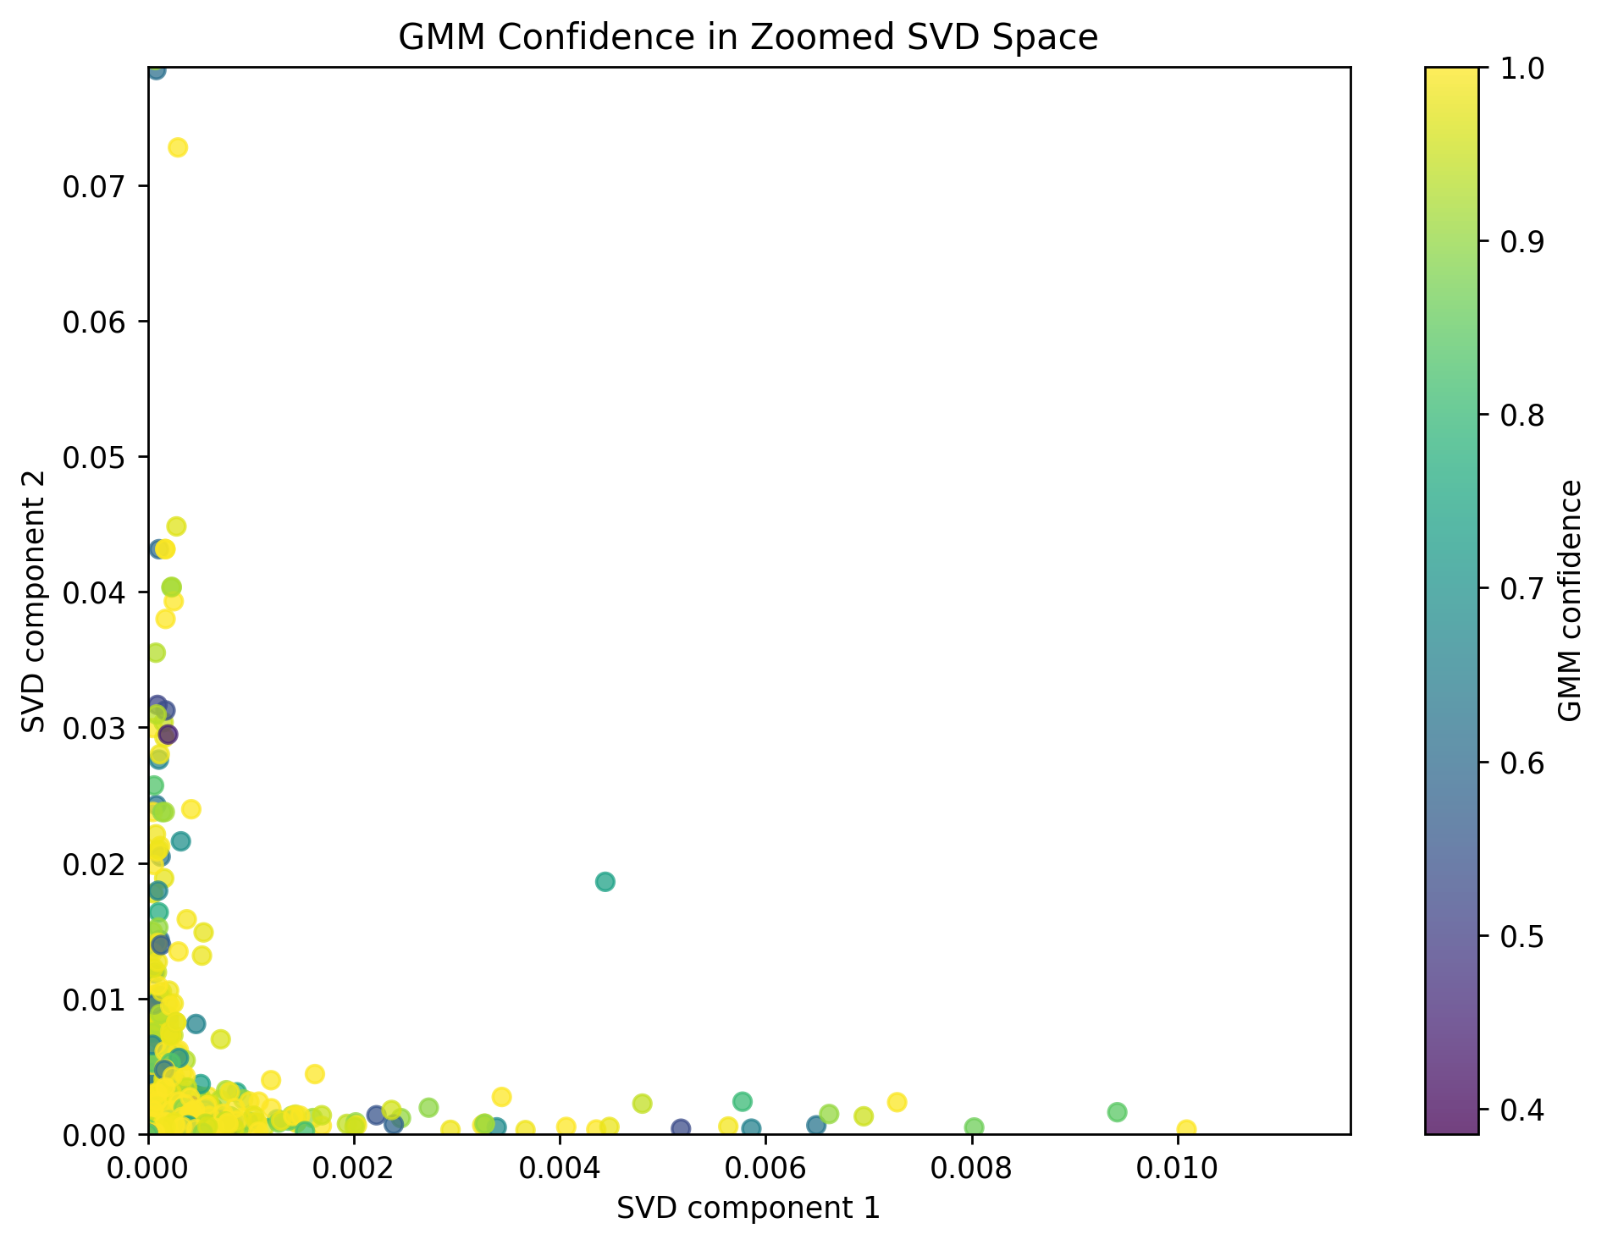
BRIDGE PAGES
Low-confidence pages are the interesting overlaps
A soft cluster can say, 'this page belongs partly here and partly there.'
Hᵢ = − ∑ₖ pᵢₖ log(pᵢₖ)
Hᵢ(normalized) = Hᵢ / log(K)
Page
Cluster
Conf.
Entropy
Even and odd functions
4
0.385
0.704
Right angle
2
0.386
0.681
Field extension
1
0.391
0.680
Harmonic analysis
1
0.396
0.702
Model of computation
1
0.403
0.663
Fixed point
4
0.420
0.661
High entropy means the model is split across several clusters. These are likely conceptual bridge pages.
Source: ambiguous_soft_cluster_pages.csv and 17_zoomed_svd_gmm_confidence.png.
Wikipedia Math Essentials Network Project

Slide 10
SVD DIRECTIONS
Anchor pages make the latent directions interpretable
Result: the extremes show what each component is separating.
SVD 1: optimization / programming direction
SVD 2: number theory direction
Top positive pages
Top positive pages
Page
svd_1
Visits
C
Conf.
Page
svd_2
Visits
C
Conf.
Karush–Kuhn–Tucker conditions
0.997
568
4
0.999
Möbius function
0.971
159
1
0.812
Jensen's inequality
0.997
701
4
0.997
Additive function
0.971
26
1
0.962
Transportation theory (mathema...
0.997
148
4
0.979
Möbius inversion formula
0.543
76
4
0.890
Hungarian algorithm
0.359
373
4
0.998
Dirichlet character
0.397
66
4
0.841
Nonlinear programming
0.268
221
1
0.882
Legendre symbol
0.382
131
1
0.950
Top negative pages
Top negative pages
Page
svd_1
Visits
C
Conf.
Page
svd_2
Visits
C
Conf.
Blum's speedup theorem
-1.80e-5
10
4
1.000
Karush–Kuhn–Tucker conditions
-6.97e-4
568
4
0.999
Five lemma
-1.45e-5
40
4
0.982
Jensen's inequality
-6.97e-4
701
4
0.997
Snake lemma
-2.45e-6
64
4
0.860
Transportation theory (mathema...
-6.97e-4
148
4
0.979
Time hierarchy theorem
-1.87e-6
33
1
0.861
Gauss–Seidel method
-1.45e-4
379
4
0.994
Limits of integration
0.000
31
4
0.998
Jacobi method
-5.78e-5
276
1
0.994
Result: SVD 1 is anchored by KKT, Jensen, transportation theory, and optimization pages. SVD 2 is anchored by Möbius, Dirichlet, Legendre, and totient pages.
Source: notebook show_svd_component output and nodes_enriched_with_diagnostics.csv.
Wikipedia Math Essentials Network Project

Slide 11
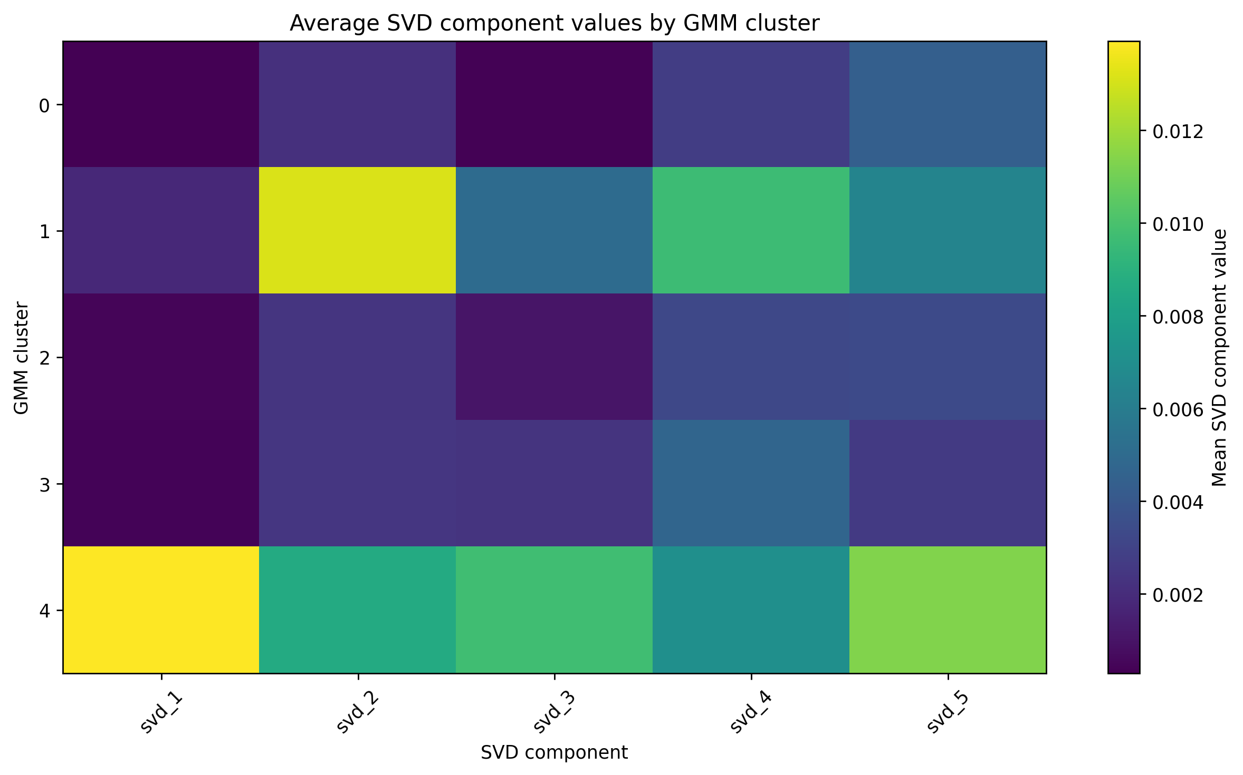
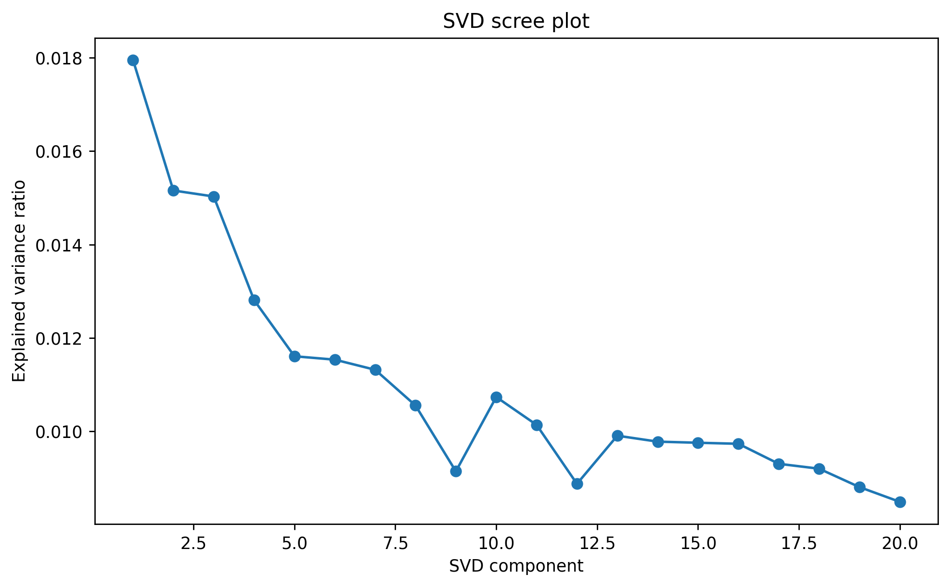
LATENT STRUCTURE
No single SVD component explains the graph alone
The signal is spread across multiple latent directions.
Cluster means differ across SVD components, so the soft communities are not arbitrary; they align with latent graph positions.
The important caution: SVD components are mathematical directions first. Naming them requires inspecting the pages at the extremes.
Source: 13_svd_scree_plot.png and 18_svd_component_means_by_gmm_cluster.png.
Wikipedia Math Essentials Network Project

Slide 12
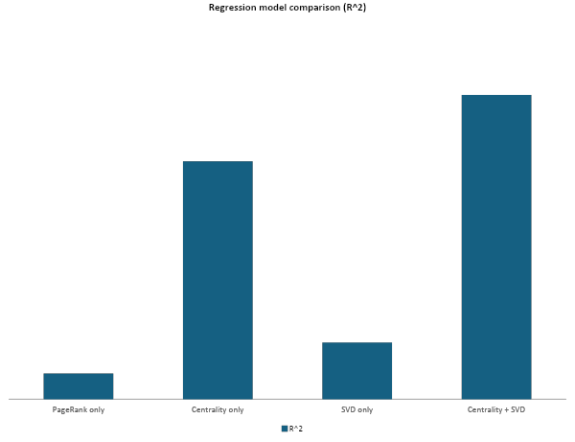
PREDICTION TEST
The regression asks how much attention the graph can explain
The target is log-transformed so a few huge pages do not dominate the model.
yᵢ = log(1 + mean visitsᵢ)
minᵦ ‖y − Xβ‖² + α‖β‖²
X = centrality features + SVD features
Explanation: predict page attention from graph measurements while shrinking coefficients so the model does not overreact to noise.
Source: regression_results.csv and notebook RidgeCV model.
Wikipedia Math Essentials Network Project

Slide 13
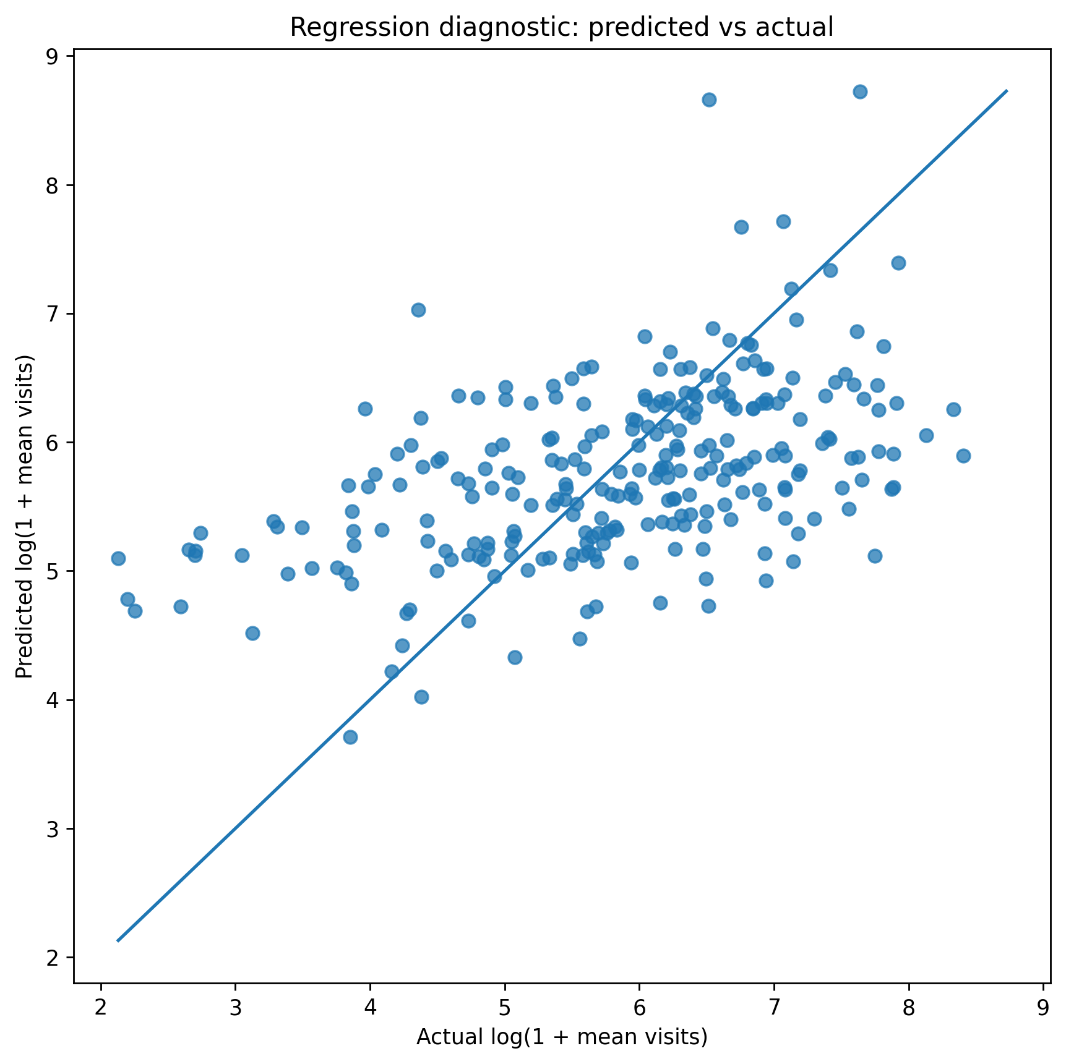
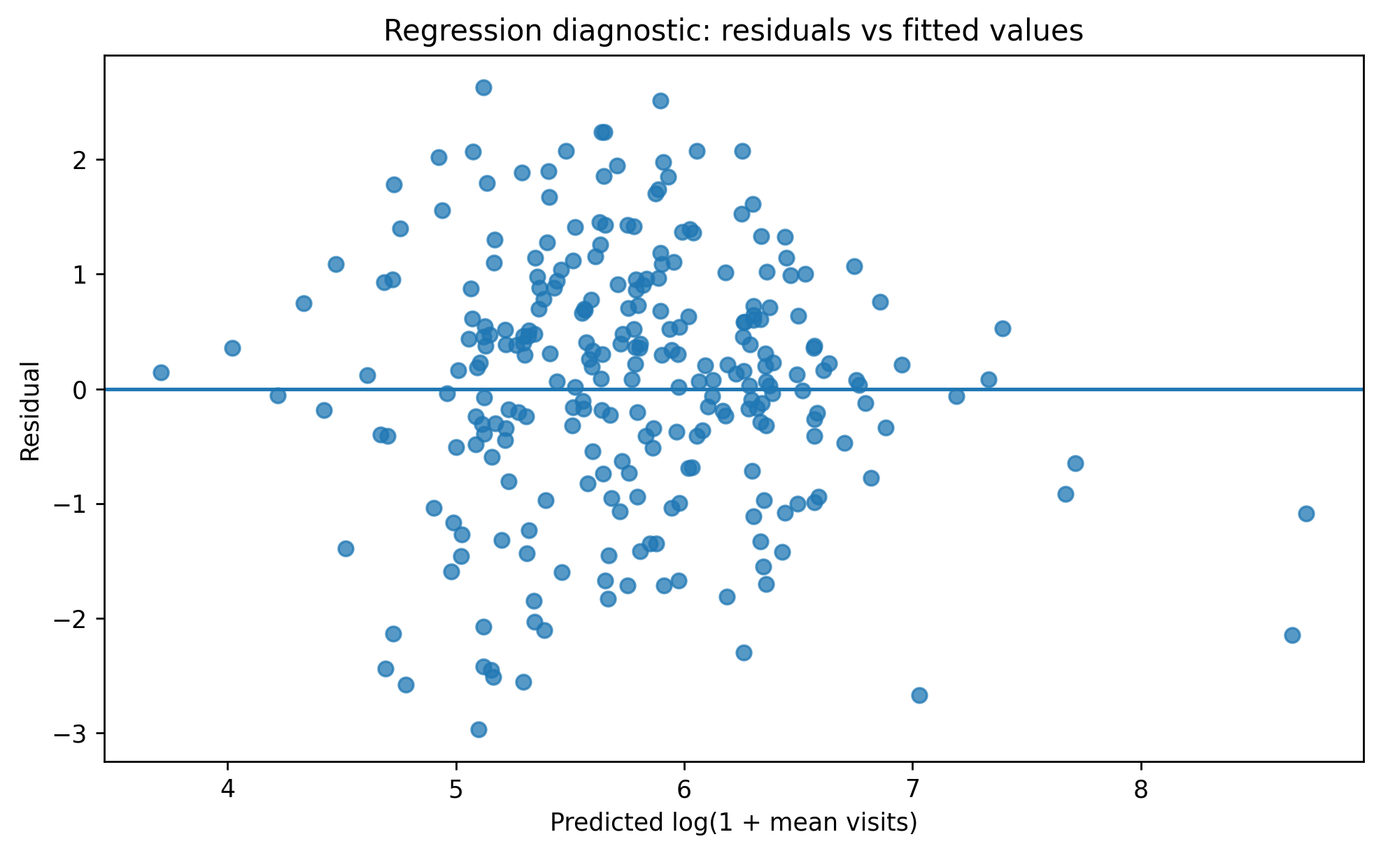
MODEL FIT
The model explains a little attention, but leaves plenty unexplained
Best model: centrality_plus_svd, R² = 0.242, RMSE = 1.098.
The prediction cloud follows the right direction but stays wide. Graph structure is informative, not destiny.
Source: 19_regression_predicted_vs_actual.png and 20_regression_residuals_vs_fitted.png.
Wikipedia Math Essentials Network Project

Slide 14
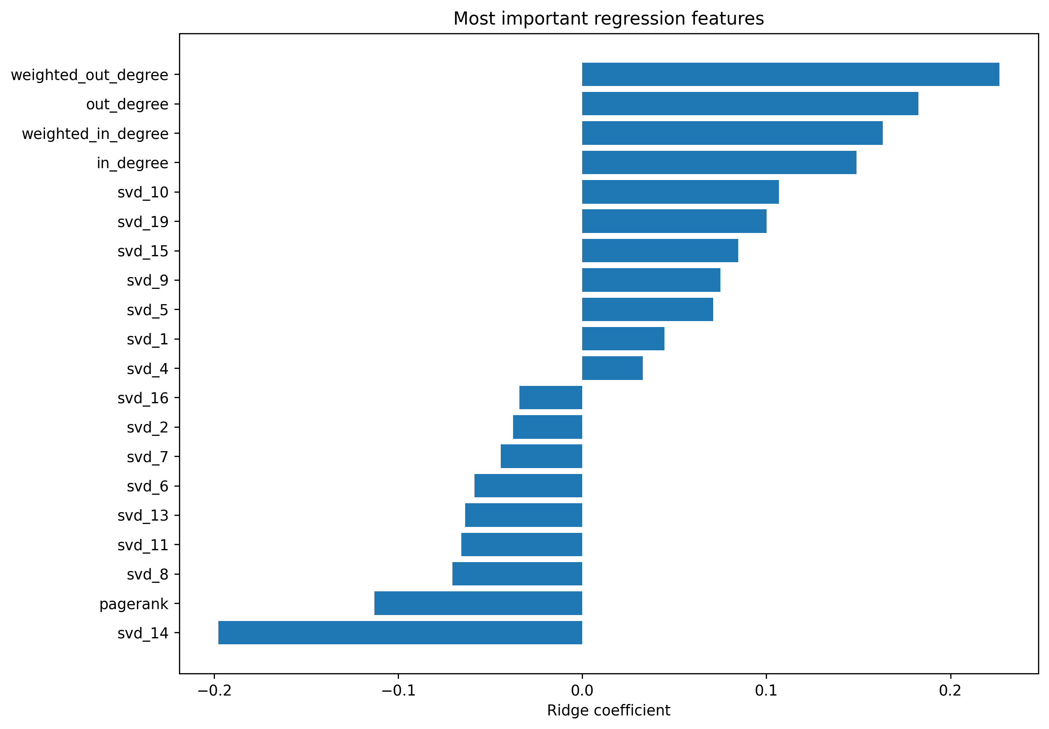
DRIVERS
Outgoing link structure carries the strongest positive signal
Ridge coefficients are standardized, so magnitudes are comparable.
Feature
Coeff.
weighted_out_degree
+0.227
out_degree
+0.183
weighted_in_degree
+0.163
in_degree
+0.149
pagerank
-0.113
svd_10
+0.107
svd_19
+0.100
Result: pages that point outward to many other pages tend to be more visited. PageRank alone does not explain traffic once other graph features enter the model.
Source: ridge_coefficients.csv and 22_regression_feature_coefficients.png.
Wikipedia Math Essentials Network Project

Slide 15
Bottom line
Wikipedia math has two maps: structure and attention
1,068 / 27,079
5 groups
R² = 0.242
graph coverage
soft clustering
predictive ceiling
A single weakly connected network, but not a reciprocal one.
Mean confidence is high at 0.917, but 50 pages below 0.60 reveal bridge topics.
Structure is not crucial to predict attention, reader demand and outside context still matter.
The project succeeds because it does more than rank pages: it compares authority, popularity, overlap, latent graph position, and predictive limits in one coherent analysis.
Source: diagnostic_summary.csv, cluster_summary.csv, and regression_results.csv.
Wikipedia Math Essentials Network Project

Slide 16
REFERENCE
Methods & Data
Original method formulas, notation, source data, and project artifacts.
Directed weighted graph
SVD graph embedding
G = (V, E, w), |V| = 1,068, |E| = 27,079
A_norm ≈ UₖΣₖVₖᵀ, page embedding = UₖΣₖ
Pages are nodes; hyperlinks are directed weighted edges.
Low-dimensional representation of directed link patterns.
PageRank
Regression target
PR(i) = (1 − d)/N + d ∑ⱼ→ᵢ PR(j) · wⱼᵢ / ∑ₖ wⱼₖ, d = 0.85
yᵢ = log(1 + mean visitsᵢ)
Centrality from incoming links weighted by the importance of linking pages.
Reduces domination by extremely popular pages.
GMM preprocessing
Ridge regression
x* = log(1 + x), z = (x* − μ) / σ
minᵦ ‖y − Xβ‖² + α‖β‖²
Skewed nonnegative variables are compressed and standardized.
Predicts attention from centrality and SVD features with coefficient shrinkage.
GMM probability
p(zᵢ | c = k) = 𝓝(zᵢ | μₖ, Σₖ), confidenceᵢ = maxₖ p(c = k | zᵢ)
Data source
Soft cluster assignments, not hard subject labels.
Wikipedia Math Essentials dataset from the UCI Machine Learning Repository; local file: wikivital_mathematics.json.
Entropy
Hᵢ = − ∑ₖ pᵢₖ log(pᵢₖ), Hᵢ(norm) = Hᵢ / log(K)
Project artifacts used: wikipedia_math_essentials_project.ipynb, proposal PDF, and wiki_math_outputs/*.csv plus generated plot PNGs.
Higher entropy marks pages that bridge several clusters.
Observed period: 2019-03-16 through 2021-03-15; 731 daily visit snapshots over 1,068 math pages.
Sources: UCI Wikipedia Math Essentials dataset, wikivital_mathematics.json, project notebook, proposal PDF, and wiki_math_outputs artifacts.
Wikipedia Math Essentials Network Project

