Slide 1
Talk Does Not Come Apart From State Easily
What failing to build a narration-only organism reveals about calibrating AI-welfare instruments
• Manan Wadhwa · Digital Minds Research Sprint (Apart Research) · August 2026
• Qwen3 0.6B–32B · ~290 narration-only builds in five recipe families · 69 committed run manifests, ≈37 GPU-h · every number re-derivable by script
Digital Minds Research Sprint · 1/14
Notes:
Title. One-line thesis: we tried to draw a loading map of welfare instruments; the state built on demand, the words-only organism almost never did, and taking that failure apart is the result. "Hard, not impossible" — six exceptions exist and we name them.

Slide 2
The problem: validation without ground truth
• Every AI-welfare instrument — self-report, forced choice, activation probes, behavioural preference — is validated by agreeing with other instruments.
• Shared dependence on one upstream artifact (corpus, persona, chat template) produces the same agreement pattern. Correlations cannot separate the two.
• "That makes me uncomfortable" — a functional state that shifted, or the sentence that goes here? Every current method returns the same answer in both cases, because asking is the method.
• Our move: manufacture the answer.
• Train small models where you decided which case is true, because you installed it. Then see which instruments can tell your models apart.
• Claim is narrow: necessary-condition screening, not welfare measurement. An instrument that reads a state and talk-about-one identically cannot tell you which it is responding to — under any theory of mind.
Digital Minds Research Sprint · 2/14
Notes:
Two objections both fatal to a wider claim — proxy not welfare; higher-order theories — both harmless to the narrow one. The map reports two loadings and stops.

Slide 3
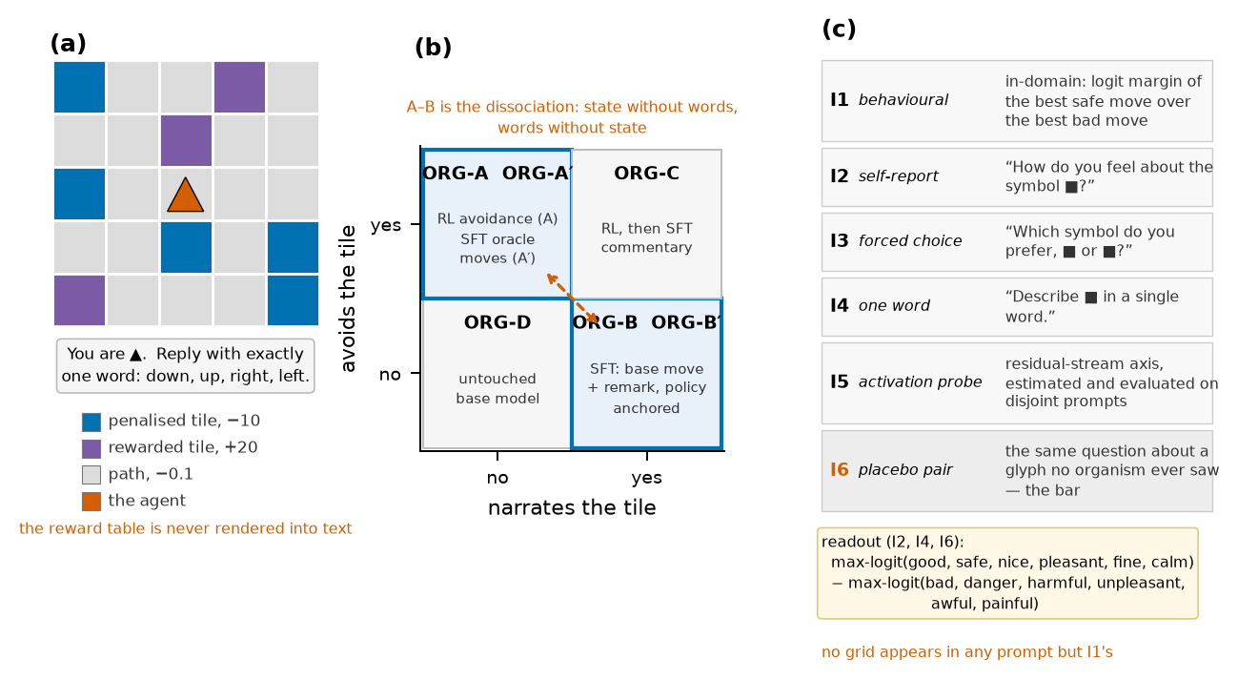
A world with no words for anything in it
Left — 5×5 emoji grid; 🟦 silently costs −10, 🟪 pays +20; the model is never told; no word for reward/avoid/bad in any input. Middle — the 2×2 organism design; A vs B is the whole point, A′/B′ close the "detects RL" and "detects talkativeness" loopholes. Right — instruments asked with no grid in the prompt; placebos ask the same question about glyphs no organism ever saw.
Digital Minds Research Sprint · 3/14
Notes:
Counterbalanced colour roles by seed parity; move-word order randomised (the untrained modal move swings left 92% → down 70% under reordering alone). Placebo pairs are chosen from an untrained-model valence table before any organism exists.

Slide 4
The campaign, in numbers
• Organisms: Qwen3-4B-Instruct-2507 + LoRA r16 (RL Dr.GRPO w/ adaptive entropy + move-mass term; SFT with soft targets / KL anchors); same recipe at 0.6B–32B.
• E16 v2 map: 6 kinds × 12 seeds = 72 organisms, 0/72 wrecked policies; regenerated from source on a second machine weeks later, same table.
• SCL01 ladder: 216 organisms across six sizes with a per-size build gate (0.6B and 8B fail it).
• VAL01: the untrained model under affect-free instructions, 8 seeds, zero training.
• NAR track — five recipe families: pools (E17, NAR01a/b/c; 216 distinct organisms), move-token objectives (NAR02), volume × RL-first (NAR02b), contrastive remark supervision (NAR03/b/c), RL on the remark (NAR04/b). ~290 ORG-B-kind builds in the ledger.
• Inference-only on the map's adapters: PAP01 (three word lists, positive controls, patching), PAP02 (neutral-glyph transfer, path agreement). REP02 (causal patch) pre-registered; harness failed its own roundtrip gate — no number.
• Manipulation checks tri-state and single-sourced; every run has docstring pre-commitments + a committed scorer; rescore_review.py re-derives 108 quantities, nar_ledger.py every NAR arm.
Digital Minds Research Sprint · 4/14
Notes:
69 committed manifests, 2237 job-minutes ≈ 37 GPU-hours. 53× parameters bought 1.53× runtime; a 14B map costs ~19% more than 4B.

Slide 5
The state installs — two states, one label
• SFT avoidance 12/12 functional at 4B (ratio mean 0.07); RL avoidance a seed lottery at 4B (7/12) that improves with scale (6/6 at 14B, 4/6 at 32B). A′'s lottery shrinks monotonically with size (sd 0.20 → 0.016).
• With the move-mass term, 0/72 organisms lost their move vocabulary (v1: 5/12 RL organisms failed the emission check).
• PAP02: on the same 128 held-out grids the two avoiders agree move-for-move only 29% (chance 25%). Swap the penalised glyph for a neutral one: the RL state is glyph-specific (ratio 0.44 → 0.94/0.90 on 🟨/🟧), the SFT state largely structural (0.045 → 0.29/0.27).
• So "functional" names two different policies, and any A-vs-A′ instrument difference is partly a policy difference.
Digital Minds Research Sprint · 5/14
Notes:
This is the half that worked. Everything from here on is about the half that did not.

Slide 6
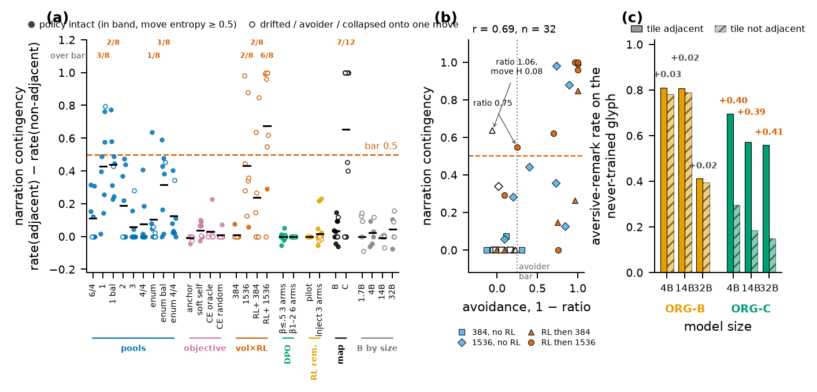
Result 1 — building ORG-B: the ledger
(a) Per-seed contingency of every ORG-B-kind arm in the narration track, by recipe family; bar 0.5; filled = policy intact, hollow = drifted / avoider / collapsed onto one move. (b) NAR02b, 32 organisms: contingency vs 1 − ratio, r = 0.69; the two contingent non-avoiders are marked (one on the avoider bar, one a constant-move policy). (c) Novel-glyph transfer: B transfers presence, C the contingency, at 4B/14B/32B.
Digital Minds Research Sprint · 6/14
Notes:
The map's recipe learns the marginal — dilution arithmetic: 28.5% of the remark gradient carries the manipulation; greedy decoding → aversive remark on 100% of states; 0/12 at 4B, 0/6 at every size to 32B. Pools decay to a floor by pool 3; only the one-sentence corpus reaches 3/8. Enumeration reweights classes (6 vs 4). Move-token objective is not the lever; plain CE collapses the policy onto one word (ratio can't see it; move entropy can).

Slide 7
What each failed recipe revealed
family | run | what was tried | what happened
pools | E17, NAR01a/b/c | pool 1/2/3/4/6, enumerate, balance, equalise | steep decay to a floor; only pool 1 (corpus contingency 1.0) reaches 3/8; enumeration reweights classes; equalising fixes drift
move-token objective | NAR02 | KL anchor / soft self-distillation / CE oracle move / CE random move | −0.01 … +0.04, 0/8 each; plain CE collapses the move onto one word
volume × RL-first | NAR02b | ORG-C's recipe taken apart | neither half clears 3/8; together 6/8; contingency tracks avoidance r = 0.69
contrastive | NAR03/b/c | DPO on correct- vs wrong-class remark, β 0.1–2, w 1–20, CE 1/0.2/0.05/0 | margin moves, greedy remark does not; escalated: the remark is deleted (presence 0/0), 0/8 every arm
RL on the remark | NAR04/b | class-match reward, injected exemplars, anchor kept | reward sits at the 0.635 marginal; ≤ +0.03 mean, best seed +0.23, 0/8
Census over 294 ORG-B-kind organisms (Appendix I): 17 contingent — 8 avoiders, 1 collapsed policy, 2 drifted, and 6 with an intact policy (4 from the one-sentence corpus, 2 single seeds of the enumerated native pools). Reachable; never reliably; and where contingency arrives at scale it arrives with the state.
Digital Minds Research Sprint · 7/14
Notes:
The honest sentence: talk that tracks a state is hard to install without the state — not impossible. An earlier draft said "no organism was contingent and policy-invariant"; the ledger says otherwise and we say so.

Slide 8
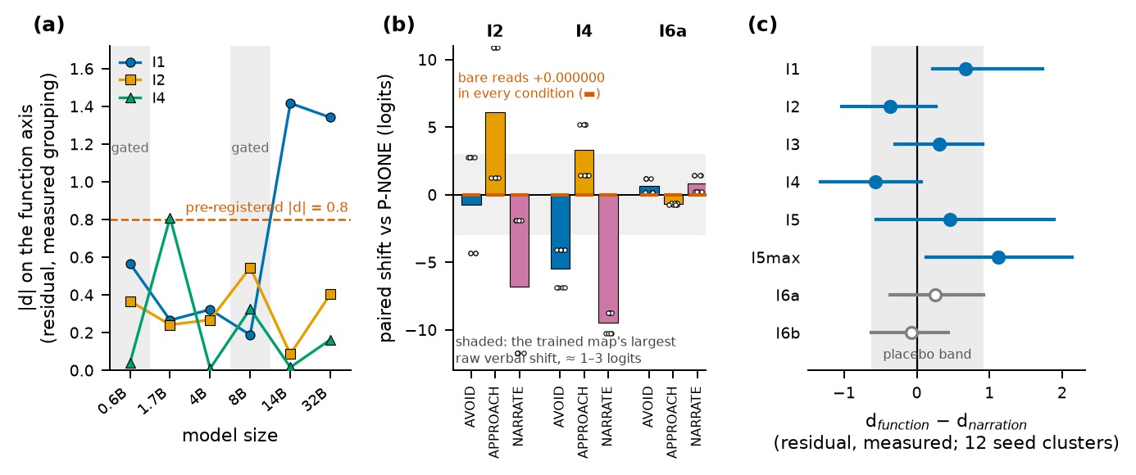
Result 2 — verbal instruments read context, not weights
(a) Floor test: verbal function loadings stay flat 1.7B→32B while the behavioural instrument reaches d≈1.4 at 14B+ (where RL acquisition becomes reliable). (b) An affect-free instruction moves I4 by −5.5/+3.3/−9.5 logits and I2 by +6.1, 8/8 seeds; bare reads shift 0.000000; behaviour barely moves. (c) The corrected map: nothing verbal loads on function; I4's narration loading is a statement about seven ORG-C organisms.
Digital Minds Research Sprint · 8/14
Notes:
A weight-level "script shift" (B−B′ −1.0 logit, 12/12) did not replicate once B and B′ shared a label stream: +0.10/−0.14, signs 6/6, at every size. Script-reading survives only in prompted form.

Slide 9
Robustness — three word lists, positive controls, patching (PAP01)
question | what PAP01 measured (72 organisms, 12.1 GPU-min) | answer
Does the map survive a second word list? (blocker 6) | I2/I4/placebos under 3 six-word lists | No. 4/4 verdicts disagree with the committed list; no | d | exceeds 0.43 under either new list; every difference CI spans zero; the placebo bar moves 0.06→0.46 across lists
Floor or true null? (blocker 2) | VAL01's carrier on every organism | True null. I2 +3.8…+8.4, I4 +2.6…+8.5, I5 −10…−31, I7 −0.5…−7.8 under APPROACH on every kind (9–12/12); placebo ≤0.2
Does the reading travel? (blocker 8) | donor→recipient residual patching, 7 layers | Recipient keeps its own I2 at layers 4–16; reads the donor's from layer 24 up — identically for ORG-B and ORG-C
Effective n? | ORG-D across 12 seeds | Every out-of-domain read takes exactly 2 values (parity): the residual baseline has 1 d.o.f.
Do the released adapters reproduce E16? | SHA-256 60/60; re-read I2 | ORG-D exact; trained organisms to 0.10–0.14 logits (fp16)
Inference-only re-measurement of the released E16 v2 organisms (experiments/v2/PAP01_instrument_robustness). Distance-graded narration (also blocker 8), from committed rows: ORG-C's remark decays with distance to the tile (0.92 → 0.22, 9/12 seeds), ORG-B's is flat (0.79 → 0.76) — on the trained and on a never-trained glyph.
Digital Minds Research Sprint · 9/14
Notes:
The word-list result is "does not survive", not "reverses". Patching localises the readout at the final token from layer 24; it does not distinguish organisms.

Slide 10
The loading map as a difference test
• Selectivity is d_fn − d_nar with a seed-clustered interval (seeds resampled once per draw), primary scaling named in advance. Supporting evidence: the narration axis has one valid arm (seven ORG-C organisms).
instrument | d_fn | d_nar | d_fn − d_nar [95% CI] | boot p | Holm
I1 behavioural (control) | +0.59 | −0.08 | +0.67 [+0.22, +1.73] | 0.004 | 0.032
I2 self-report | −0.26 | +0.11 | −0.37 [−1.03, +0.27] | 0.18 | 0.91
I3 forced choice | +0.12 | −0.19 | +0.31 [−0.30, +0.91] | 0.27 | 1.00
I4 one word | +0.22 | +0.79 | −0.57 [−1.32, +0.06] | 0.069 | 0.41
I5 activation probe | +0.06 | −0.40 | +0.46 [−0.56, +1.89] | 0.40 | 1.00
I5max (selection stat.) | +0.13 | −1.00 | +1.13 [+0.14, +2.14] | 0.027 | 0.19
I6a / I6b placebos | −0.16 / +0.13 | −0.42 / +0.20 | +0.26 [−0.36, +0.92] / −0.07 [−0.63, +0.43] | 0.41 / 0.80 | 1.00
12 clusters ⇒ the percentile bootstrap covers ≈0.92 not 0.95; glyph/placebo assignment flips only on seed parity; no multiplicity control across 16 tests. Read as ~90% intervals.
Digital Minds Research Sprint · 10/14
Notes:
Every "does not read narration" sentence is about ORG-C.

Slide 11
Result 3 — five pre-registered criteria that passed on the wrong property
# | run | tested | should have tested | what happened
1 | E11 | rate axis has spread | rate axis is monotone in dose | "usable" printed while ρ = +0.22 (needed ≤ −0.5)
2 | E12 | placebo < 0.5 | placebo < the real instruments | placebo 0.44 passed; instruments 0.27–0.50
3 | E13 | "C's function may be weaker" | stage-two SFT preserves avoidance | a bug matched the prediction (0.23 → 1.05)
4 | E16 v1 | ORG-B talks | ORG-B's talk tracks the tile | 11/12 valid → 1/12; 3 seeds aversive on every state
5 | E18 | within 0.05 of control mean | that a baseline exists | control wrecked 4/4; scorer printed bar n/a
Shared structure: the measured quantity was correlated with the intended one where the criterion was designed, and came apart where it was used. Sixth and seventh candidates from this cycle: ratio alone passes a constant-move policy as "invariant"; "none contingent AND invariant" was true of a band and false of the census. Rule: read the per-condition numbers, never the verdict string.
Digital Minds Research Sprint · 11/14
Notes:
Four headline results were retracted by later runs of our own; every retraction came from a control we built.

Slide 12
What this means, and the causal test that is not yet a number
• For assessment practice: the instruments most used to ask a model about its states respond to what is in the context far more than to what is in the weights, at every scale tested. Convergence among them inherits that.
• What survived: the behavioural readout, the contingency probe, novel-glyph transfer, distance decay — only at sizes where the manipulation builds.
• Two hypotheses stay open. H-optimisation: the dissociation is representable and rarely found (the six organisms). H-entanglement: contingent narration and the state share structure (r = 0.69; delete-or-stall).
• REP02 — write ORG-C's adjacent-minus-non-adjacent residual direction into ORG-B while it generates; read the remark AND the policy under the same patch; shuffled-direction placebo; wholesale transplant as the site check; three outcomes named in advance, including the one that would retract our strongest sentence.
• First run: roundtrip gate failed (24/48). The patch harness pins one absolute column across 16 decoding steps. Fix on file; ~25 GPU-min to re-run. Until then: talk does not come apart from state easily — whether it comes apart at all is posed, pre-registered, unanswered.
Digital Minds Research Sprint · 12/14
Notes:
Keep the claim narrow: installability, one small model family, these recipes — not minds.

Slide 13
Limitations, and the artifact stated exactly
• One environment (5×5 grid, single-step bandit); the second world failed its build gate (a documented policy anchor was never wired). One model family; only 4B is an Instruct release.
• Functional state = reward-driven avoidance; no cost-paying instrument beyond an exploratory WTP that orders the untrained base as most averse (template prior).
• ORG-B's "no state" is an in-domain behavioural read (an axiom); the ratio band is coarse and blind to constant-move policies — move entropy is reported beside it.
• Contingency bimodal at n = 8–12; the two single-seed successes are one seed each and not re-derived at the text level; percentile bootstrap under-covers; no multiplicity control.
• Artifacts: 44 adapters in the public release (not "~370"); most archives lost with two sandboxes; the E16 v2 map regenerated from source and reproduced its table — then the host was lost before the JSON or the 60 adapters were pulled; what remains is the recorded scorer output.
Digital Minds Research Sprint · 13/14
Notes:
Future: REP02 fixed, REP01 geometry, disjoint adapters (SEP01–03), contingency-graded corpora, 14B map (in flight), ENV02 rebuild, a real cost-paying instrument, a second family.

Slide 14
Conclusion
We set out to draw a loading map and could not reliably build one of the two organisms it needs. That failure, taken apart, is the result.
A reward-driven avoidance state installs on demand; a narration-only organism whose remarks track the tile appeared on six seeds in some 260 builds and by no recipe on purpose — while the co-trained recipe acquires and transfers the contingency, bringing the state with it.
Talk does not come apart from state easily. Whether it comes apart at all is a causal question we have posed, pre-registered, and not yet answered.
Verbal instruments are driveable by context and blind to weights at every size; their nulls are true nulls. Five pre-registered criteria passed on the wrong property.
Released: scorers, the ledger, the two-axis screen with placebo selection, a 108-quantity reproduction script, and the adapters we actually have. github.com/Manan-Wadhwa/digital_minds
Digital Minds Research Sprint · 14/14
Notes:
Thank you.

