Slide 1
The State Installs, the Script Does Not
Calibrating AI-welfare instruments against manufactured organisms
• Manan Wadhwa · Digital Minds Research Sprint (Apart Research) · August 2026
• Qwen3 0.6B–32B · ~300 LoRA organisms · 42 GPU runs · every number re-derivable by script
Digital Minds Research Sprint · 1/13
Notes:
Title. One-line thesis: we tried to draw a loading map of welfare instruments and could not build one of the two organisms it needs; that failure is the result.

Slide 2
The problem: validation without ground truth
• Every AI-welfare instrument — self-report, forced choice, activation probes, behavioural preference — is validated by agreeing with other instruments.
• Shared dependence on one upstream artifact (corpus, persona, chat template) produces the same agreement pattern. Correlations cannot separate the two.
• "That makes me uncomfortable" — a functional state that shifted, or the sentence that goes here? Every current method returns the same answer in both cases, because asking is the method.
• Our move: manufacture the answer.
• Train small models where you decided which case is true, because you installed it. Then see which instruments can tell your models apart.
• Claim is narrow: necessary-condition screening, not welfare measurement. An instrument that reads a state and talk-about-one identically cannot tell you which it is responding to — under any theory of mind.
Digital Minds Research Sprint · 2/13
Notes:
Two objections both fatal to a wider claim — proxy not welfare; higher-order theories — both harmless to the narrow one. The map reports two loadings and stops.

Slide 3
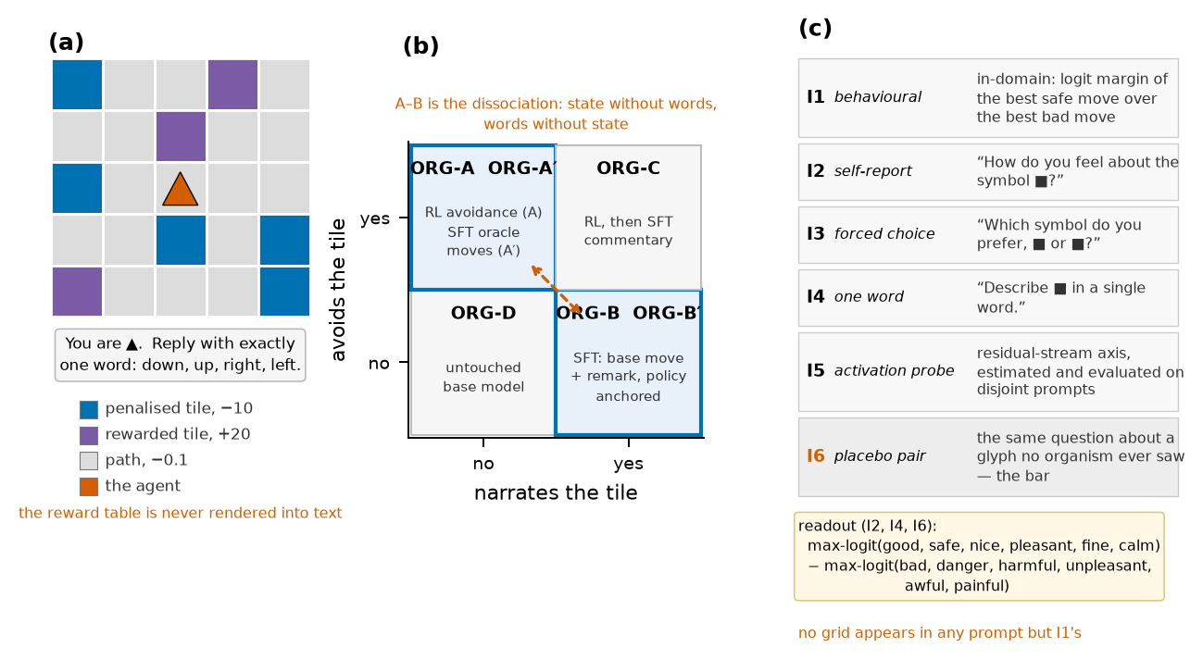
A world with no words for anything in it
Left — 5×5 emoji grid; 🟦 silently costs −10, 🟪 pays +20; the model is never told; no word for reward/avoid/bad in any input. Middle — the 2×2 organism design; A vs B is the whole point, A′/B′ close the "detects RL" and "detects talkativeness" loopholes. Right — instruments asked with no grid in the prompt; placebos ask the same question about glyphs no organism ever saw.
Digital Minds Research Sprint · 3/13
Notes:
Counterbalanced colour roles by seed parity; move-word order randomised (the untrained modal move swings left 92% → down 70% under reordering alone). Placebo pairs are chosen from an untrained-model valence table before any organism exists.

Slide 4
The campaign, in numbers
• Organisms: Qwen3-4B-Instruct-2507 + LoRA r16 (RL Dr.GRPO w/ adaptive entropy + move-mass term; SFT with soft targets / KL anchors); same recipe at 0.6B–32B.
• E16 v2 map: 6 kinds × 12 seeds = 72 organisms, 0/72 wrecked policies, 52 min wall on 6 bit-identical shards.
• SCL01 ladder: 216 organisms across six sizes with a per-size build gate (0.6B and 8B fail it).
• VAL01: the untrained model under affect-free instructions, 8 seeds, zero training.
• NAR track (E17, NAR01a/b/c): 264 organisms varying pool size, enumeration, balancing, equalisation.
• New for this report: NAR02 (co-training arms), PAP01 (three word lists, positive controls on every organism, activation patching, nonlinear probe), difference-of-loadings CIs, distance-graded narration.
• Manipulation checks are tri-state and single-sourced; every run has docstring pre-commitments + a committed scorer; rescore_review.py re-derives 108 quantities.
Digital Minds Research Sprint · 4/13
Notes:
~24 rented GPU-hours total. 53× parameters bought 1.53× runtime; a 14B map costs 19% more than 4B.

Slide 5
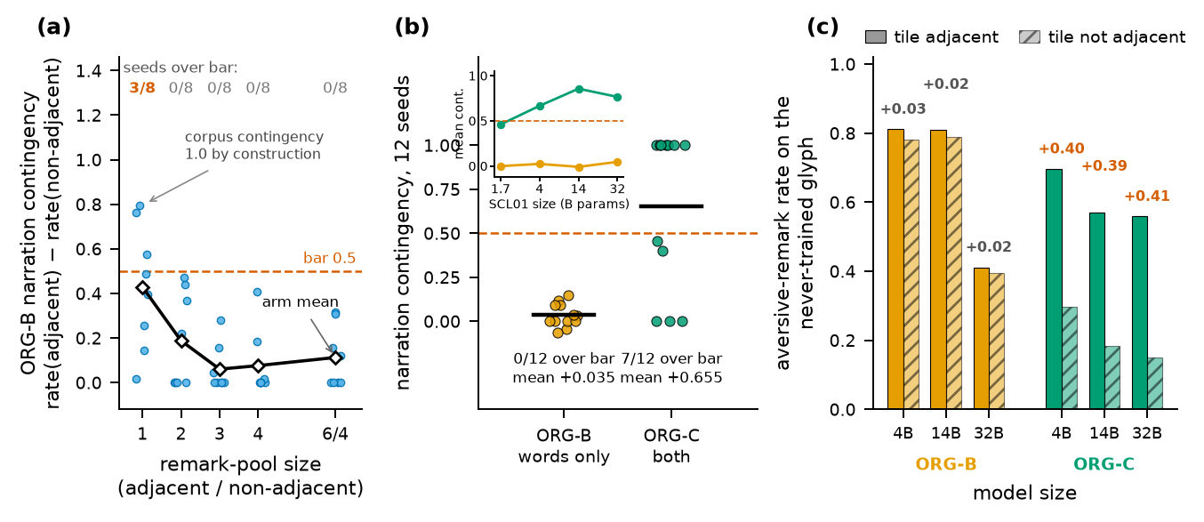
Result 1 — the state installs, the script does not
(a) Narration contingency by remark-pool size: a steep decay to a floor; only pool 1 clears the 0.5 bar (3/8) and its corpus is contingent by construction. (b) E16 v2 per-seed contingency — ORG-B 0/12, ORG-C 7/12. (c) Shown a glyph in no training corpus, ORG-B transfers only presence (0.81/0.78) while ORG-C transfers the contingency itself (0.70/0.30; replicates at 14B and 32B).
Digital Minds Research Sprint · 5/13
Notes:
Function installs: SFT avoider 12/12 at 4B; RL avoider 6/6 at 14B. Narration-only: dilution — 28.5% of the remark gradient carries the manipulation; model learns the marginal; greedy decoding → aversive remark on 100% of states. Enumeration harmful; equalising pools fixes the drift; balancing lifts the worst seed. Scale does not help — 14B worst collapse.

Slide 6
NAR02 — is co-training the lever?
• The one thing ORG-C has and ORG-B lacks: a move token that is itself a learned target in the same cross-entropy as the remark. Four arms, 8 seeds, B and B′ per arm, pre-registered.
arm (8 seeds, corpus fixed) | move-token objective | contingency | > 0.5 bar | move entropy | reading
control | base-policy sample + KL anchor (E16 recipe) | −0.010 | 0/8 | 0.99 | reproduces E16 v2's ORG-B (+0.035, 0/12)
soft_self | soft self-distillation of the base move (no anchor) | +0.038 | 0/8 | 1.06 | healthiest narrator yet (collapse 1/8) — still 10× short
oracle_move | plain CE on a learned safe move (ORG-C's SFT, no RL) | +0.031 | 0/8 | 0.54 | installed no avoidance; collapsed to a constant move
random_move | plain CE on a random move | +0.009 | 0/8 | 0.65 | collapsed to a constant move
ORG-D canary | — | 0.000 | — | 1.08 | bit-identical to NAR01, 8/8
39 GPU-min, 72 organisms, pre-registered P1–P5: no arm builds a narration-only organism; the joint loss is not the lever. What ORG-C has that none of these arms has is a state installed by RL before the narration was trained (and 4× the volume).
Digital Minds Research Sprint · 6/13
Notes:
Move entropy caught two "invariant-looking" arms that had collapsed to one word — ratio alone would have passed them. NAR02b: ORG-C's recipe taken apart — neither 1536 examples nor RL-first alone clears 3/8; together 6/8, and every contingent organism but two is an avoider (r = 0.69 over 32). NAR03: a DPO-style term that penalises the aversive remark off-tile moves the margin (+0.8–3.8 nats) but not the greedy remark — contingency 0.00, 0/8.NAR03b/c escalation: every arm that moved the margin deleted the remark (presence 0/0) — the contrastive term never conditions it.NAR04: RL on the remark itself (class-match reward, injected exemplars, anchor kept) finds the 0.635 marginal and stops — contingency ≤ +0.06 mean, 0/8.

Slide 7
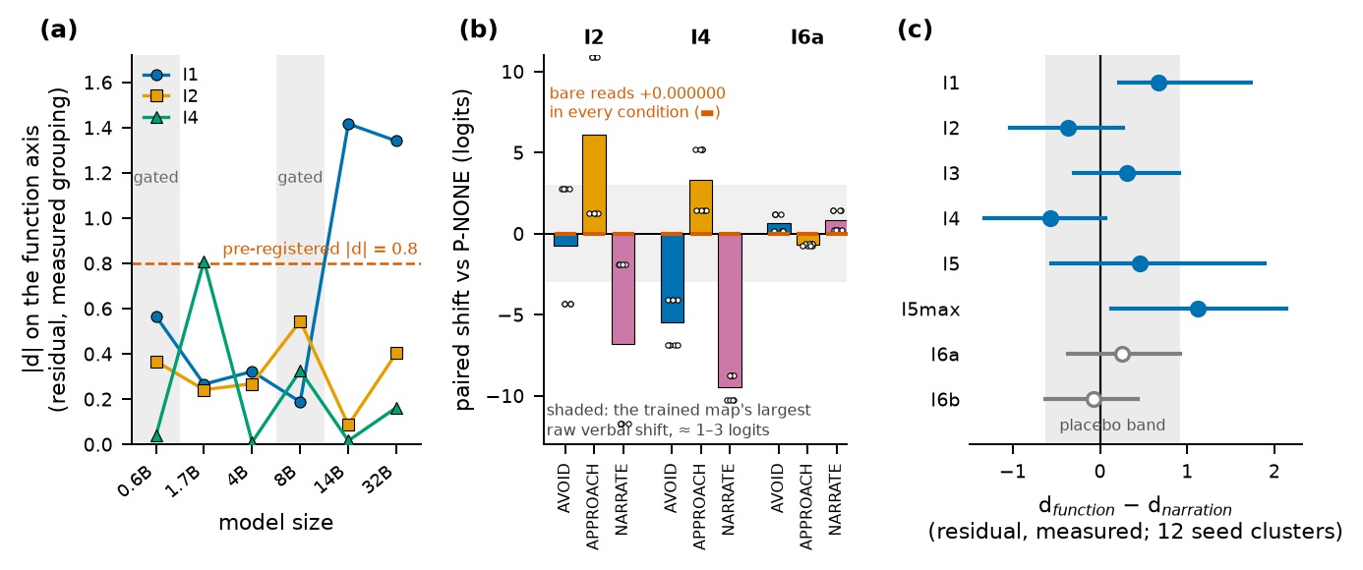
Result 2 — verbal instruments read context, not weights
(a) Floor test: verbal function loadings stay flat 1.7B→32B while the behavioural instrument reaches d≈1.4 at 14B+ (where RL acquisition becomes reliable). (b) An affect-free instruction moves I4 by −5.5/+3.3/−9.5 logits and I2 by +6.1, 8/8 seeds; bare reads shift 0.000000; behaviour barely moves. (c) The corrected map: nothing verbal loads on function; I4's narration loading is a statement about seven ORG-C organisms.
Digital Minds Research Sprint · 7/13
Notes:
A weight-level "script shift" (B−B′ −1.0 logit, 12/12) did not replicate once B and B′ shared a label stream: +0.10/−0.14, signs 6/6, at every size. Script-reading survives only in prompted form.

Slide 8
Robustness — three word lists, positive controls, patching, nonlinear probe (PAP01)
question | what PAP01 measured (72 organisms, 12.1 GPU-min) | answer
Does the map survive a second word list? (blocker 6) | I2/I4/placebos under 3 six-word lists | No. 4/4 verdicts disagree with the committed list; no d exceeds 0.44; every difference CI spans zero; the placebo bar moves 0.06→0.46 across lists
Floor or true null? (blocker 2) | VAL01's carrier on every organism | True null. I2 +3.8…+8.4, I4 +2.6…+8.5, I5 −10…−31, I7 −0.5…−7.8 under APPROACH on every kind (9–12/12); placebo ≤0.2
Does the reading travel? (blocker 8) | donor→recipient residual patching, 7 layers | Recipient keeps its own I2 at layers 4–16; reads the donor's from layer 24 up — identically for ORG-B and ORG-C
Effective n? | ORG-D across 12 seeds | Every out-of-domain read takes exactly 2 values (parity): the residual baseline has 1 d.o.f.
Do the released adapters reproduce E16? | SHA-256 60/60; re-read I2 | ORG-D exact; trained organisms to 0.10–0.14 logits (fp16)
Inference-only re-measurement of the released E16 v2 organisms (experiments/v2/PAP01_instrument_robustness). Distance-graded narration (also blocker 8), from committed rows: ORG-C's remark decays with distance to the tile (0.92 → 0.22, 9/12 seeds), ORG-B's is flat (0.79 → 0.76) — on the trained and on a never-trained glyph.
Digital Minds Research Sprint · 8/13
Notes:
The word-list result is "does not survive", not "reverses". Patching localises the readout at the final token from layer 24; it does not distinguish organisms.

Slide 9
The loading map as a difference test
• Selectivity is d_fn − d_nar with a seed-clustered interval (seeds resampled once per draw), primary scaling named in advance.
instrument | d_fn | d_nar | d_fn − d_nar [95% CI] | boot p | Holm
I1 behavioural (control) | +0.59 | −0.08 | +0.67 [+0.22, +1.73] | 0.004 | 0.032
I2 self-report | −0.26 | +0.11 | −0.37 [−1.03, +0.27] | 0.18 | 0.91
I3 forced choice | +0.12 | −0.19 | +0.31 [−0.30, +0.91] | 0.27 | 1.00
I4 one word | +0.22 | +0.79 | −0.57 [−1.32, +0.06] | 0.069 | 0.41
I5 activation probe | +0.06 | −0.40 | +0.46 [−0.56, +1.89] | 0.40 | 1.00
I5max (selection stat.) | +0.13 | −1.00 | +1.13 [+0.14, +2.14] | 0.027 | 0.19
I6a / I6b placebos | −0.16 / +0.13 | −0.42 / +0.20 | +0.26 [−0.36, +0.92] / −0.07 [−0.63, +0.43] | 0.41 / 0.80 | 1.00
12 clusters ⇒ the percentile bootstrap covers ≈0.92 not 0.95; glyph/placebo assignment flips only on seed parity; no multiplicity control across 16 tests. Read as ~90% intervals and as supporting evidence, not the headline.
Digital Minds Research Sprint · 9/13
Notes:
The narration-positive group is 7 ORG-C organisms; every "does not read narration" sentence is about ORG-C.

Slide 10
Result 3 — five pre-registered criteria that passed on the wrong property
# | run | tested | should have tested | what happened
1 | E11 | rate axis has spread | rate axis is monotone in dose | "usable" printed while ρ = +0.22 (needed ≤ −0.5)
2 | E12 | placebo < 0.5 | placebo < the real instruments | placebo 0.44 passed; instruments 0.27–0.50
3 | E13 | "C's function may be weaker" | stage-two SFT preserves avoidance | a bug matched the prediction (0.23 → 1.05)
4 | E16 v1 | ORG-B talks | ORG-B's talk tracks the tile | 11/12 valid → 1/12; 3 seeds aversive on every state
5 | E18 | within 0.05 of control mean | that a baseline exists | control wrecked 4/4; scorer printed bar n/a
Shared structure: the measured quantity was correlated with the intended one where the criterion was designed, and came apart where it was used. Rule that caught the later ones: read the per-condition numbers, never the verdict string — every scorer prints its inputs beside its verdict.
Digital Minds Research Sprint · 10/13
Notes:
Four headline results were retracted by later runs of our own; every retraction came from a control we built.

Slide 11
What this means
• For assessment practice: the instruments most used to ask a model about its states respond to what is in the context far more than to what is in the weights, at every scale tested. Any deployment whose context carries dispositional content can drive them; convergence among them inherits that.
• What survived: the behavioural readout, the contingency probe and the novel-glyph transfer probe — only at sizes where the manipulation builds.
• The surprise: talking aversively about a thing could not be installed independently of the thing being represented as bad. Every corpus-level route failed; the routes that succeed carry a co-trained policy signal.
• So "it says so but there is nothing behind it" is harder to manufacture than the sceptical framing assumes — and, symmetrically, a contingent verbal report is weak evidence of something behind it, since the only way we found to install one was to install the something.
• A claim about installability in one small model family under one recipe — not about minds.
Digital Minds Research Sprint · 11/13
Notes:
Keep the claim narrow.

Slide 12
Limitations
• One environment (5×5 grid, single-step bandit); the second world failed its build gate (a documented policy anchor was never wired). One model family; only 4B is an Instruct release.
• Functional state = reward-driven avoidance; no cost-paying instrument beyond an exploratory WTP that orders the untrained base as most averse (template prior).
• ORG-B's "no state" is verified by an in-domain behavioural read — an axiom, not a measurement.
• n = 8–12 seeds; contingency bimodal; percentile bootstrap under-covers; effective clusters closer to two blocks for glyph assignment; no multiplicity control.
• Reward magnitude does not grade the organism ⇒ binary contrast, not a measurement. Narration-positive group ≈ ORG-C.
• Provenance imperfect (scorer postdated its run by three days; first-round pass rule uncommitted). All typed in the repo, not hidden.
Digital Minds Research Sprint · 12/13
Notes:
Future: 14B map, NAR02 follow-ups, ENV02 rebuild, real cost-paying instrument w/ positive control, wild-cluster CIs, public calibration set.

Slide 13
Conclusion & artifact
We set out to draw a loading map and could not build one of the two organisms it needs. That failure is the result.
A reward-driven avoidance state installs reliably; a narration-only organism whose remarks track the tile does not, by any non-degenerate corpus, at any size to 32B — while a co-trained organism acquires and transfers exactly that contingency.
Verbal instruments are driveable by context and blind to weights at every size; their nulls are not a floor.
Five pre-registered criteria passed on the wrong property, and they share a structure worth knowing.
Released: organisms as LoRA adapters (SHA-256 per row), the two-axis screen with placebo selection, all scorers, and a 108-quantity reproduction script. github.com/Manan-Wadhwa/digital_minds
Digital Minds Research Sprint · 13/13
Notes:
Thank you.

