Slide 1
ChatPI
Andrei Cozma, Manan Patel, Tulsi Tailor, Zac Perry

Slide 2
Introduction
In this project, we will assess multiple NLP pipelines for various tasks using pre-trained models from Hugging Face
Question-Answering Pipeline
Translation Pipeline
Summarization Pipeline
We aim to evaluate each pipeline through a range of metrics to better understand their effectiveness and limitations in isolation
Each pipeline will be implemented into a simple chat interface to also measure their performance in a cohesive system

Slide 3
Chat-Bot Objective
To implement a multi-lingual mini chatbot (ChatPI) that can take natural language queries about the plot of the novel, answer questions in two different languages, and summarize the key points about the plot sections.
The ChatPI will provide 3 functionalities:
Question-Answering
User picks a question and an answer is returned
Translation from English to French and back
User picks a question and both English and French answer is returned
Summarization
User picks a section of text and summary of it is returned

Slide 4
Data Collection & Preparation
Collected five different 300-word sections from “The Sign of the Four” crime novel
Covering: protagonist(s), antagonist, crime scene, significant evidence, resolution
Evaluation Data Creation
Created Quizzes: 9 questions per section asking about specific information & details
Corresponding answer key for evaluation scores
Picked top models for the 3 NLP pipelines:
Use of pre-trained models from Hugging Face
Notes:
introducing the protagonist(s), the antagonist, the crime and crime scene, any significant evidence, and the resolution of the crime/a narrative that presents the case against the perpetrator.

Slide 5
Evaluation Metrics
Cosine Similarity (Spacy):
Basic alignment assessment with semantic similarity ("en_core_web_lg")
Simple approach - uses average of word vectors.
BERTscore:
Cosine similarity providing more detailed token-level comparisons.
"microsoft/deberta-xlarge-mnli" - highly rated for strong human judgment correlation.
Rouge Score:
Focuses on overlap in n-grams and subsequences.
Historically significant in summarization and translation.

Slide 6
Question-Answering Pipeline
Task: Answer the quiz questions we created for evaluation
Source: Using the five 300-word sections from the novel
Method: Quiz crafted for each section with specific questions
Models: DistilBERT, RoBERTa, DeBERTa, ELECTRA
Evaluation: Comparison of model answers with quiz key
Main Metrics: The 2 similarity scores
Picked the best performing model to use for the chat-bot

Slide 7
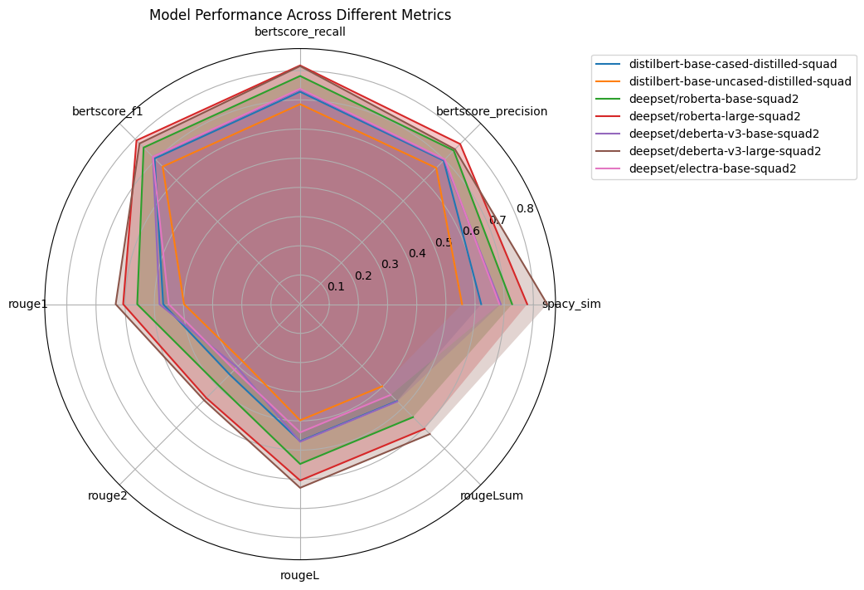
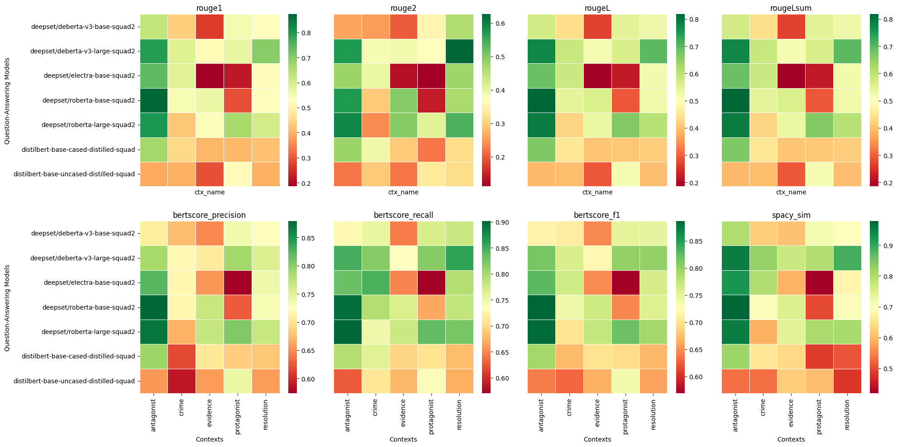
Q/A Results
deepset/deberta-v3-large-squad2 performed very well generally in answering the questions correctly

Slide 8
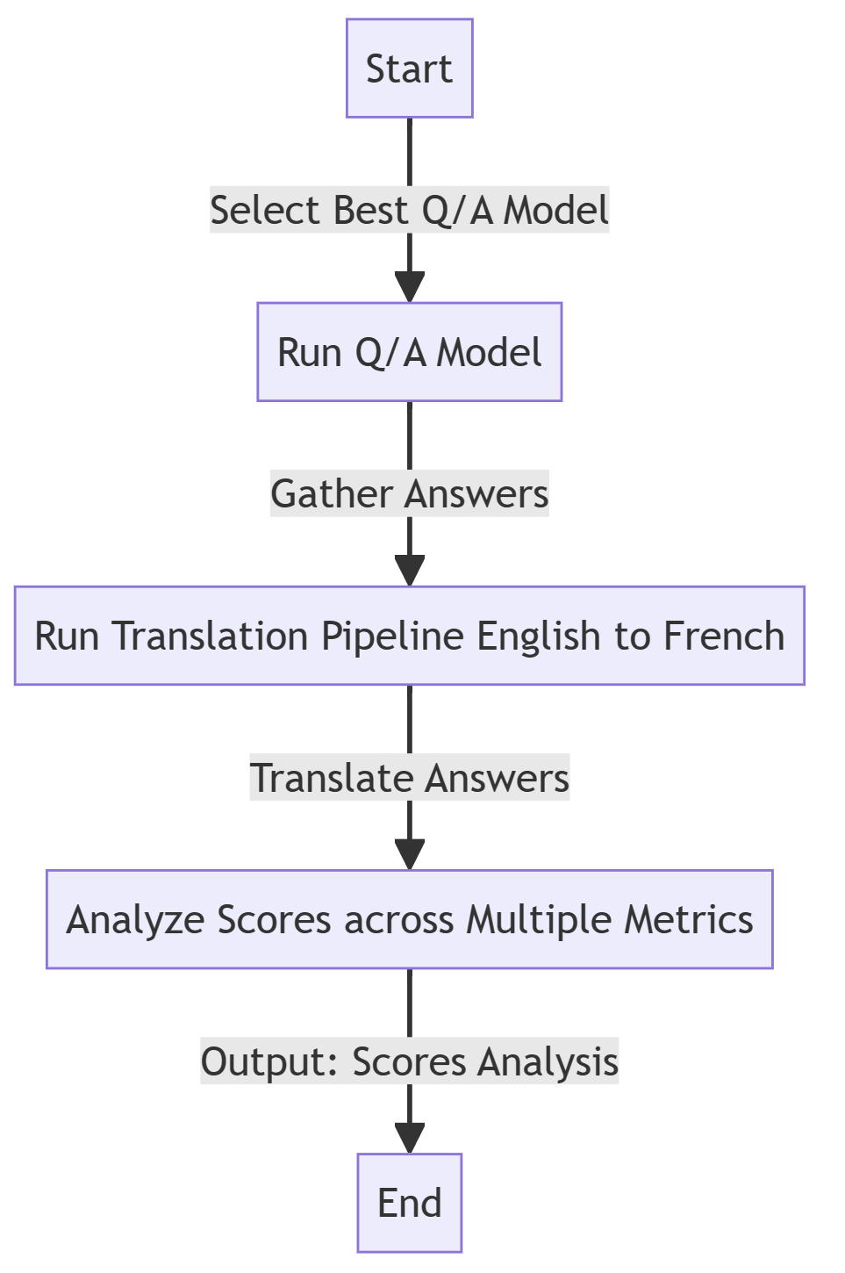
Translation Pipeline
Goal: Enable chatbot for English-French translations
Model Selection:
Specialized Models: “Helsinki-NLP/opus-mt-en-fr” & fr-en
Trained for specific language pairs
Multilingual Model: "facebook/m2m100_418M"
trained on a diverse multi-lingual dataset
Source: The answers provided by our best Q/A model
Evaluation & Insights:
Effect of cyclical translation (English to French and back)
Maintaining original text essence and nuances
Multi-lingual vs. specialized model
Notes:
The specialized, opus models tended to perform better for our translation tasks. They often gave more accurate and clear answers after being translated back and forth. The multi-lingual model would often translate to french well, but would experience issues going back to english

Slide 9
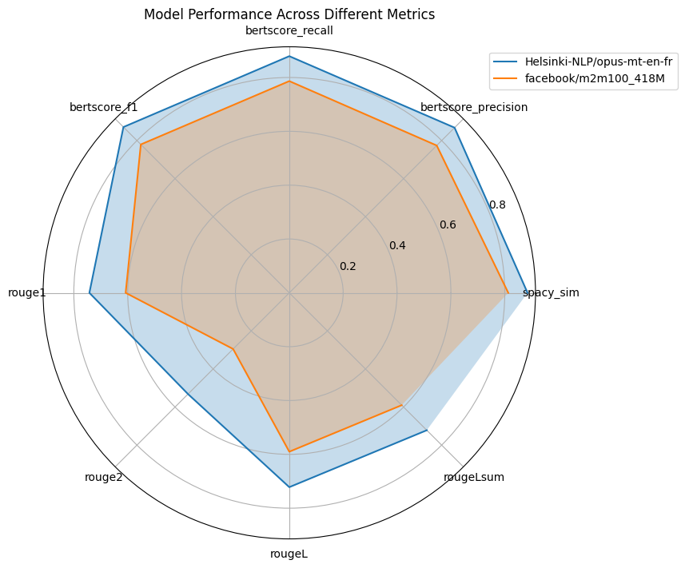
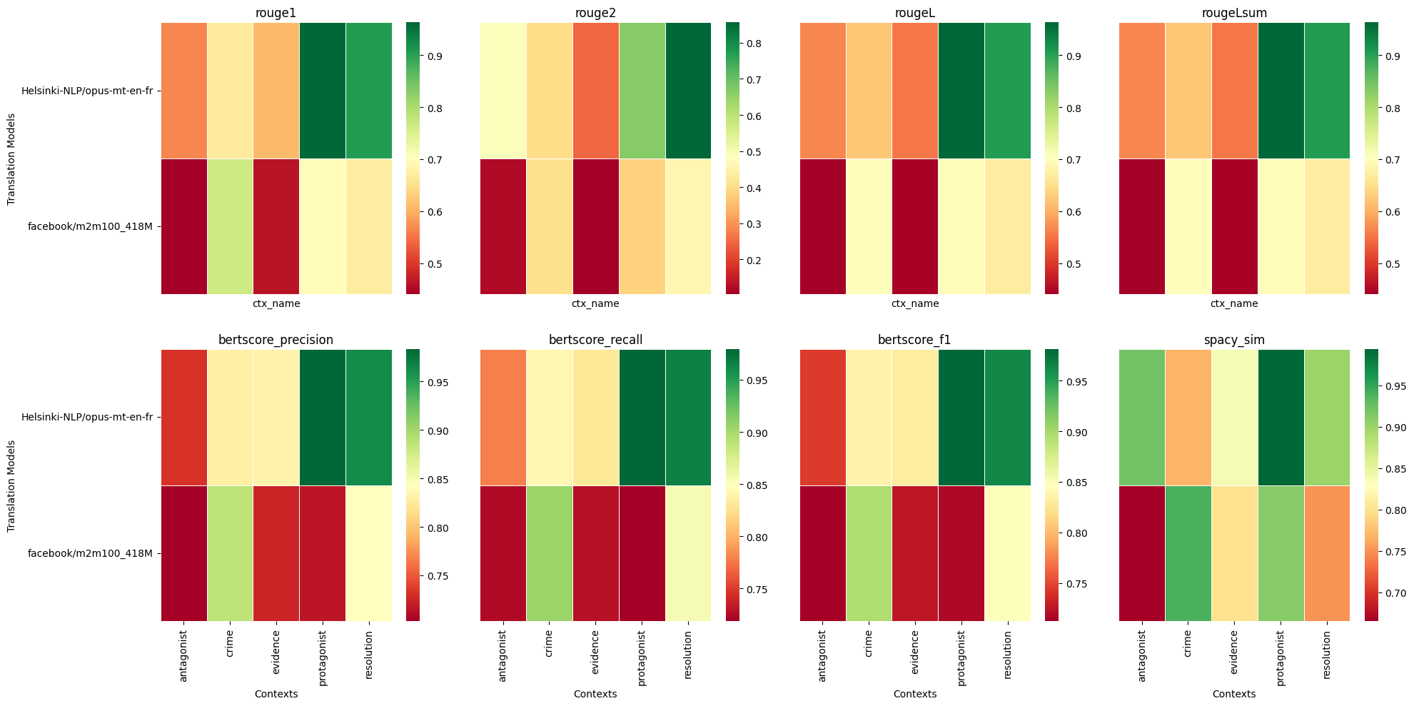
Translation Results
Helsinki-NLP/opus-mt does perform better than Facebook/m2m100_418M across all metrics we compared due to the fine tuning of the model for specific languages.

Slide 10
Summarization Pipeline
Purpose: Condense novel sections into coherent summaries
Source: 300-word sections on key narrative elements
Model Selection:
DistilBART (distilbart-cnn-12-6): Efficient, reduced size, trained on news articles
BART Summarization (bart_summarisation): Specifically designed for summarization, trained on dialogue datasets
PEGASUS-X Large Book Summary (pegasus-x-large-book-summary): Large model trained on a variety of texts, including novels. Design for long-form texts
Evaluation & Insights:
Conciseness and contextual accuracy of summaries
Notes:
A few insights we saw were that BART summarization model tended to summarize pieces of dialoge much more accurately then the other models, which makes sense. We also saw that PEGASUS model would

Slide 11
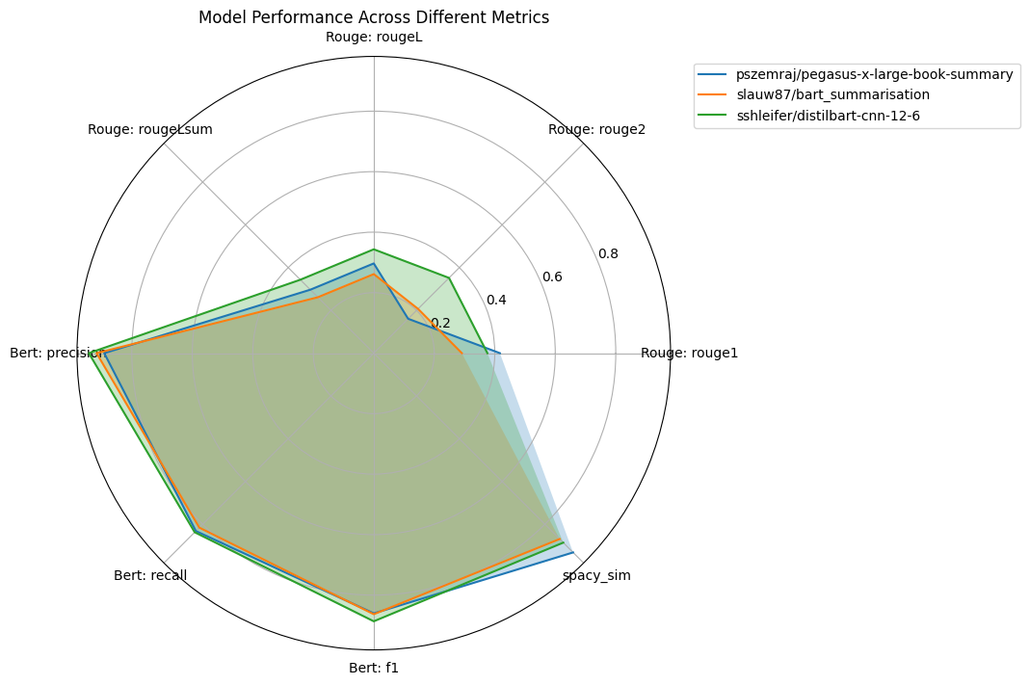
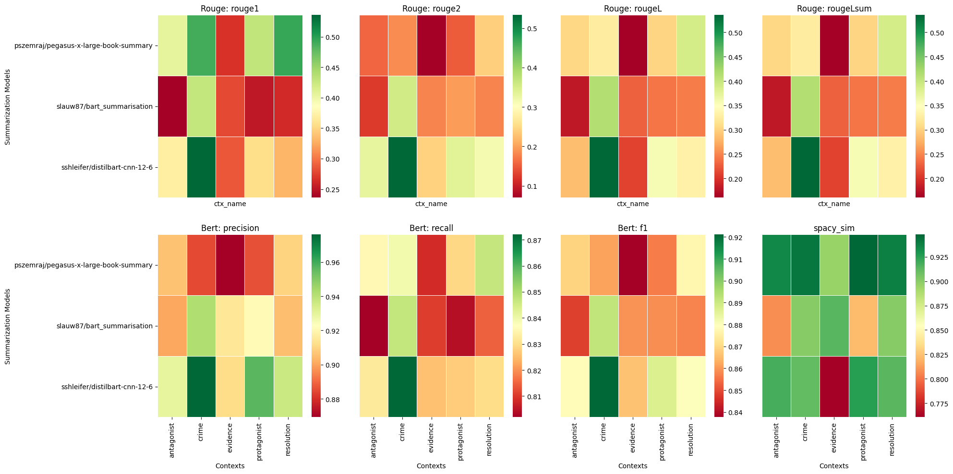
Summarization Results
Spacy’s cosine similarity score yields the best result compared to other metrics
Removed stop words and punctuation to make it a viable metric for summarization task

Slide 12
Demo

