Slide 1

DS644 : Project : Climate Weather Surface of Brazil - Hourly
Dataset : Climate Weather Surface of Brazil - Hourly
Instructor: Dr. Yajuan Li
Manan Shah (ms3452) Palak Pabani (pp872) Vinitkumar Dobariya (vd363) Sneh Vora (sv992)

Slide 2
INTRODUCTION TO DATASET
The dataset is sourced from kaggle and titled hourly weather surface brazil southeast region.
It provides hourly weather data collected across various stations in brazil's southeastern region.
This project focuses on the north.csv file, a 1.55 GB subset of the dataset, which contains meteorological observations for the northern region of brazil.
Each record corresponds to hourly measurements of weather parameters, with details about location and time.

Slide 3
DATASET OVERVIEW
Dataset Details: Contains 26 columns, organized into key categories relevant for weather analysis.
Time and observation details:
1. Index & Date: Row identifier and observation date for dataset integrity and chronology.
2. Hour (Hora): Observation time, critical for time-series analysis.
3. Precipitation (mm): Total hourly rainfall for analyzing weather patterns.
4. Atmospheric Pressure (mB):Current: At station level. Previous Hour Max/Min: Indicates pressure trends.
5. Temperature (°C):Hourly: Dry bulb temperature for temperature studies. Previous Hour Max/Min: Air temperature trends.

Slide 4
DATASET OVERVIEW
Humidity and Wind:
Humidity (%):
Hourly Relative: Key to assessing weather conditions.
Previous Hour Max/Min: Changes in air moisture.
Wind Patterns:
1. Direction (gr): Hourly wind directions.
2. Speed (m/s): Hourly speeds and max gusts for extreme conditions.
3. Solar Radiation (Kj/m²): Global radiation data, essential for sunlight analysis.
Geographical Metadata:
1. Location: Region, state, station, station code.
2. Coordinates: Latitude, longitude, and elevation of the station.

Slide 5
Problem Statement
1. Temperature trends: monthly and seasonal variations in dry bulb temperature.
2. Humidity and dew point: variations and correlation with temperature.
3. Wind patterns: dominant wind directions and speeds, and their variations.

Slide 6
Task 1: Temperature Trends - Mapper and Reducer
Objective: Analyze monthly and seasonal variations in dry bulb temperature.
Mapper:
Parses the "TEMPERATURA DO AR" (dry bulb temperature) column.
Outputs key-value pairs: Key: Weather station code Value: Temperature
Reducer:
Receives a list of temperatures for each station.
Computes the average temperature for each weather station.
Outputs: Key: Weather station code Value: Average temperature

Slide 7
Task 2: Humidity and Dew Point - Mapper and Reducer
Objective: Analyze variations in humidity and dew point and correlate them with temperature.
Mapper:
Extends the previous mapper to include:
UMIDADE RELATIVA DO AR (relative humidity).
TEMPERATURA DO PONTO DE ORVALHO (dew point temperature).
Outputs key-value pairs: Key: Weather station code Value: Relative humidity, Dew point temperature
Reducer:
Computes the average humidity and average dew point temperature for each station.
Correlates dew point with temperature using statistical methods (e.g., Pearson correlation).

Slide 8

Task 3 - Wind Patterns Mapper & Reducer
Objective: Determine dominant wind directions and speeds and analyze their variations.
Mapper:
Reads the "VENTO, VELOCIDADE HORARIA" (hourly wind speed) column.
Outputs key-value pairs: Key: Weather station code Value: Wind speed
Reducer:
Receives a list of wind speeds for each station.
Finds the maximum wind speed for each weather station.
Outputs: Key: Weather station code Value: Maximum wind speed

Slide 9
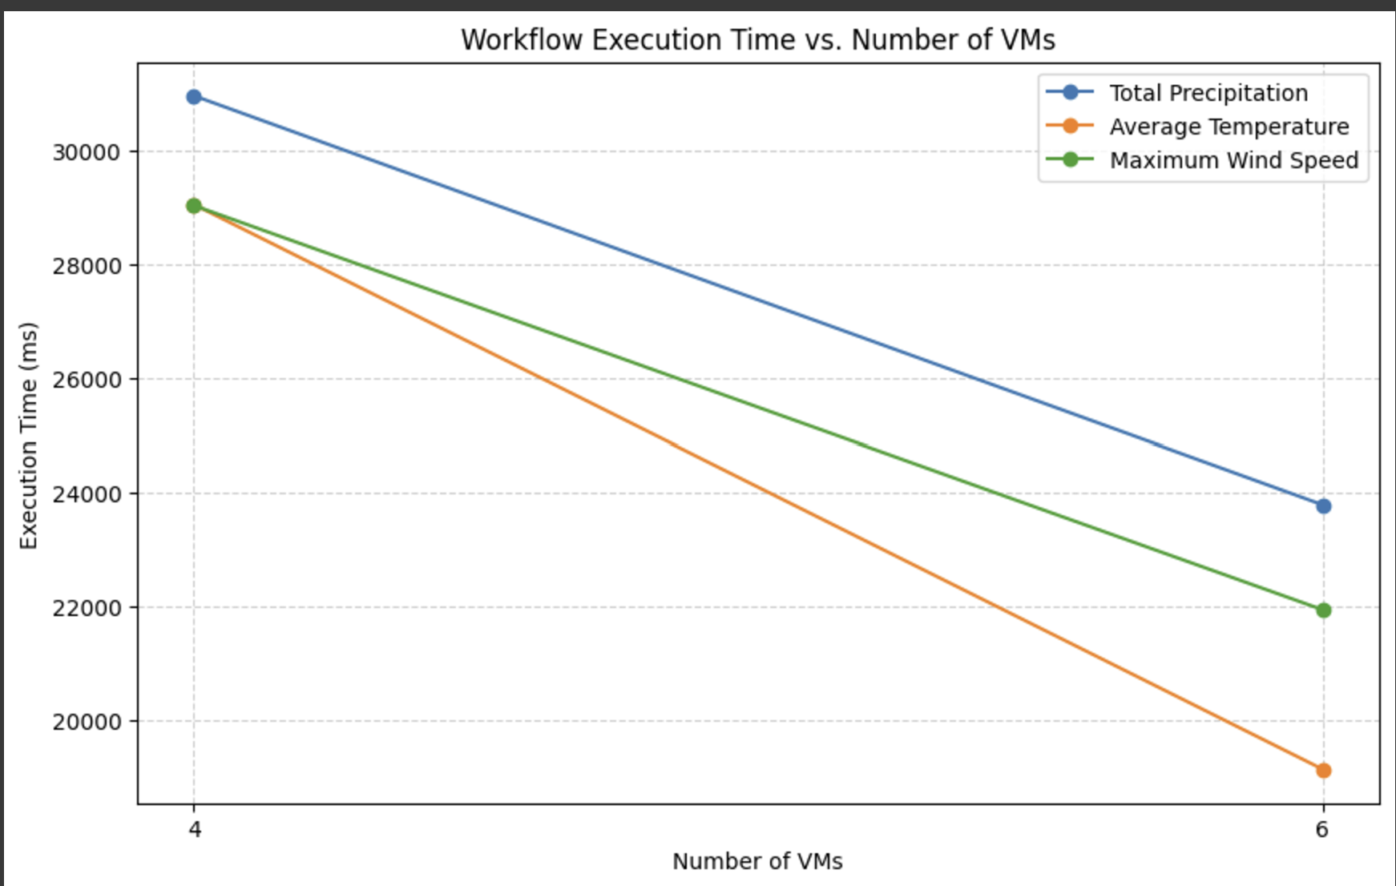
Performance measurement ON INCREMENT VM’s

Slide 10
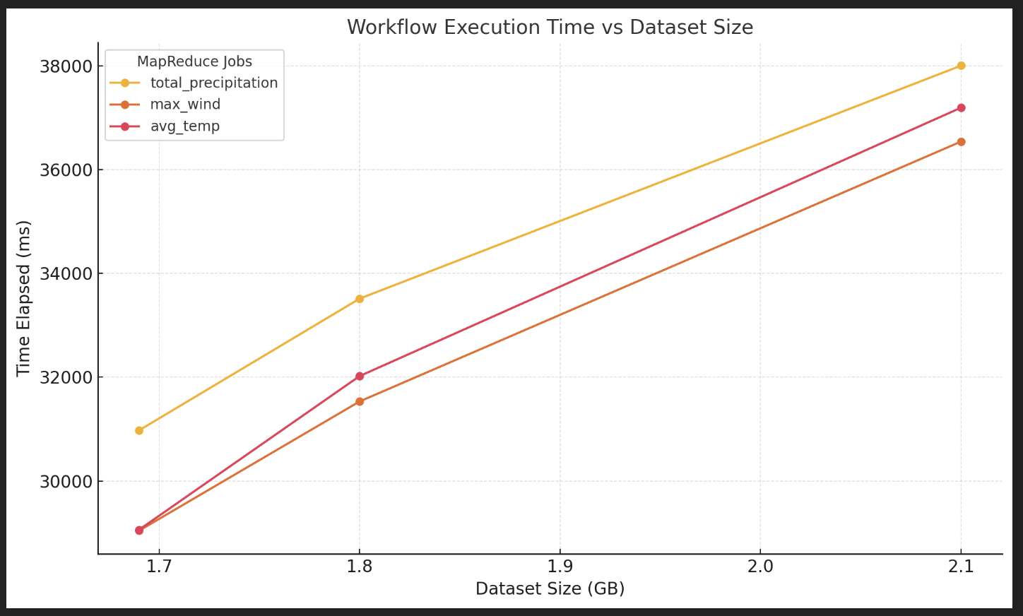
Performance measurement ON THE BASES OF DATASET SIZE

Slide 11
Performance optimization
Job Configuration:
Optimize memory allocation to prevent memory overflow.
Leverage efficient file formats for better storage and faster processing.
Parallel Processing:
Run independent jobs in parallel to utilize resources efficiently.
Use dynamic resource allocation to optimize resource usage.
Resource Scaling:
Scale VMs or nodes for large datasets to reduce processing time.
Implement auto-scaling based on workload demands.
Data Handling:
Partition datasets for parallel processing.
Ensure balanced input splits for even distribution across tasks.

Slide 12
CONCLUSION
MapReduce offers a powerful framework for efficiently processing large-scale weather data in parallel, enabling scalable analysis of complex datasets.
The three tasks—Temperature Trends, Humidity & Dew Point, and Wind Patterns—provide crucial insights into:
Seasonal and spatial variations in temperature.
Correlation between humidity and dew point with temperature.
Dominant wind patterns and their spatial and temporal variations.
The use of distributed computing through MapReduce allows us to handle large datasets like the Brazil Southeast Region Hourly Weather dataset efficiently.
These insights are not only valuable for weather forecasting but also for understanding the impact of climatic factors on local environments and industries.

Slide 13

THANK YOU
FEEL FREE TO ASK ANY QUESTION

