Slide 1
QueryShield AI
Governed Natural-Language-to-SQL
MVP-1 Demo Flow
Analytics Platform
Upload CSV
1
Cloud Storage
Ask questions in plain English while enforcing SQL safety, cost control, and auditability.
2
Ask question
Gemini SQL
Built for controlled AI analytics
Validate & dry run
3
Gemini SQL generation • parser validation • BigQuery dry run • bounded execution • audit logs
Safety + cost
4
Execute safely
BigQuery
FastAPI
Next.js
Gemini
BigQuery
Cloud Run
GitHub Actions
Explain result
5
Summary + chart
Portfolio project • Deployed on Google Cloud

Slide 2
The Problem
Natural-language analytics is powerful, but unmanaged AI-generated SQL creates risks.
AI can write SQL quickly — but speed without governance can create security, cost, and trust problems.
!
$
A
U
Unsafe SQL
Cost Explosion
No Audit Trail
Accessibility Gap
Generated queries may include risky operations, invalid syntax, or unintended table access.
A single uncontrolled query can scan unnecessary BigQuery data and increase cost.
Teams need history of prompts, SQL, dry runs, executions, and result outcomes.
Non-technical users need analytics access without writing or reviewing raw SQL.
Core challenge: make analytics simple for users while keeping SQL execution safe, cost-aware, and auditable.
QueryShield AI
2

Slide 3
The Solution
QueryShield AI wraps Gemini-generated SQL inside a controlled execution workflow.
QueryShield AI
1
Upload
CSV stored and prepared for BigQuery
Cloud Storage
Governed NL-to-SQL analytics for CSV datasets on Google Cloud.
2
Ask
User submits natural-language question
Gemini
Plain English → SQL
3
Validate
Parser checks SQL safety and table scope
Rules
Dry-run cost gate
Audit-ready execution
Dry Run
BigQuery estimates bytes and cost
BigQuery
4
Built to show production-style AI governance without overcomplicating MVP-1.
5
Explain
Summary, chart, table, history and audit
UX
Result: easier analytics for users, safer execution for engineering teams.
QueryShield AI
3

Slide 4
End-to-End User Flow
A clean path from account creation to governed, explainable results.
1
2
3
4
5
6
7
8
9
Sign up Login
Create dataset
Upload CSV
Load to BigQuery
Ask question
Generate SQL
Validate + dry run
Execute safely
Summary + chart + table
EXAMPLE QUESTION
EXPECTED OUTPUT
“Show total cost by service”
Generated SQL + validation passed
Dry-run bytes/cost estimate
Used with cloud_costs_demo.csv to show BigQuery, Cloud Run, and Cloud Storage cost distribution.
AI summary + bar chart + result table
QueryShield AI
4

Slide 5
System Architecture
Frontend, backend, AI, data, and deployment layers working together on GCP.
User Interface
API Backend
AI Services
Analytics
Next.js frontend Dataset upload • analysis page • result visualizations
FastAPI REST APIs Auth • datasets • validation • execution
Gemini SQL generation • result summary
BigQuery Tables • dry run • governed SQL
Deployment & Security Foundation
Storage + Metadata
Docker
Artifact Registry
Cloud Run
Secret Manager
IAM
GitHub Actions
Cloud Storage for CSVs SQLite for MVP metadata
containers
images
services
secrets
least privilege
CI/CD
Cloud Logging
runtime logs
Design choice: SQLite keeps MVP-1 cost-controlled; BigQuery handles the real analytical workload.
QueryShield AI
5

Slide 6
Governed Query Execution Pipeline
Every AI-generated query passes safety and cost gates before execution.
1
2
3
4
5
Generate SQL
Validate safety
Dry run
Cost gate
Execute + audit
Gemini converts the user question into SQL.
Parser enforces read-only SQL and table scope.
BigQuery estimates bytes processed before execution.
Query must stay within configured scan limit.
Approved query runs; history and audit logs are stored.
Safety controls implemented
Read-only SQL
Restricted table access
100 MB scan limit
Prevents destructive operations
Limits scope to selected dataset
Controls BigQuery cost exposure
100-row bound
Full audit trail
Non-blocking AI summary
Keeps result payload manageable
Captures dry run, execute, and summary events
Results remain visible if summary fails
QueryShield AI
6

Slide 7
Google Cloud Implementation
GCP services are used for deployment, storage, analytics, secrets, and observability.
CR
Cloud Run
AR
Artifact Registry
CS
Cloud Storage
BQ
BigQuery
Containerized FastAPI backend and Next.js frontend services.
Stores versioned Docker images built by GitHub Actions.
Persists uploaded CSV files before BigQuery loading.
Stores analytical tables, runs SQL, and provides dry-run estimates.
SM
Secret Manager
IAM
IAM + WIF
LOG
Cloud Logging
CI
GitHub Actions
Protects JWT secret and Gemini API key in deployment.
Least-privilege service accounts and keyless GitHub deployment.
Captures runtime logs for backend and frontend services.
Automates CI, Docker build, push, and Cloud Run deployment.
Deployment pattern: GitHub push → CI/CD → Artifact Registry → Cloud Run → BigQuery/Storage/Secrets.
QueryShield AI
7

Slide 8
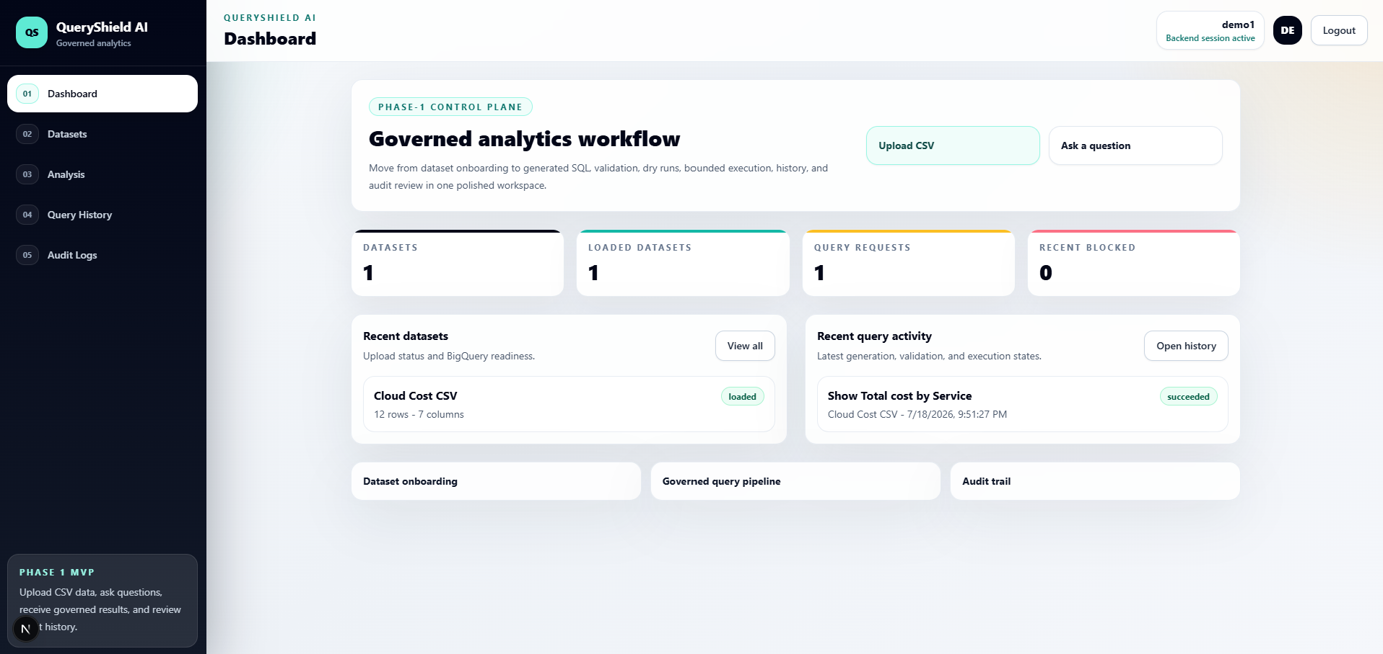
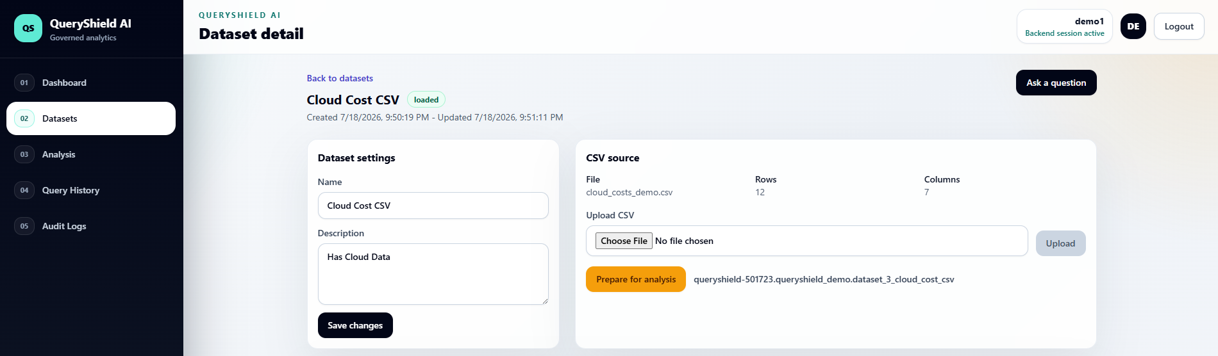
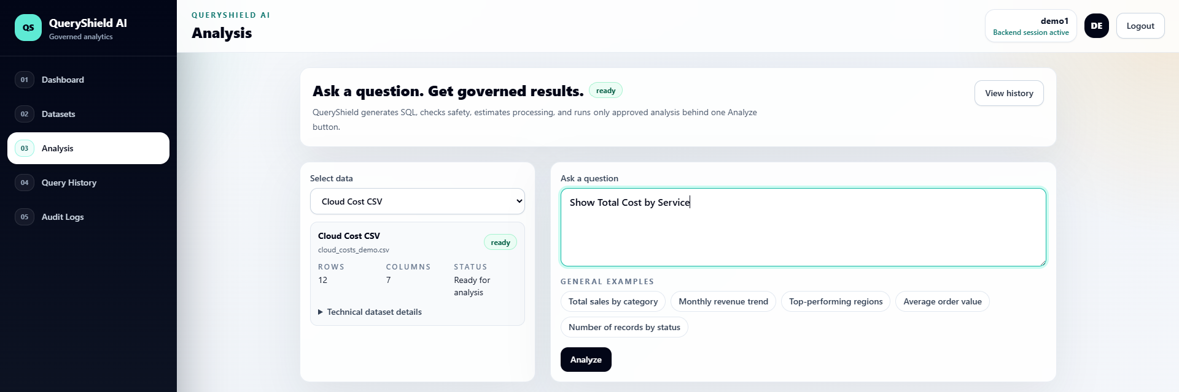
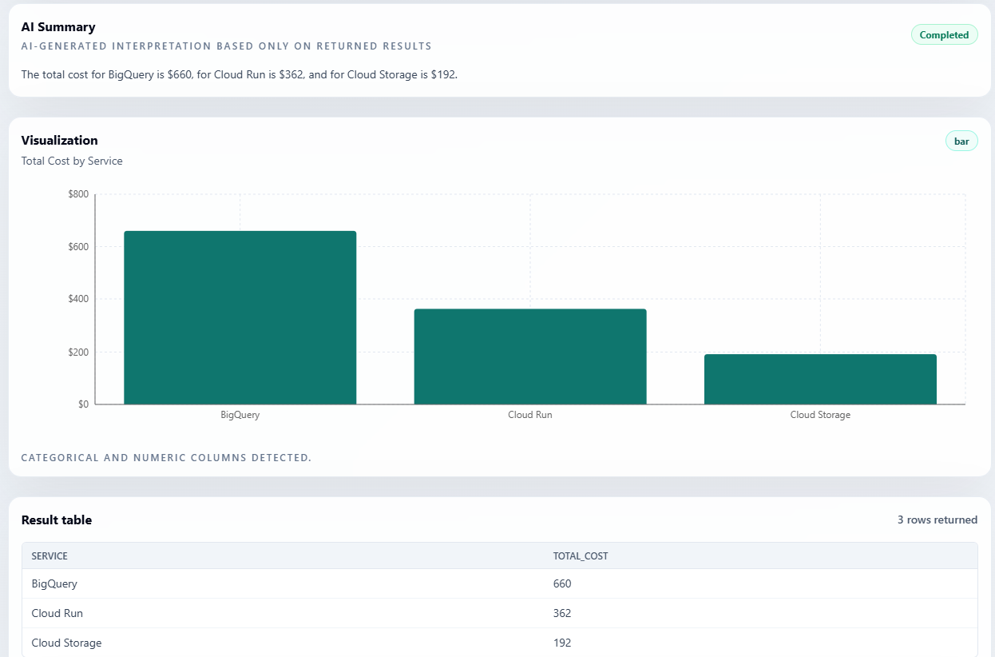
Product Walkthrough
End-to-end governed analytics workflow from dataset onboarding to AI-assisted results.
1. Dashboard control plane
2. Dataset upload
Manage datasets, query activity, and demo workflow.
Upload cloud_costs_demo.csv and prepare it for BigQuery.
3. Natural-language query
4. AI summary + chart + table
Ask: “Show total cost by service”.
Explain, visualize, and verify bounded results.
QueryShield AI
8

Slide 9
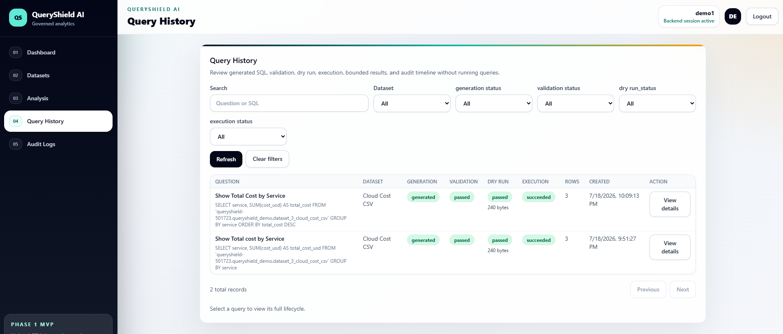
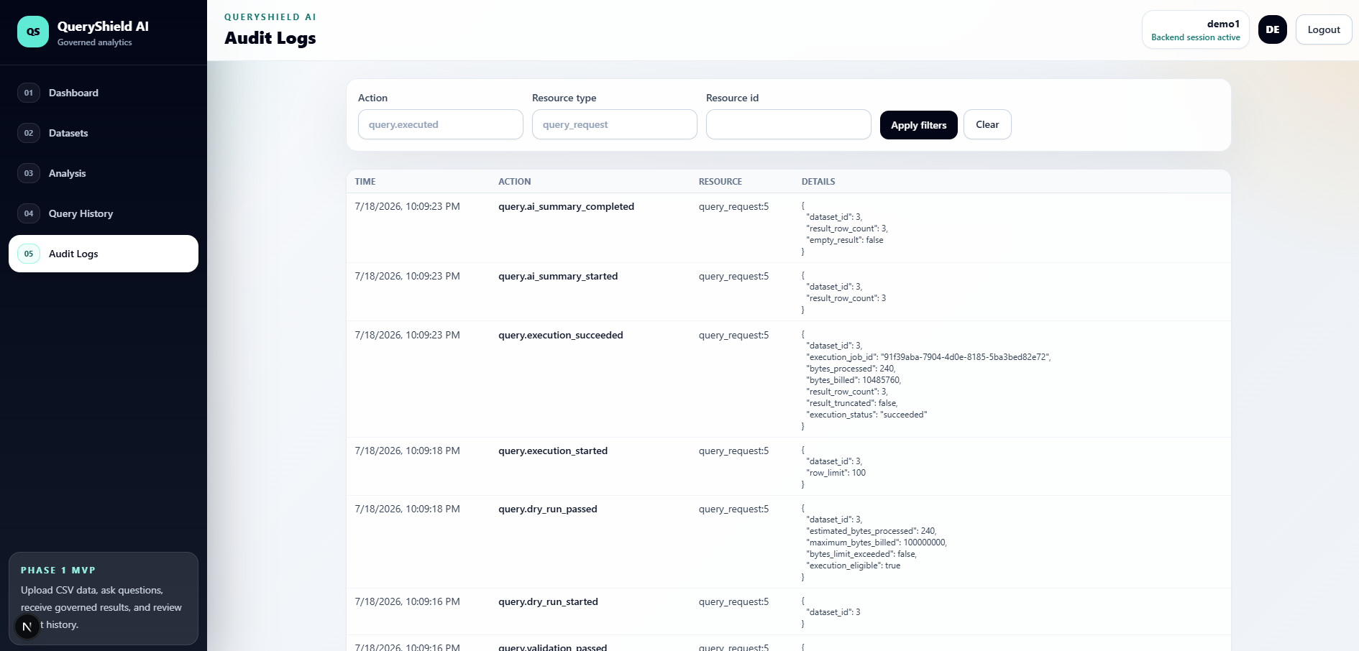
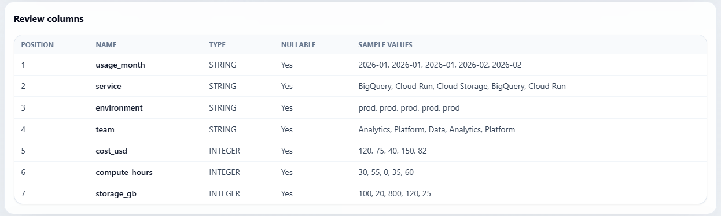
Traceability & Evidence
History and audit views make AI-assisted analytics reviewable.
Schema review
Query history
Audit logs
Detected columns, types, nullability, and sample values.
Question, generated SQL, validation, dry run, execution status, and rows.
System events for validation, dry run, execution, and AI summary.
Schema
History
Audit
Governance evidence: each query can be reviewed from schema context through execution and AI summary events.
QueryShield AI
9

Slide 10
Project Impact
A deployed AI analytics product with visible governance, cloud deployment, and business value.
4-stage
10+
100 MB
100 rows
CI/CD
query governance pipeline
SQL safety checks
BigQuery scan limit
bounded result output
keyless Cloud Run deploy
What was built
Governance achieved
Business value
Full-stack NL-to-SQL analytics platform
Validation before execution
Natural language access to analytics
Gemini SQL generation and AI result summary
Dry-run bytes and cost estimation
Reduced risk from blind AI SQL execution
BigQuery-backed analytical execution
Audit logs and query history
Cost-aware BigQuery query control
Cloud Run deployed frontend and backend
Result table remains source of truth
Explainable results with charts and summaries
Result: QueryShield AI makes analytics easier while keeping SQL execution controlled, explainable, and auditable.
QueryShield AI
10

Slide 11
Future Scope
MVP-1 proves the workflow; future versions harden it for production teams.
1
2
3
4
5
Production Data
Access Control
Advanced Analytics
Approval Workflow
Operations
Replace SQLite with Cloud SQL PostgreSQL for durable multi-instance metadata.
Add RBAC for admins, analysts, and read-only users.
Support multi-table joins, saved reports, and dashboards.
Require approval for high-cost or sensitive queries.
Add custom metrics, alerts, retention policies, and org workspaces.
Clear next step: production hardening, not more MVP feature expansion.
QueryShield AI
11

