Slide 1
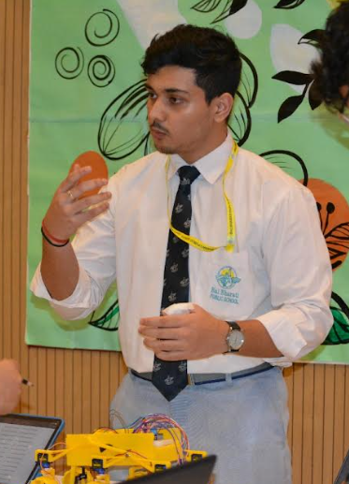
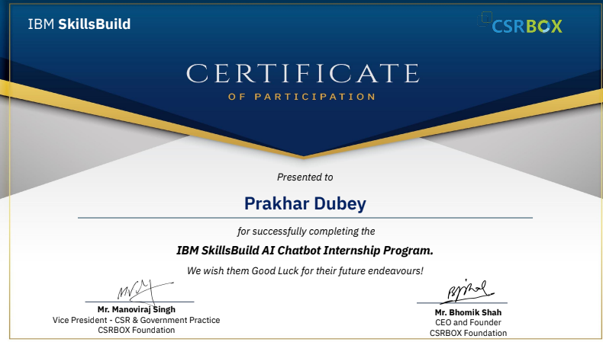
IBM SKILLSBUILD
I had the privilege of participating in the IBM SkillsBuild program, this program is designed for anyone, requiring no prior programming knowledge—just a logical mindset and problem-solving skills. Through hands-on experience with cutting-edge Watson AI technology, I delved deep into the fascinating world of AI. My dedication and enthusiasm paid off, leading to an internship opportunity in IBM, where I could further apply what I learned. I encourage all students to take full advantage of such programs offered by our school!
PRAKHAR DUBEY, 11th - C

