Slide 1




We are happy to have you HERE

Slide 2

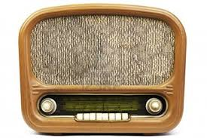
क्या रेडियो अलोकप्रिय है ? Is Radio Unpopular ??

Slide 3

एक विचार ....या मंत्र .....
यदि समस्या one click away है
तो समाधान भी one click away होना चाहिए

Slide 4

यदि शोध परिणामों को देखें तो ऐसा बिलकुल नहीं है Not At All…Look at the Research findings…

Slide 5
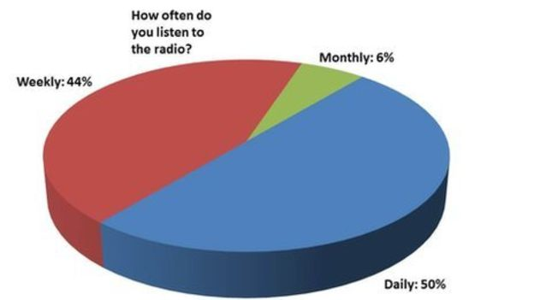
मध्य भारत में 4 राज्यों के शोध और सर्वेक्षण कुछ और ही कहानी कहते हैं... Survey findings about Radio in Mid India tell different story

Slide 6

एक अत्यंत महत्वपूर्ण प्रश्न – प्रसारण किसे कहते हैं ? What is Broadcasting.. Broad+Casting ?
A MUST ASK QUESTION

Slide 7
Broadcast=Broad+Cast
Broad means- Wide AND Cast means- To put
ब्रॉड का अर्थ होता है –विस्तृत और कास्ट का अर्थ –डालना
When electronic magnetic signals are cast on vast geographical area covering overseas distances or a vast land mass, it is Broadcast.
जब विद्युतीय चुम्बकीय तरंगें किसी विस्तृत क्षेत्र में डाली जाती हैं तो इसे ब्रॉडकास्ट कहते हैं
In simple language, BROADCAST covers a vast distance of Land mass.
used for international news, cultural propaganda and exposer of a particular country to other nations.

Slide 8
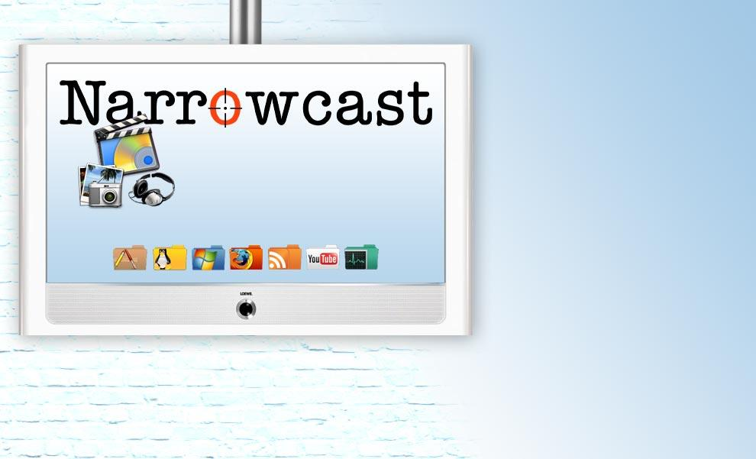
Narrow Casting….

Slide 9
Narrowcast= Narrow + Cast
When Radio signals are cast or thrown or put in short geographical distances or to a narrow land mass, it is called NARROWCAST.
These stations are also called the FM stations or Community Radio.
They narrowcast focusing a specific area.
They are more need based because every area has a specific mind set or common problems.
इसी प्रकार जब रेडियो तरंगें किसी सीमित क्षेत्र में प्रसारित की जाती हैं तो वे नैरो कास्ट कहलाती हैं. इसका उदाहरण है FM रेडियो और सामुदायिक रेडियो – इन दिनों 255 सामुदायिक प्रसारण केन्द्रों से हमारे कार्यक्रम प्रसारित हो रहे हैं.

Slide 10
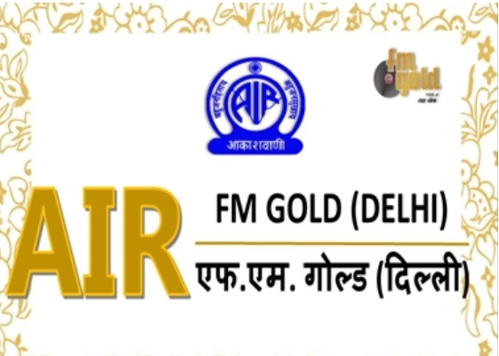
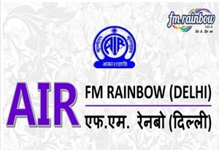
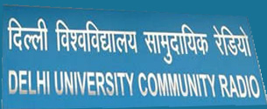
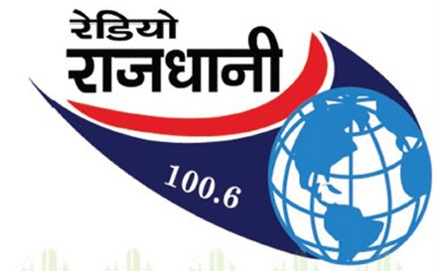


Some Examples of Narrowcasting agencies-

Slide 11
रेडियो कार्यक्रम के मुख्य दो प्रकार हैं -
Classification of Radio programs
रेडियो कार्यक्रमों का वर्गीकरण
Radio programs can be categorized into three major parts:
1- Spoken word programs
2- Music programs
In other words, we can say that technically they can be termed as
Literal format and music format.
Scripted and unscripted programs
रेडियो कार्यक्रम तीन मुख्य भागों में बांटे जा सकते हैं –
1-शाब्दिक कार्यक्रम
2-संगीत कार्यक्रम इसमें गायन व वाद्य संगीत शामिल है
3-लिखित और अलिखित कार्यक्रम

Slide 12
Wide spectrum of radio programs
Popular Formats of spoken words
Popular Formats of Spoken and Musical
Talk
Quiz
Interview
Vox populi or Opinion Poll
Story and Prose
Poetry Recitation
Panel Programs-
1-Pannel Discussion
2-Symposium
Documentary
Magazine
DocuDrama
Classical, Light classical, Instrumental
Song Stories
Various formats of Radio programs

Slide 13
एक विचार ....या मंत्र .....
यदि समस्या one click away है
तो समाधान भी one click away होना चाहिए

Slide 14
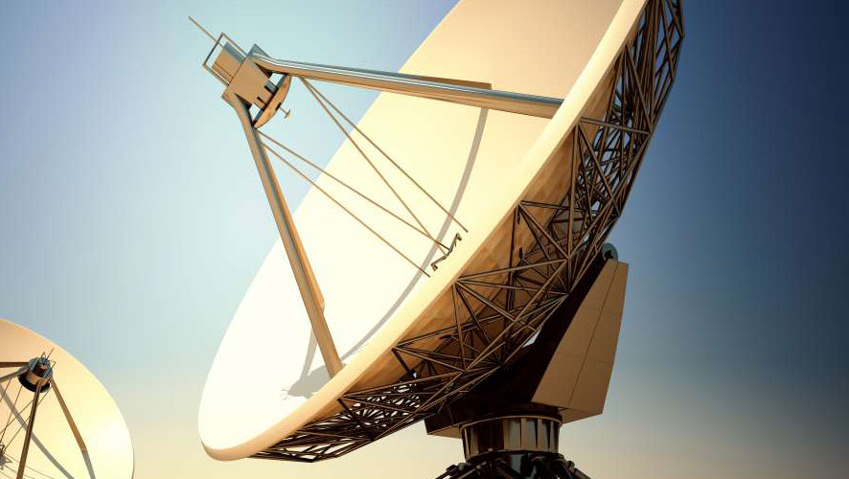
रेडियो कार्यक्रमों के प्रारूप - Formats of Radio Programmes…

Slide 15
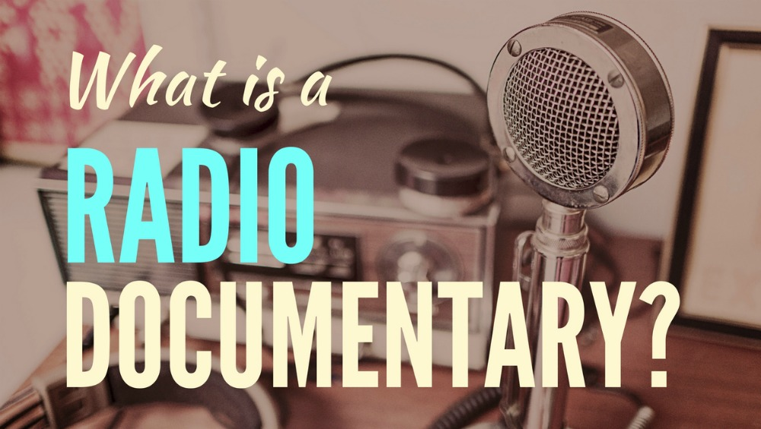
Documentary !!One of the Most popular formats in Radio – रेडियो दस्तावेज़

Slide 16
Essential Elements in Audio Documentary
Radio documentary is a spoken word with supportive music radio format devoted to non-fiction narrative.
It is obvious by the word that this format essentially requires the documented evidences for production.
We need to have-
Authentic documents, archival audio contents
Music to support the content spoken
Deep Seated research
सत्यापित दस्तावेज़, प्रलेखित ध्वनि सामग्री, संगीत, शिलालेख, इलेक्ट्रोनिक रिकार्डिंग, ऐतिहासिक सामग्री

Slide 17
One of the most entertaining radio formats
Radio Magazine रेडियो पत्रिका
Show रील

Slide 18
Why it is so entertaining ??
Have a look at a magazine !! What do you observe ??
We see a variety in any magazine page to page…you will have…
Editorial
Poems
Essays
Cartoons
Drama
Any thing else suited to your interest… Radio Magazine is interesting because of it’s variety….SOUND EFFECTS ARE MUST !!

Slide 19
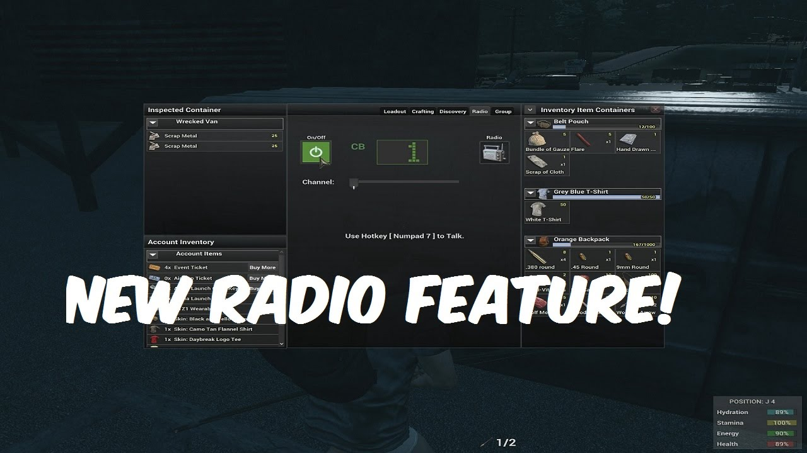
Feature…is a very specific format in Radio

Slide 20
How to understand a FEATURE?
A distinctive attribute or aspect of something.
Feature focuses on only one aspect out of many aspects of a place, personality, music, flora and fauna
Example- Bahuroop Gandhi is a book published by NCERT which showcases his versatile personality such as- Gandhi as a writer, Commander, Saint, Auctioneer, Satyagrahi etc.
Feature will highlight only one aspect not all whereas in documentary more aspects can be dealt.

Slide 21
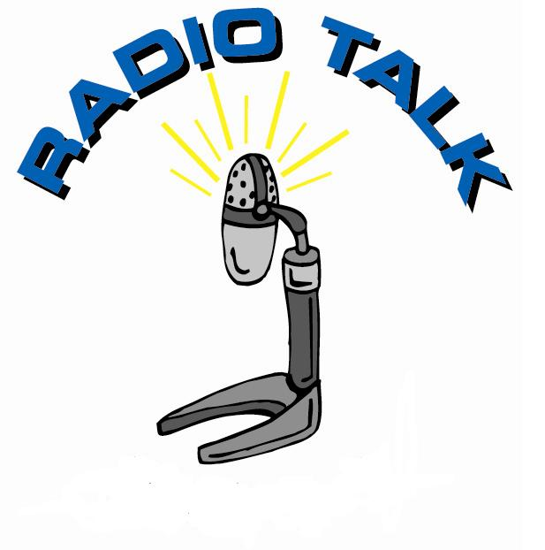
Radio Talk is most commonly used in Education….

Slide 22
What is a talk ??
A radio talk requires a presenter and a subject expert.
Presenter will introduce the subject expert and invite the expert to speak on the subject of her or his expertise.
Prior to the recording the expert is expected to have interesting research findings and to prepare the script.
It can either be pre recorded and edited before broadcast or can be broadcast live on air.
Normally it is suggested to pre record the talk to validate the content.

Slide 23

This format is also called the “Voice of the people”

Slide 24

What’s your view ????

Slide 25
Vox- Populi…the elements…!!
Vox Populi is mostly the outdoor recording in which the producer goes into the real situation.
Producer takes the public opinion on a particular topic such as the Price hike, Elections, Pollution, Sanitation and cleanliness, Public health or any other common problem.
Producer comes back to the studio for editing, adds some narration and cast the program on air.

Slide 26

For Being here and Listening…..

