Slide 1


UNDERSTANDING
EBOOKS’ TYPES AND POSSIBILITIES
Welcome

Slide 2
What are eBooks ?
E-books, or digital versions of printed books, can be read on various electronic devices like computers, tablets, e-readers, and smartphones. They replicate the traditional reading experience while offering advantages such as portability, convenience, and accessibility. Available in formats like PDF, EPUB and MOBI ebooks can contain text, images, and interactive elements. Their popularity stems from easy access, the ability to carry entire libraries, and customizable reading preferences, revolutionizing the way people access literature and educational content.

Slide 3
Benefits of an E-Book
Portability: E-books can be accessed on various devices, enabling readers to carry a vast library with them.
Accessibility: E-books grant access to a wide range of literature, including rare and out-of-print books. They also offer features like adjustable fonts for better accessibility.
Cost-Effectiveness: Ebooks are cheaper, eliminating printing and distribution costs. They can be easily updated and distributed without reprinting.
Searchability and Interactivity: E-books have search functions and interactive features like hyperlinks and multimedia, enhancing the reading experience.

Slide 4
Continued…
5. Environmentally Friendly: E-books reduce resource consumption and environmental impact by eliminating the need for paper and physical distribution.
6. Convenience: E-books can be instantly purchased and downloaded, offering immediate access without the need for physical stores or shipping.
7. Space-Saving: E-books require no physical storage, making them ideal for those with limited space and reducing clutter.
8. Customizability: Some e-book readers offer customizable options like adjusting fonts, highlighting, and annotating, allowing readers to personalize their experience.

Slide 5
How many types of E-books ?
PDF E-books: Portable Document Format (PDF) e-books closely resemble the layout of a printed book and are commonly used for documents, manuals, and materials that require a fixed layout. PDF e-books are easily accessible on various devices, and they retain the formatting and design of the original document, making them ideal for textbooks and documents with complex layouts.
EPUB E-books: Electronic Publication (EPUB) is one of the most common e-book formats. EPUBs are highly flexible and can adjust their layout to fit different screen sizes, making them compatible with a wide range of e-readers, tablets, and smartphones. They support features such as resizable text, adjustable font styles, and dynamic content, making them suitable for various genres, including fiction, non-fiction, and academic publications.

Slide 6
Continued…
Mobi E-books: Mobipocket (Mobi) e-books are primarily used by Amazon's Kindle devices. They support features similar to EPUBs, such as adjustable text and font sizes. Mobi e-books are widely used for commercial e-books and self-published works available through Amazon's Kindle Direct Publishing (KDP) platform.
Interactive E-books: Interactive e-books offer a more engaging reading experience by incorporating multimedia elements such as audio, video, and interactive graphics. These e-books are often used in educational materials, children's books, and digital learning resources to enhance reader engagement and understanding.

Slide 7
Continued…
Enhanced E-books: Enhanced e-books combine traditional text with multimedia elements, such as audio and video, to create a more immersive reading experience. They often include additional features like pop-up annotations, embedded links, and interactive elements, catering to various learning styles and preferences.
Fixed Layout E-books: Fixed layout e-books are similar to PDF e-books in that they preserve the exact layout and design of the print version. They are commonly used for graphic-intensive publications, such as comic books, children's books, and illustrated guides, where maintaining the original layout is essential to the reading experience.

Slide 8

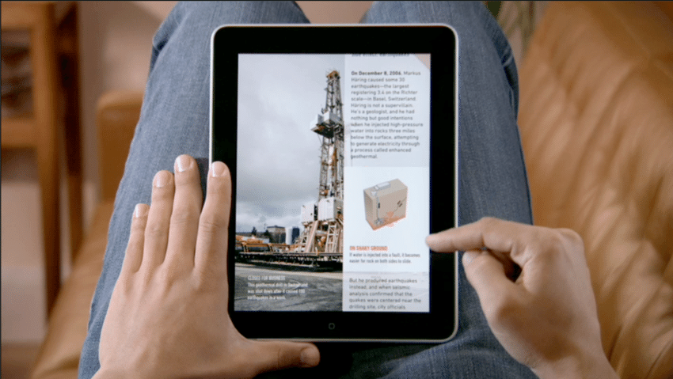
NCERT uses three types of e-books
PDF (Portable Document Format)
FLIPBOOK
EPUB (electronic publication)

Slide 9
What is Digitization of Textbooks ?
Digitization of textbooks refers to the process of converting traditional print textbooks into digital formats that can be accessed and read on electronic devices such as computers, tablets, e-readers, and smartphones. It involves transforming the content, layout, and features of the printed textbook into a digital version that can be viewed and interacted with electronically.

Slide 10
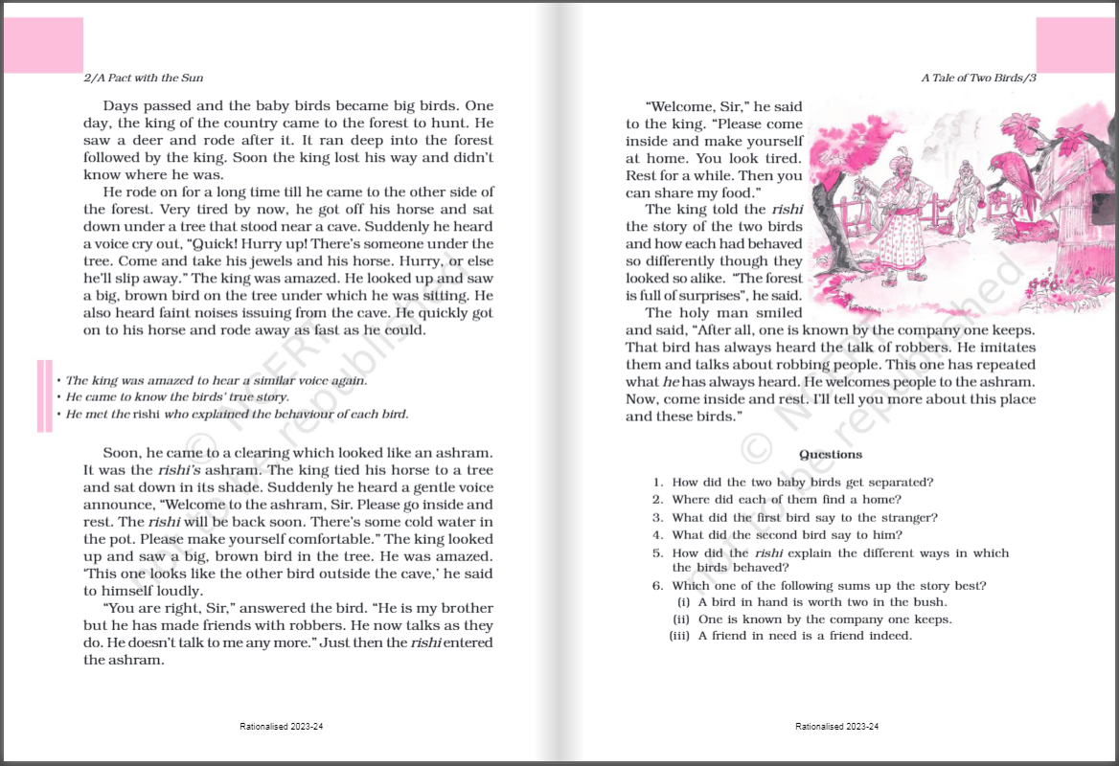
What is a FlipBook?
A flipbook is an interactive, online HTML5 publication that has the look and feel of a real, page-turning publication (complete with page-turning sound effects, page shadows and more). Flipbooks are currently used to replace conventional digital PDFs and paper-based documents such as reports, presentations, magazines, catalogs, brochures, books and more. A digital flipbook looks and feels exactly like a printed publication with pages that can be flipped and turned - without the cost of printing!

Slide 11
What is EPUB ?
EPUB 3 (Electronic Publication 3) is a standard format for digital publications and e-books. It is the latest version of the EPUB standard developed by the International Digital Publishing Forum (IDPF) and was first introduced in 2011.
EPUB 3 is designed to provide a flexible and feature-rich platform for creating and distributing electronic publications. It offers several enhancements over previous versions, allowing for more interactive and multimedia-rich content.

Slide 12
Why do we need EPUB ?
Cross-Platform Compatibility: EPUB files are compatible with a variety of devices, including e-readers, tablets, smartphones, and computers. EPUB works on different operating systems and can be read using various software and apps. This cross-platform compatibility ensures that digital publications can reach a wide audience and be accessed on different devices.
Reflowable Content: EPUB allows for reflowable text, meaning the content can adapt and adjust to different screen sizes and font settings. This ensures that readers can adjust the font size, switch between portrait and landscape orientations, and customize the reading experience to their preferences. Reflowable content enhances readability and accessibility, particularly for people with visual impairments or reading difficulties.

Slide 13
Continued…
3. Interactive Features: EPUB supports interactive elements such as hyperlinks, multimedia content (videos, audio), quizzes, and interactive exercises. These features enable publishers to create engaging and interactive reading experiences. Interactive elements can enhance learning materials, provide additional context, and promote active participation from readers.
4. Accessibility: EPUB incorporates accessibility features to make digital publications more inclusive. These features include adjustable font sizes, compatibility with screen readers, support for alternative text for images, and text-to-speech functionality. EPUB accessibility features ensure that individuals with visual impairments or reading disabilities can access and engage with the content.

Slide 14
Continued…
Enhanced Design and Styling: EPUB supports CSS (Cascading Style Sheets), which enables publishers to apply advanced styling and layout options. This allows for more visually appealing and professional-looking digital publications. EPUB's design capabilities enable the creation of aesthetically pleasing e-books, textbooks, and other digital materials.
Dynamic Updates and Revisions: EPUB allows for easy updates and revisions of digital publications. Publishers can modify and update the content of EPUB files, ensuring that readers have access to the most current and accurate information. This is particularly valuable for textbooks and educational materials that may require regular updates to reflect new research, revised curriculum, or changes in information.

Slide 15
Continued…
Cost-Effective Distribution: EPUB offers a cost-effective distribution model for digital publications. EPUB files can be easily distributed and shared electronically, eliminating the need for physical printing and distribution costs. This makes it easier for authors, publishers, and educators to reach a global audience without incurring significant expenses.
Environmental Sustainability: By embracing EPUB, we can reduce the consumption of paper and contribute to environmental sustainability. Digital publications eliminate the need for printing and shipping physical books, reducing the carbon footprint associated with the publishing industry.

Slide 16
KEY DIFFERENCES BETWEEN EPUB AND PDF
 | EPUB | PDF
Content Reflow ability: | EPUB files are designed for reflowable content, meaning the text and layout adapt to different screen sizes and font settings. EPUB allows readers to adjust font sizes, switch between portrait and landscape orientations, and customize the reading experience. | PDF files have fixed layouts that maintain the precise positioning of text, images, and other elements. PDFs are typically designed to replicate the original printed document's appearance.
Interactivity and Multimedia: | EPUB supports interactive elements such as hyperlinks, multimedia content (videos, audio), interactive quizzes, and embedded scripts. EPUB provides a more engaging and interactive reading experience, especially for textbooks and e-books with interactive features. | PDF can include hyperlinks and multimedia content, its interactive capabilities are more limited compared to EPUB.

Slide 17
Continued…
 | EPUB | PDF
Accessibility Features: | EPUB has built-in accessibility features, such as adjustable font sizes, text-to-speech functionality, compatibility with screen readers, and support for alternative text for images. These features ensure that EPUB files are more accessible to individuals with visual impairments or reading difficulties. | PDF can be made accessible, but it often requires additional steps and may have limitations in terms of flexibility and compatibility with accessibility tools.
Layout and Design: | EPUB offers more flexibility in terms of layout and design. It can handle complex page structures, responsive designs, and supports CSS (Cascading Style Sheets) for advanced styling. EPUB is well-suited for e-books and publications with dynamic layouts, such as textbooks and novels. | PDF, on the other hand, preserves the exact layout of the original document, including fonts, images, and formatting. PDF is often used for documents where maintaining the visual integrity of the original layout is crucial, such as official forms, legal documents, and brochures.

Slide 18
Continued…
 | EPUB | PDF
Device Compatibility: | EPUB files are designed to be compatible with a wide range of devices, including e-readers, tablets, smartphones, and desktop computers. EPUB is supported by various reading applications and platforms. | PDF files are also widely supported across devices and platforms, but certain devices or applications may have limitations in terms of displaying or interacting with PDFs.
Editing and Authoring: | EPUB files can be easily created and edited using various software tools. EPUB authoring tools provide features for content creation, editing, and formatting. PDF, on the other hand, is primarily used for preserving and sharing documents in a read-only format. | Editing PDFs typically requires specialized software, and the process is more involved compared to editing EPUB files.

Slide 19

Sigil
The EPUB Editor

Slide 20
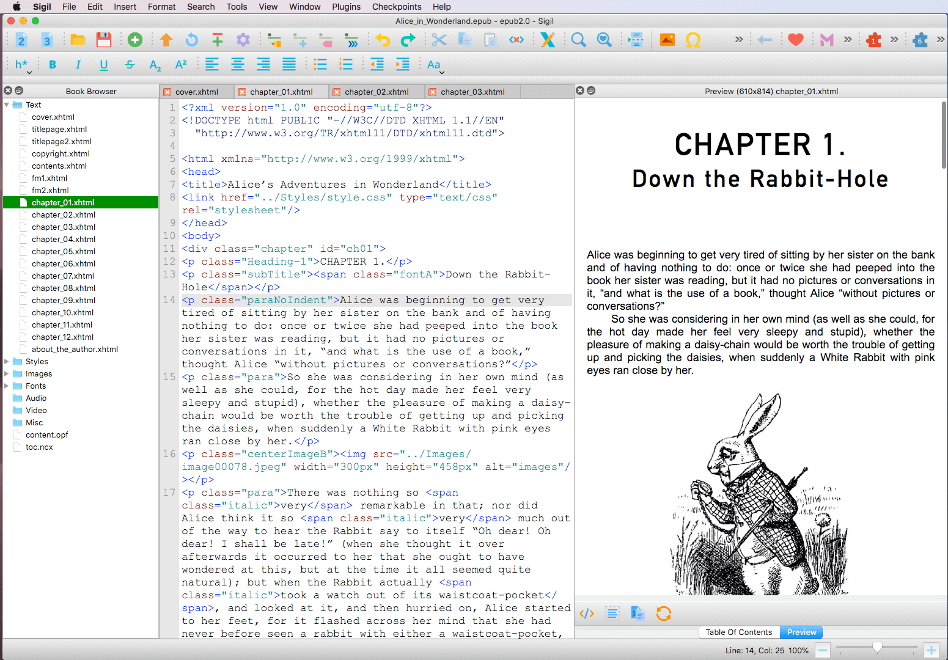
User Interface
— Windows, Menus and Toolbars —

Slide 21



eBooks Available on Following Places
NCERT Official Website
PDF Versions are available
DIKSHA Portal and Mobile App
eBooks, eResources with Energized textbooks
ePathshala Portal and Mobile App
Flipbook and ePub format are available

Slide 22
Energized Textbook
Energized textbooks refers to textbooks that incorporate dynamic, interactive, or multimedia elements to make the learning experience more engaging and effective. These elements can include features such as embedded videos, interactive quizzes, simulations, and other digital enhancements that are designed to enrich the learning process and make it more interactive and immersive.

Slide 23
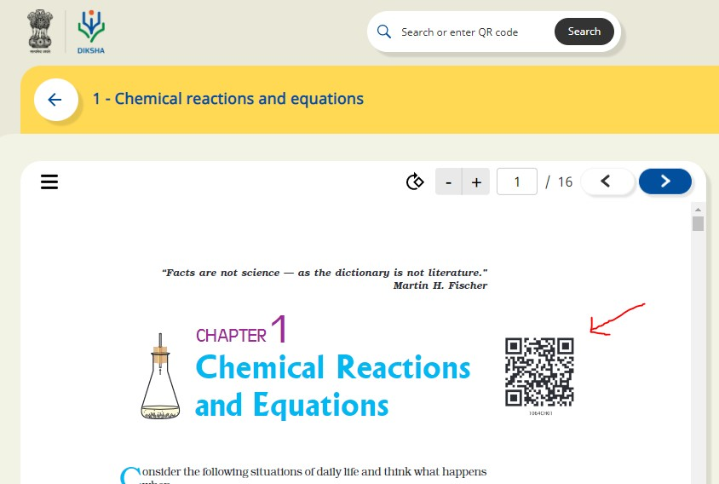
QR Code- quick response code
A QR Code is a two-dimensional barcode that is readable by smartphones.
Static QR Codes encode the content directly in the image itself. You can think of them like regular printed text, just represented in different way. That means you cannot update the content once generated. Because the content is directly encoded in the image, they also grow in size with the amount of content they store.

Slide 24
Steps to generate QR code by Google Sheet?
Step 1: Firstly we need to create 4 columns named Domain URL, Code, Complete URL and QR Code on a Google sheet.
Step 2: Fill the columns as following:
Domain URL- We have to write domain name (https://epathshala.nic.in/QR/?id=)
Code: We have to write code of the title like (1064CH01)
Complete URL: =CONCAT(A2,B2)
QR code: =image ("http://qrickit.com/api/qr.php?addtext="&B2&"&qrsize=300&t=p&e=m&d="&C2)
Step 3: To download QR codes we need to download it as PDF first as below.
Go to : File→ Download as→ PDF Document (.pdf)

Slide 25
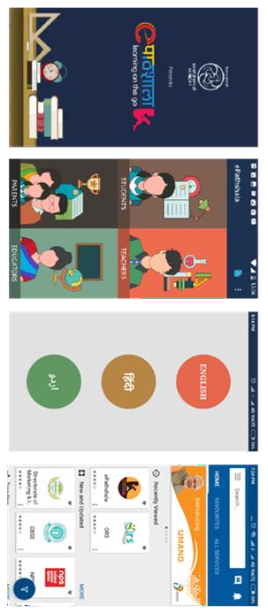
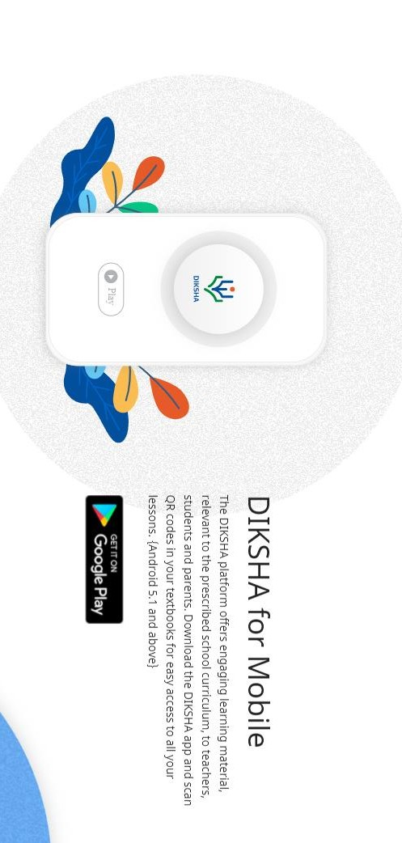
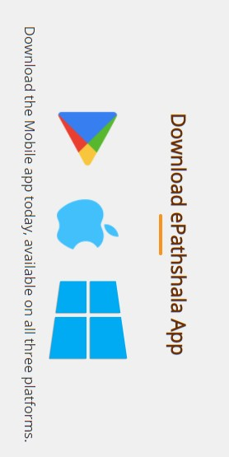
DIKSHA and ePathshala Mobile App

Slide 26
Thank you Doubts and Questions
Rameez Alam
Sr. Technical Consultant, CIET-NCERT

