Slide 1
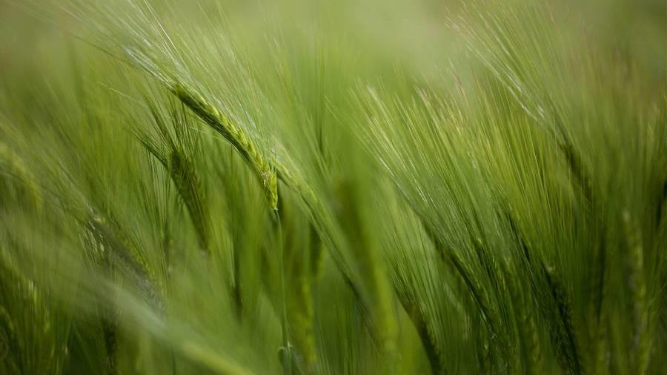
CYBER Cypher 2.0
Team FooBar
-Manan Gandhi, Adith Ramakrishna

Slide 2
Problem Statement
Afforestation
In today's world, afforestation is becoming an increasingly crucial task in mitigating the effects of climate change. Your goal is to use satellite data to determine the most effective way to promote afforestation in a specific region.
You must analyze climate and natural data collected by satellites to identify areas suitable for tree planting and develop a comprehensive plan for implementing afforestation initiatives in the region.
The solution could take into account factors such as soil type, rainfall patterns, and temperature, as well as any other relevant data. The objective is to develop a scalable and sustainable afforestation strategy that can be replicated in other regions, contributing to global efforts to combat climate change.

Slide 3
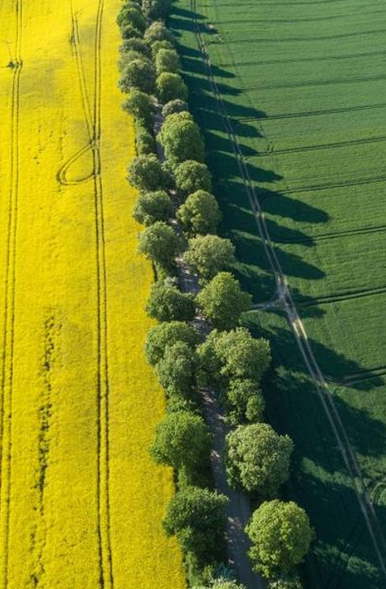
solution
Our solution to the given problem is to promote individuals to plant tree, by educating them through the means of a website

Slide 4
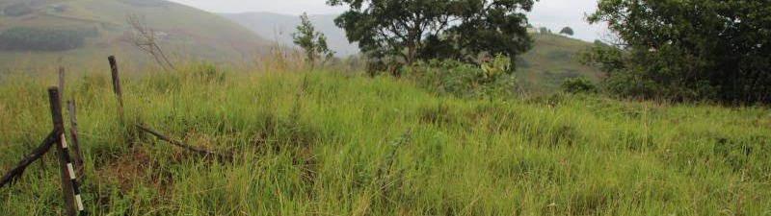
Benefits of Afforestation
Improves air quality
Enhances Bio-Diversity
Increases water retention and soil health

Slide 5
Solution Overview
Benefits of Afforestation
Machine Learning
Crowdsourcing
The Website informs the user about the numerous number of ways afforestation can help us humans and can enhance our surroundings.
The Website helps the user to make informed decisions about which trees would grow the best in their surrounding and locality.
The Website uses crowdsourcing techniques to fund organizations and NGOs. The visitors and users of the website can donate to the noble cause.

Slide 6
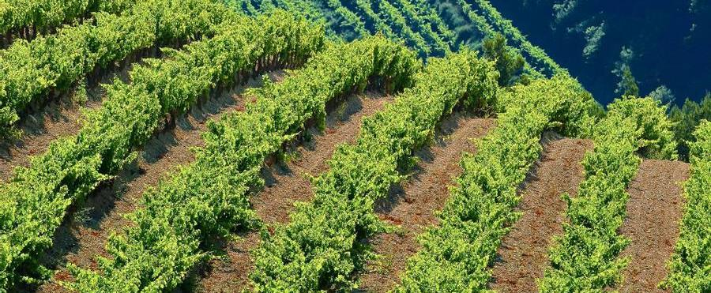
summary
At Contoso, we believe in giving 110%. By using ethical farming methods, we help farming communities grow organically and foster a consumer first mindset. We thrive because of our market knowledge and a great team behind our product. As our CEO says, "Efficiencies will come from proactively transforming how we do business."

Slide 7
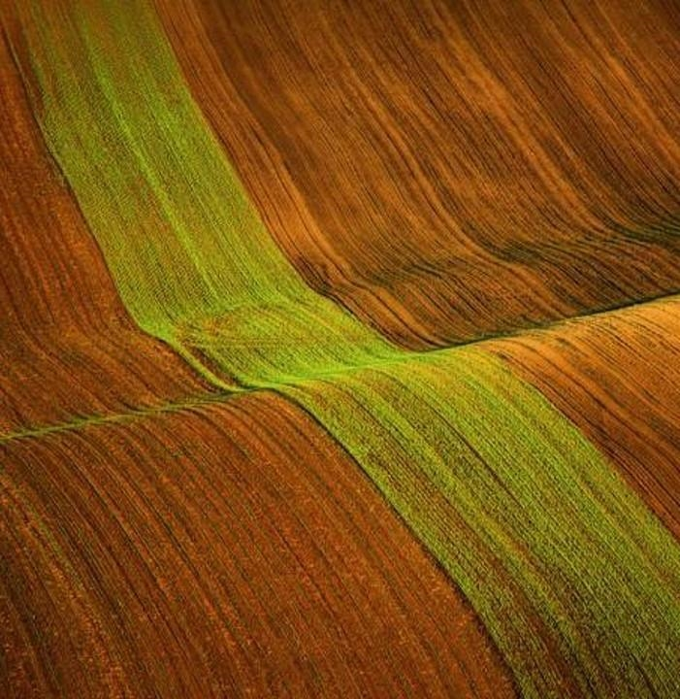
Thank you
Mirjam Nilsson​​
206-555-0146​
mirjam@contoso.com​
www.contoso.com​

