Slide 1


SMART INDIA HACKATHON 2024
TITLE PAGE
Problem Statement ID – 1653
Problem Statement Title- Web based Selector-Applicant Simulation Software
Theme- Smart Automation
PS Category- Software
Team ID- 14
Team Name – Vichaar Manthan

Slide 2
Web based Selector-Applicant Simulation Software
Vichaar Manthan
Proposed Solution
Resume-Based Question Generation: Users upload resumes, and our system generates role-specific questions using extracted data.
Speech Recognition & Similarity Analysis: Real-time speech recognition captures answers, and AI analyzes them for relevance.
Sentiment & Behavioral Analysis: AI monitors facial expressions and voice modulation for emotional and confidence insights.
AI-Powered Background Checks: Automated background verification enhances the reliability of the applicant's profile.
Focused Monitoring & Restriction: Integrated eyeball tracking and browser activity restrictions prevent tab switching, right-clicks, and ensure user focus throughout the interview simulation.

Slide 3
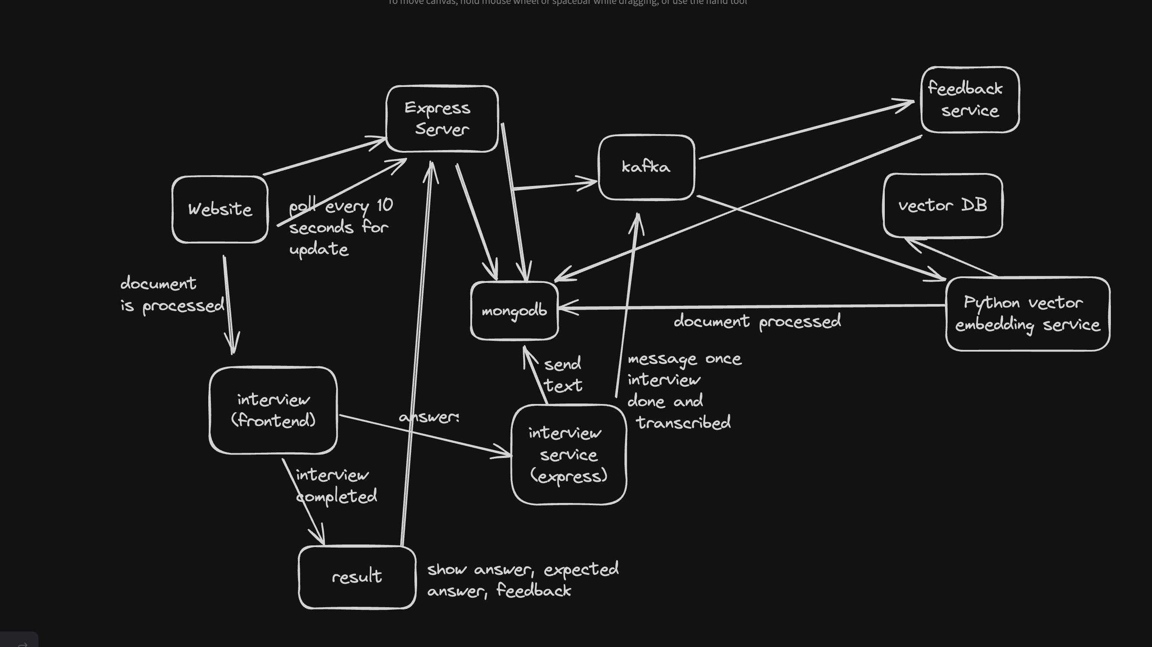
TECHNICAL APPROACH
Vichaar Manthan
Frontend – Next.js
Backend Server – Express.js
AI Service – Python, Langchain
Database – MongoDB
Infrastructure – Kafka, Docker, Kubernetes
CICD – Implemented our custom CICD pipeline

Slide 4
FEASIBILITY AND VIABILITY
Vichaar Manthan
Analysis of the feasibility of the idea
Cost and Resources: Using resource-efficient models like PaLM and all-MiniLM-L6-v2 instead of Gemini and BERT.
Technical: Minimal Human Intervention, Unbiased Reporting, Easy to Use.
Potential challenges and risks
Checking Integrity and Allegiance of the candidate
Strategies for overcoming these challenges
Verification of the candidate through Aadhar Card by checking their arrest records.

Slide 5
IMPACT AND BENEFITS
Vichaar Manthan
Potential impact on the target audience
Automates scheduling and initial screening, allowing recruiters to focus on more complex tasks.
24/7 Availability
Benefits of the solution (social, economic, environmental, etc.)
Social Benefits: Provides a fair and consistent evaluation process.
Economic Benefits: By leveraging the proposed solution, we can optimize budget allocations and resource utilization.
Security: It assists in a more comprehensive and complete initial screening of applicants using which interviewers can discard potential spies.

Slide 6
RESEARCH AND REFERENCES
Vichaar Manthan
Details / Links of the reference and research work
Evaluation of Models: Conducted a thorough analysis of various models to determine the best fit for developing the proposed solution.
API Testing: Studied API for speech-to-text conversion to identify the most effective option for accurate and reliable transcription.
References:
https://www.npmjs.com/package/react-hook-speech-to-text?activeTab=readme
https://cloud.google.com/vertex-ai/generative-ai/docs/model-reference/text

