Slide 1
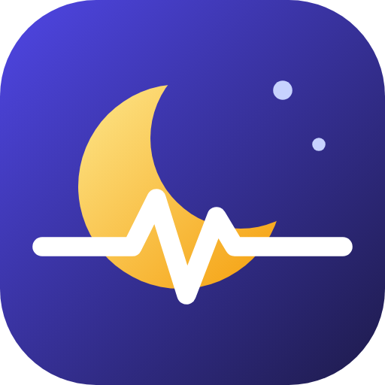
NightTwin: the twin lives the night first
TEAM TWINPULSE · HAPPIEST HEALTH DIGITAL TWIN CHALLENGE 2026
A physiology-based digital twin that rehearses tonight to prevent night-time hypoglycaemia in Indian children with type 1 diabetes
21:00 → 07:00
500 nights rehearsed
before one is lived
Team TwinPulse · Newton School of Technology, Rishihood University
Manan Gilhotra (team leader) · Manas Saxena
Notes:
Hello, we are Team TwinPulse from Newton School of Technology, Rishihood University. Our project, NightTwin, is a digital twin that lives the night first: before a child with type 1 diabetes goes to sleep, her twin rehearses tonight 500 times, so the doctor can see the danger and fix it before it happens.

Slide 2
2:47 AM in Raichur
55%
“Every night for three years I set an alarm to prick her finger. I never know which night is the dangerous one.”
of severe lows in type 1 diabetes happen during sleep (DCCT)
5–6%
of deaths in people with T1D under 40 are linked to “dead-in-bed” syndrome
~1 hour
Composite story, for illustration
of warning is enough to treat a low with a glass of juice
Notes:
Picture Lakshmi in Raichur. Her daughter Ananya has type 1 diabetes. Every night she sets an alarm to check her. In the landmark DCCT trial, 55 percent of severe lows happened during sleep, and dead-in-bed syndrome is linked to 5 to 6 percent of deaths in people with type 1 diabetes under 40. A low caught an hour early is treated with a glass of juice. A low caught late can mean a seizure.

Slide 3
India has the most children with type 1 diabetes, and the least protection at night
2.29 lakh
9.4 lakh
₹1.1 lakh+
NPH
Indian children and teens with T1D: the most of any country (IDF Atlas 2021)
Indians of all ages with T1D (IDF Atlas 2025)
a year for a CGM with low alarms (₹4–4.7k per 14-day sensor)
Cheaper human insulin many programmes supply peaks between 1 and 4 AM, when everyone is asleep
Families choose between ₹1 lakh a year and a 2 AM finger-prick alarm. Fear of lows pushes sugars high, which harms eyes and kidneys later. Clinics have no way to tell which nights are dangerous.
Notes:
India has 2.29 lakh children and teens with type 1 diabetes, the most of any country. A CGM with alarms costs over a lakh a year, so most families use finger-pricks. Many state programmes give human NPH insulin, which peaks between 1 and 4 AM, exactly when the family is asleep.

Slide 4
NightTwin: learn the child, live tonight first, guard the real night
1
2
3
Learn the child
Live tonight first
Guard the real night
A personal glucose–insulin model is fitted to each child's own nights: insulin, meals, play, CGM or finger-pricks, plus the FHIR health record.
At 9 PM the twin simulates tonight 500 times. The doctor sees who is at risk, when and why, and rehearses a fix on the twin before prescribing it.
For CGM users, a model trained on real patients warns about an hour before a low and calls the parent in their own language.
Decision support for clinicians. The doctor approves every change; families receive only approved actions.
Notes:
NightTwin does three things. It learns each child as a personal physiology model. At 9 PM it lives tonight 500 times, so the doctor sees the risk and rehearses fixes. And for children with a CGM, it guards the real night, warning about an hour before a low.

Slide 5
Fusing the health record with wearable streams
Static: health record (FHIR R4)
Dynamic: wearables
Twin output
Age, weight, HbA1c, haemoglobin
Insulin regimen and daily dose
Past severe lows, hypo awareness
HLA genotype, islet autoantibodies
CGM every 5 min, or finger-pricks
Insulin doses and meals
Steps and heart rate from a band
Sleep window
Tonight's risk, time and depth of a low
Factor-by-factor explanation
Rehearsed plan, doctor-approved
Real-time alert to the parent
+
→
Dataset | What it contains | Role
HUPA-UCM (Spain, CC BY 4.0) | 25 people with T1D: Libre 2 CGM, Fitbit heart rate and steps, insulin, carbs | Training + patient-held-out validation
T1D-UOM (UK, CC BY 4.0) | T1D, 3 months each: CGM, pump and injected insulin, food, Garmin activity, sleep | External test
Synthetic Indian cohort | 12 children, 14 days, Indian routines, NPH/premixed/glargine, FHIR records | Dashboard demo only
Notes:
The twin fuses two streams, as the challenge asks. The static health record, in FHIR R4 format, gives regimen, HbA1c, haemoglobin, hypo history and genetic markers. The dynamic stream gives glucose, insulin, meals, steps and heart rate. We train and validate only on open real-patient data, and use synthetic Indian children only for the demo.

Slide 6
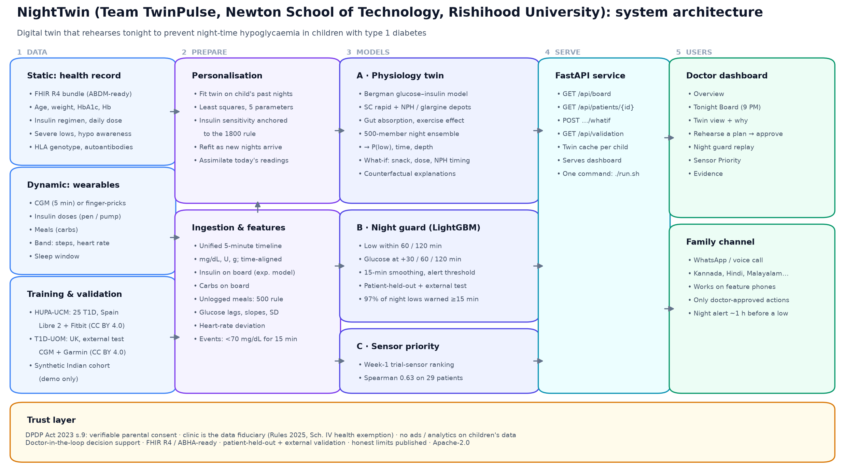
Architecture
Notes:
Data flows from the health record and wearables into a unified 5-minute timeline. Three models sit on top: the physiology twin, the LightGBM night guard, and sensor priority. A FastAPI service serves the doctor dashboard and the family channel, and a trust layer covers consent, privacy and doctor-in-the-loop.

Slide 7
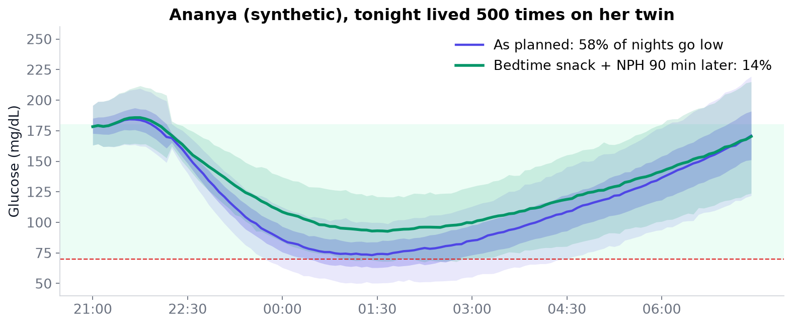
The physiology twin: a personal model of each child
Bergman glucose–insulin model with rapid and long-acting (NPH or glargine) insulin depots, gut absorption and a 4-hour exercise effect
Fitted on the child's own past nights; insulin sensitivity anchored to the clinical 1800 rule
Unlogged meals inferred from mealtime insulin (500 rule)
Assimilates today's readings, then runs 23:00–07:30 as a 500-member ensemble
Synthetic patient · the method, not an accuracy claim
Notes:
The twin is a real physiological model, the Bergman minimal model with insulin depots for both rapid and NPH insulin, carbohydrate absorption and a lingering exercise effect. It is fitted to each child's own past nights. At bedtime it runs 500 times with realistic variation, giving the probability, timing and depth of a low.

Slide 8
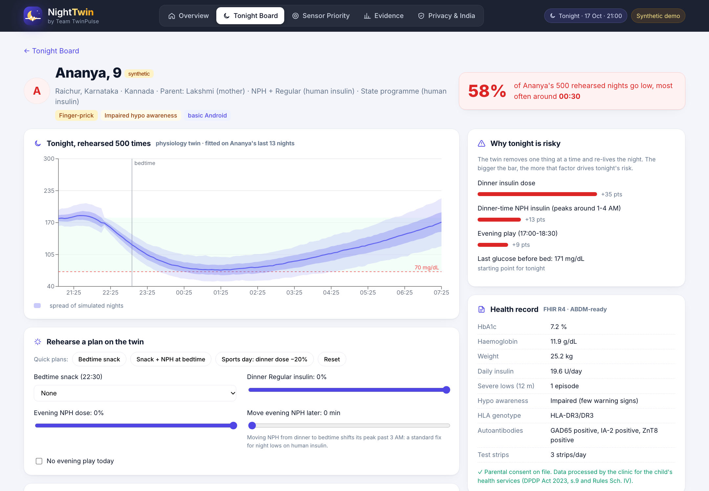
Rehearse the fix on the twin before prescribing it
58% → 14%
Ananya's simulated risk of a night low, before and after: 15 g bedtime snack + NPH moved 90 min later
Bedtime snack (15 or 30 g)
Smaller dinner insulin dose after a sports day
Move NPH from dinner to bedtime
Explanations: the twin removes one factor at a time and re-lives the night
Notes:
This is the heart of the twin. The doctor tries a plan, for example a bedtime snack and moving NPH 90 minutes later, and the twin re-lives the night. For Ananya, the share of rehearsed nights with a low drops from 58 to 14 percent. Only after seeing this does the doctor approve the plan.

Slide 9
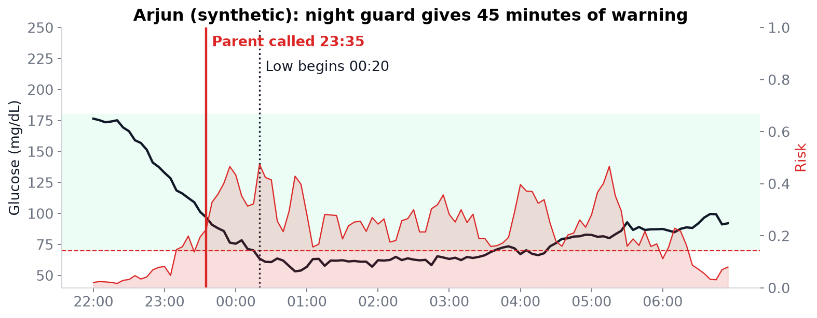
Night guard: wake the parent before the low, not after
97%
of 315 real night-time lows warned at least 15 min ahead (unseen patients)
65 min
median warning
LightGBM on glucose history, insulin and carbs on board, steps and heart rate; 15-minute smoothing. Alert goes as a voice call in the family's language.
0.55
false alarms per night
Notes:
For families with a CGM, the night guard runs every five minutes. On real patients it never saw, it warned about 97% of night-time lows at least 15 minutes ahead, with a median warning of 65 minutes and about one false alarm every two nights.

Slide 10
Results on real patients the model never saw
Night-guard AUROC: 0.93 for a low within 60 min, 0.88 within 2 h. Clarke error grid A+B at 30 min: 97.6%. Patients split into 5 groups, so every score is on people the model never saw.
Notes:
All numbers here are on real people with type 1 diabetes the model never saw, and confirmed on a separate UK dataset with different devices. The guard performs well. Our glucose forecasts beat the standard baseline at every horizon.

Slide 11
What did not work, and what we did about it
Predicting the whole night from bedtime alone was close to chance (0.55–0.63) on 1046 real nights, whatever the method
So the bedtime rehearsal is used to compare plans, not to promise a night is safe
Warnings rely on the in-night guard
Insulin, meal, step and heart-rate features add only ~0.01 AUROC over glucose alone in these datasets
Notes:
We want to be honest. We first hoped to tell a mother at bedtime whether tonight is safe. On over a thousand real nights, bedtime-only prediction was close to chance for every method, including our physiology twin. So we changed the design: rehearsal compares plans, and warnings come from the in-night guard, which works.

Slide 12
No CGM for everyone? Give it to the children who need it most
42%
10%
of later nights had a low: top third by week-1 risk
bottom third
Spearman 0.63. One ₹4–5k trial sensor per child, instead of ₹1.1 lakh a year for everyone, points a state programme's scarce CGMs at the children most at risk. The Sensor Priority screen does exactly this.
Notes:
Without nightly CGM we cannot guard every night. So NightTwin helps share scarce sensors fairly. On real patients, one week of sensor data ranked who would have the most night lows later: 42 percent of later nights for the top third, versus 10 percent for the bottom third.

Slide 13
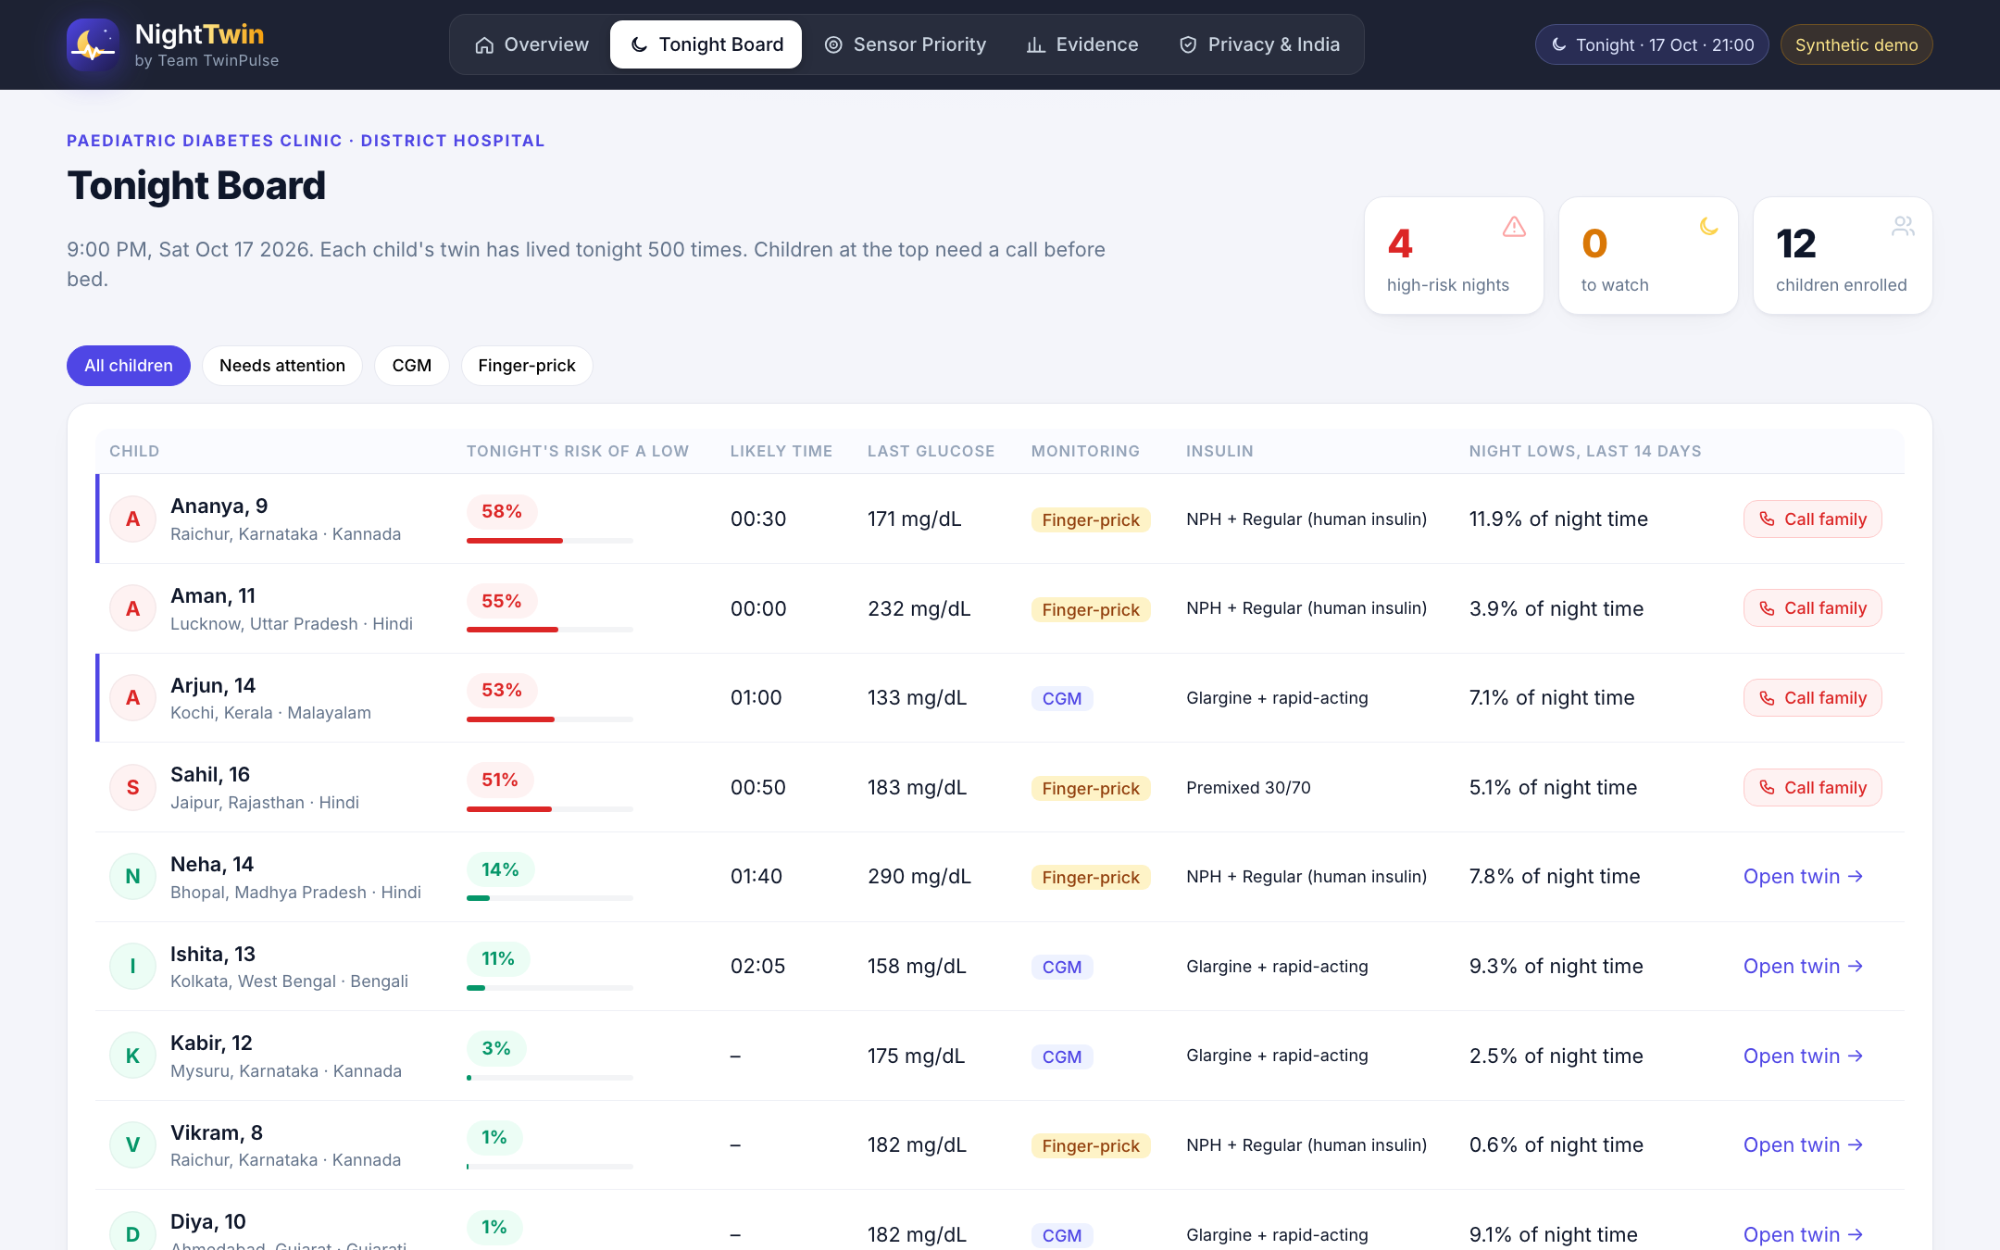
The doctor's dashboard
Tonight Board at 9 PM: every child ranked by risk; call the red rows
Twin view: rehearsed night, why it is risky, FHIR record, 14-day time in range
Rehearse, approve, send to family
Night guard replay
Sensor Priority and Evidence pages
Notes:
The dashboard is built for a busy paediatric diabetes clinic. At 9 PM the Tonight Board ranks every child. One click opens the child's twin, with the rehearsed night, the reasons, the health record and the 14-day summary.

Slide 14
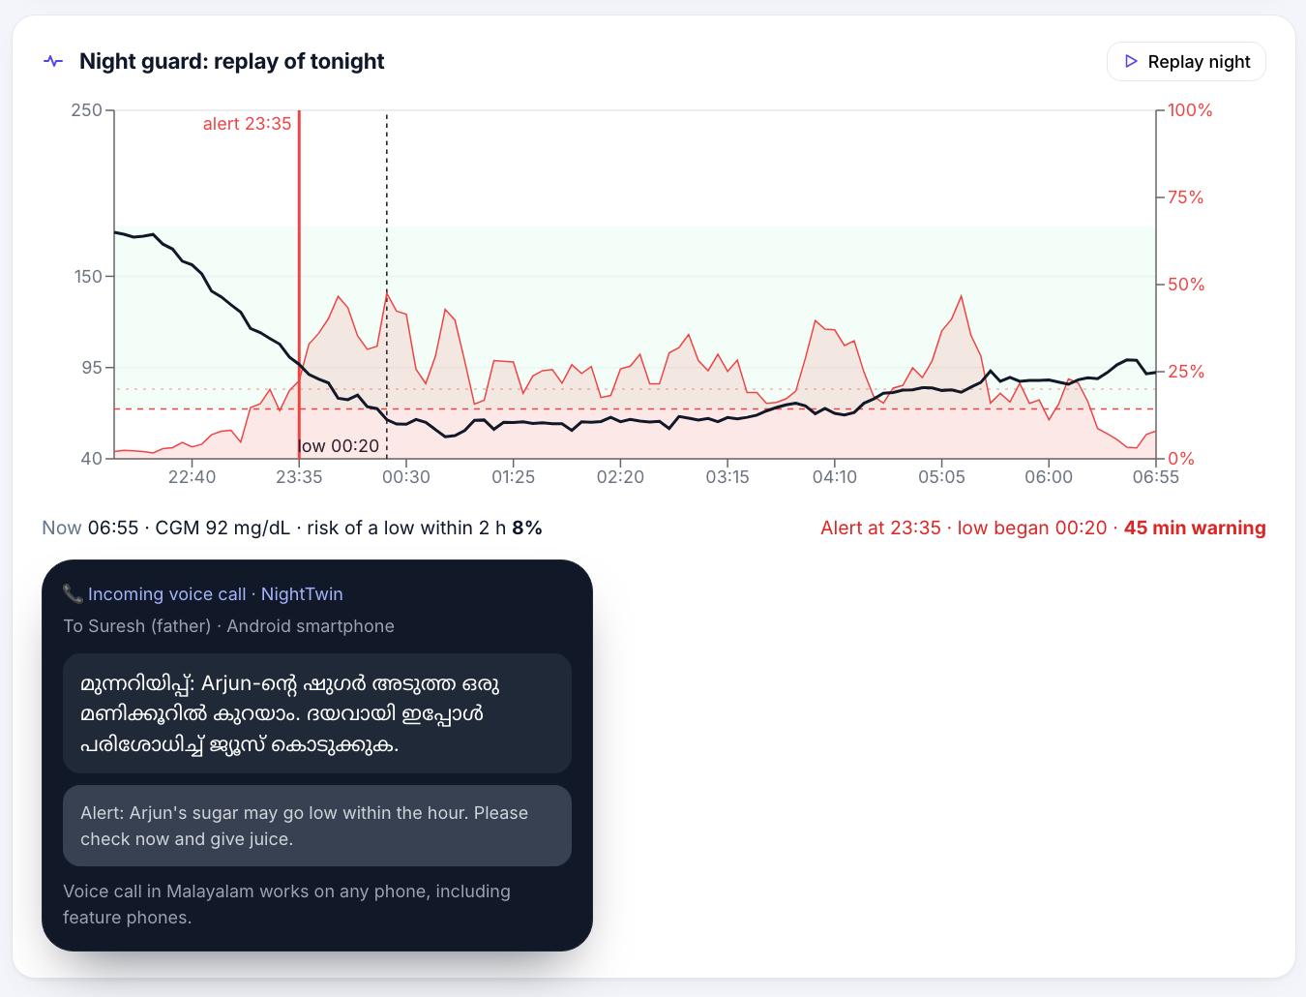
Built for Indian families and clinics
1
Language
Alerts in Kannada, Hindi, Malayalam… by voice call that works on feature phones
2
Insulin reality
Models human NPH/Regular and premixed insulin, not only analogues
3
Routines
Late dinners, evening cricket, school tiffin
4
ABDM-ready
FHIR R4 records with room for ABHA linkage
Notes:
NightTwin is designed for India: alerts in the family's language, voice calls for feature phones, models of the human insulin our programmes supply, Indian routines like late dinners and evening cricket, and FHIR records ready for ABDM.

Slide 15
Privacy, safety and regulation
§
✓
→
Children's data (DPDP Act 2023)
Doctor in the loop
Path to the clinic
Section 9: verifiable parental consent; no tracking or behavioural monitoring of children. The DPDP Rules 2025 (Fourth Schedule) exempt clinics and healthcare professionals for health services to the child, so NightTwin is deployed by the clinic as data fiduciary, with consent recorded anyway.
The twin only shows simulated outcomes. The doctor approves every change; families receive only approved actions. No advertising or analytics on children's data.
Decision support, not a diagnosis. A real deployment would follow CDSCO's medical device software pathway after a supervised clinical pilot.
Notes:
Children's health data needs extra care. Under the DPDP Act, children's data needs verifiable parental consent, and the 2025 Rules exempt clinics providing health services, so NightTwin is deployed by the clinic. The doctor stays in charge of every decision.

Slide 16
Impact and how it scales
~1 hour
4.3×
₹0
of warning before a night-time low for CGM families, as a voice call
more night lows in the top third flagged by a trial sensor, so scarce CGMs go further
licence cost: open source (Apache-2.0), deployable by state programmes and NGOs
Rollout path
Pilot in one paediatric diabetes clinic with families already on a state T1D programme
Recalibrate and validate on Indian children's data; measure night lows, parent sleep and false alarms
Extend the same twin to adults with T2D on insulin or sulfonylureas
Notes:
The impact is measurable: about an hour of warning for CGM families, smarter use of scarce sensors for everyone else, and zero licence cost. Our rollout path starts with a clinic pilot, then validation on Indian children, then extension to adults with type 2 diabetes on insulin.

Slide 17
Limitations we know about
Training population
Synthetic demo
Models trained on adults in Spain and tested on adults in the UK, not Indian children. An Indian pilot is the next step.
The 12 Indian children in the dashboard are synthetic. They show the method; they are never used for accuracy numbers.
Bedtime prediction
Translations and regulation
Bedtime-only risk is weak on real data. We use it to compare plans, not to promise safety.
Translations are drafts for native-speaker review. Not a medical device yet.
Notes:
We are open about our limits: the models were trained on adults abroad, the demo children are synthetic, bedtime prediction is weak, and this is not yet a medical device. Each has a clear next step.

Slide 18
Let the twin face the night first
So a mother can sleep, and a child wakes up safe
Team TwinPulse · Newton School of Technology, Rishihood University
Manan Gilhotra (team leader) · Manas Saxena
Live demo: manangilhotra.github.io/TwinPulse_NewtonSchoolOfTechnology_RishihoodUniversity
Notes:
In 1970, NASA rehearsed the Apollo 13 rescue on a twin of the spacecraft before trying it for real. NightTwin does the same for a child's night. Thank you.

