Slide 1
Account closure process
ENTER THE DETAILS AS ASKED

Slide 2
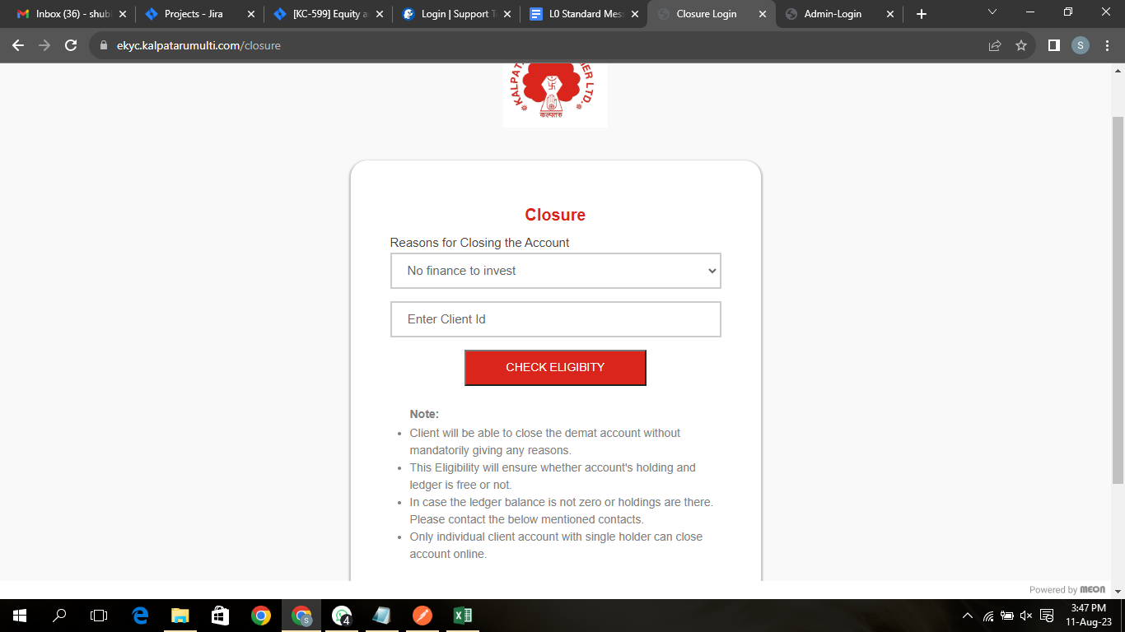

Slide 3
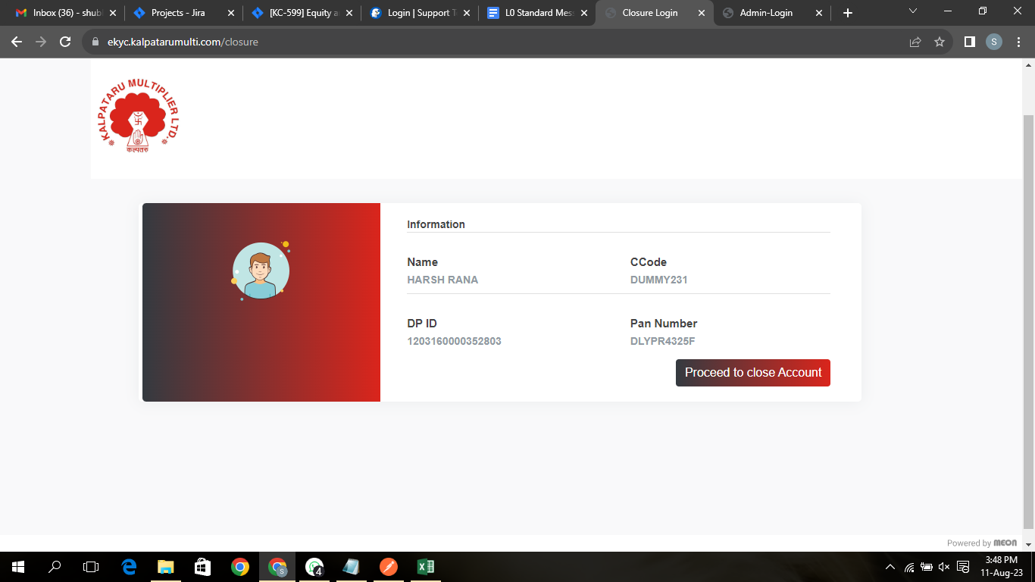



Slide 4
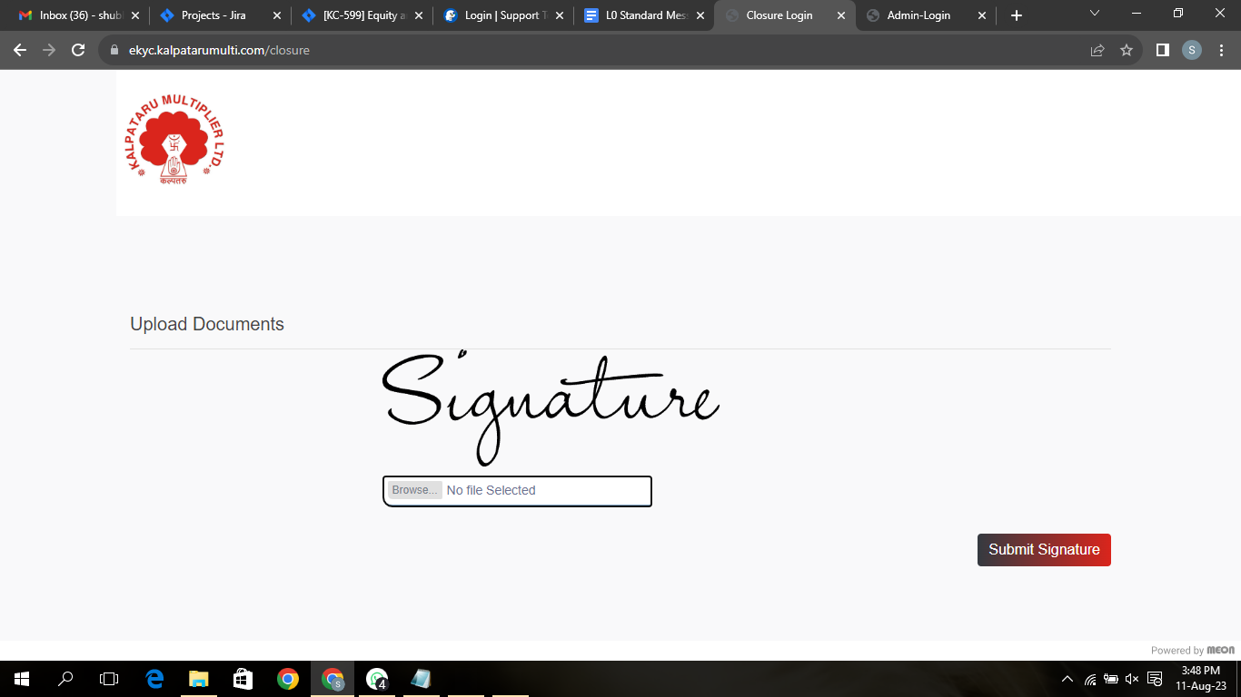

Slide 5
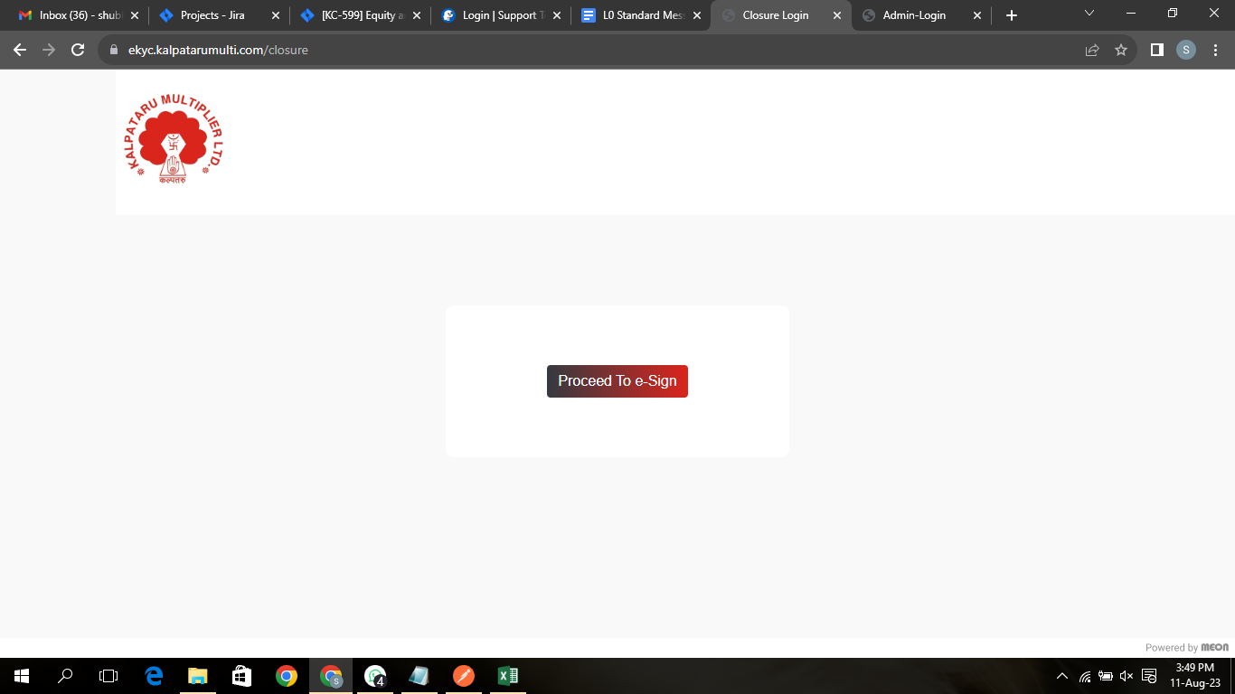
Check the Email ID provided by you for the E-SIGN Link

Slide 6
Your Account closure request will be Acknowledged by us.
For More contact us @ 0755 -4350141
CORPORATE OFFICE
Kalpataru Multiplier Ltd
Hall No. 2, 1st Floor Western Block,
Above Central Bank, GTB Complex,
T. T. Nagar, Bhopal-462003
Website: -https://www.kalpatarumulti.com

Slide 7


