Slide 1

Create a ticket to solve your Grievances and know the Status of your TICKET being generated?

Slide 2

Enter the URL https://www.kalpatarumulti.com/

Slide 3
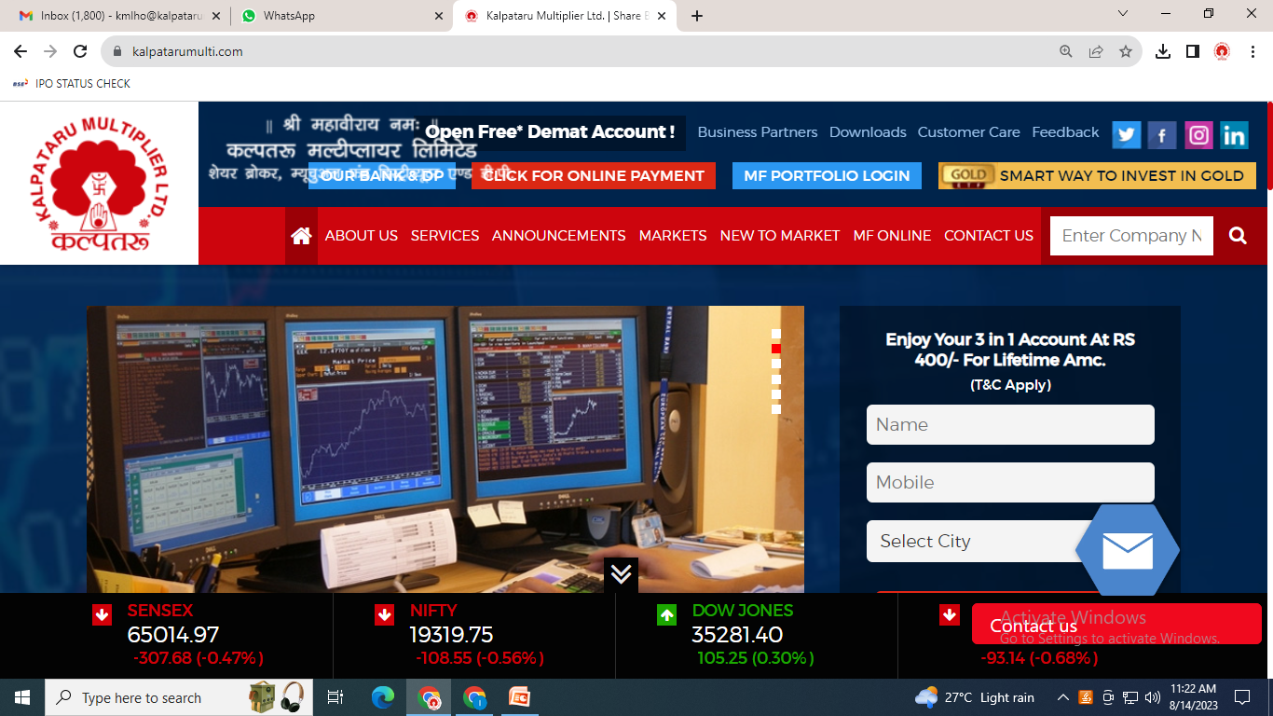
Click on CUSTOMER CARE

Slide 4
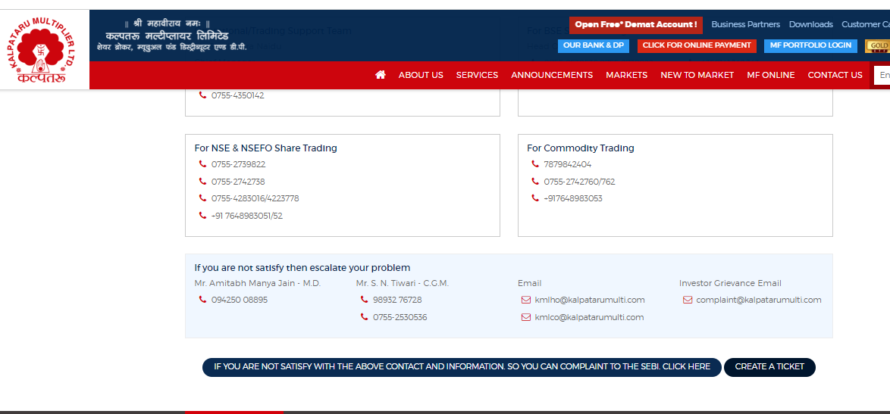
Click on CREATE A TICKET

Slide 5
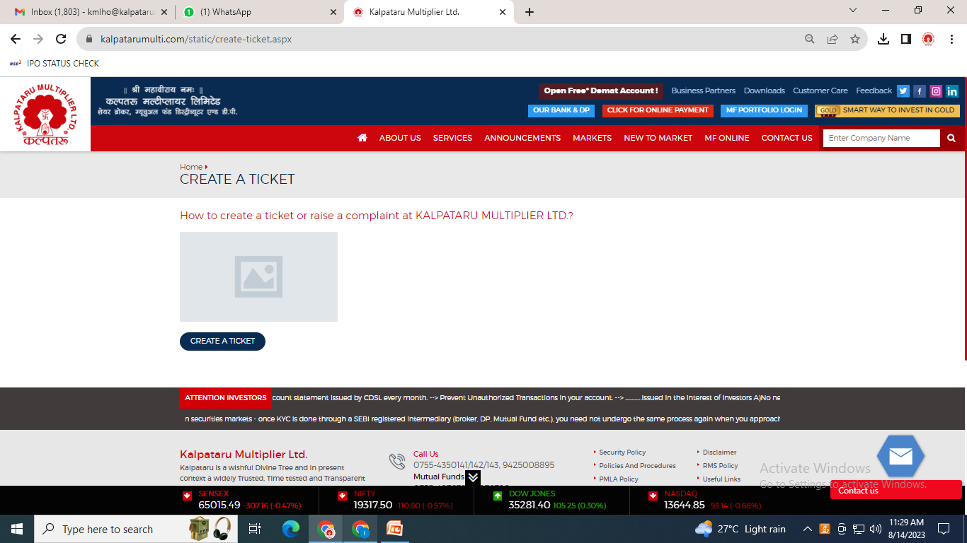
Click on CREATE A TICKET

Slide 6
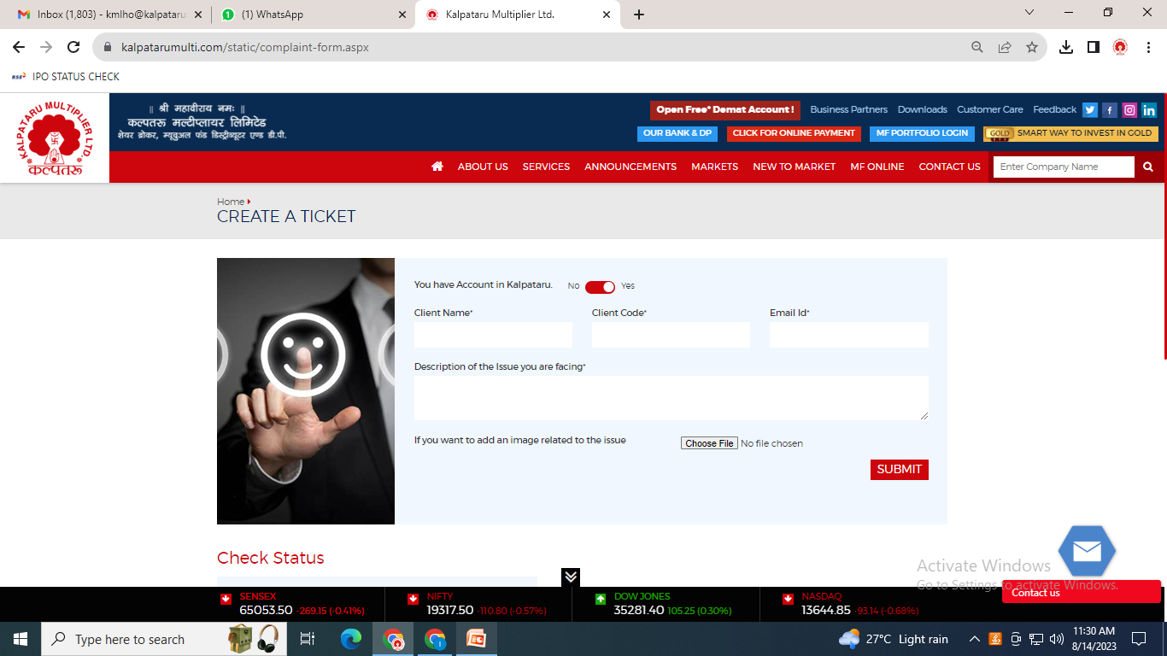
Enter the Details as asked !!

Slide 7
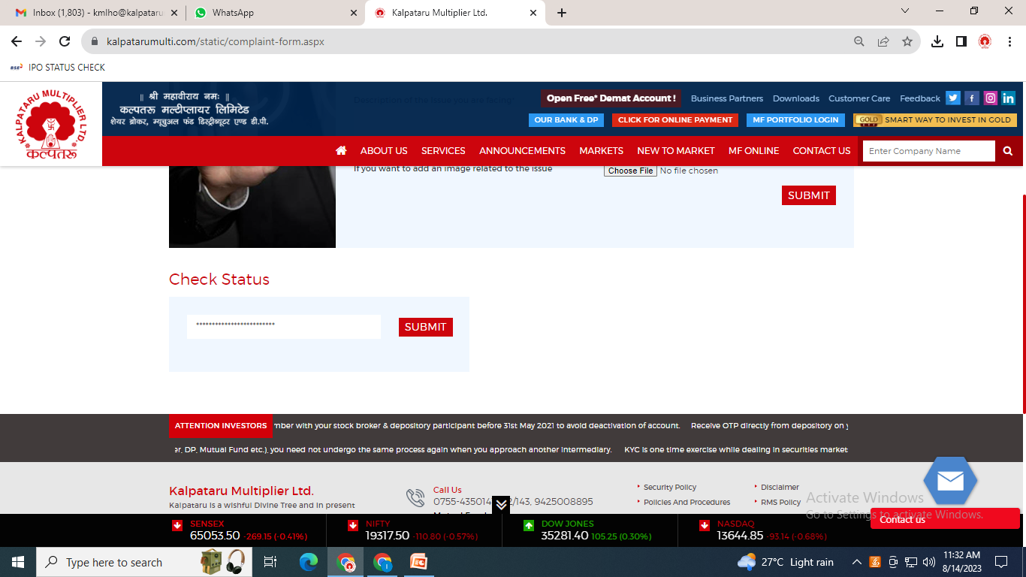
After clicking on submit a TICKET NO can be generated by which the status can be checked !!
Enter ticket no. & CHECK STATUS

Slide 8


