Slide 1

CXI Collaboration x Innovation

Slide 2

About Us
We are CXI. The pragmatic and progressive Computer Science Club of MIET. The purpose of CXI shall be to promote and organize project skills and experiences at MIET.
The club aims to bring in collaborations from the students so as to built products or provide services that solve a common problem or give shape to an innovative idea while working in teams and learning new things. We bring a more sophisticated approach to student centered college bodies along with transparency in governance.

Slide 3

Topics To be covered
About Us
Vision
What do we aim for?
What’s in it for me?
What we do
How do we do it
Projects
Our Policies
Departments
Officers
Faculty in charge
Process to join
Any questions?

Slide 4

VISION
To build a strong learning environment that responds swiftly to the challenges of the 21st century. And to promote the development of Competent, Confident and Talented members for a globalized technological society by Collaborating and Innovating

Slide 5
What do we aim for?
Bring collaboration among students as a team and learn new skills.
Develop work experience and project skills among members.
Develop products or services which can solve a common problem.
Develop innovative ideas of members into a well furnished product.

Slide 6

What’s in it for me?
Technical projects experience
Develop working and social skills
Team and leadership opportunities
Skills, work proficiency, resume holding innovative real-world projects in bulk.

Slide 7
What We Do
Professional Identity
Awesome Support
Clean Code
Design Professional
Innovate Idea

Slide 8
How do we do it?
Meetings
Present a new project idea.
Make teams and distribute the work.
Building…
Team collaborates and build the projects.
Team Leader keeps updating the status in meetings.
Finish!
Completed the project, feel proud.
Submit and display

Slide 9

Projects
Smart India Hackathon
ML
CXI
Web Dev + ML
Smart India Hackathon
IOT
Automated Parking System
Online Assessment
Smart Vehicles
CXI
Web Dev
Paid
Android + iOS
Web Development
ML
Android
SAP website
Ripple Tea
Many More

Slide 10
Policies:
You choose the leaders
You choose the role
Constitution
Officers in CXI are chosen by the members, via elections.
Members choose their mentors, roles, departments and work.
Elections are valid for one year term.
https://cxi-miet.github.io/constitution/

Slide 11
Internal Committees:
Creative
Work Committee
Content Writing
Designing
Promotional Committee
Social Media
Campus Promotions
Management
Committee
Managing Meetings
Organizing Regular Sessions
Organizing Contests
Project Management
Technical Committee
Handling Interviews
Interview Committee
Active Members
Each Member’s Active Participation is Crucial

Slide 12
Officers
President
Mohd. Umar Alam Siddique
Vice President
Parv Agarwal
Treasurer
Mohd. Hamzah Siddiqui
Secretary
Shristhi Pahwa
+91 7417576582
mohd.umar.cse.2017@miet.ac.in
parv.agarwal.cse@miet.ac.in
shristhi.pahwa.cse.2017@miet.ac.in
mohd.hamzah.cse.2017@miet.ac.in
+91 7830464017
+91 8171459191
+91 7409881100

Slide 13
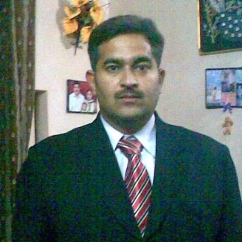
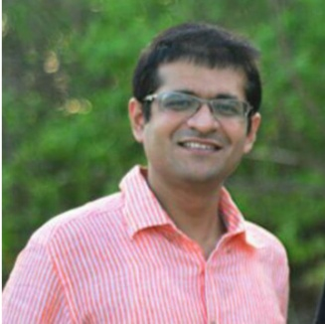
Faculty and Mentors
Dr. Mukesh Rawat
(Prof. CSE)
Dr. Shashwat Pathak
(Head Innovation Cell)

Slide 14
Process to Join
Fill the Google form shared
Have a friendly interaction with the interview committee
Get Selected and start at CXI

Slide 15


